Slide 1

Retail Sales Prediction
By: Snehal Dahule

Slide 2
Problem Statement
Hoffman operates over 3,000 drug stores in 7 countries. Hoffman store managers are currently tasked with predicting their daily sales up to six weeks in advance. Store sales are influenced by many factors, including promotions, competition, school, and state holidays, seasonality, and locality. With thousands of individual managers predicting sales based on their unique circumstances, the accuracy of results can be quite varied.
You are provided with historical sales data for 1,115 Hoffman stores. The task is to forecast the "Sales" column for the test set. Note that some stores in the dataset were temporarily closed for refurbishment.
Project Goal
Our goal here is to forecast the sales for six weeks for each store and find out the factors influencing it and recommend ways in order to improve the numbers.

Slide 3
Data Dictionary-1
Id - an Id that represents a (Store, Date) duple within the set
Store - a unique Id for each store
Sales - the turnover for any given day (Dependent Variable)
Customers - the number of customers on a given day
Open - an indicator for whether the store was open: 0 = closed, 1 = open
State Holiday - indicates a state holiday. Normally all stores, with few exceptions, are closed on state holidays. Note that all schools are closed on public holidays and weekends. a = public holiday, b = Easter holiday, c = Christmas, 0 = None
School Holiday - indicates if the (Store) was affected by the closure of public schools
Store Type - differentiates between 4 different store models: a, b, c, d

Slide 4
Data Dictionary-2
Assortment - describes an assortment level: a = basic, b = extra, c = extended. An assortment strategy in retailing involves the number and type of products that stores display for purchase by consumers.
Competition Distance – the distance in meters to the nearest competitor store
Competition Open Since[Month/Year] - gives the approximate year and month of the time the nearest competitor was opened
Promo - indicates whether a store is running a promo on that day
Promo2 - Promo2 is a continuing and consecutive promotion for some stores: 0
= store is not participating, 1 = store is participating
Promo2 Since[Year/Week] - describes the year and calendar week when the store started participating in Promo2
Promo Interval - describes the consecutive intervals Promo2 is started, naming the months the promotion is started anew. E.g. "Feb, May, Aug, Nov" means each round starts in February, May, August, and November of any given year for that store.

Slide 5
Data Structure
We have two datasets. Hoffman store data is for years 2013, 2014 and 2015 with 10,17,209 observations on 9 variables. Stores data with 1115 observations on 10 variables.
Data 1
Store | DayOfWeek | Date | Sales | Customers | Open | Promo | StateHoliday | SchoolHoliday
1 | 5 | 31-07-2015 | 5263 | 555 | 1 | 1 | 0 | 1
2 | 5 | 31-07-2015 | 6064 | 625 | 1 | 1 | 0 | 1
3 | 5 | 31-07-2015 | 8314 | 821 | 1 | 1 | 0 | 1
4 | 5 | 31-07-2015 | 13995 | 1498 | 1 | 1 | 0 | 1
5 | 5 | 31-07-2015 | 4822 | 559 | 1 | 1 | 0 | 1
6 | 5 | 31-07-2015 | 5651 | 589 | 1 | 1 | 0 | 1
7 | 5 | 31-07-2015 | 15344 | 1414 | 1 | 1 | 0 | 1
8 | 5 | 31-07-2015 | 8492 | 833 | 1 | 1 | 0 | 1
9 | 5 | 31-07-2015 | 8565 | 687 | 1 | 1 | 0 | 1
10 | 5 | 31-07-2015 | 7185 | 681 | 1 | 1 | 0 | 1
11 | 5 | 31-07-2015 | 10457 | 1236 | 1 | 1 | 0 | 1
12 | 5 | 31-07-2015 | 8959 | 962 | 1 | 1 | 0 | 1
13 | 5 | 31-07-2015 | 8821 | 568 | 1 | 1 | 0 | 0
14 | 5 | 31-07-2015 | 6544 | 710 | 1 | 1 | 0 | 1

Slide 6
Data 2
Store | StoreType | Assortment | CompetitionDistance | CompetitionOpenSinceMonth | CompetitionOpenSinceYear | Promo2 | Promo2SinceWeek | Promo2SinceYear | PromoInterval
1 | c | a | 1270 | 9 | 2008 | 0
2 | a | a | 570 | 11 | 2007 | 1 | 13 | 2010 | Jan,Apr,Jul,Oct
3 | a | a | 14130 | 12 | 2006 | 1 | 14 | 2011 | Jan,Apr,Jul,Oct
4 | c | c | 620 | 9 | 2009 | 0
5 | a | a | 29910 | 4 | 2015 | 0
6 | a | a | 310 | 12 | 2013 | 0
7 | a | c | 24000 | 4 | 2013 | 0
8 | a | a | 7520 | 10 | 2014 | 0
9 | a | c | 2030 | 8 | 2000 | 0
10 | a | a | 3160 | 9 | 2009 | 0
11 | a | c | 960 | 11 | 2011 | 1 | 1 | 2012 | Jan,Apr,Jul,Oct
12 | a | c | 1070 |  |  | 1 | 13 | 2010 | Jan,Apr,Jul,Oct
13 | d | a | 310 |  |  | 1 | 45 | 2009 | Feb,May,Aug,Nov
14 | a | a | 1300 | 3 | 2014 | 1 | 40 | 2011 | Jan,Apr,Jul,Oct
15 | d | c | 4110 | 3 | 2010 | 1 | 14 | 2011 | Jan,Apr,Jul,Oct
16 | a | c | 3270 |  |  | 0
17 | a | a | 50 | 12 | 2005 | 1 | 26 | 2010 | Jan,Apr,Jul,Oct

Slide 7
Exploratory Data Analysis
Hypothesis:
There's a feature called "DayOfWeek" with the values 1-7 denoting each day of the week. There would be a week off probably Sunday when the stores would be closed and we would get low overall sales.
Customers would have a positive correlation with Sales.
The Store type and Assortment strategy involved would be having a certain effect on sales as well. Some premium high quality products would fetch more revenue.
Promotion should be having a positive correlation with Sales.
Some stores are closed due to refurbishment, those would generate 0 revenue for that time period.
There would be some seasonality involved in the sales pattern, probably before holidays sales would be high.

Slide 8
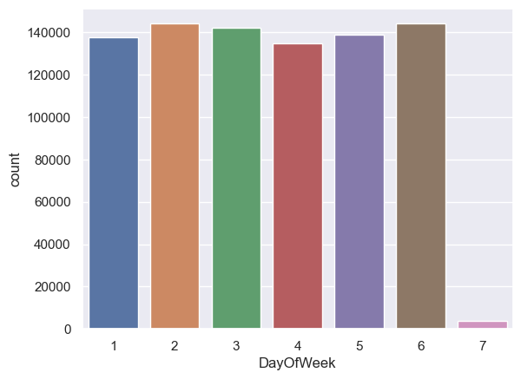
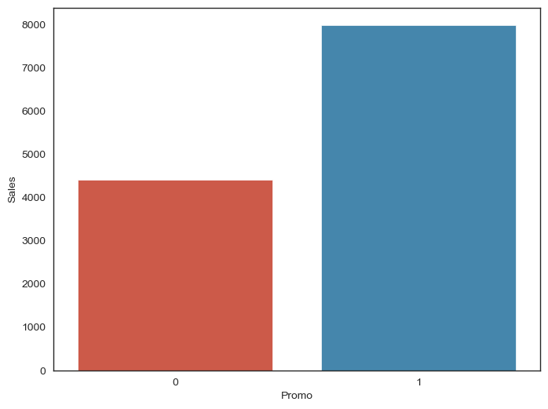
Exploratory Data Analysis
Day wise trends in sale
Impact of promo on sales

Slide 9
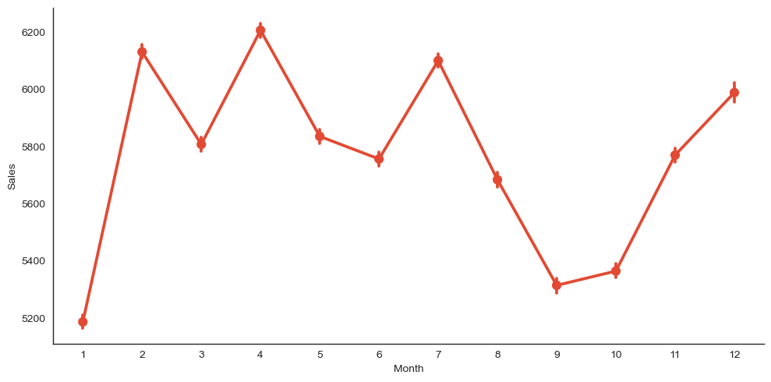
Exploratory Data Analysis
Monthly Trends in Sales

Slide 10
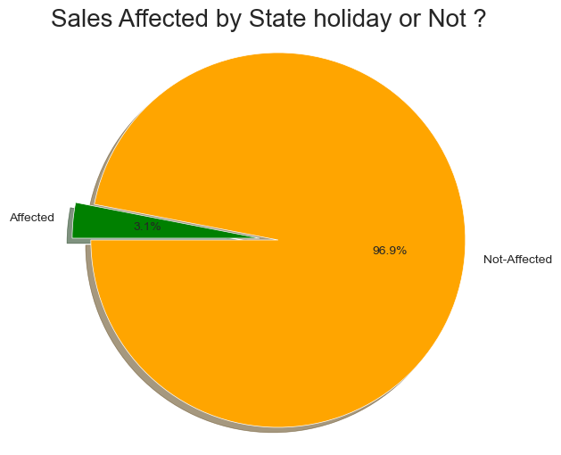
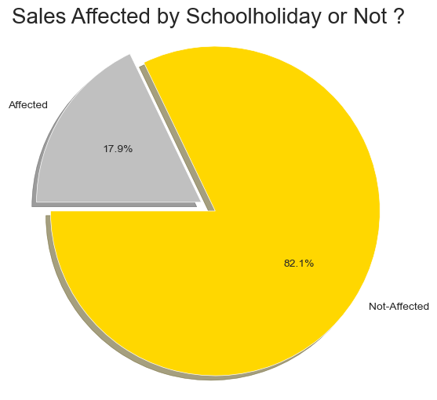
Exploratory Data Analysis

Slide 11
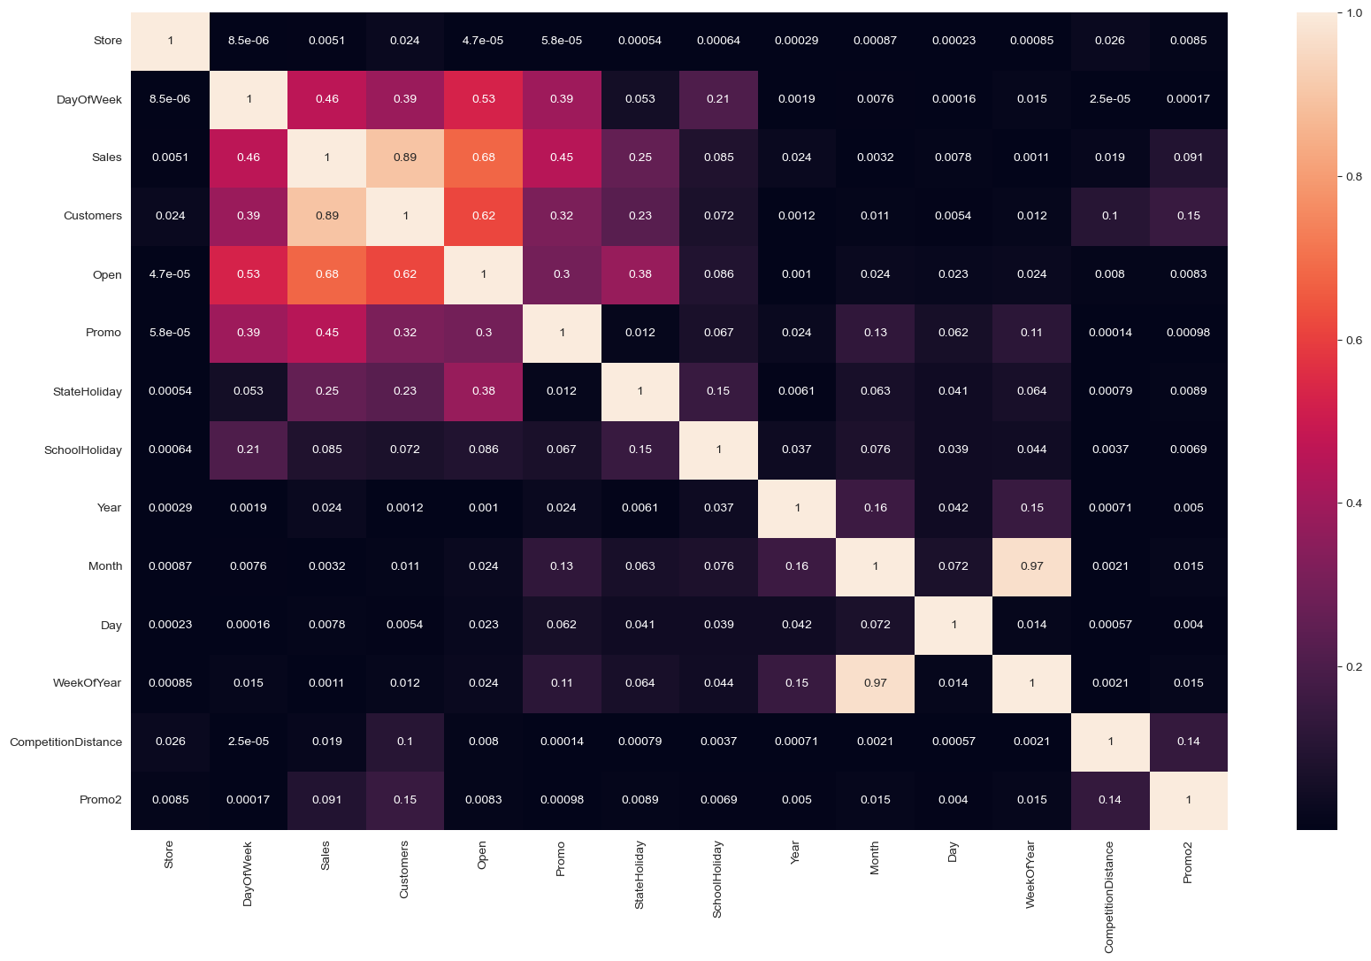
Exploratory Data Analysis
Heatmap Of Merged Dataset
Observation:
Day of the week has a negative correlation indicating low sales as the weekends, and promo, customers and open has positive correlation.
State Holiday has a negative correlation suggesting that stores are mostly closed on state holidays indicating low sales.
Competition Distance showing negative correlation suggests that as the distance increases sales reduce.
There's multicollinearity involved in the dataset as well. The features telling the same story like Promo2, Promo2 since week are showing multicollinearity.

Slide 12
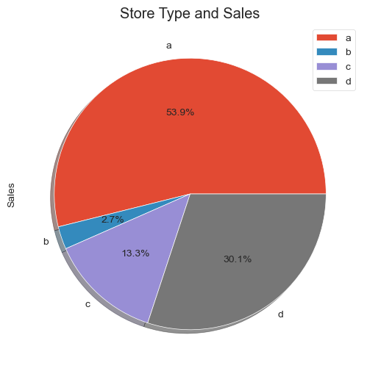
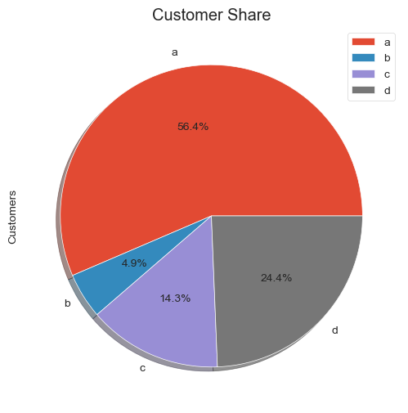
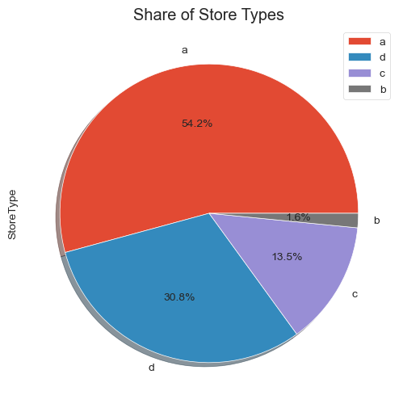
Exploratory Data Analysis
it was seen that the store type b had the highest sales on an average.
Store type a and c had a similar kind of sales and customer share.
Interesting insight to note is that store type b with highest average sales and per store revenue generation looks healthy.

Slide 13
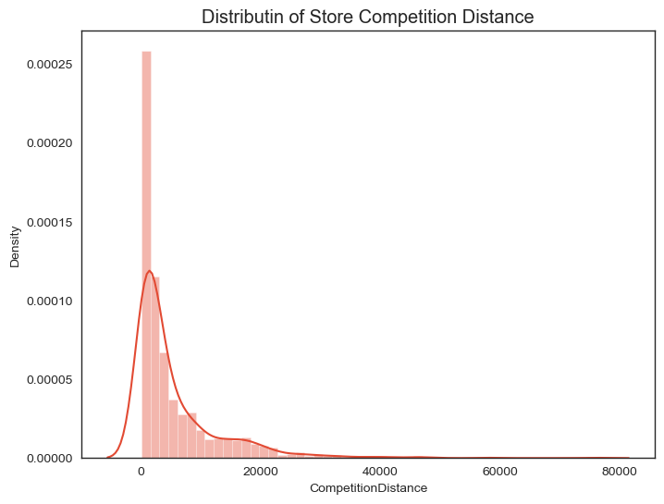
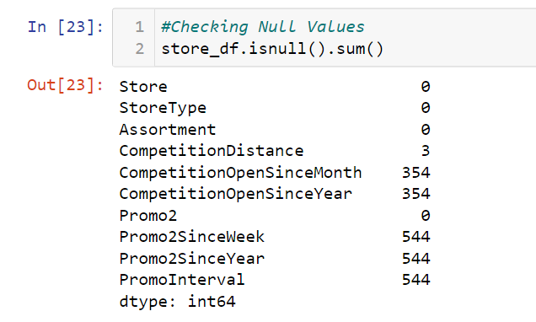
Data Pre-Processing
Handling the missing values:
The distribution is right skewed, so we'll replace missing values with the median.

Slide 14
Extracting week, month, year from Date and adding them in dataset.
Merging both dataset.
One hot encoding for Storetype, Assortment.
Splitting dataset into Training and Test set and applying MinMaxScaler for scaling dataset.
Model Selection
Comparing all the model performances, I found that RandomForestRegressor
has given highest R2_score and least MAPE(mean absolute percentage error).
R2_score for test data is 96%
MAPE for test data is 0.056

Slide 15
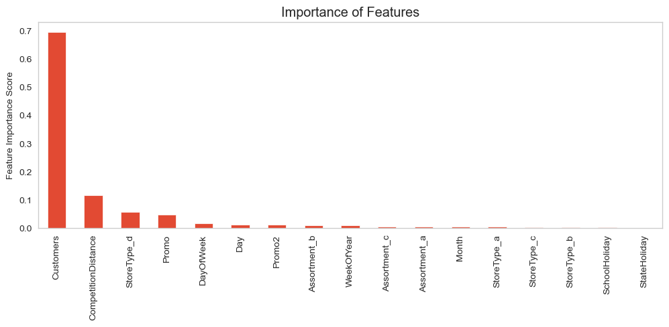
Important Features

Slide 16
THANK YOU!

