Slide 1
FINAL INTERNSHIP PROJECT
Job Skill Extraction from Job Descriptions using NLP
Turning 1.6M+ unstructured job descriptions into structured, standardized skills.
NLP
Machine Learning
Transformers
Power BI
Skill Analytics
Snehal Desai | Internship Project
01

Slide 2
Problem Statement
Why automatic skill extraction is needed
THE CHALLENGE
WHY RULES ALONE FALL SHORT
OUR SOLUTION
Recruiters must read large volumes of job descriptions to identify required skills. The information is unstructured, inconsistent and often contains abbreviations, synonyms and multi-word technologies.
Python / Python 3 ML / Machine Learning PowerBI / Power BI Natural Language Processing A simple keyword search can miss or duplicate skills.
Build an NLP pipeline that: • cleans text • identifies skills • handles variations • normalizes names • evaluates extraction quality
02

Slide 3
Business Use Case
From extracted skills to recruitment intelligence
JOB DATA
SKILL EXTRACTION
STANDARDIZED SKILLS
BUSINESS INSIGHTS
• Recruitment automation — reduce manual screening effort
• Candidate–job matching — compare required and available skills
• Skill-gap analysis — identify missing capabilities
• Job-market analytics — discover high-demand skills
BUSINESS VALUE • Faster screening • Better matching • Data-driven decisions
03

Slide 4
Dataset
Large-scale job posting data used for NLP
1,615,940
23
CSV
Job Description
Job records
Columns
Source format
Main NLP input
KEY INPUT
REFERENCE / CONTEXT
Job Description Unstructured text containing role requirements, responsibilities, technologies, experience and qualifications.
skills Used as a reference field for understanding and validating extracted skills where available.
Examples of fields: Job Title • Role • Experience • Location • Work Type • Responsibilities • Company • Job Description
04

Slide 5
Data Cleaning
Making noisy job text NLP-ready
RAW TEXT
CLEANING STEPS
CLEAN TEXT
<p>Data Analyst</p> • Apply: www.company.com Email: hr@company.com Call: +91-9876543210 Required: Python, SQL, Power BI!!!
HTML removal URLs & email removal Phone-number removal Special-character cleanup Whitespace normalization Duplicate / quality checks
Data Analyst Required Python SQL Power BI
Result: consistent text prepared for tokenization, matching and advanced NLP.
05

Slide 6
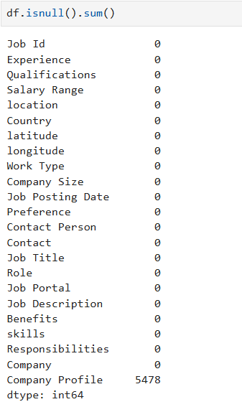
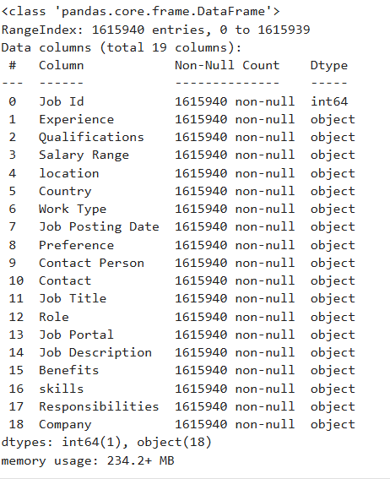
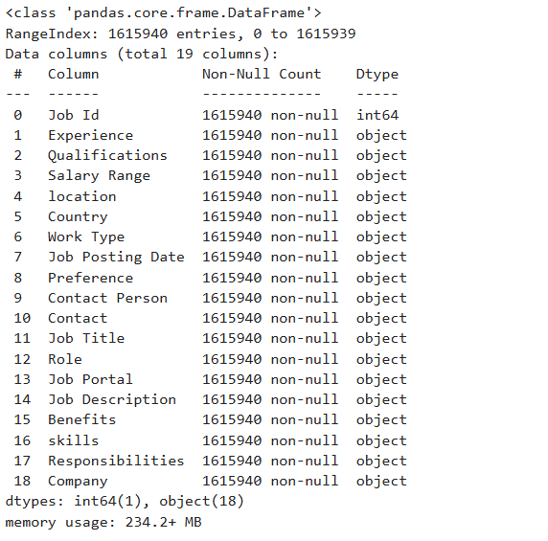
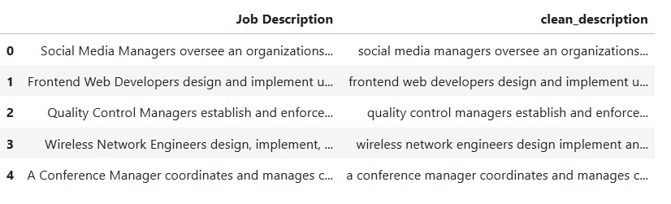

Slide 7
Exploratory Data Analysis
Understanding the dataset before modeling
JOB VOLUME
TEXT QUALITY
JOB MIX
DATA QUALITY
1.6M+ postings
Length & missing-value checks
Titles, roles & locations
Duplicates & completeness
VISUAL ANALYSIS
KEY TAKEAWAY
Top Job Titles Jobs by Location Description Length Distribution Missing Values Top Companies
EDA revealed the structure and quality of the dataset and confirmed Job Description as the core NLP field.
06

Slide 8
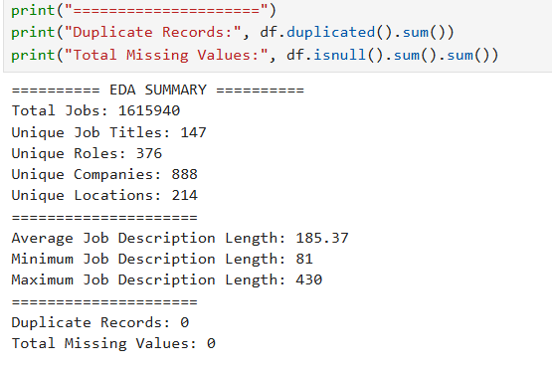
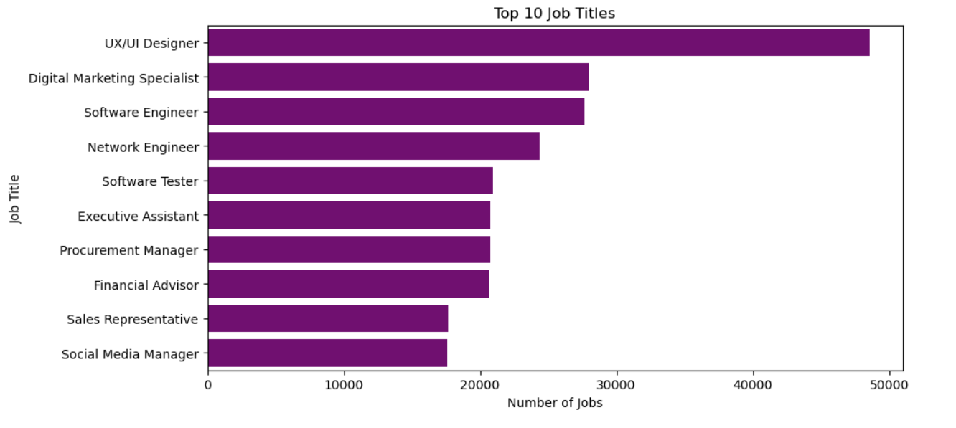
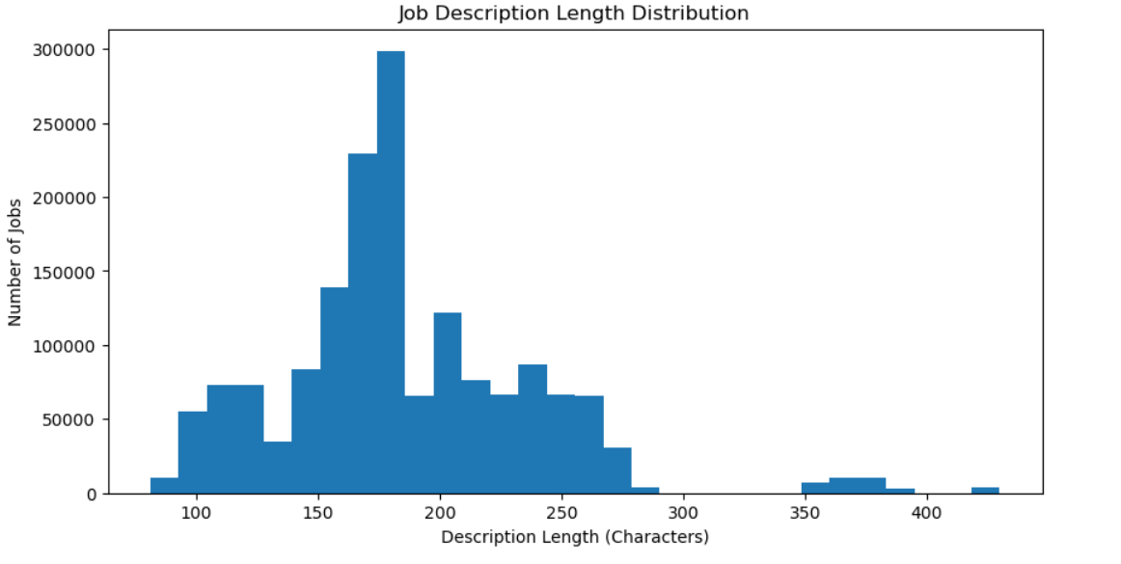
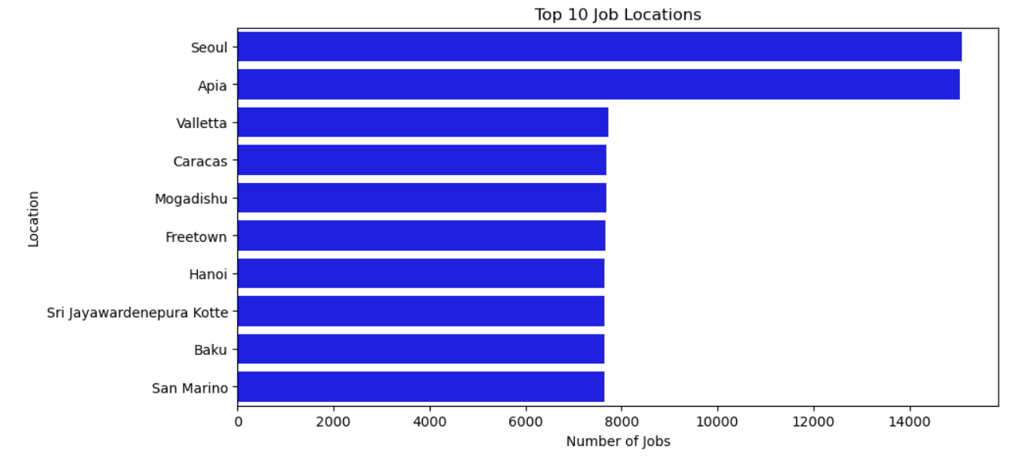
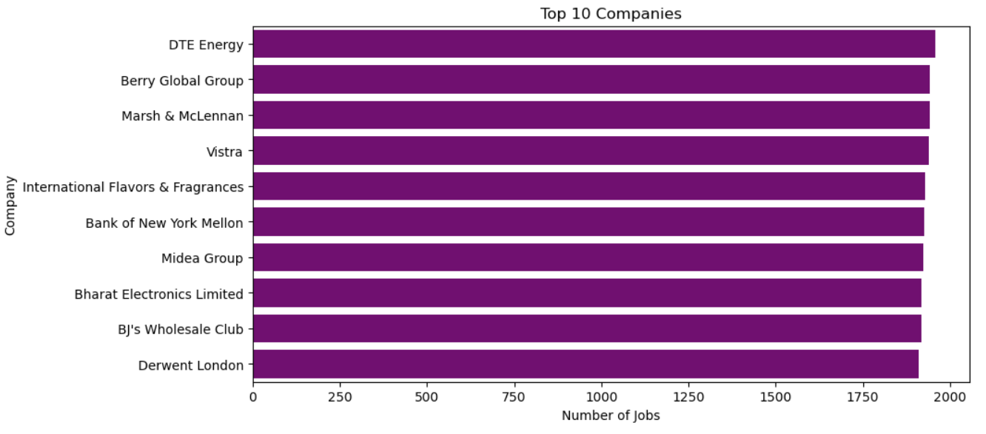

Slide 9
NLP Pipeline
End-to-end architecture of the project
Job Dataset
Cleaning
NLP Preprocessing
Skill Taxonomy
Regex + Phrase Matching
ML / Transformer
Normalization
Evaluation
Dashboard / App
Goal: transform unstructured text into a clean, standardized and evaluatable skill list.
Dictionary → Regex → Phrase Matching → TF-IDF / N-Grams → ML → Transformers → Normalization
07

Slide 10
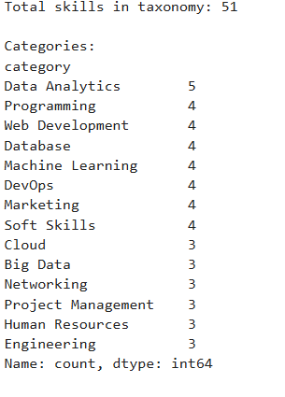
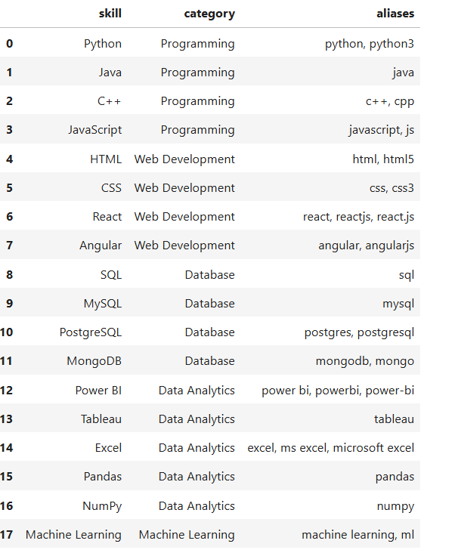

Slide 11
Rule-Based Approach
A transparent baseline, strengthened with Regex and Phrase Matching
1 DICTIONARY MATCHING
2 REGEX MATCHING
3 PHRASE MATCHING
Master skill taxonomy Python • SQL • Excel Power BI • Tableau AWS • Azure Machine Learning • Git
Handles variations: Python 3 → Python Python programming → Python PowerBI → Power BI Power-BI → Power BI
Detects complete phrases: Machine Learning Deep Learning Natural Language Processing Data Science Power BI
Outcome: stronger baseline for known skills, variations and multi-word terms.
08

Slide 12
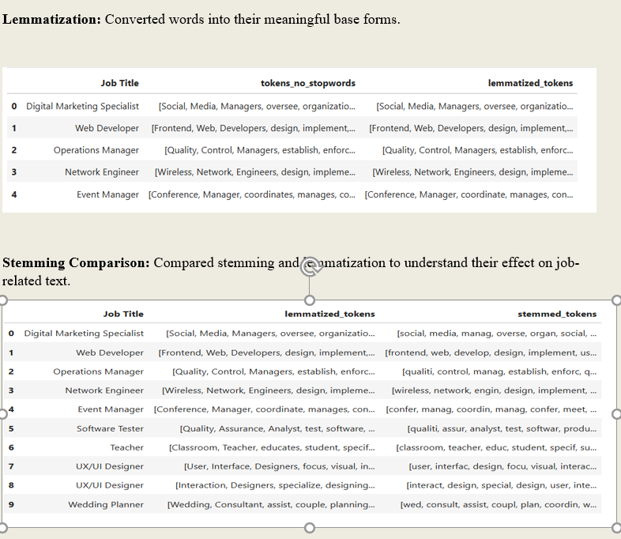
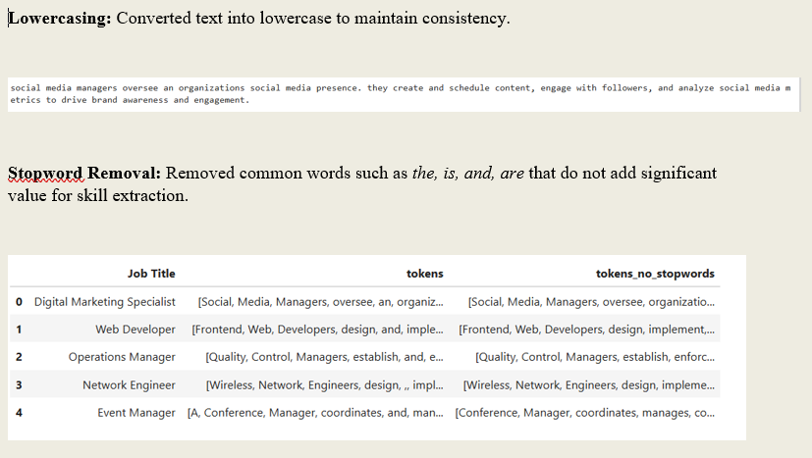
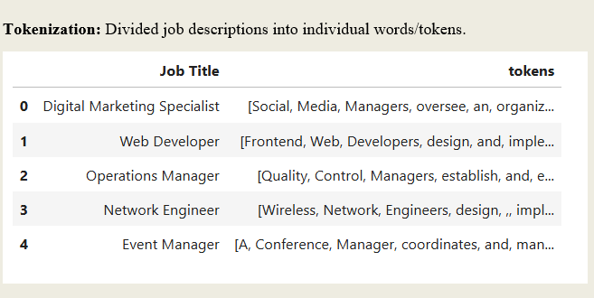
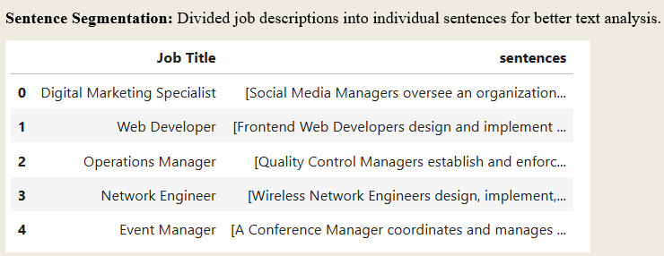

Slide 13
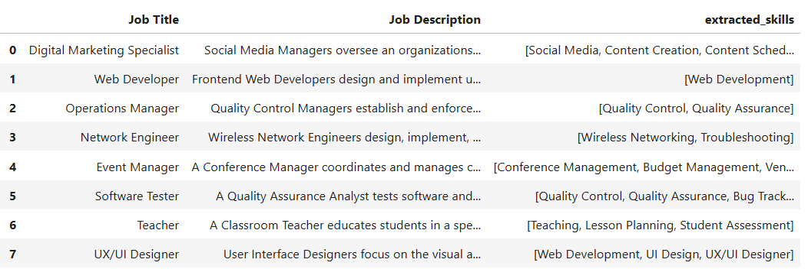
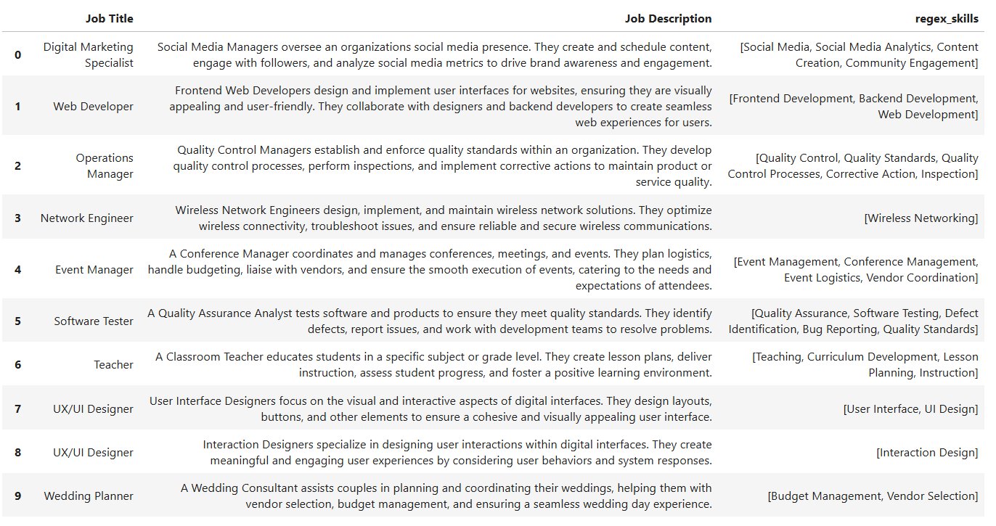
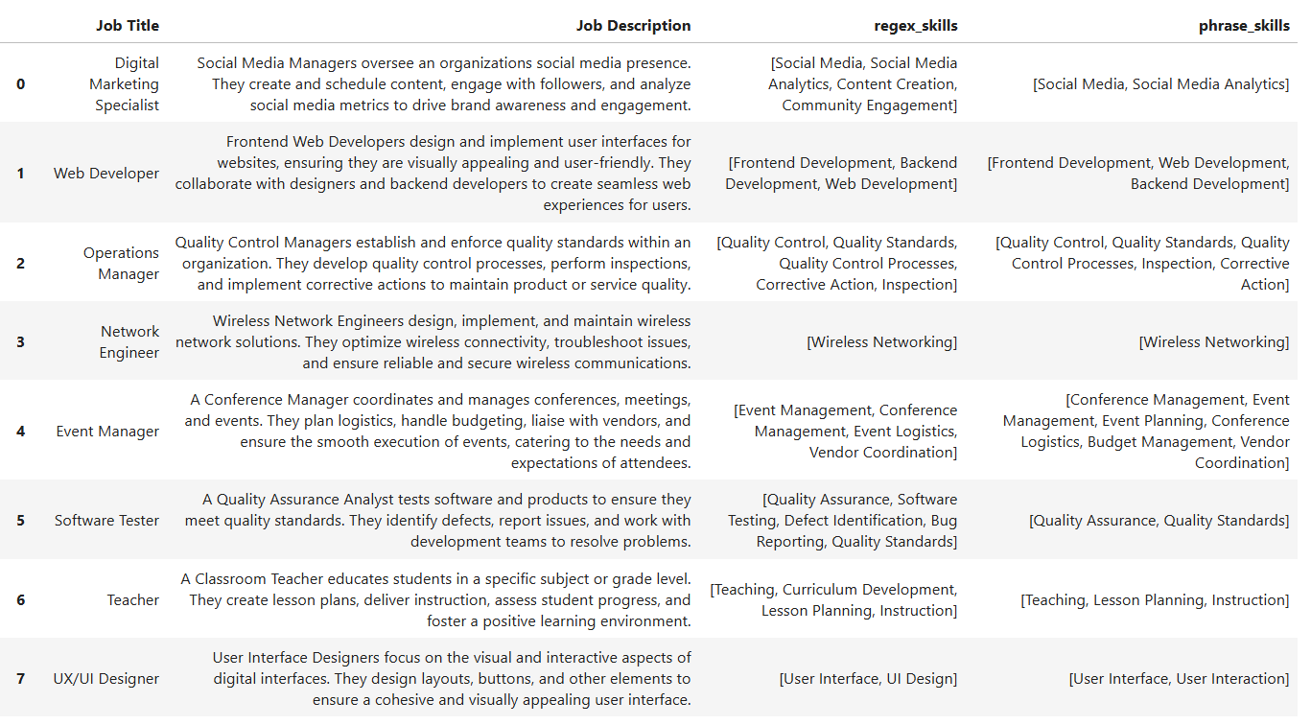
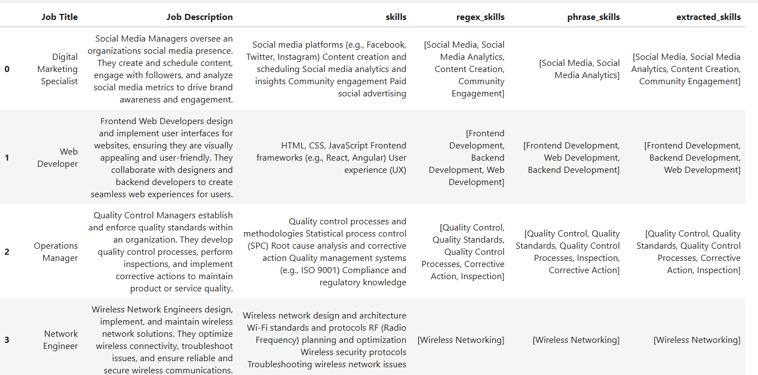

Slide 14
Machine Learning Approach
Moving from manually defined rules to learned patterns
Labeled Skill Data
TF-IDF Features
Logistic Regression
Skill Category
Example categories
Python
AWS
SQL
Power BI
SKILL
CLOUD
DATABASE
BI TOOL
Advantage: the classifier learns from labeled examples rather than relying only on manually written rules.
09

Slide 15
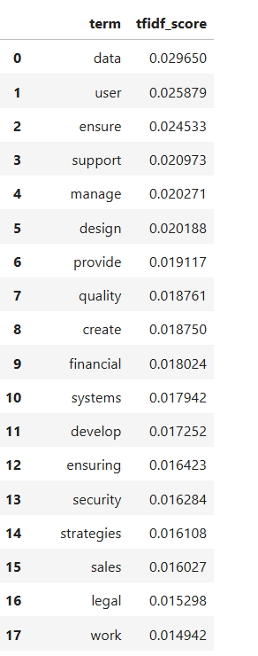
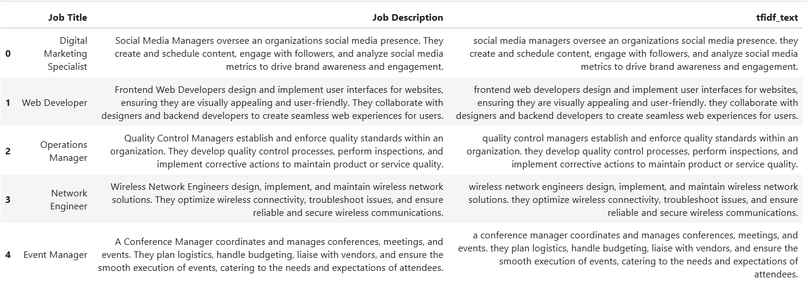
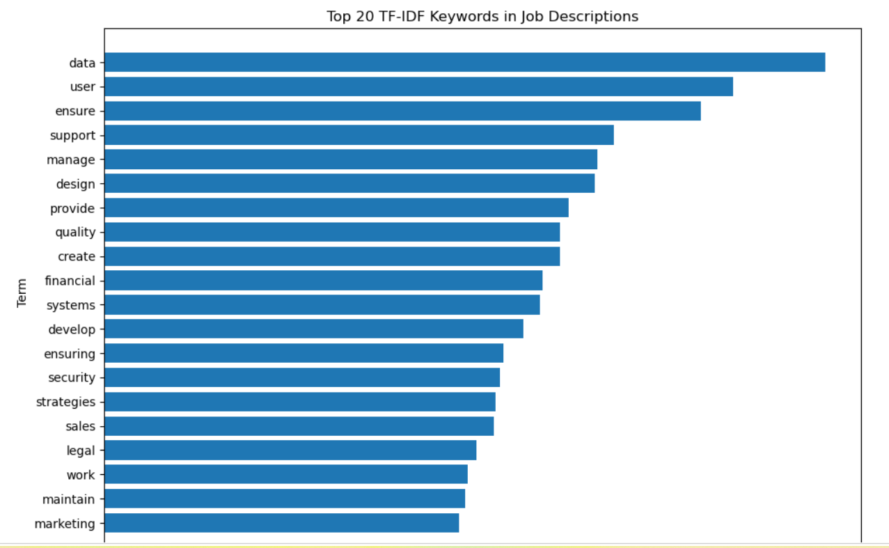

Slide 16
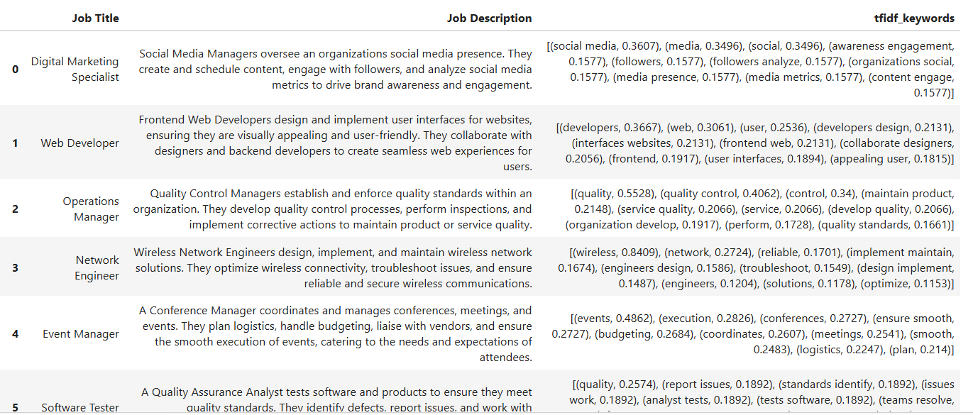
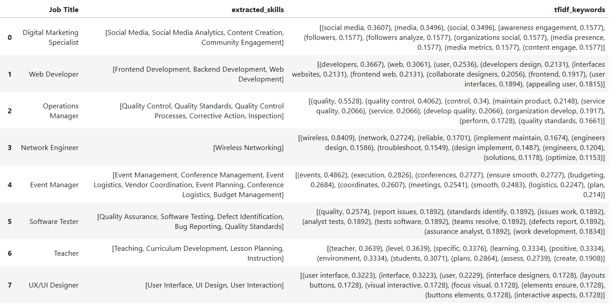
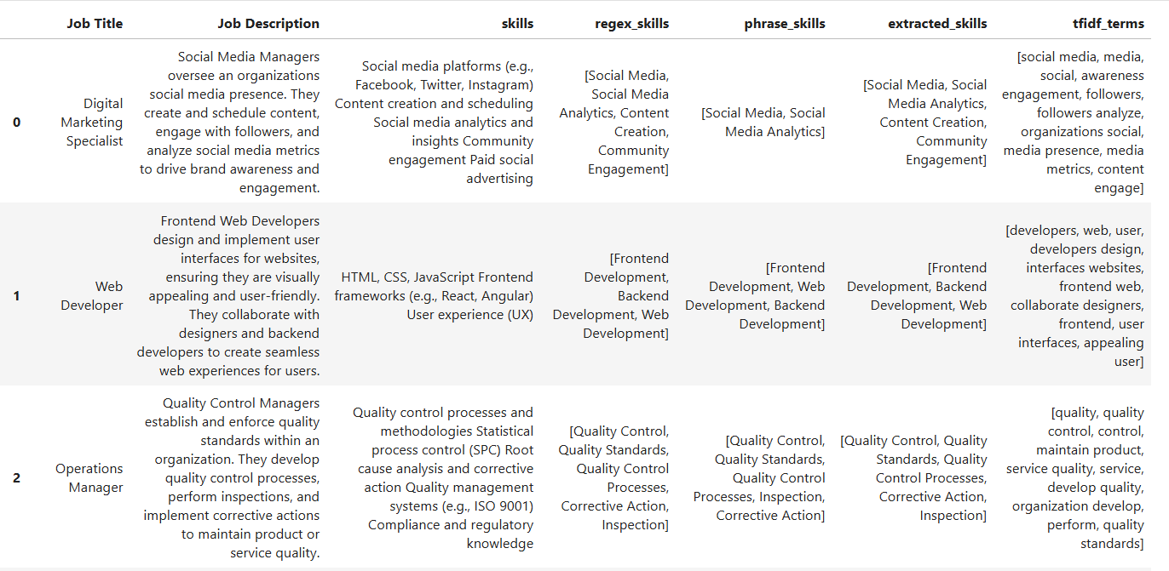
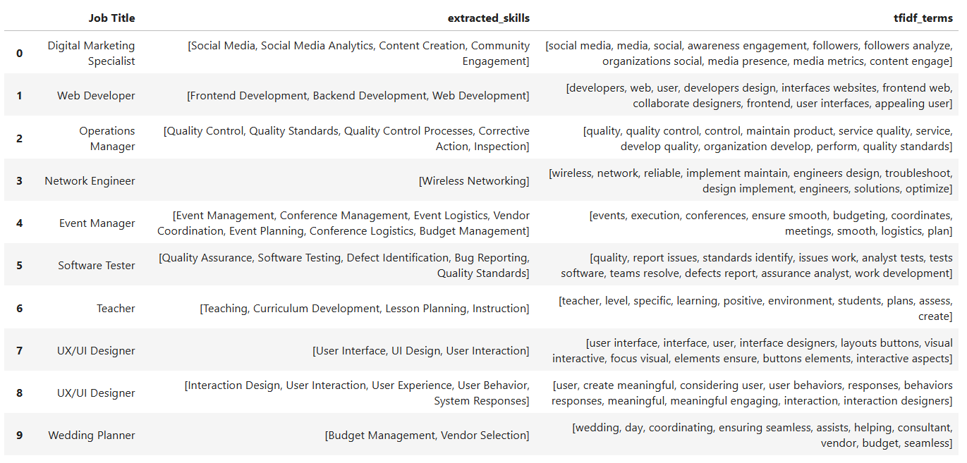

Slide 17
Transformer Approach
Adding contextual understanding for advanced NLP
WHY TRANSFORMERS?
EXAMPLE INPUT
STRUCTURED OUTPUT
Keyword matching focuses on exact forms. Transformers use surrounding context to understand how words and phrases are used. Models explored: BERT, DistilBERT, RoBERTa.
“Experience with Python, SQL and AWS.” ↓ Context-aware entity / skill detection
Python → SKILL SQL → SKILL AWS → SKILL Potential foundation for a domain-specific fine-tuned model.
10

Slide 18
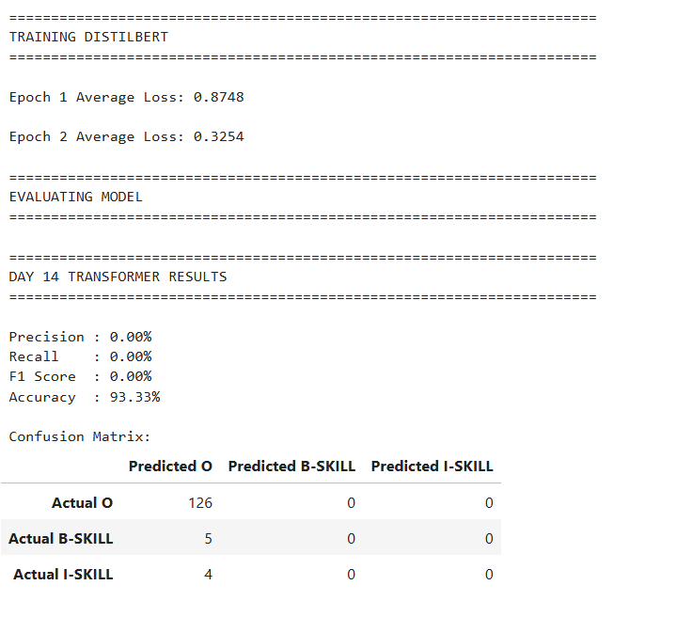
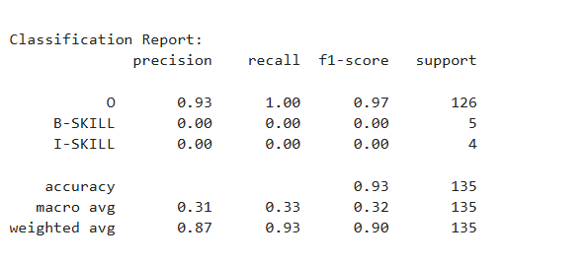
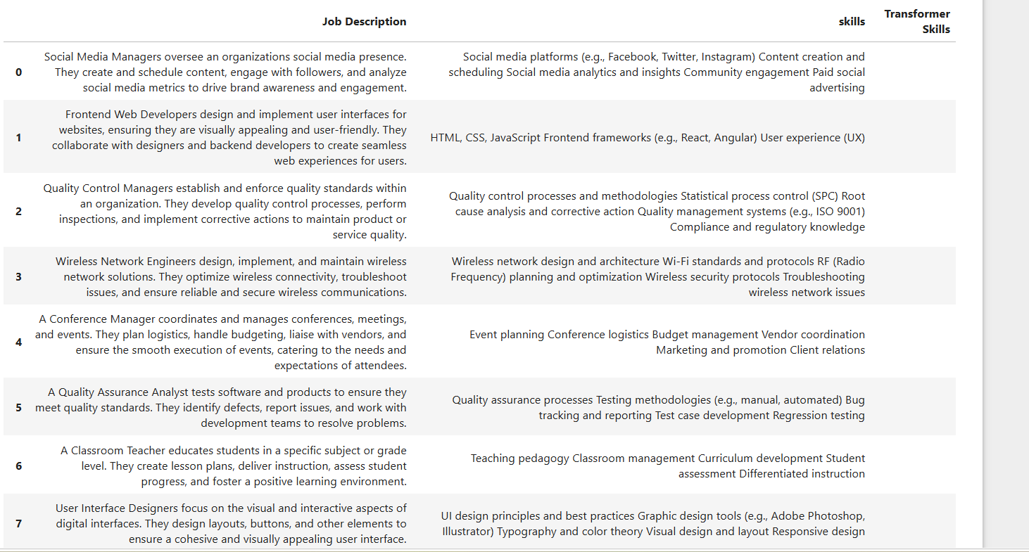

Slide 19
Model Comparison
Compare approaches using evidence, not assumptions
Dictionary
Fast baseline
ADD SCORE
Regex
Variation handling
ADD SCORE
Phrase Match
Multi-word skills
ADD SCORE
ML
Learned patterns
ADD SCORE
Transformer
Contextual NLP
ADD SCORE
Metrics: Precision • Recall • F1-Score • Accuracy
Replace “ADD SCORE” with your actual evaluation values from the final notebook.
11

Slide 20
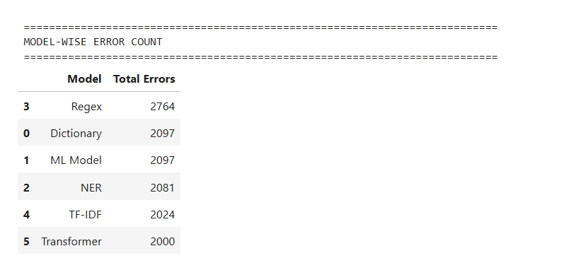
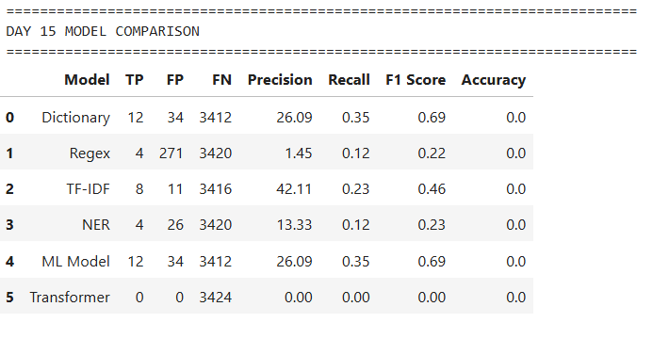
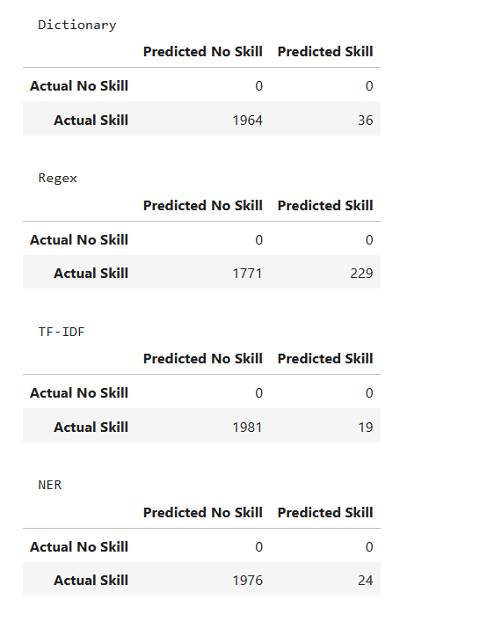
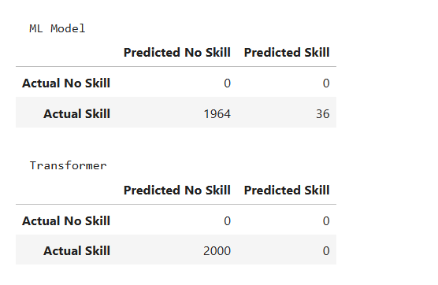
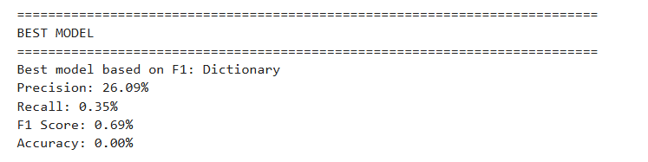

Slide 21
Error Analysis
Understanding why predictions fail — and how to improve them
FALSE POSITIVE
FALSE NEGATIVE
NORMALIZATION / ENTITY
A non-skill term is extracted as a skill. Example: “experience with cloud technologies” Root cause: broad matching / context.
An actual skill is missed. Example: A new or uncommon technology not present in the taxonomy. Root cause: limited vocabulary.
Examples: ML → Machine Learning Python 3 → Python PowerBI → Power BI Root cause: synonyms, abbreviations and formatting.
Key lesson: evaluation tells us HOW WELL the system works; error analysis tells us WHY.
12

Slide 22
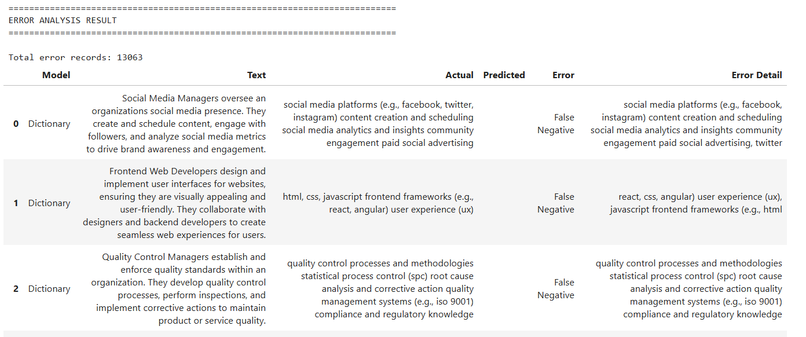
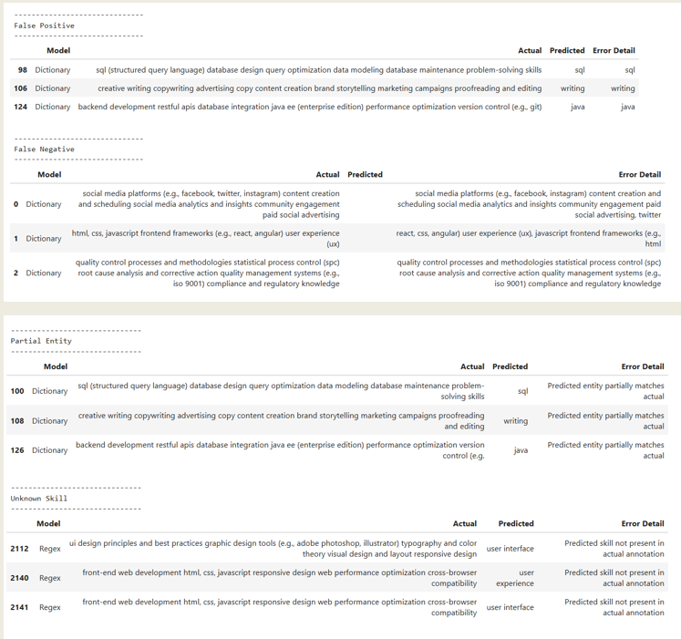
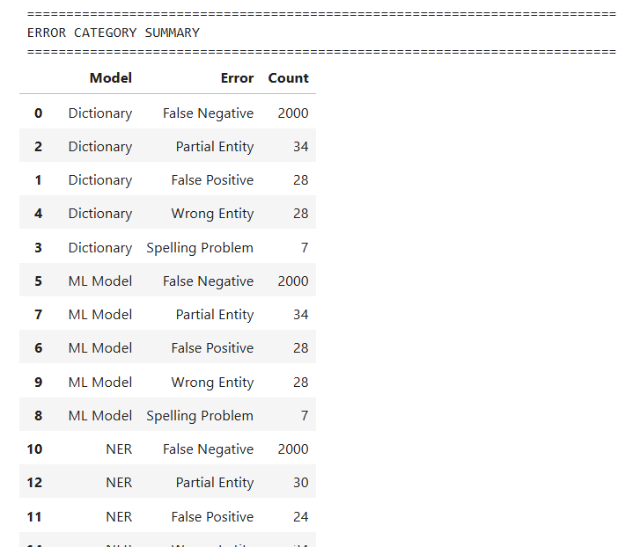

Slide 23
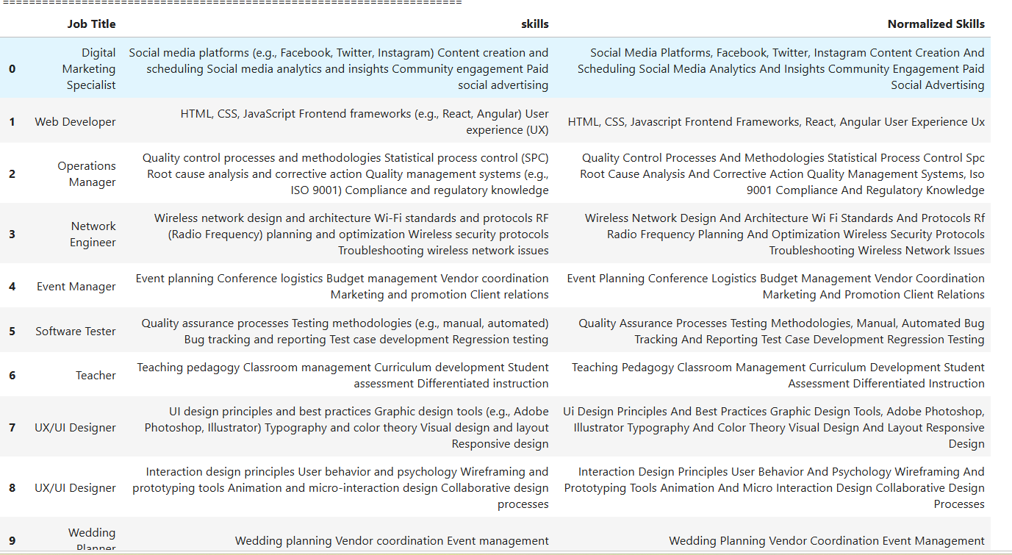
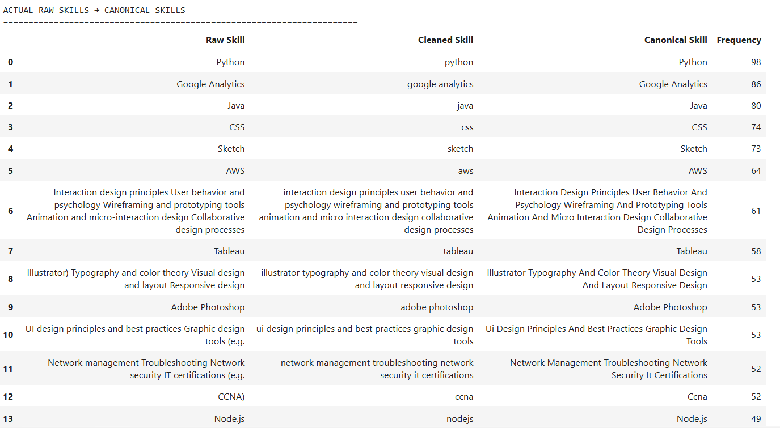
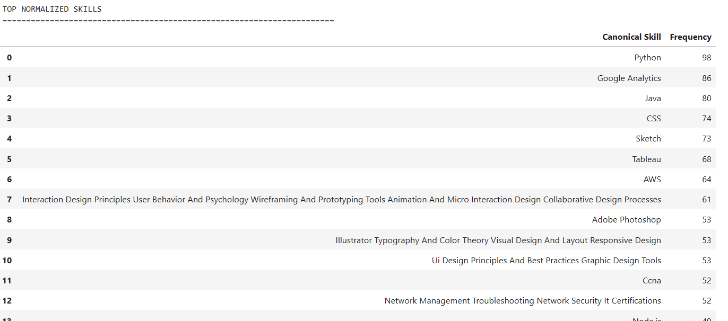

Slide 24
Dashboard
Turning extracted skills into business insights
JOB POSTINGS
TOP SKILL
ROLES
LOCATIONS
1.6M+
Python
Job Title
Location
TOP IN-DEMAND SKILLS
SKILLS BY ROLE / LOCATION
Python SQL Excel Power BI Machine Learning
Use Power BI visuals to compare skill demand across job titles, roles, locations and experience levels.
Dashboard goal: convert NLP output into clear, actionable recruitment analytics.
13

Slide 25
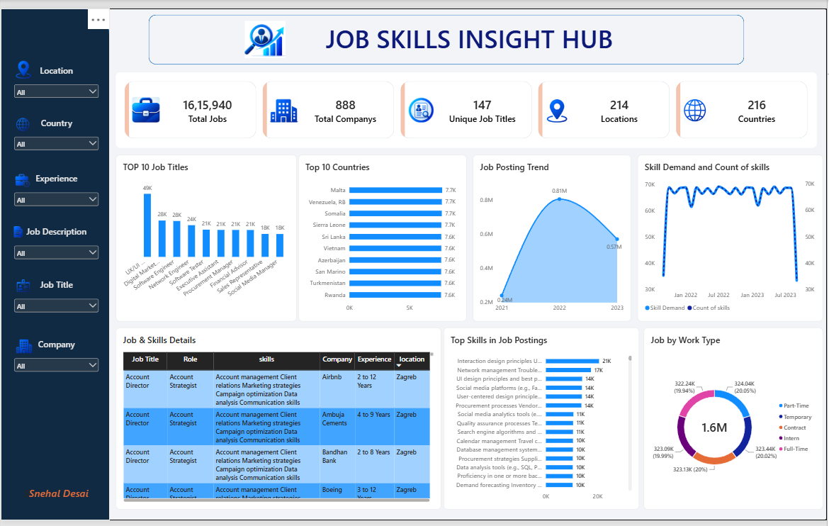

Slide 26
Application Demo
Demonstrating the complete extraction flow
INPUT — JOB DESCRIPTION
NLP ENGINE
OUTPUT
Looking for a Data Analyst with Python, SQL, Excel and Power BI experience.
Clean ↓ Extract ↓ Normalize ↓ Return skills
Python SQL Excel Power BI
Demo message: unstructured text in → standardized skills out.
14

Slide 27
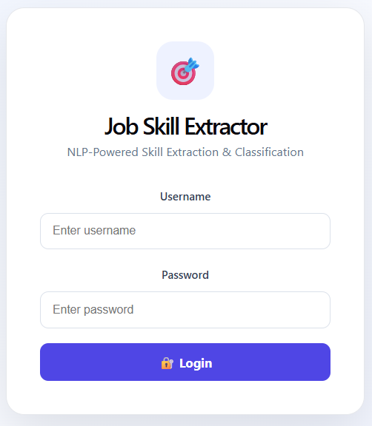
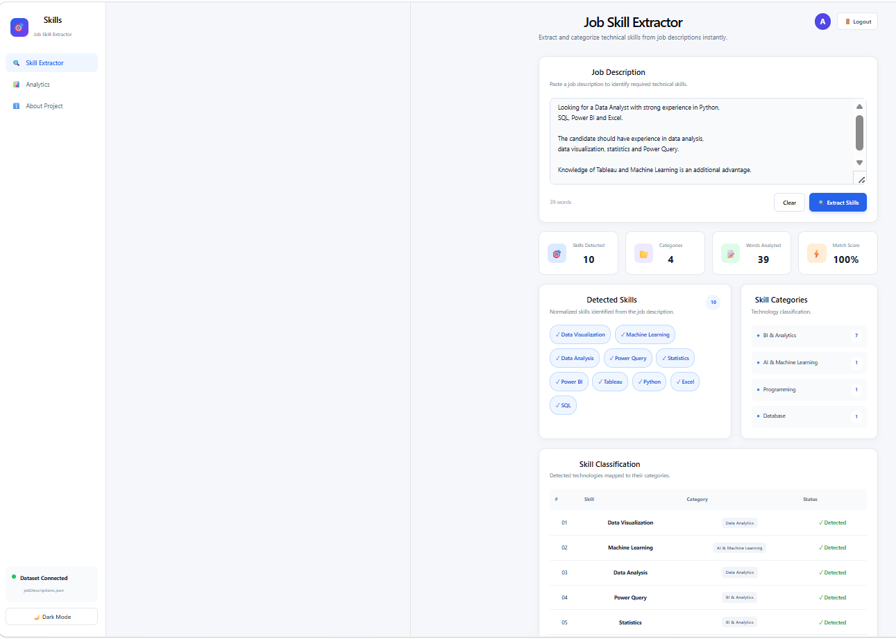

Slide 28
Conclusion
What the project achieved
• Prepared and analyzed a 1.6M+ job-description dataset.
• Built a structured skill taxonomy for consistent extraction.
• Implemented dictionary, Regex and phrase-matching baselines.
• Explored TF-IDF, N-Grams, Machine Learning and Transformer approaches.
• Performed evaluation and error analysis to understand model weaknesses.
• Normalized skill variations into canonical names.
• Prepared outputs for Power BI analytics and application demonstration.
UNSTRUCTURED TEXT → NLP → STANDARDIZED SKILLS → BUSINESS INSIGHTS
15

Slide 29
Future Improvements
From internship prototype to production-ready recruitment intelligence
01
05
Fine-tune a Transformer model with domain-specific skill annotations.
Expose real-time extraction through an API.
02
06
Continuously expand the taxonomy with emerging technologies.
Add resume–job matching and skill-gap analysis.
03
07
Improve synonym, abbreviation and context handling.
Build personalized job recommendations.
04
08
Support multilingual job descriptions.
Deploy the solution as a scalable web application.
LONG-TERM VISION • Jobs + Skills + Candidates + Recommendations
16

