Slide 1
Omnichannel Retail Analytics Project
Python | SQL Server (SSMS)| Power BI
Snehal Desai

Slide 2
Problem Statement
Retail data is scattered across multiple channels (online & offline), making it difficult to get a unified view of overall business performance.
Businesses struggle to make data-driven decisions due to limited visibility and absence of a centralized analytical dashboard.

Slide 3
Project Overview
Objective:
Clean and integrate retail data.
Perform data analysis using SQL.
Build interactive dashboard in Power BI.
Generate business insights.

Slide 4
Tools & Technologies
Tools Used:
- Python (Pandas, NumPy)
- SQL Server (SSMS)
- Power BI (DAX, DATA Modeling)
- GitHub

Slide 5
Data Cleaning Techniques (Python)
Imported raw dataset into Python
Handled missing values (CustomerID, Description)
Removed duplicate records
Standardized date/time formats
Validated and corrected data types
Feature Engineering (Revenue = Quantity × UnitPrice)

Slide 6
SQL Data Analysis
Imported cleaned data into SQL Server
Validated dataset and schema
Performed aggregations and KPI calculations
Prepared data for visualization

Slide 7
Data Modeling
- Created relationships between tables
- Star schema approach
- Defined measures using DAX
- Optimized data model

Slide 8
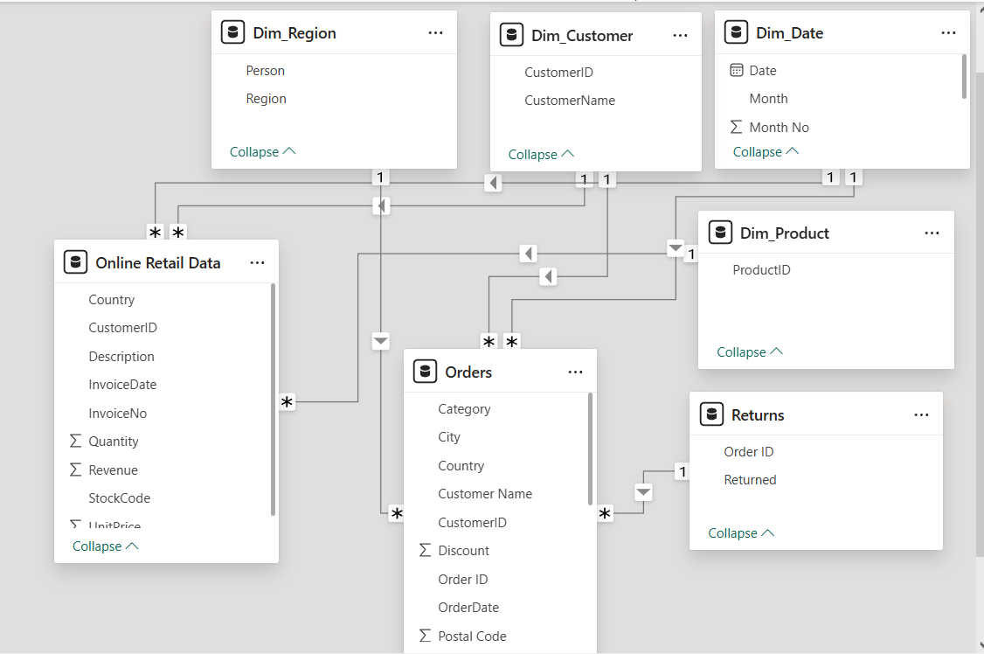
Data Modeling

Slide 9
Conclusion
Python used for efficient data cleaning
SQL used for data analysis
Power BI used for visualization & modeling
Project demonstrates end-to-end data analytics workflow

