Slide 1
Assignment:Docker Volumes
-Snehal Deshmukh

Slide 2
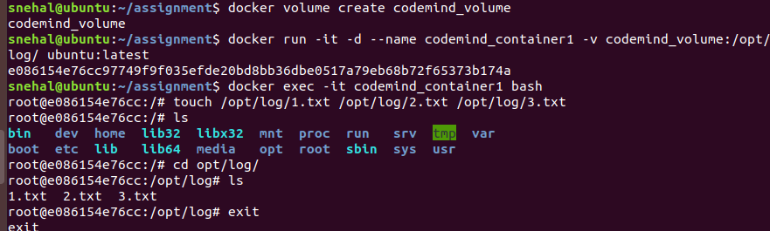
- Create a docker volume: codemind_volume. - Map it within container name: codemind_container1 to a location: /opt/log/. - Get some data generated [touch [1..3].txt] inside container on location: /opt/log/.

Slide 3
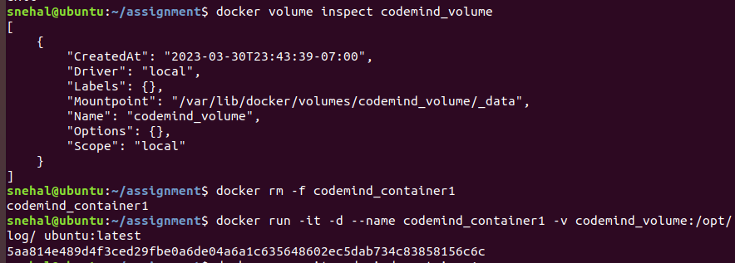
-Validate this data is getting copied in docker volume host's path. - Remove container name: codemind_container1. - Run a new container name: codemind_container1 with mapping of volume: codemind_volume.

Slide 4
-Test and validate that data from previous container is getting reflected in the new container via this volume mapping.

