Slide 1
Assignment
-Snehal Deshmukh

Slide 2
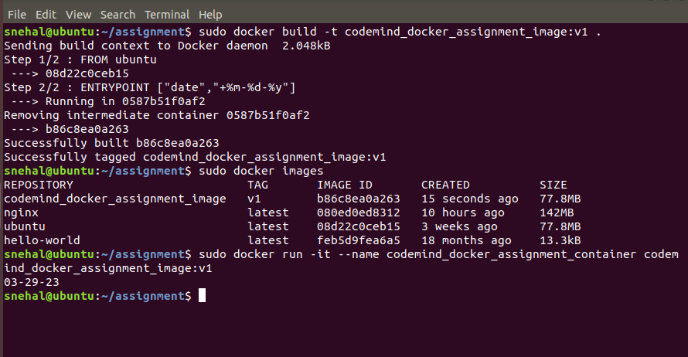
Display the date in form pf mm-dd-yy [ENTRYPOINT use case]

Slide 3
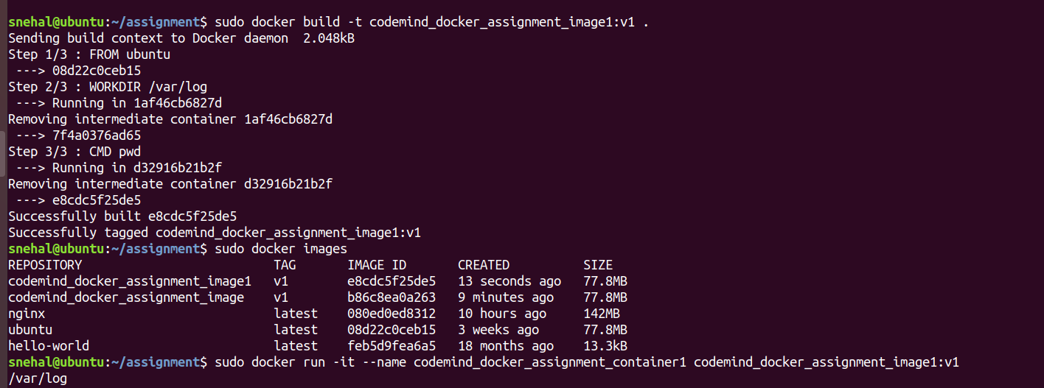
Display the pwd to be `/var/log` [CMD and WORKDIR use case]

Slide 4
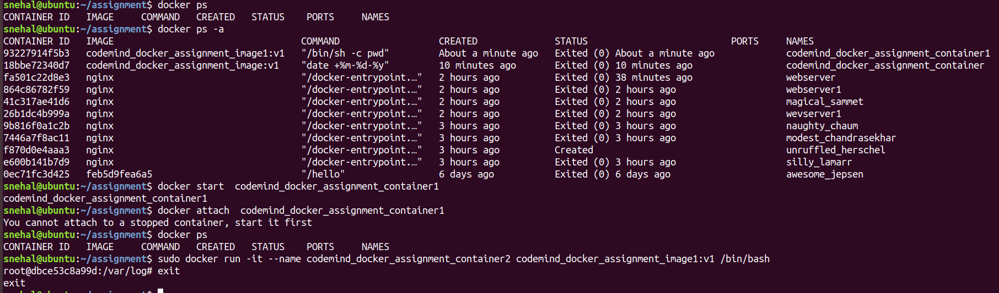

Slide 5
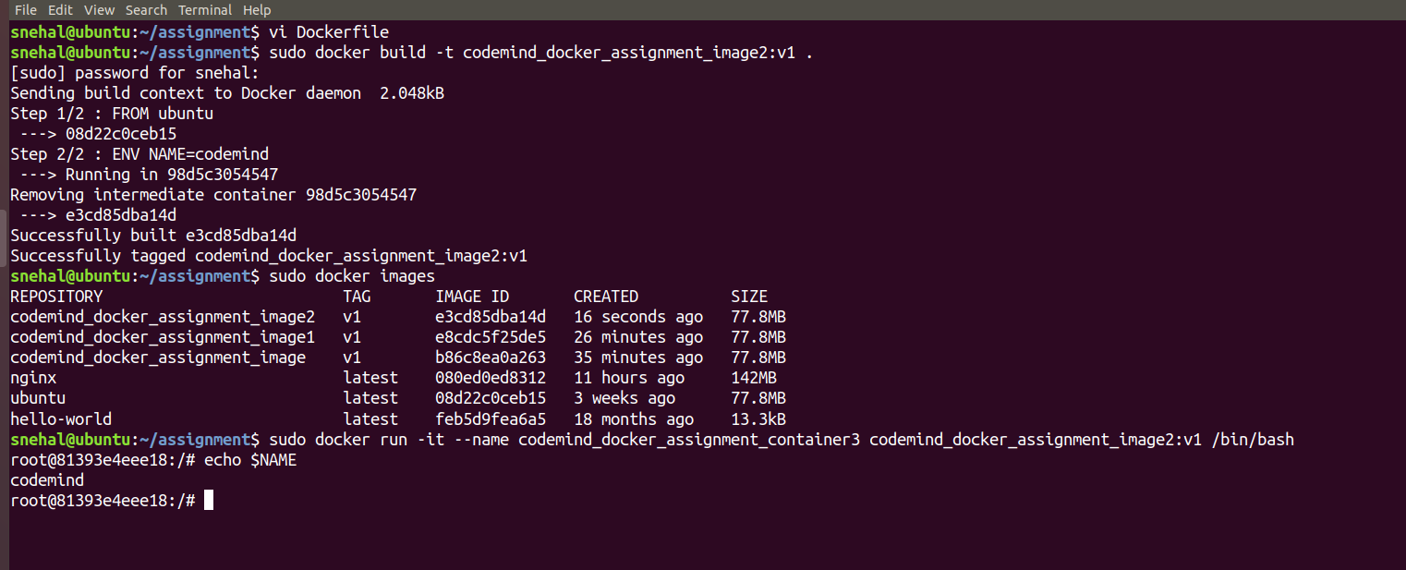
Display output of echo $NAME to be CODEMIND [ENV use case]

Slide 6
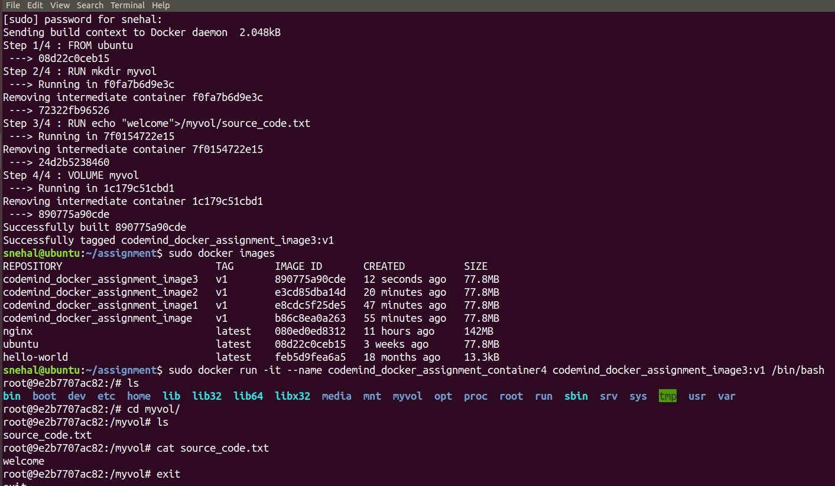
Map a source_code.txt inside the container in a way it should sync the content inside the container at container run time. [VOLUME use case]

