Slide 1


Slide 2

GLOBAL TERRORISM PROJECT
EXPLORATORY DATA ANALYSIS ON GLOBAL TERRORISM DATA
PRESENTED BY
MS. SNEHAL GADDIME

Slide 3

GLOBAL TERRORISM ANALYSIS
Defining the problem statement
Importing the Libraries
Missing Value Imputation
Descriptive Statistics
Graphical Representation

Slide 4


GLOBAL TERRORISM DATA INTRODUCTION
World peace was one of the core reasons for forming the United Nations organization. Terrorism is the biggest hurdle to world peace. Terrorism is commonly ignored by the civilians who are not affected directly by the dangers. For the most part, terrorism is considered unpredictable and unfortunate calamity that strikes some parts of the world more than others. Based on the location of the events, people at large have very limited information about any such event happening in other parts of the world and hence react differently.
In this project, we focus on terrorism by analyzing the dataset provided by START (Study of Terrorism and Response to Terrorism) Consortium to explore meaningful patterns and statistics.

Slide 5
DATA DESIGN STRUCTURE
1.IMPORT LIBRARIES : In this part , we had imported required libraries to perform Exploratory Data Analysis Libraries used are Pandas for Data manipulation and aggregation. Matplotlib and seaborn is for Visualization.
2.DESCRIPTIVE STATISTICS : In this part we start by looking at descriptive statistic parameters for the dataset. We will use describe() for this. The dataset contains over 1,81,691 rows and 135 columns .Columns have data type object , integer, and float. Data had NO duplicates values.
3.MISSING VALUE IMPUTATION: We will now check the missing values in our dataset. In case there are any missing entries , we will impute them with appropriate values.
4.GRAPHICAL REPRESENTATION : We will start with the Univariate analysis where the data will be analyzed only one variable. Where as Bivariate analysis ,the data will be compared with two variables to study their relationships. Multivariate analysis is similar to bivariate analysis but comparing more than two variables.

Slide 6
DATASETS
Incident Date and Time: The date and time when the terrorist incident occurred. This feature enables temporal analysis.
Geographical Location: Information about the location of the incident, including latitude and longitude coordinates, city, region, and country.
Attack Type: The nature of the attack, such as bombing, shooting, kidnapping, hijacking, or cyberterrorism.
Target Type: The type of target or victim, which could include civilians, government officials, military personnel, religious institutions, transportation systems, and more.
Casualty Counts: Data on the number of casualties, including deaths and injuries, caused by the terrorist incident.
Perpetrator Information: Details about the individuals or groups responsible for the attack, including affiliations, ideologies, and any known leaders.
Motivations: The stated or inferred motivations behind the terrorist act, such as political, religious, ideological, or economic factors.
Weapons Used: Information on the weapons or tools used in the attack, including firearms, explosives, vehicles, or other implements.

Slide 7
Tactics and Strategies: How the attack was carried out, including tactics employed and strategies used by the perpetrators.
Hostage Situations: If applicable, details about hostage situations, including the number of hostages and their fate.
Media Coverage: Data on how the incident was covered in the media, including news reports and social media mentions.
Terrorist Group Information: Information about the terrorist organization responsible, such as its history, structure, and notable past activities.
Geospatial Features: Geospatial information, such as region-specific variables or geographic characteristics that may affect terrorism patterns.
Predictive Features: Variables or features used for predictive modeling, such as historical data on terrorism incidents, demographics, or socio-economic indicators.
Ethical and Privacy Features: Features that address ethical considerations, data anonymization, and privacy protection in the dataset.
Day, month, year : Calendar details of the event.

Slide 8
Topics for discussion
Which region is mostly got attacked in global terrorism?
Where the mostly done attacks have happened by the terrorists?
Which are the states had mostly been part of attacks happened by the terrorists?
What kind of weapons are used in terrorists’ attacks?
What type of attacks terrorists have done to kill most of people?
In which year most attacks have happened by the terrorists?
By which type of attack most people got injured?
which type of attack was reason of mostly killed people?
Which weapon type caused to make injured most of the people?
Which source has recorded the most injured people in the attacks by the terrorists?
In which year, people were killed with badly injured by terrorists?
By which type of attack most of the people got injured mostly by the terrorists?
In which region people mostly killed by which attack in terrorism?
What is the Percentage of attacks increased from 1970 to 2017?

Slide 9

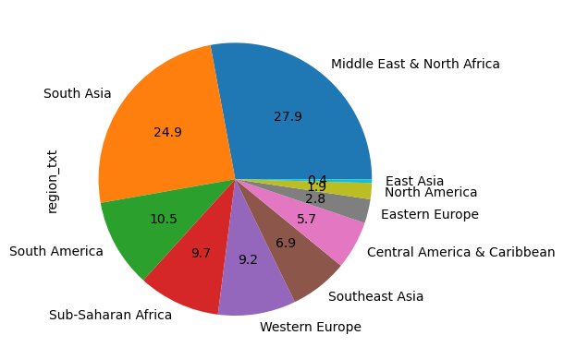
1. Which region is mostly got attacked in global terrorism ?
From the pie chart, it seems like mostly people In region Middle East & North Africa have highly affected by the global terrorism attack where as East Asia is less attacked in global terrorism attack.

Slide 10
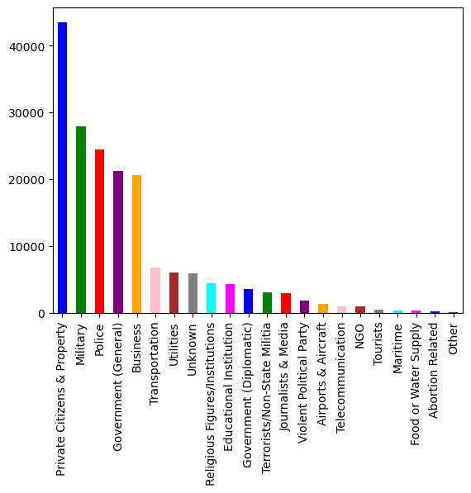
2. Where the mostly done attacked have happened by terrorists?
In piechart it is clearly visible that Private Citizens & Property has been mostly attacked where as Educational Institute has least attacked happened

Slide 11
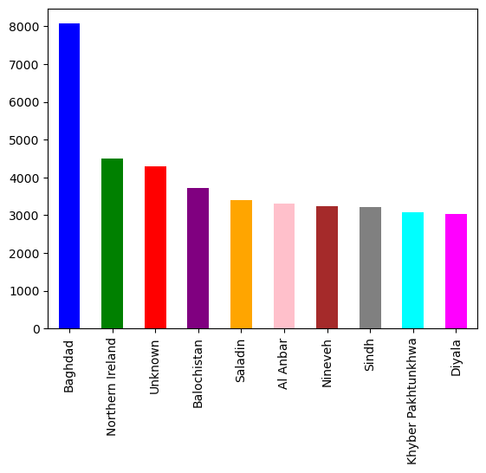
3. Which are the states had mostly been part of the attacks happened by terrorists ?
With the help of piechart we can see that Baghdad state is mostly involved where as Diyala is less involved in the attacks done by the terrorists.

Slide 12
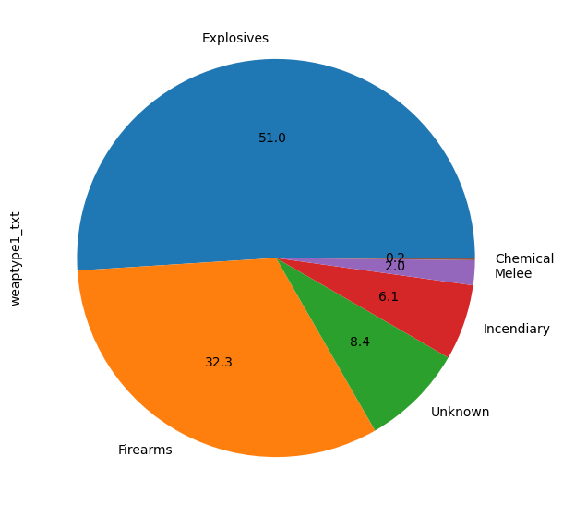
4. What kind of weapons are used in the terrorists’ attacks?
In weapons, Explosives have been mostly used in the attacks to kill most people and Chemical weapons are least used as it shows in the chart.

Slide 13
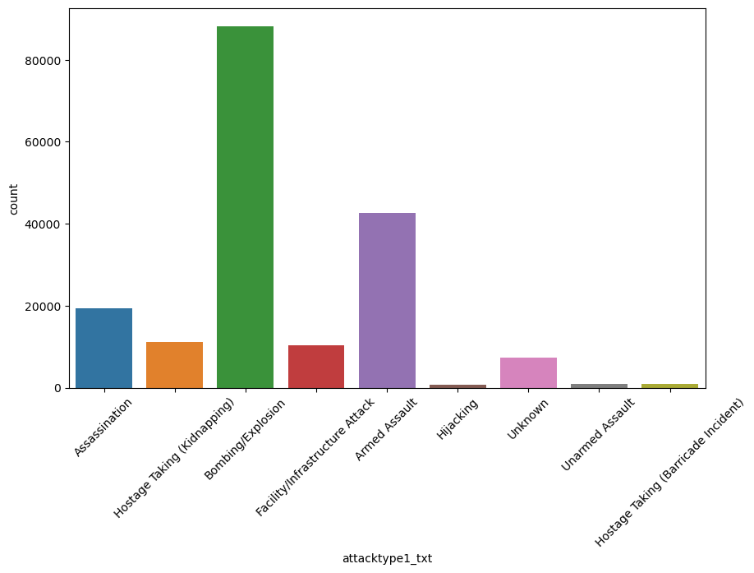
5. What types of attacks terrorists have done to kill most of people?
As we can see in the graph, Mostly done crimes and attacks by the terrorists are by Bombing/ Explosion.
After Bombing, second most attacks were done by Armed Assault.

Slide 14
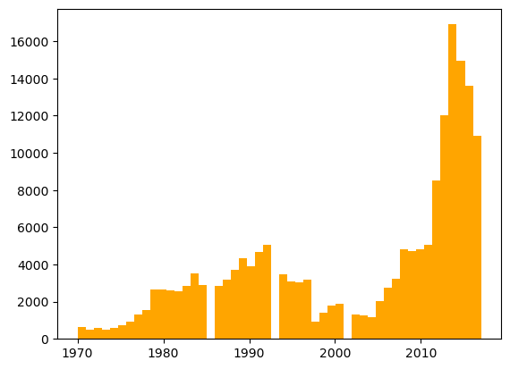
6. In which year most attacks have happened by the terrorists?
Globle terrorism mostly happened in year 2010 . it was actually started increasing from the year 1970 and in 2000 it was decresed but in 2010 it was at peak as most of the attacks of all time have happened in 2010 only as per the data.

Slide 15
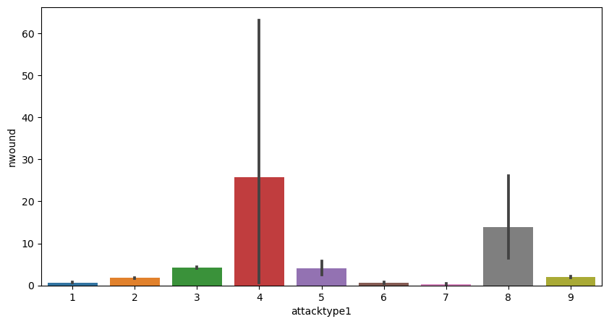
7. By which type of attack most of the people got injured ?
As it is showing in the graph we can see the In the Global terrorism, Mostly people were injured by the attack of bombing and explosion by the terrorists.

Slide 16
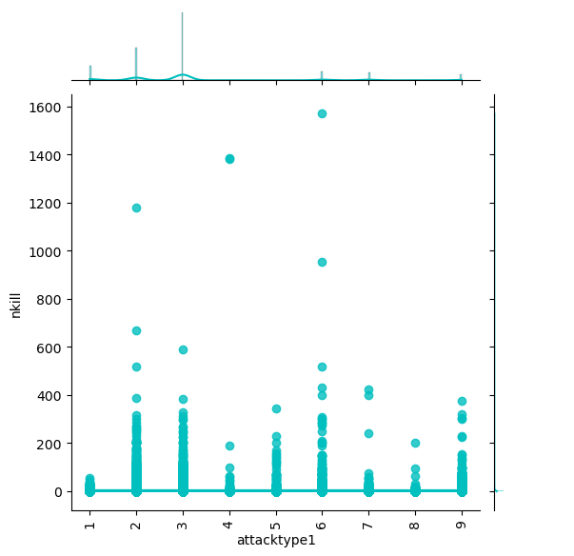
8. By which type of attack most of the people got killed ?
As it is showing in the graph we can see the in the Global terrorism, Mostly people were killed by the attack of bombing and explosion by the terrorists.

Slide 17
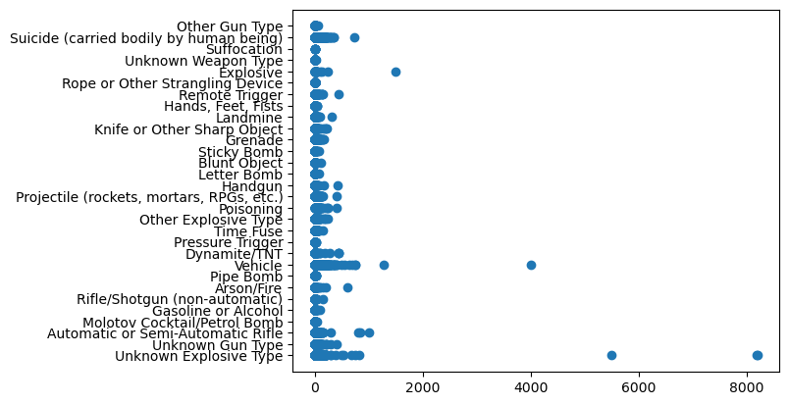
9. Which weapon type caused to make injured most of the people?
As we can see in the plot people were mostly injured by the vehicles and Explosive types of weapons in the global terrorism attack

Slide 18
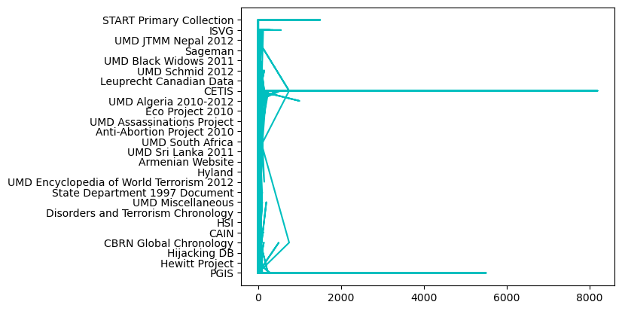
10. Which source has recorded the most injured people in the attacks by the terrorists?
So, information of mostly injured people in the global terrorism attack which is done by the terrorists was recorded from the CETIS source as it is showing the plot.

Slide 19
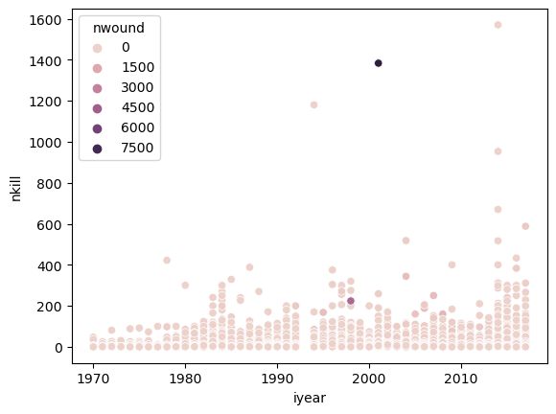
11. In which year, people were killed with badly injured by terrorists?
As the plot showing it is clear that there are most killed people were in the year of 2010 but mostly people were injured by the attack of terrorists in year of 2000.

Slide 20
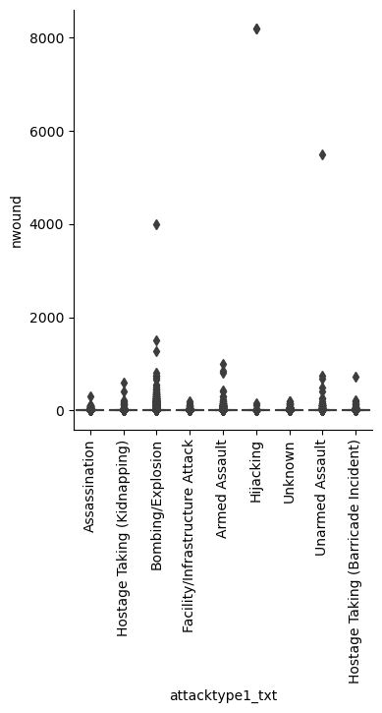
12. By which type of attack most of the people got injured mostly by the terrorists?
As it is showing in the plot, in the terrorist attack, people were attacked and injured mostly by the Bombing/Explosion attack types .
also by Armed attack so many people got injured by the terrorists

Slide 21
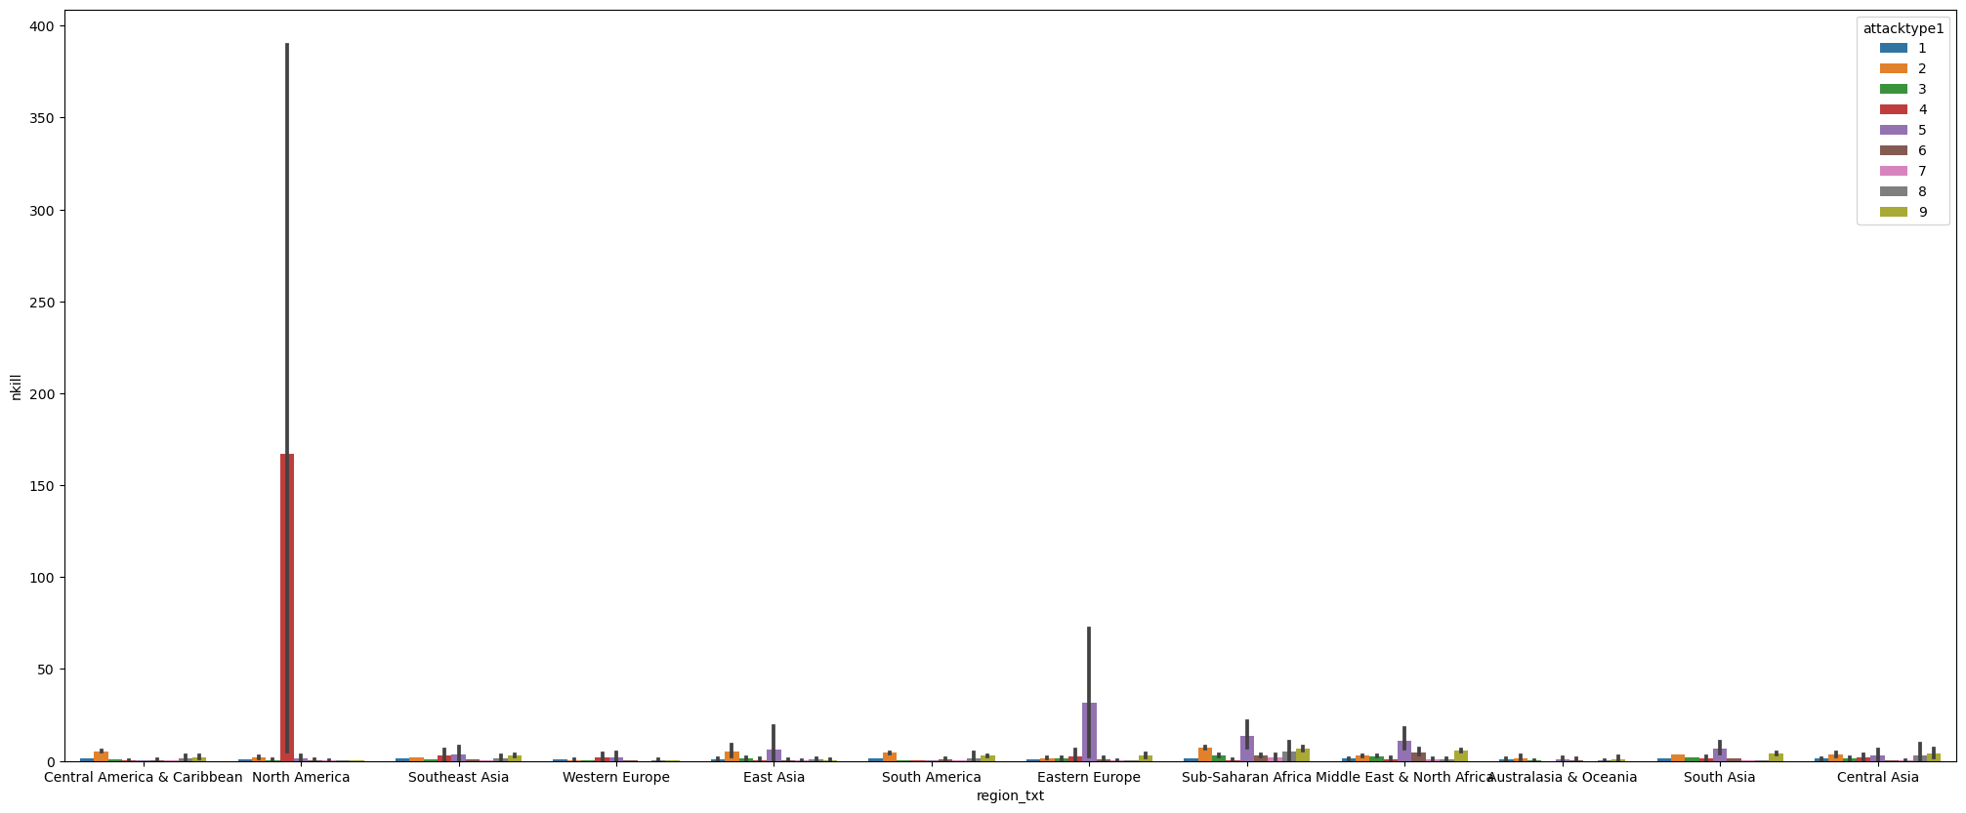
13. In which region people mostly killed by which attack in terrorism?
As the result showing in the plot North America region people mostly killed and injured in the global terrorism by the attack of bombing and explosion.
also by Armed attack so many people got injured by the terrorists

Slide 22
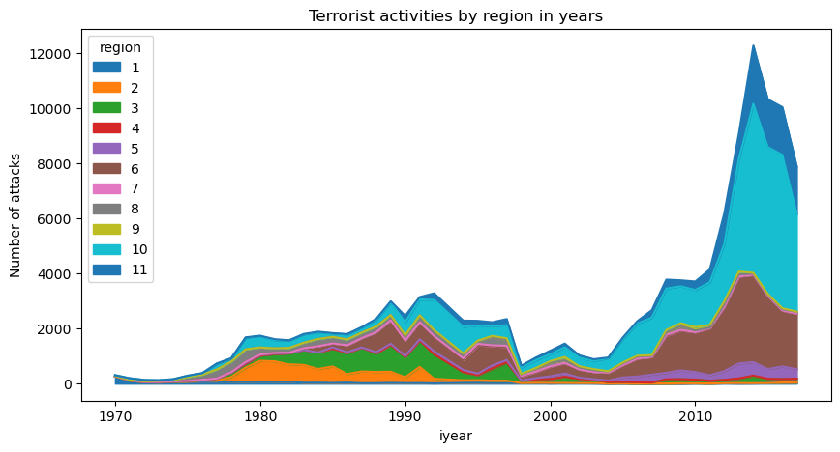
14. What is the Percentage of attacks increased from 1970 to 2017?
As it is showing in the plot, Attacks from 1970 to 2010 had increased and the number attacks happened by the terrorists is 309.
Attacks have increased by 96% from 1970 to 2010.

Slide 23


