Slide 1


DEPARTMENT OF INFORMATION TECHNOLOGY
Sanjivani Rural Education Society’s
SANJIVANI COLLEGE OF ENGINEERING,
KOPARGAON 423 603 (MS)
(An Autonomous Institute affiliated to SPPU Pune)
Academic Year 2023-2024

Slide 2
SUBJECT
DATA STRUCTURE
PROBLEM STATEMENT
PHONEBOOK USING TRIE DATA STRUCTURE
TEAM MEMBERS
ATHARE SNEHAL
JAGTAP VAISHNAVI
CHAVAN AARYA
GAWALI TEJASHREE
BHOJANE SAGAR
DHOKCHAULE ADITYA
SUBJECT TEACHER
PROF K.D.PATIL

Slide 3
1.Trie data structure
The term "trie" comes from the word "retrieval." Unlike binary search trees where each node has two children, trie nodes can have multiple children, typically equal to the size of the alphabet.
In a trie, each node represents a single character of a string. The root represents an empty string, and as you traverse down the trie, the characters build up, forming complete words at the leaf nodes. This structure allows for quick insertion, deletion, and search operations on strings.
One significant advantage of tries is their efficiency in handling tasks that involve searching or retrieving words with common prefixes. Since prefixes are shared among words in a trie, it reduces redundancy and speeds up operations.
Tries are commonly used in applications like autocomplete features in text editors and search engines.Nodes in a trie may also have associated values, making it versatile for various applications. For instance, tries can be employed in IP routers for routing table lookups or in spell-checking algorithms.
While tries offer fast string-related operations, they can be memory-intensive, especially when dealing with a large alphabet or sparse datasets. Various optimizations, such as compressed tries, aim to address these concerns.
In summary, a trie is a tree-like data structure designed for efficient string storage and retrieval, particularly useful in scenarios where quick searches based on common prefixes are essential.

Slide 4
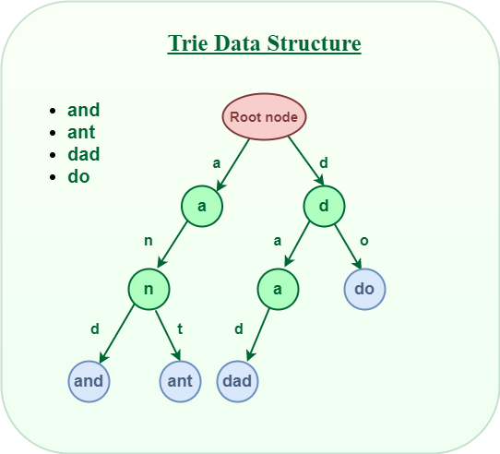

Slide 5
Implementation logic
1.TrieNode Class:
- Represents a node in the trie.
- Has a HashMap to store children nodes, each associated with a character.
- `isEndOfName` indicates whether the current node marks the end of a name.
2. Trie Class:
- Has a root node to start the trie.
- Supports insertion of names into the trie.
- Provides a search method to check if a given prefix exists in the trie.
3. PhoneInfo Class:
- Represents information about a person, including name and phone number.
- Implements `Serializable` for object serialization.
- Overrides `hashCode` and `equals` methods for HashSet operations.

Slide 6
4. PhoneBookManager Class:
- Manages the overall functionality of the phone book.
- Uses a HashSet (`infoStorage`) to store unique PhoneInfo objects.
- Implements a Trie (`trie`) for efficient name searching.
- Uses Singleton pattern (`inst`) to ensure a single instance of the manager.
- Initializes the trie by building it from the stored information during creation.
5. buildTrie Method:
- Populates the trie with names from the `infoStorage` HashSet.
6. searchTrie Method:
- Utilizes the trie to search for names that match a given prefix.
- Calls `searchContacts` to retrieve matching contacts.
7. searchContacts Method:
- Traverses the trie to find matching contacts and appends them to a StringBuilder.

Slide 7
8. search Method:
- Searches for a specific name in the trie and returns the corresponding PhoneInfo.
9. getNodeName Method:
- Extracts the name represented by a trie node.
10. readFromFile Method:
- Reads serialized PhoneInfo objects from a file (`PhoneBook.dat`) into the `infoStorage` HashSet.
11. deleteData Method:
- Deletes a contact by name from `infoStorage` and rebuilds the trie.
12.storeToFile Method:
- Serializes and stores PhoneInfo objects in the `infoStorage` HashSet to the file.
13.SearchEventHandler Class:
- Implements ActionListener for the search button.
- Calls `searchData` method in `PhoneBookManager` and displays the result in a JTextArea.

Slide 8
14. AddEventHandler Class:
- Implements ActionListener for the add button.
- Creates a new PhoneInfo object, adds it to `infoStorage`, and updates the trie.
15. DeleteEventHandler Class:
- Implements ActionListener for the delete button.
- Deletes a contact by name from `infoStorage` and updates the trie.
16. MainFrame Class:
- Extends JFrame to create the main window of the phone book.
- Defines components such as buttons, text fields, and JTextArea for user interaction.
- Sets up event handlers for search, add, and delete operations.
17. PhoneBook Class:
- Contains the `main` method to initialize the PhoneBookManager and create the main GUI frame.

Slide 9
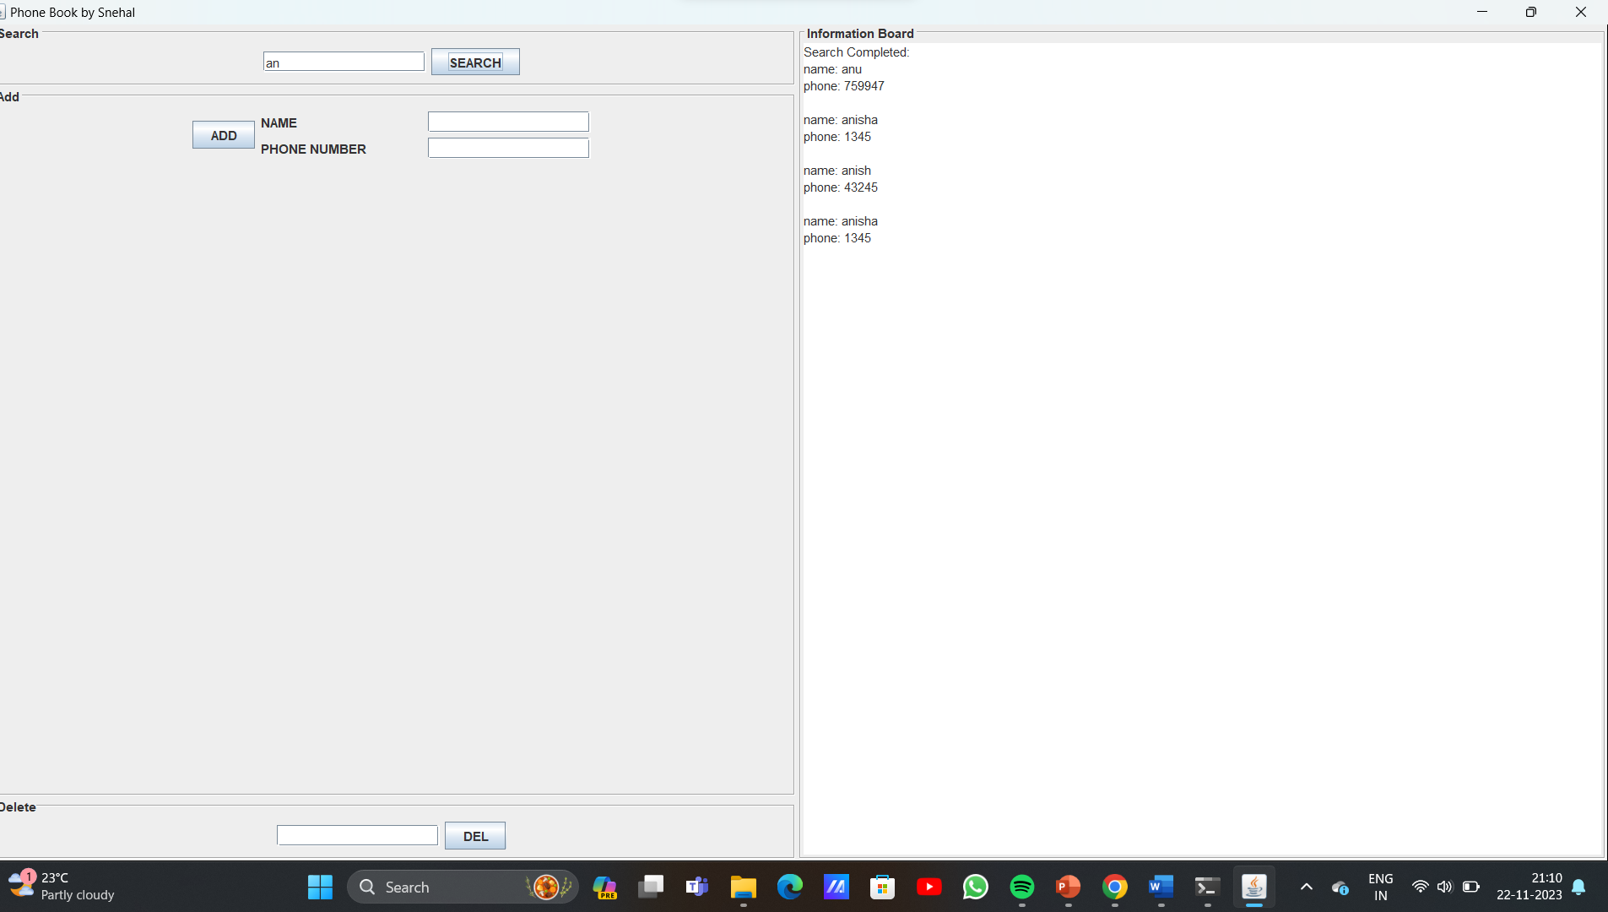
Output:

Slide 10
conclusion
This Java program implements a simple phone book application using Swing for the graphical user interface. Here's a brief conclusion:
1. Data Structure:
The program uses a Trie data structure for efficient prefix-based searching of names in the phone book. Each node in the Trie represents a character in a name.
2. Serialization:
PhoneInfo objects are serialized and stored in a HashSet. Serialization allows the program to persistently store and retrieve phone book data in a file ("PhoneBook.dat").
3. User Interface:
The GUI is created using Swing components, providing a user-friendly interface with options for searching, adding, and deleting entries. The main frame includes text fields, buttons, and an information board (text area) to display results.
4. Event Handling:
ActionEvent listeners are implemented for search, add, and delete functionalities. These listeners interact with the PhoneBookManager to perform operations on the phone book data.

Slide 11
5. File Handling:
The program reads data from the serialized file during initialization and saves changes back to the file after each update. This ensures data persistence across program executions.
6. Efficient Searching:
The Trie structure enhances searching efficiency by quickly identifying names with a given prefix.
Overall, the program provides a functional phone book application with an efficient search mechanism and a well-designed graphical interface.

Slide 12
references
-GeeksforGeeks Trie Data Structure: - [GeeksforGeeks Trie Data Structure]
(https://www.geeksforgeeks.org/trie-insert-and-search)
-Introduction to Algorithms (CLRS) by Thomas H. Cormen, Charles E. Leiserson, Ronald L. Rivest, and Clifford Stein
-12Object Serialization in Java:- [Object Serialization in Java]
(https://docs.oracle.com/javase/8/docs/technotes/guides/serialization/index.html)

