Slide 1
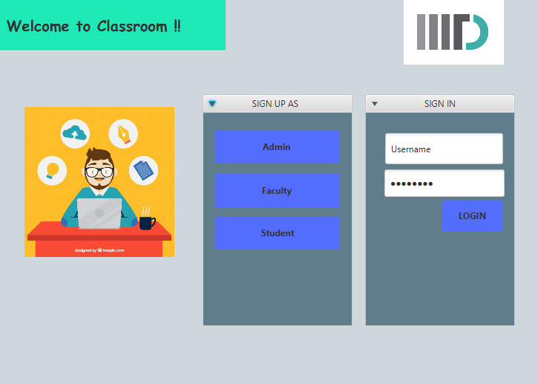
Classroom booking app
Implementation Details:
Design pattern : Proxy
Serialization : College object serialized after every session and deserialized for restoring previous session.
Association relationship: Nearly all the classes are associated with each other.
Exception Handling : Exceptions are generated and dialog boxes are displayed in case of invalid user input.

Slide 2
Classroom booking app
Problems faced :
View_Room availabilty and Request handling: It took us a lot of time in implementing this feature as we did not realise we created multiple objects of same room no. while loading database. We used hashmap for mapping objects to room number and debugged our code.

Slide 3
Classroom booking app
Snehal Gupta:
Creation of database and processing it.
Sign Up and login
Controller classes management
Personalized Time-table of Students and Faculty.
Anushka Bhandari :
GUI frontend
Controller classes management
View Rooms Availability
Request handling
Javadoc generation

Slide 4
Classroom booking app
Bonus features :
Validation of email during sign-up -
We send a confirmation key to every user who signs up in our application to check whether they have entered correct email-id or not.
Faculty Personalized time-table :
We have provided every faculty member a personalized time-table .
Multiple users login : Allows multiple users to login and work on the application on different windows.
User-interactive : Confirmation prompts and Dialog boxes for invalid inputs.

