Slide 1
DIGITAL MENU CARD FOR RESTAURANT
Under the Guidance of Prof. Jagtram Gaydhane
outline
Presented By:
Snehal Hingane
Nikita Ichale
Mrunali Jadhav

Slide 2
1
2
3
4
5
Existing Problem
Working
Advantages
Application
Future Scope
outline

Slide 3
Existing Problem
Customer need to wait for a waiter to give our order for food.
Existing Problem
Working
Time Consuming.
Difficult to access the records of customer.

Slide 4
Customer View
LCD Display
Touch Screen
Microcontroller
89s51
Advantages
Working
RF Encoder
RF Receiver

Slide 5
Customer View
X
LUNCH
COLD_DRINKS
DINNER
Panjabi_Thali
Softy
Fish_Cury
Screen
Quantity
Quantity
Quantity
Advantages
Working
Pav_bhaji
Softy
Biryani
Quantity
Quantity
Quantity
Confirm Order
Cancel Order
Y

Slide 6
Kitchen View
Computer Screen
Advantages
RF Decoder
Working
RF Receiver

Slide 7
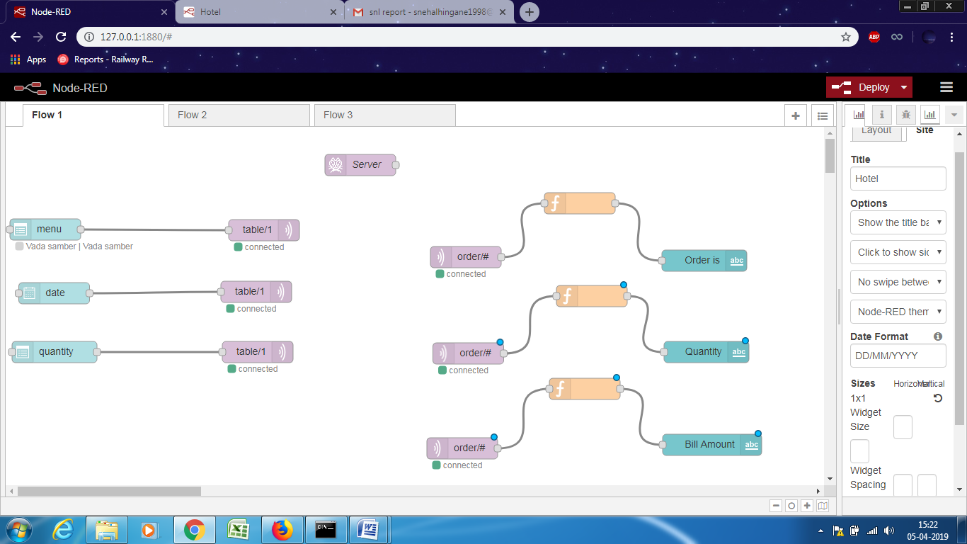
Project View
Advantages
Working

Slide 8
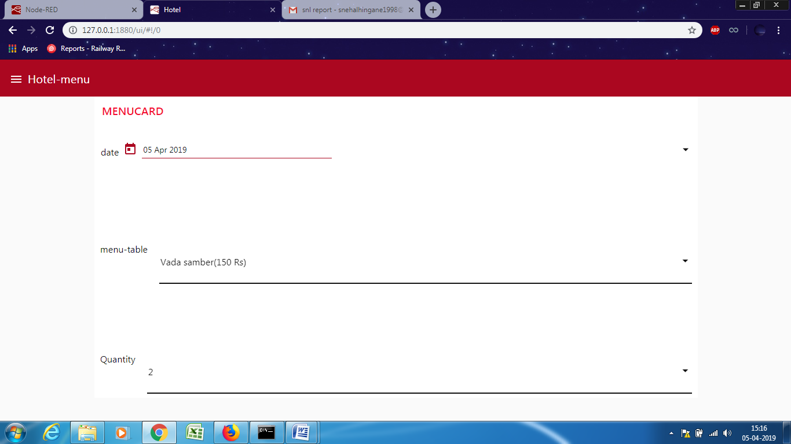
Project View
Advantages
Working

Slide 9
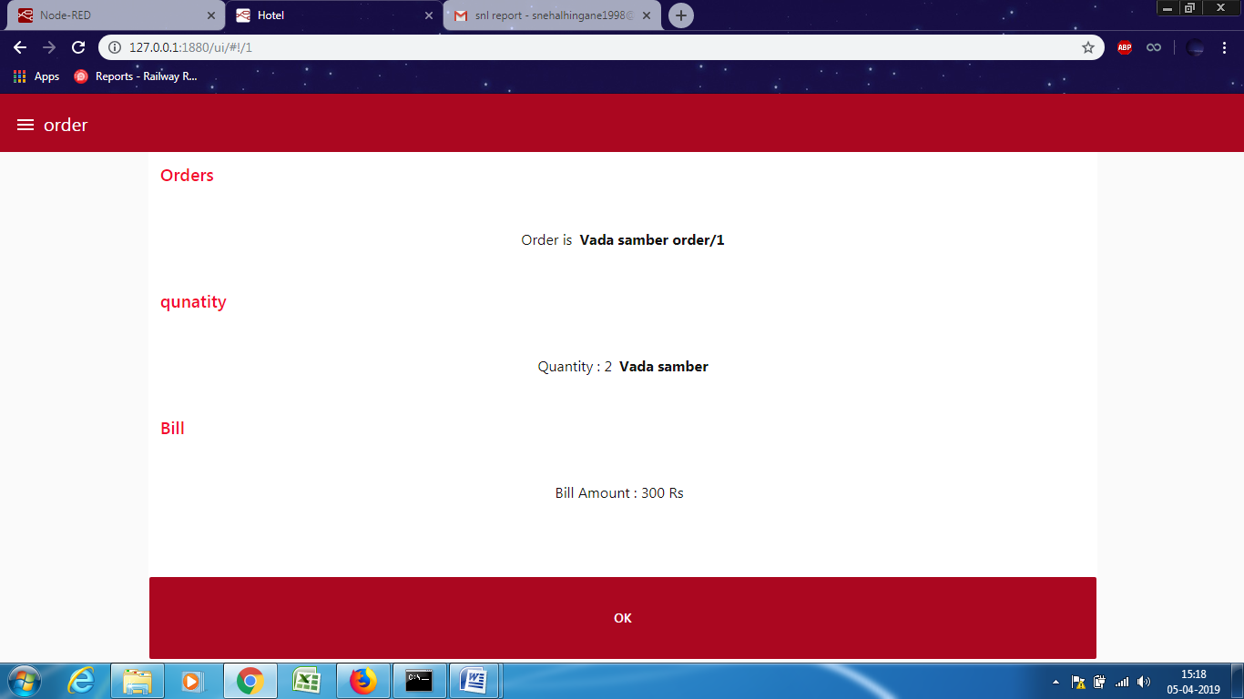
Project View
Working
Advantages

Slide 10
Project View
Advantages
Working

Slide 11
Advantages
It reduces customer’s time for waiting.
customers don’t have to wait for the waiter to take the order.
saves the time.
users friendly and fast.
Application
Advantages

Slide 12
Application
customer can give the order immediately.
with little changes in the project, it can be the used in library.
Future Scope
Application

Slide 13
Future Scope
We can add graphical LCD under this touch screen. Thus this project will become more interactive.
Users can select option 1 and then the sub option under that option 1 will be displayed.
We can add printer to this project so users can immediately get printout of the bill.
Future Scope
Overview

Slide 14
Thank You !!!!!!

