Slide 1
Naïve_bayes

Slide 2
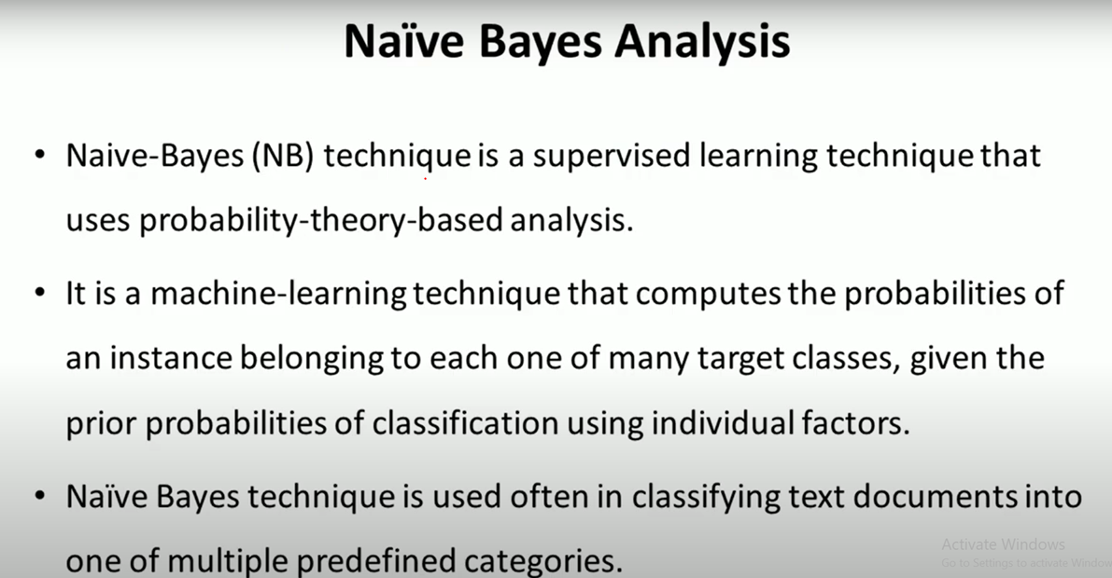

Slide 3
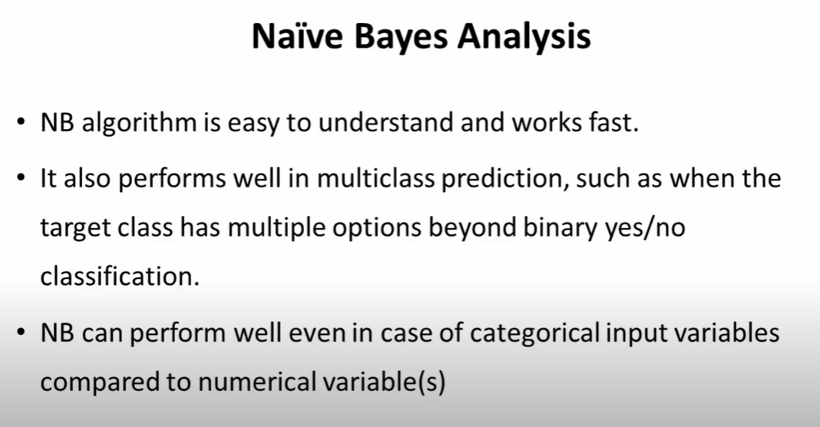

Slide 4
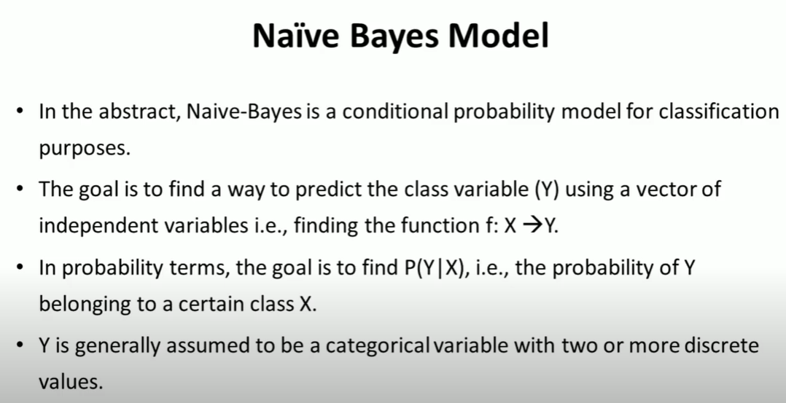

Slide 5
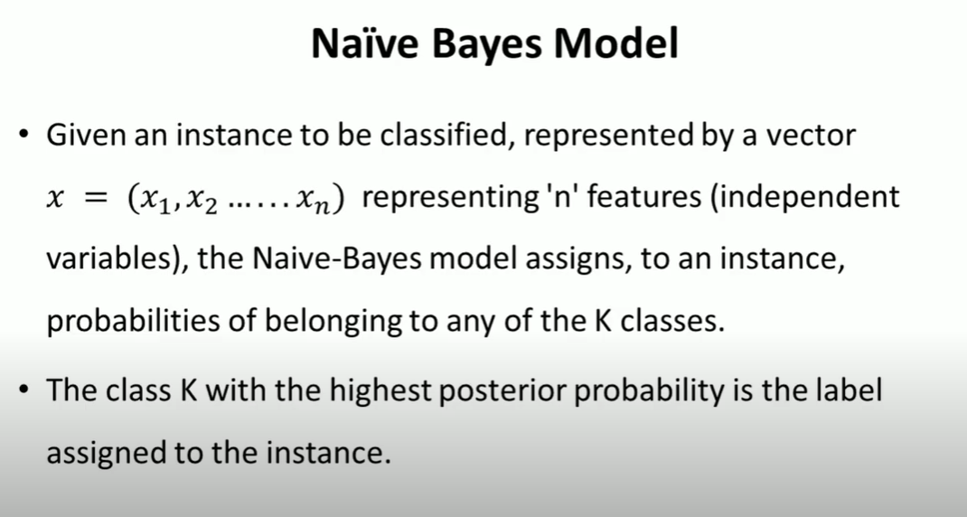

Slide 6
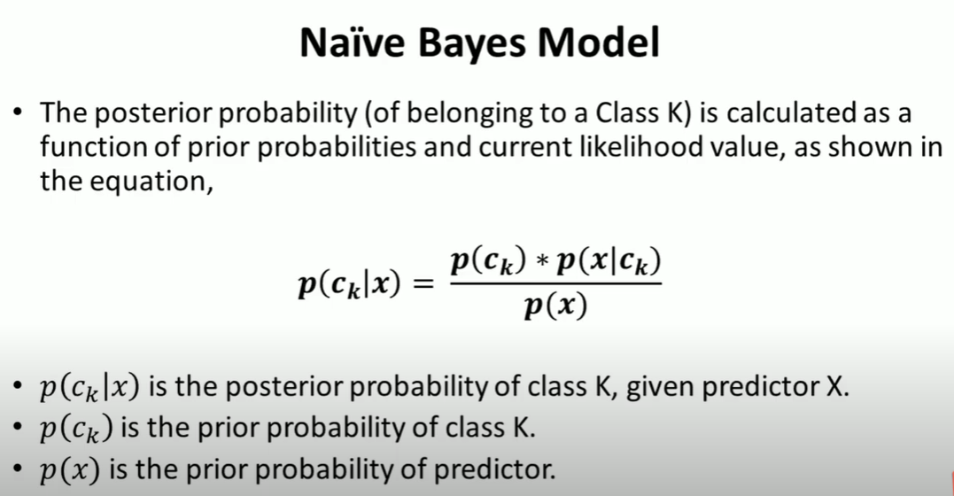

Slide 7
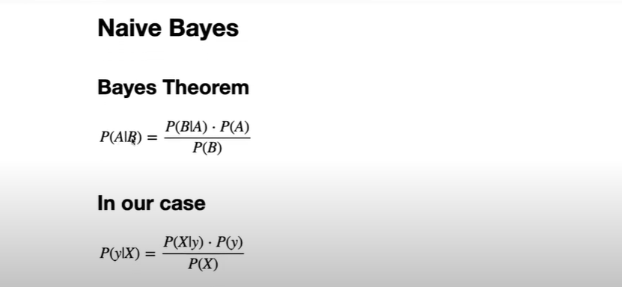

Slide 8
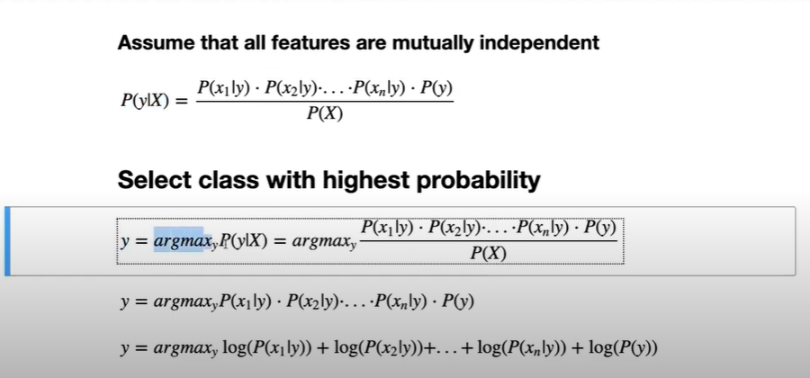

Slide 9
Principle of Naive Bayes Classifier:
A Naive Bayes classifier is a probabilistic machine learning model that’s used for classification task. The crux of the classifier is based on the Bayes theorem.
Bayes Theorem:
Using Bayes theorem, we can find the probability of A happening, given that B has occurred. Here, B is the evidence and A is the hypothesis. The assumption made here is that the predictors/features are independent. That is presence of one particular feature does not affect the other. Hence it is called naive.

Slide 10
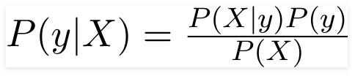
Example:

Slide 11
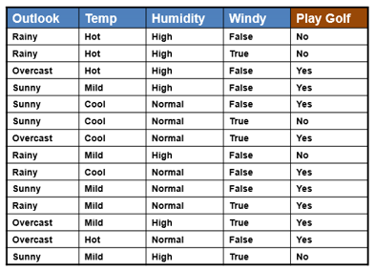

Slide 12
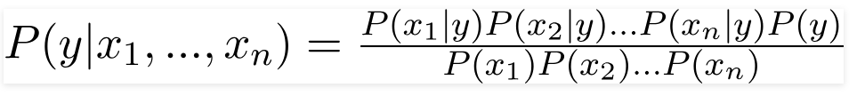



Slide 13
Types of Naive Bayes Classifier:
Multinomial Naive Bayes:
This is mostly used for document classification problem, i.e whether a document belongs to the category of sports, politics, technology etc. The features/predictors used by the classifier are the frequency of the words present in the document.
Bernoulli Naive Bayes:
This is similar to the multinomial naive bayes but the predictors are boolean variables. The parameters that we use to predict the class variable take up only values yes or no, for example if a word occurs in the text or not.
Gaussian Naive Bayes:
When the predictors take up a continuous value and are not discrete, we assume that these values are sampled from a gaussian distribution.

Slide 14
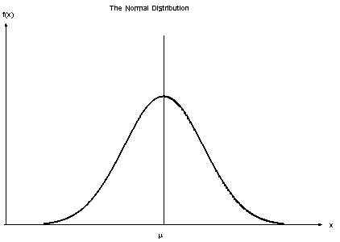
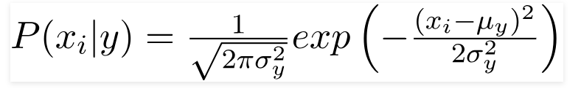
Gaussian Distribution(Normal Distribution)

Slide 15
Conclusion:
Naive Bayes algorithms are mostly used in sentiment analysis, spam filtering, recommendation systems etc. They are fast and easy to implement but their biggest disadvantage is that the requirement of predictors to be independent. In most of the real life cases, the predictors are dependent, this hinders the performance of the classifier.

Slide 17
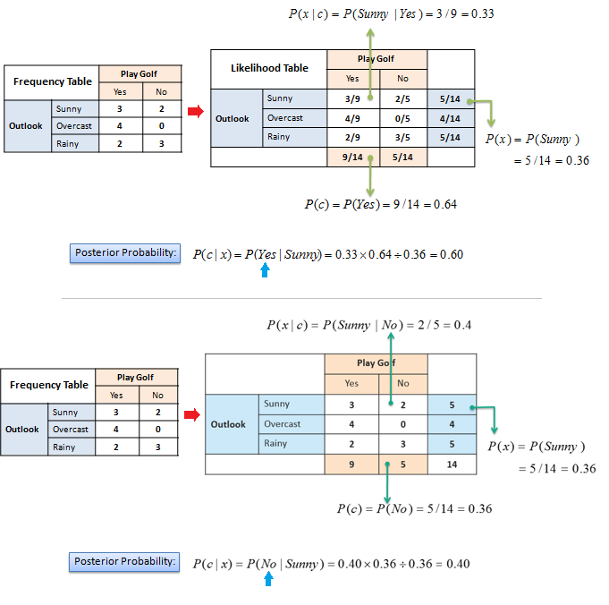

Slide 18
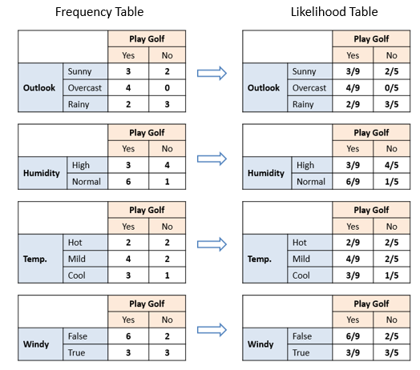
The likelihood tables for all four predictors.

Slide 19
Probability of playing:
P(Yes | Overcast) = P(Overcast | Yes) P(Yes) / P (Overcast) .....................(1)
Calculate Prior Probabilities:
P(Overcast) = 4/14 = 0.29
P(Yes)= 9/14 = 0.64
Calculate Posterior Probabilities:
P(Overcast |Yes) = 4/9 = 0.44
Put Prior and Posterior probabilities in equation (1)
P (Yes | Overcast) = 0.44 * 0.64 / 0.29 = 0.98(Higher)

Slide 20
Probability of not playing:
P(No | Overcast) = P(Overcast | No) P(No) / P (Overcast) .....................(2)
Calculate Prior Probabilities:
P(Overcast) = 4/14 = 0.29
P(No)= 5/14 = 0.36
Calculate Posterior Probabilities:
P(Overcast |No) = 0/9 = 0
Put Prior and Posterior probabilities in equation (2)
P (No | Overcast) = 0 * 0.36 / 0.29 = 0
The probability of a 'Yes' class is higher. So you can determine here if the weather is overcast than players will play the sport.

