Slide 1
Secret…
SNEHA GUPTA
AFSHA PARVEEN

Slide 2
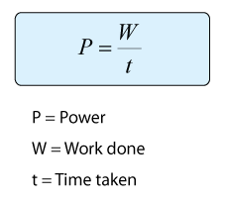






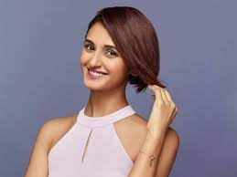
GUESS OUR TOPIC
POWER FORMULA
SHAKTI
POWER​
THE POWER​
SCIENCE
MOVIE
MOVIE
Movie
BODYBUILDER
GIRL POWER
POWER BUTTON
SAKTI MOHAN
LOGO
WE
BUTTON
Actress

Slide 3
AGENDA
Introduction​
Characteristics
​Two faces
Types
​Summary​

Slide 4
Introduction
Power is one of the means to influence others for getting results. Influence process occurs in a particular way when it is attempted by the use of power.
Power is used not only in getting certain result achieved but also includes negative decisions or the action of non decisions.
Power is not the act of changing the other persons attitudes or behaviour, it is only the potential to do So.
Power is one of the essential components of practically every organization.
Power refers to a capacity that has to influence the behaviour of B so B acts in according with 'A' s wishes.

Slide 5
CHARACTERSTICS
There is no relation ship between the power exercised by an individual and the position or the role he holds sometimes higher level people may have no power and sometimes lower level people may exert more power.
Those who are in power would like to get more they resist any attempt which tries to weaken the hold of power.
An individual cannot have power at all times at times he may have to give up this power if there is a failure in performance.
people who are able to with stand and cope with uncertainly in organizations have more power
people who use power do not want others to know of it unless it is legitimate power.

Slide 6
TWO FACES OF THE POWER
POSITIVE POWER
NEGATIVE POWER
The positive face of power is shown by a concern for group goals by helping to formulate and achieve them.
→ It involves exerting influence on behalf of rather than over others.
→ Leaders who exercise this power positively encourage their subordinate to develop their competence to succeed.
The negative face of power is usually expressed in terms of dominance submission transactions.
It mean "if I win you lose" →Having power implies having power over some one else who does not have it.

Slide 7
SUMMARY
At Contoso, we believe in giving 110%. By using our next-generation data architecture, we help organizations virtually manage agile workflows. We thrive because of our market knowledge and great team behind our product. As our CEO says, "Efficiencies will come from proactively transforming how we do business."

Slide 8
THANK YOU
Sneha-
https://github.com/snehalive

