Slide 1

Note: The data and information in this document is reflective of a hypothetical situation and client. This document is to be used for KPMG Virtual Internship purposes only.
Sprocket Central Pty Ltd
Data analytics approach
[Division Name] - [Engagement Manager], [Senior Consultant], [Junior Consultant]

Slide 2
Note: The data and information in this document is reflective of a hypothetical situation and client. This document is to be used for KPMG Virtual Internship purposes only.
Agenda
Introduction
Data Exploration
Model Development
Interpretation

Slide 3

Note: The data and information in this document is reflective of a hypothetical situation and client. This document is to be used for KPMG Virtual Internship purposes only.
Introduction
Data Matters
If you torture the data long enough, it will confess.
The goal is to turn data into information, and information into insight.
Place any supporting images, graphs, data or extra text here.

Slide 4
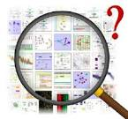
Note: The data and information in this document is reflective of a hypothetical situation and client. This document is to be used for KPMG Virtual Internship purposes only.
Data Exploration
Understanding data and dataset.
Need to find out valuable customers for a company.
Check their spending over the year.
Check job title and background of each customer.
Last thing need to check do they have car.
Place any supporting images, graphs, data or extra text here.

Slide 5
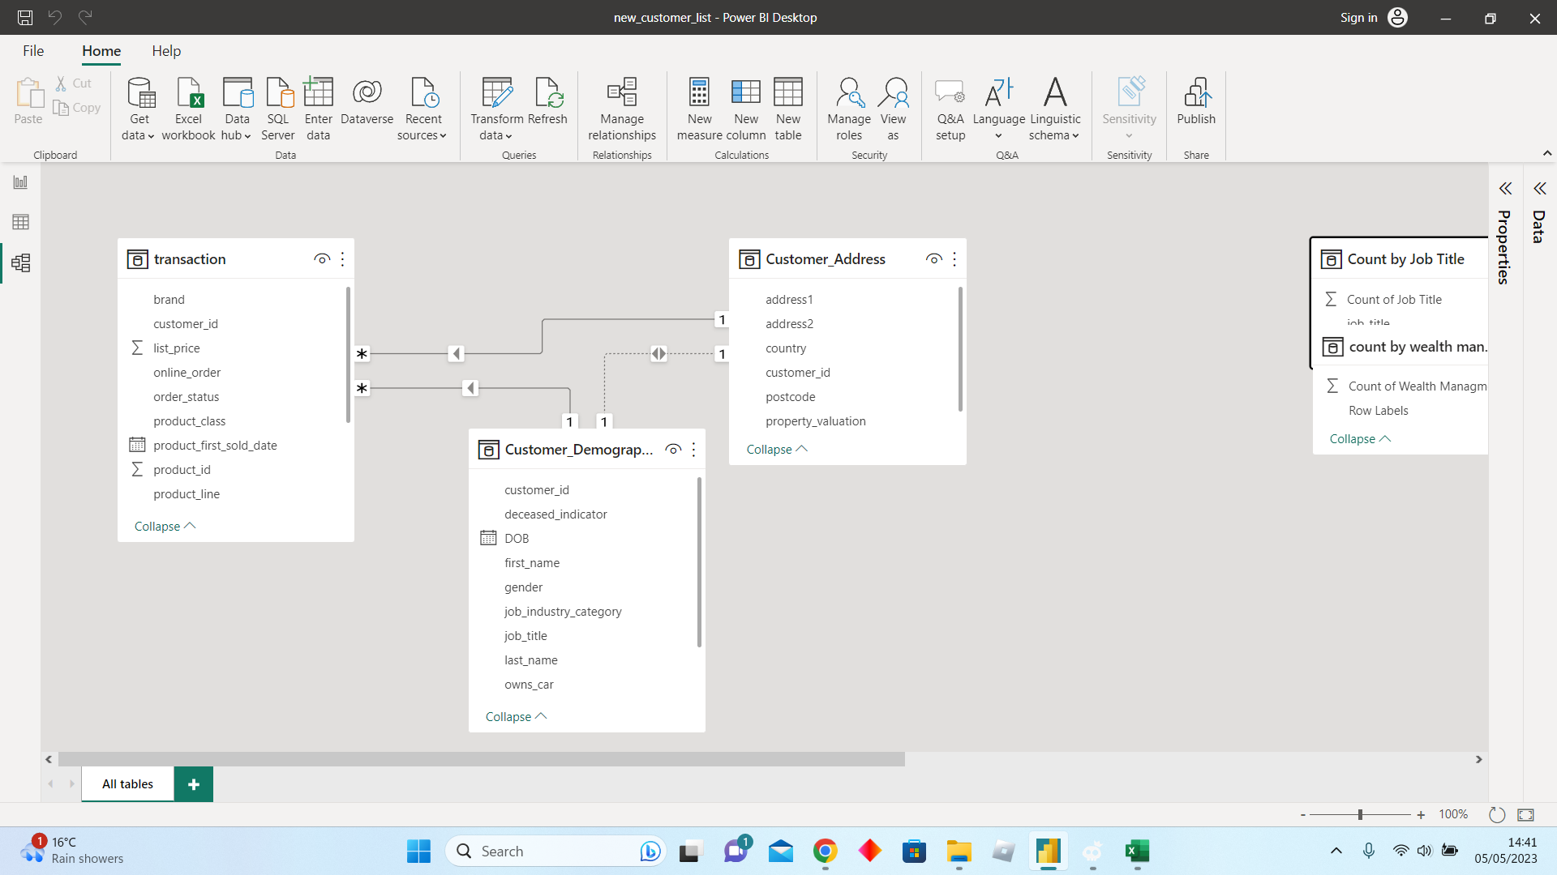
Note: The data and information in this document is reflective of a hypothetical situation and client. This document is to be used for KPMG Virtual Internship purposes only.
Model Development
Process of creating a visual representation and connection of data and structures
Making the relationship between customer and transaction dataset.
This helps to find, list of customers with multiple transactions.
Place any supporting images, graphs, data or extra text here.

Slide 6
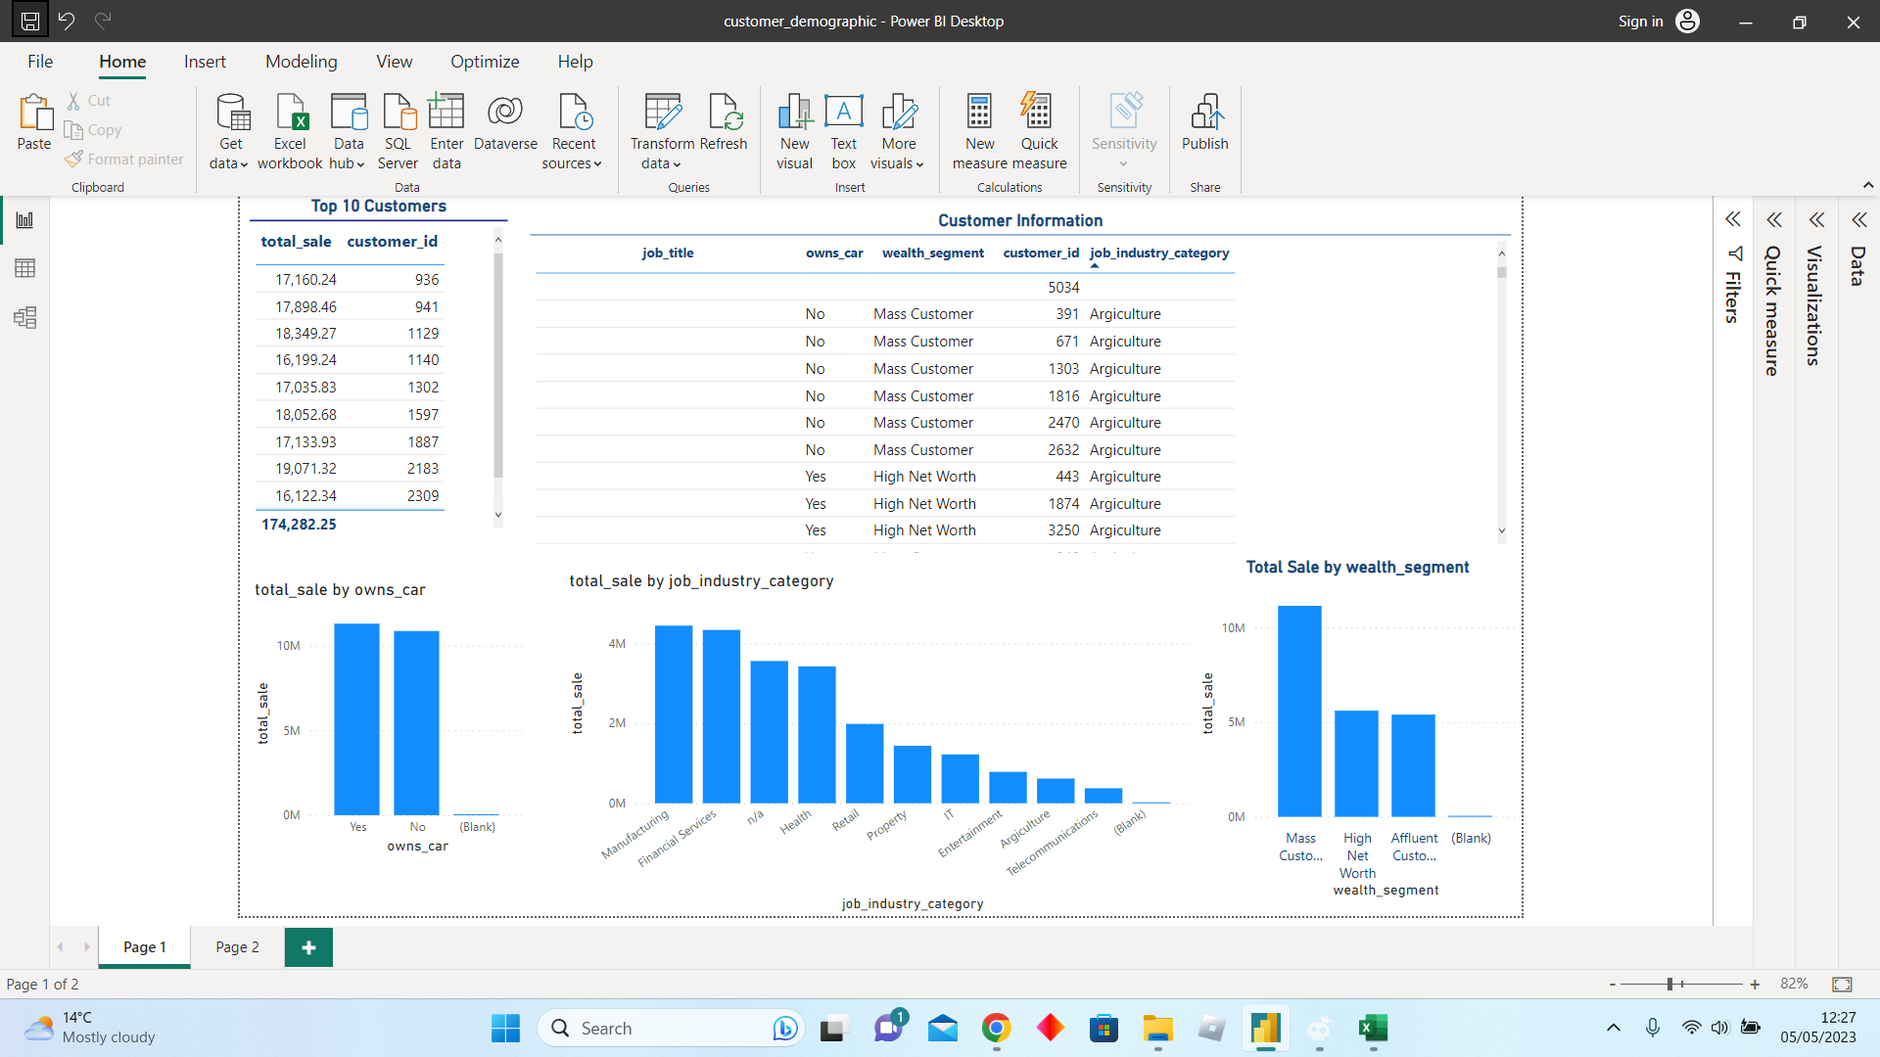
Note: The data and information in this document is reflective of a hypothetical situation and client. This document is to be used for KPMG Virtual Internship purposes only.
Interpretation
Review data and come to conclusion
This visualization helps us to identify, customers from affluent and high net worth are valuable customers.
We sub-categories them, customers from Manufacturing and Financial Services are valuable customers.
Place any supporting images, graphs, data or extra text here.

Slide 7
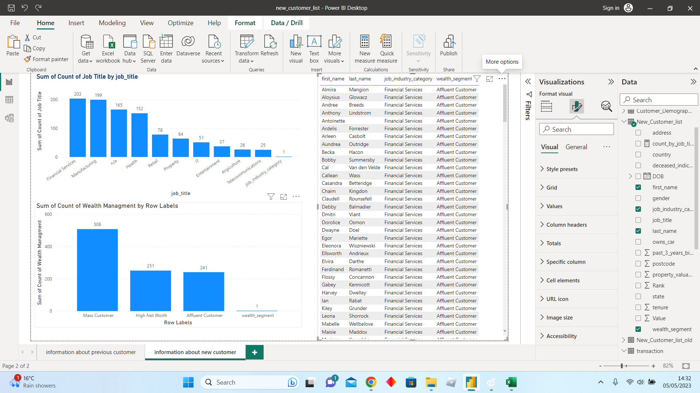
Visualization of new customer
This is the list of new customers who are valuable to company with job title and background we discussed in previous slide.
There are 209 customers we need to focus on.

