Slide 1


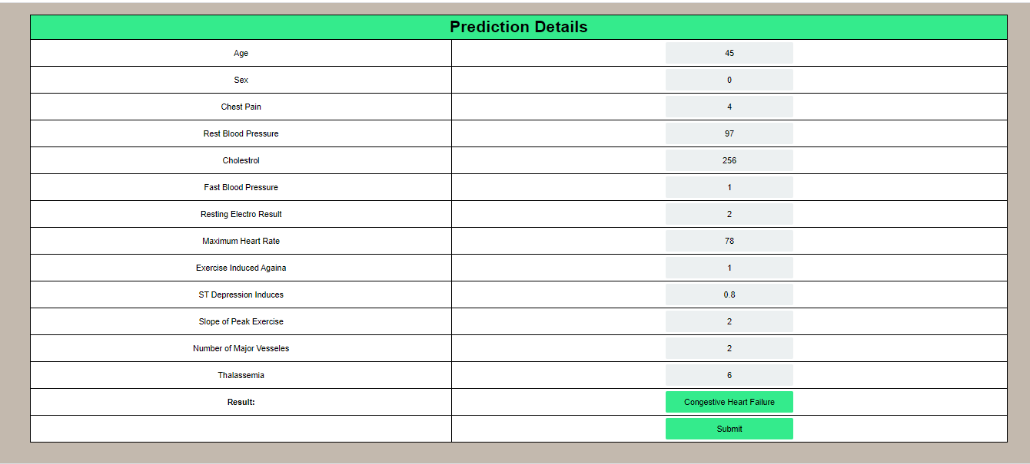
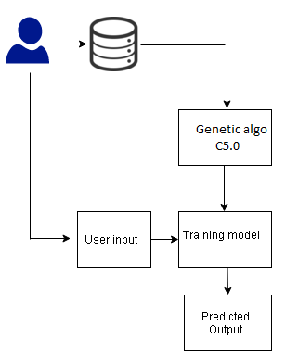
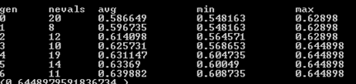
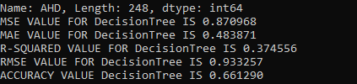
Abstract
Existing system
The individuals are given as input for every application, here we considered 9, where this is the number of features to be selected for heart disease prediction application.
C 5.0 Algorithm
C 5.0 is the extension of ID3 algorithm, it works based on decision tree model for classification from input data samples. Divide and conquer is applied for each construction of tree, which is based on information gain from the attributes. There are three major steps involved in the decision tree.
The samples of same class in the dataset, then the leaf node is created for decision tree of same class
If information gain is not available, the node is created high up the tree with expected class value.
The class of unseen data is detected, the decision node is created again high up the tree with the expected class value.
Cardiovascular diseases is the main cause of death all over the world and becomes severe health threat among higher age people. Early diagnosis of the disease can save lives and medical diagnosis plays key role. the practitioners are applying many advance treatments. The proposed works studies the risk of Cardiovascular diseases prediction based on machine learning and genetic algorithm. This work is an ensemble model of combining the efficacy of genetic algorithm along with decision tree classification. The features determined by the genetic algorithm are used for machine learning classification, which improves the efficacy of proposed prediction system. The dataset provided by UCI repository, named Cleveland dataset is used for the study. The dataset with 303 instances and 14 attributes with five class types are used for the study. The class values range from 0 - Normal to 4- Stoke. The experimental results shows that the Genetic Algorithm based feature selection and classification bring best results on multiple class disease threat prediction. The application is designed that patients can able to predict and discuss with practitioners through the designed web application.
The inference from existing study concludes that there is highly demand for highly effective ensemble model to get an optimized result for heart disease prediction. The existing work discussed above were studied enormously on applying classification algorithms for disease prediction. However, there is a method which needs to be effective on feature selection, thus to avoid over fitting dataset. Most of the existing system uses KNN for prediction purpose. One of the existing studies applying neural network to self-applied questionnaire (SAQ) data to develop a heart disease prediction system. The validation of the work was provided by checking against the result of the neural network with “Dundee Rank Factor Score” which is related to statistically 3 risk factors (blood pressure, smoking and blood cholesterol) together with sex and age to determine risk of having heart disease.
Proposed system
Results
Introduction
Data mining techniques like classifications are highly useful in machine learning domain, in which clinical decision making can be arrived accurately. The proposed system used the ensemble model, which used Genetic Algorithm (GA) and C 5.0 as classification after feature selection through GA. The overview of Proposed system is as below
Coronary disease or cardiovascular disease (CVD), which stays the main reason of death around the world and adds to roughly 30% of worldwide mortality rates. If this issue is unattended then the projected mortality rate could be as high around 22 million in 2030. Heart disease is very common in half of the adults are affected in America. The developing countries such as India is also having severe threat on this disease. It takes severe mortality rate of around 17 million persons, as per report every year. Coronary disease may cause the or obstruct the flow of blood through blood vessel and may cause heart failure or even a stoke. A few risk factors, which may cause heart failures may include lack of physical activity, junk foods, use of liquor and tobacco, growing life styles, lack of exercise and is common in lesser age group people too. These danger components can be limited by reviewing daily activities, healthy food, reducing salt amount in food, consuming green leaves and vegetable foods, doing regular exercise, and avoiding utilization of tobacco and liquor which in the long run could assist with lessening the danger of heart failure . Early detection of disease may save several lives with improved and high-quality diagnosis methods; thus, a highly accurate prediction system may lessen mortality rate and helps in decision making for practitioners for further treatment.
The proposed system work is carried out with following methodologies and it is also represented as architecture in Fig. 2 the work has following benefits
The feature selection algorithm selects the best features based on scoring values by Genetic algorithm
The effective learning model is built using C 5.0, Decision Tree algorithm
The application ensure that patients can give input and get live predictions and communicate to doctors through application interface.
Conclusions
The system work considers the unique model for detection. In this work, we proposed Genetic algorithm-based feature selection and then C5.0 machine learning classification is applied for detection. The work also proposed with a Web interface, wherein patients and doctor able to communicate and get their benefits of early detection and treatment. This application detects heart disease as type 0 - Normal; 1- High Blood Pressure; 2- Coronary Artery Disease; 3- Congestive Heart Failure; 4- Stroke. Experimental results shows that the system outperforms in detection accuracy, even though considered as multi class problem.
To ensure availability and accessibility of minimum heart disease care for all population.
To encourage the application of Heart dieses in general health care and in social development.
To Create the awareness about the Heart Disease.
To develop an intelligent clinical decision support system for the diagnosis of heart disease
Aim And Objectives
Algorithm using for System implementation
references
Feature selection through Genetic algorithm
The dataset with 13 features is taken for the study, each individual in the total population attributes is a predictive model. The genes represent total number of attributes in our dataset. The genes are numeric values taken in various ranges.
1. Yekkala, Indu & Dixit, Sunanda. (2018). Prediction of Heart Disease Using Random Forest and Rough Set Based Feature Selection. International Journal of Big Data and Analytics in Healthcare. 3. 1-12. 10.4018/IJBDAH.2018010101.
2. P K, Anooj. (2012). Clinical decision support system: Risk level prediction of heart disease using weighted fuzzy rules. Journal of King Saud University - Computer and Information Sciences. 24. 27- 40. 10.1016/j.jksuci.2011.09.002.
Notes:
1

