Slide 1
Core Java
-Kamal

Slide 2
What we see today….
Not all manual testers will disappear, only the professional ones will stay.
The Professional automation engineer will stay for long time, the other one will fade away
Continued..

Slide 3
Content
Eclipse IDE
Core Java Concepts
Control Flows
Oops Concepts
Collection
Continued..

Slide 4
Eclipse
Configuring Eclipse
Write & compile Java programs
Debug java code
Run Java code
Write and Execute sample java programs
Continued..

Slide 5
Continued..
Introduction
Java is a programming language and a platform.
Java has its own runtime environment (JRE) in which a program runs, hence known as a platform.
Java used in distributed environment of the Internet
Where it is used
Desktop Applications such as acrobat reader, media player, antivirus etc.
Web Applications such as irctc.co.in,
Enterprise Applications such as banking applications.
Mobile
Embedded System
Smart Card
Robotics
Games etc.
Continued..

Slide 6
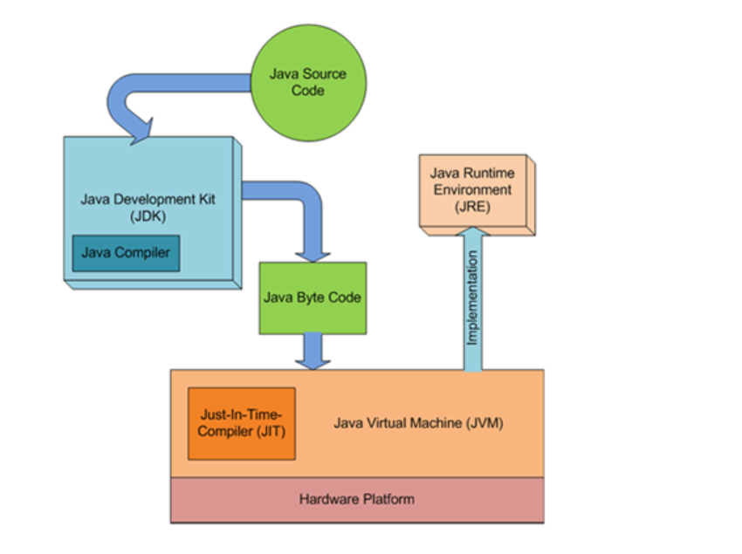
Continued..
Introduction
JDK = JRE + Development Tool
JRE = JVM + Library Classes
Continued..

Slide 7
Basics of Java
Java programming Keywords
Default, if, else, super, this, static, abstract, public, private, protected, while, do, extends, interface, class, throw, throws, import, final, finally, char, catch, try, break, float, double, char, boolean, implements, double, new,
Literals
Syntactic representations of boolean, character, numeric, or string data. Literals provide a means of expressing specific values in your program
E.g. int decimal = 100 – Integer literal
\n for new line -Character literals
“This is string” -String literals
Continued..

Slide 8
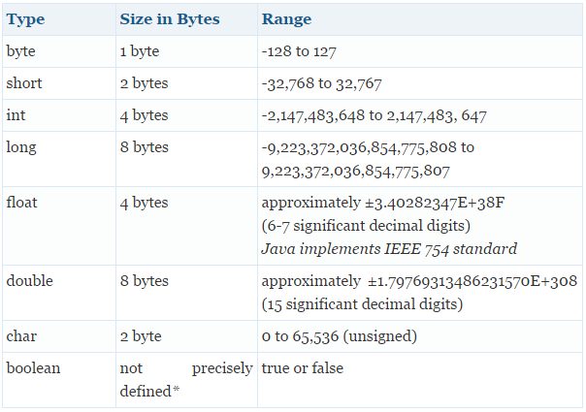
Basics of Java
Data types
Data Type | Default Value | Default size
boolean | false | 1 bit
char | '\u0000' | 2 byte
byte | 0 | 1 byte
short | 0 | 2 byte
int | 0 | 4 byte
long | 0L | 8 byte
float | 0.0f | 4 byte
double | 0.0d | 8 byte
Continued..

Slide 9
Classes & Objects
Classes
Template or blueprint from which objects are created
data member
method
Constructor
Syntax
class <class_name>{
data member;
method;
}
Objects
Object is an instance of a class.
<class name> objName=new <class name>();
Continued..

Slide 10
Control Flows
If else statement
Switch statement
For loop
Do while loop
Continued..

Slide 11
If else
if(condition){
//code to be executed
}else{
//this code will be executed
}
Continued..

Slide 12
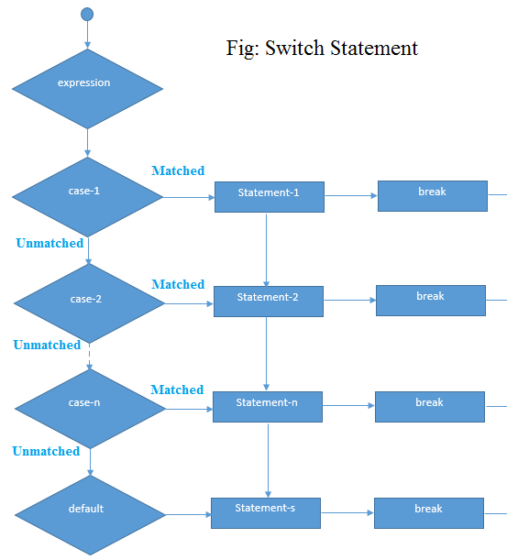
switch
switch(value10){
case value1:
//code to be executed;
break; //optional
case value2:
//code to be executed;
break; //optional
......
default:
code to be executed if all cases are not matched;
}
Continued..

Slide 13
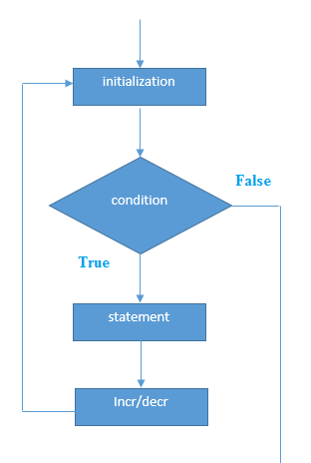
For loop
Simple For Loop
for(initialization; condition; incr/decr){
//code to be executed
}
For-each Loop
for(Type var:array){
//code to be executed
}
Continued..

Slide 14
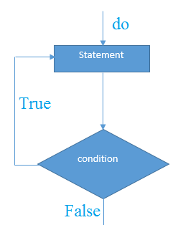
While and Do-While
While
while(condition){
//code to be executed
}
Do-While
do{
//code to be executed
}while(condition);
Continued..

Slide 15
Local, Instance & static variable
Local
A variable that is declared inside the method is called local variable
Instance/Class/Global
A variable that is declared inside the class but outside the method is called instance variable.
Each object will have it’s own unique copy of that variable
Static
A variable that is declared as static is called static variable. It cannot be local.
Static variable value will be shared across all the objects
Continued..

Slide 16
Basics
Basics of Class and Object
Basics of Method
Arrays
Importing packages
Continued..

Slide 17
Access Specifiers
Public
The public access modifier is accessible everywhere
Private
The private access modifier is accessible only within class
Protected
The protected access modifier is accessible within package and outside the package but through inheritance only
Default
The default modifier is accessible only within package
Continued..

Slide 18
Oops Concepts
Constructors & ways to initialize class
Encapsulation
Abstraction
Inheritance
Types of Inheritance
Polymorphism
Method overloading
Method overriding
Exception handling
Continued..

Slide 19
Constructors
Constructor in java is a special type of method that is used to initialize the object
Java constructor is invoked at the time of object creation.
It constructs the values i.e. provides data for the object that is why it is known as constructor.
Constructor name must be same as its class name
Constructor must have no explicit return type
Types
Default
Parameterized
Default constructor provides the default values to the object like 0, null etc. depending on the type.

Slide 20
Inheritance
Inheritance in java is a mechanism in which one object acquires all the properties and behaviors of parent object.
Types of Inheritance
Single
Multilevel
Hierarchical
Multiple - is not supported

Slide 21
Polymorphism
Polymorphism in java is a concept by which we can perform a single action by different ways
Method overloading
Number Of Argument, Data Type and Sequence of arguments
Method overriding
Same method declaration in parent and subclass, number of arguments also same, data type is also same and sequence of arguments is also same
Polymorphism
Compile time
Runtime/Dynamic dispatch (achieved by Method overriding)

Slide 22
Encapsulation
Encapsulation in java is a process of wrapping code and data together into a single unit.
Can create a fully encapsulated class in java by making all the data members of the class private
use setter and getter methods to set and get the data in it
Used to change the behavior
It provides you the control over the data, you can write the logic inside the setter method.

Slide 23
Abstraction
Abstraction is a process of hiding the implementation details and showing only functionality to the user.
A class that is declared with abstract keyword, is known as abstract class in java. It can have abstract (method without body) and non-abstract methods (method with body).
A method that is declared as abstract is known as abstract method.
If there is any abstract method in a class, that class must be abstract
If you are extending any abstract class that have abstract method, you must either provide the implementation of the method or make this class abstract.

Slide 24
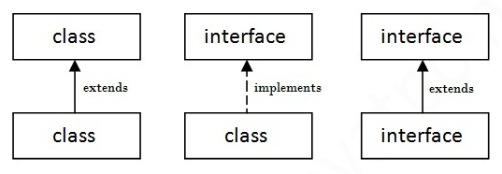
Interface
Abstract methods only
The interface in java is a mechanism to achieve fully abstraction.
It cannot be instantiated
Why to use Interface
It is used to achieve fully abstraction.
By interface, we can support the functionality of multiple inheritance

Slide 25
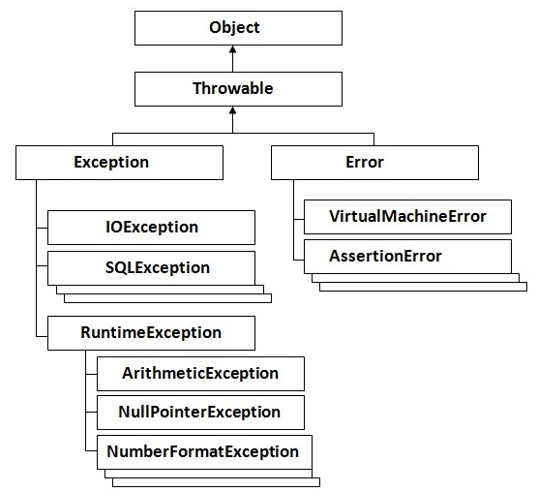
Exception Handling
Exception is an abnormal condition.
Mechanism to handle the runtime errors so that normal flow of the application can be maintained.
Types
Checked Exception (compile time)
IOException, SQLException
Unchecked Exception (Runtime)
Arithmetic Exception, NullPointerException
Errors
OutOfMemoryError, AssertionError
Try Catch block
Finally Block
E.g. int i = 10/0 – ArithmeticException

Slide 26
Throw and Throws Exception
throw
throw keyword is used to explicitly throw an exception
throw either checked or uncheked exception
mainly used to throw custom exception
Syntax
throw exception;
throws
throws keyword is used to declare an exception
It provides information to the caller of the method about the exception
Syntax
Void method() throws exception_class_name{
//method code
}

Slide 27
Collection Framework
ArrayList
HashMap
TreeSet

Slide 28
Thank you

