Slide 1
Selenium Automation
-Kamal

Slide 2
Content
Training prerequisite
Automation concepts
TestNG
Basics of Selenium
Advanced Selenium
Framework Overview
Advanced Framework development and consideration

Slide 3
Continued..
Course Prerequisite
Laptop or desktop with Internet connection
Basic understanding of programming
Installed version of JAVA 8 (preferred)
Windows 7, 10 OS (Preferred) or any compatible
Eclipse (Eclipse Mars, Neon, Oxygen)

Slide 4
Course Prerequisite
TestNG (6.8/6.9)
How to install TestNG to eclipse
Open Eclipse 🡪 Click Help 🡪 Install New Software 🡪 Add
Enter name as TestNG and add URL https://testng.org/testng-eclipse-update-site
Click Next to complete the installation
Firefox

Slide 5
Automation Concept
Why
Fast Execution
Early defect reporting
No fatigue/tiredness
When
Multiple release/development cycle of the product
To avoid huge regression efforts
How
Rest of the training

Slide 6
Basics of Selenium
Introduction
Why Selenium
Selenium Vs other tools (QTP etc)
Selenium Components Selenium RC Vs Webdriver
Selenium IDE
Remote Control (Selenium 1, 2)
Webdriver (Selenium 4)
Grid

Slide 7
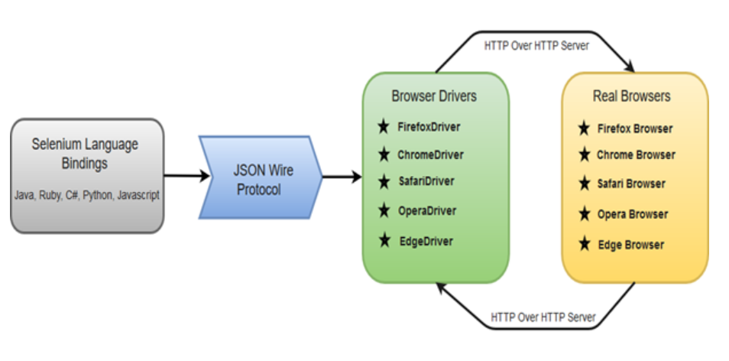
Selenium Architecture
Components
Selenium Language Bindings
JSON Wire Protocol
Browser Drivers
Real Browsers

Slide 8
Why Selenium
Free to use
Can be easily integrated with external tools
Supports multiple languages
Robust and reliable
Supports multiple OS
Parallel execution possible

Slide 9
Selenium Vs QTP/UFT
Selenium
Free to use
Add-ons also free of cost
Require good amount of coding efforts
Only Supports Web based application
Supports Window, Linux, Mac
Supports Java, C#, Python, Ruby
Browser can be minimized or invisible
Parallel execution possible
QTP
Licensed tool
Add-ons also needs to be purchased
Less efforts to write the scripts
Support Desktop as well as Web based application
Support only windows platform
Supports VBscript
Browser can not be minimized while executing the scripts
Parallel execution NOT possible

Slide 10
Xpath & CSS
Used to identify the UI element
Relative xpath
Absolute xpath
//div/a
//div//a
//div[@id='example']//a
//div[@class='example']//a
//a/span[contains(text(),'Login with Facebook')]
//table[@id="Table8"]/td[2]
//a[starts-with(@class,'fbb')]
//a[contains(@class,'fbbt')]
//div/option[(text()='Android')]
css=div > a
css=div a
css=div#example a
css=div.example a
css=input[id^='ema']
css=input[id$='ema']
css=input[id*='ema']
css=form>label>input[id=Persistent Cookie]

Slide 11
Selenium IDE
Introduction
IDE features
Installing & configuring IDE
Inspecting elements in IDE
Recording and playback the scripts
Building test cases
Running test cases
Debugging

Slide 12
TestNG
Introduction
Configuring TestNG
Annotations
Composing tests
Assertions
Generating reports
Troubleshooting

Slide 13
Basic: Selenium Webdriver (3.0/4.0)
Introduction
Create project
Configuring Webdriver with Eclipse
Create and run tests
Executing tests on multiple browsers Debugging tests
IE
Firefox
Chrome
Continued..

Slide 14
Basic : Selenium Webdriver (2.0/3.0)
Using locators (Id, Class, Name, xpath, css etc)
Choosing locating Strategies
Handling Alerts / Dialog boxes
Error handling
Working with various Web Elements
Buttons
Input boxes
List
Links
Radio buttons
Check boxes
Continued..

Slide 15
Advanced : Selenium Webdriver (2.0/3.0)
Complex xpath construction(relative xpath, xpath for tables)
Attachment using native window
Handling iFrame/Frame
Screenshots
UI Mapping/Object Map
Data Handling
Parameterization

Slide 16
Advanced : Selenium Webdriver (2.0/3.0)
Executing test using Selenium and TestNG
Hands on experience

Slide 17
Automation Framework
What is Automation Framework ?
Data Driven Framework
BDD cucumber Framework
Hybrid Framework
Page Object Model
Reading the data from external files (Excel)
Executing test in parallel using Selenium and TestNG
Hands on experience

Slide 18
Data Driven Framework
What is data driven framework
When to use DDF?
Same script with different data sets
Create test data
Write data provider
Get the data and process it for the test

Slide 19
Advanced Automation Framework
What is Automation Framework ?
Data Driven Framework
Keyword Driven Framework
Hybrid Framework (Data Driven+Keyword)
Page Object Model
Object Repository
Reading the data from external files (Excel)
Executing test in parallel using Selenium and TestNG
Hands on experience

Slide 20
Advanced Automation Framework Concepts (No Coding)
Selenium Integration with build tool. (MAVEN)
Database testing using selenium
Integration with Continuous Integration tool (Jenkins/Hudson)
Common Automation platform development for Desktop, REST api, Mobile Automation

Slide 21
Resume Contents
Sound understanding of Waterfall and Agile development model
Eclipse IDE
Automation Tool
Selenium Webdriver / Selenium IDE
TestNG (Test tool/Test Framework)
Scripting language
Java, xpath
Understanding of Automation Concepts
Hands on Experience on writing automation scripts using selenium and Java.
Execute regression suite, analyzing the automation failure and report issue.
Knowledge of Data Driven Framework, Keyword driven framework
Hybrid Framework, POM model

