Slide 1

Department of Electronics & Telecommunication Engineering
“Sign Language Capture and Illustration System with Sensor Integration ”
By
1) Ms.Snehal Bhagwan Patil (2455005)
1

Slide 2
Introduction
Communication is a basic need, but it is diffcult for hearing-impaired and speech-impaired people because they use sign language.
Most people do not understand sign language, which creates a communication gap.
This project aims to reduce that gap by developing a sensor-based sign language recognition system.
In this system, a glove with flex sensors and an IMU sensor is used to capture hand movements and gestures.
The data is processed using machine learning to recognize gestures, which are then converted into text or visual illustrations, enabling effective communication between sign language users and others.
2

Slide 3
Brief Description
Problem Statement
Most people are unfamiliar with sign language, making communication difficult for hearing- or speech-impaired individuals. Existing vision-based systems are expensive, complex, and sensitive to lighting conditions. Hence, a cost-effective, portable, and reliable sensor-based solution is required.
3

Slide 4
Brief Description
Objectives:-
To design a sensor-based system to recognize sign language gestures.
  This system enables effective communication for deaf and mute individuals.
To use flex sensors and an IMU sensor to capture accurate hand movements.
  These sensors provide precise motion and orientation data of the hand.
To apply machine learning techniques for sign language recognition.
  The model classifies hand gestures based on learned sensor patterns.
To convert recognized gestures into text and voice output.
  This output allows easy understanding by normal users.

Slide 5
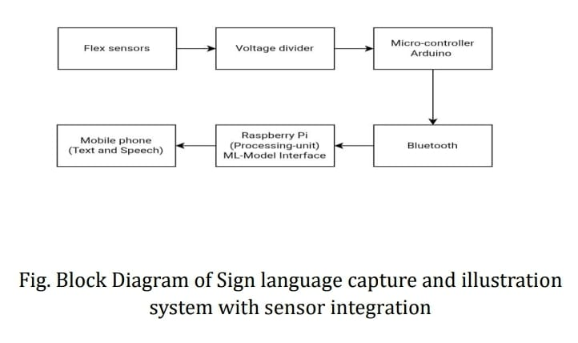
Proposed Block Diagram
Figure 1. Block Diagram of Proposed Work
5

Slide 6
Hardware components
Flex Sensors (5)
Arduino Microcontroller (Uno / Nano)
Raspberry Pi (Model 3 / Model 4)
Bluetooth Module (HC-05 / HC-06)
Voltage Divider Resistor
Speaker / Audio Output Device
Display Device (Mobile / Monitor)
Hardware & Software Requirement
6

Slide 7
Hardware & Software Requirement
Software Components
1. Arduino IDE
2. Python Programming Language
3. NumPy and Pandas
4.Jupyter Notebook / Google Colab
5.Text-to-Speech (TTS) Engine

Slide 8
Methodology
1. Gesture Capture
User performs a predefined hand gesture using a sensor-equipped glove.
2. Sensor Detection
Five flex sensors detect the bending of each finger and generate corresponding sensor values.
3. Data Acquisition
The sensor readings are collected and processed using the Raspberry Pi.
4. Data Preprocessing
The acquired readings are cleaned and arranged into a suitable format for the ML model.
5. Gesture Recognition
The trained Machine Learning model analyzes the sensor pattern and identifies the corresponding gesture.
6. Illustration & Output
The recognized gesture is converted into text and voice output.
8

Slide 9
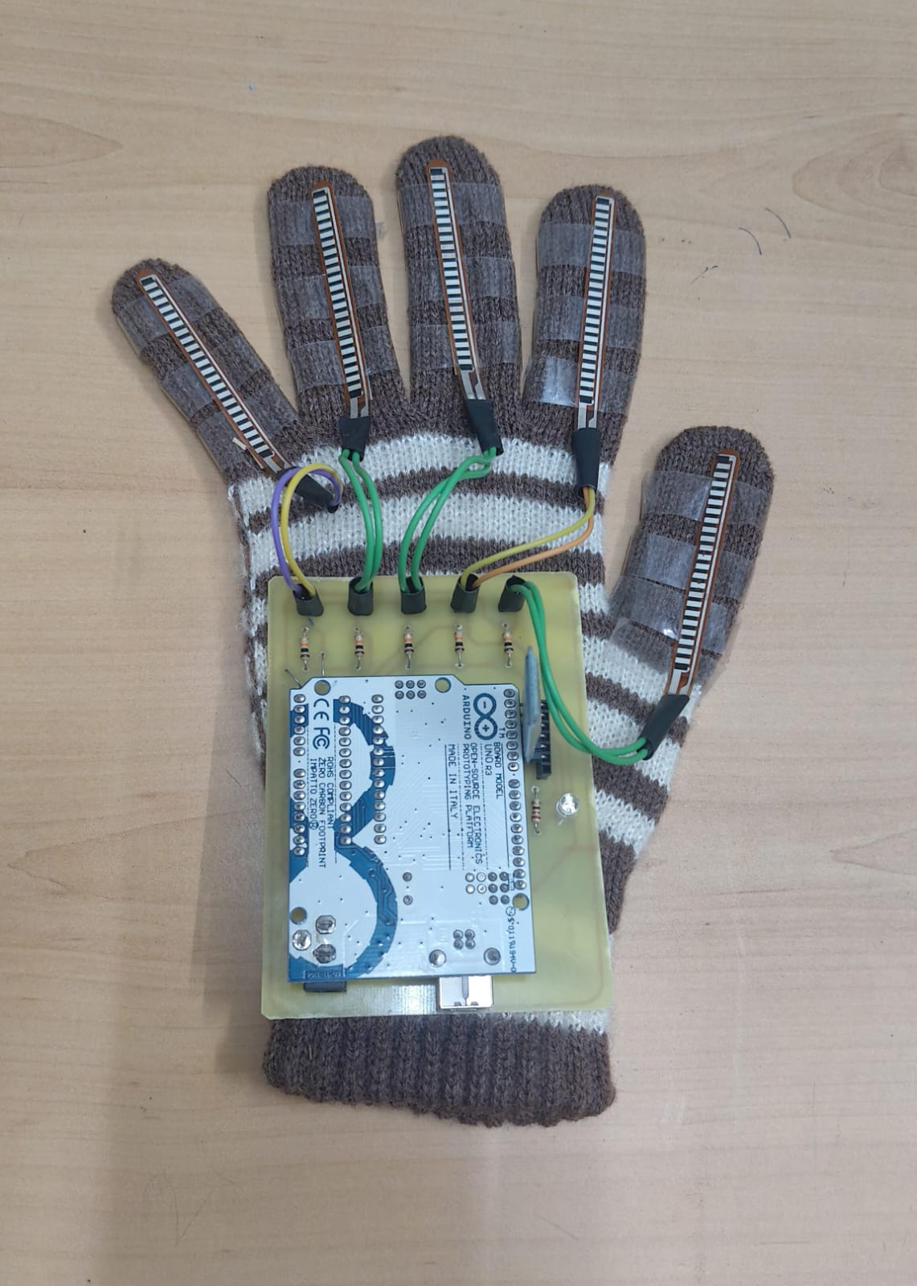
Result
Successfully developed the sensor-based glove prototype.
Integrated five flex sensors, one for each finger.
Connected the sensors with resistors and Arduino Uno for data acquisition.
Established the basic hardware setup for capturing finger-bending movements.
The prototype is ready for sensor-value testing and data collection.
Further work includes gesture dataset creation, ML model training, and real-time gesture recognition.

Slide 10
Applications
Used as a communication aid for hearing and speech impaired individuals to interact with non-sign language users.
Helps convert Indian Sign Language gestures into text and speech in real time.
Useful in hospitals and healthcare centers for patient–doctor communication.
Supports human–computer interaction through gesture-based control systems.
Acts as a learning and research tool for sign language recognition and assistive technologies.
Can be integrated with smart devices and IoT-based assistive systems.
10

Slide 11
References
[1] A. K. Pandey and A. K. Singh, “Sign language recognition using flex sensors and machine learning,” International Journal of Innovative Research in Computer and Communication Engineering, vol. 6, no. 4, pp. 112–118, 2018.
[2] S. M. Patel and R. S. Jain, “Hand gesture recognition system using Arduino and Bluetooth communication,” International Journal of Engineering Research & Technology (IJERT), vol. 9, no. 5, pp. 225–230, 2020.
[3] R. Gupta and P. Kumar, “Real-time sign language translation using Raspberry Pi and machine learning,” in Proc. International Conference on Smart Technologies for Smart Nation (SmartTechCon), 2021, pp. 345–350.

Slide 12
Thank You!!!
12
Notes:
12

