Slide 1
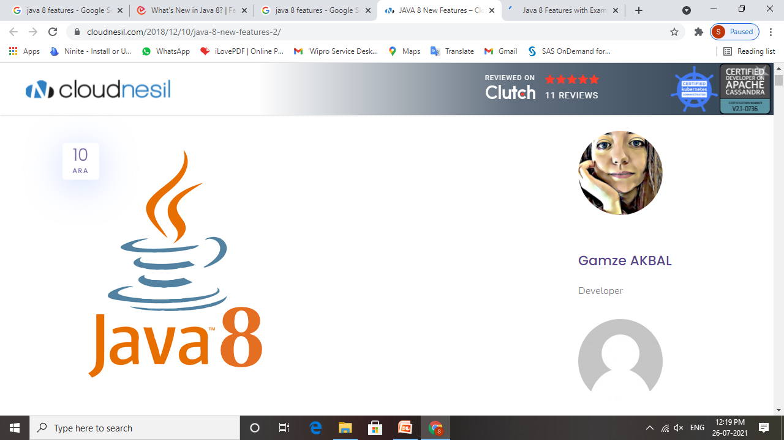

Slide 2
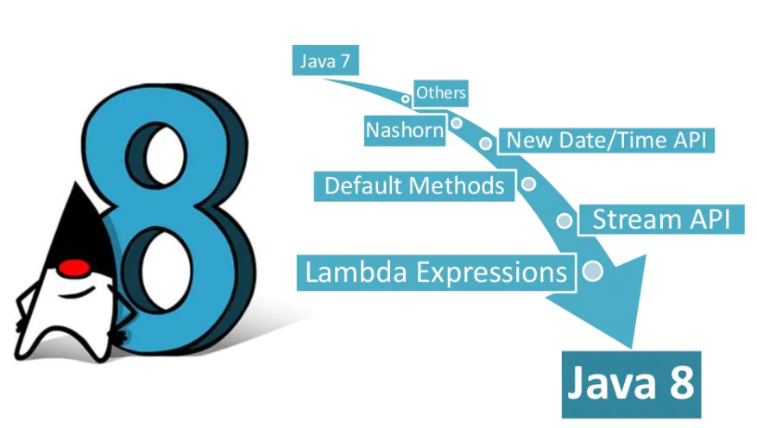
Java 8 features

Slide 3
Practical implementation
1.Inheritance:
2.For each
3.Interface default
4.Abstraction
5.Polymorphism

Slide 4
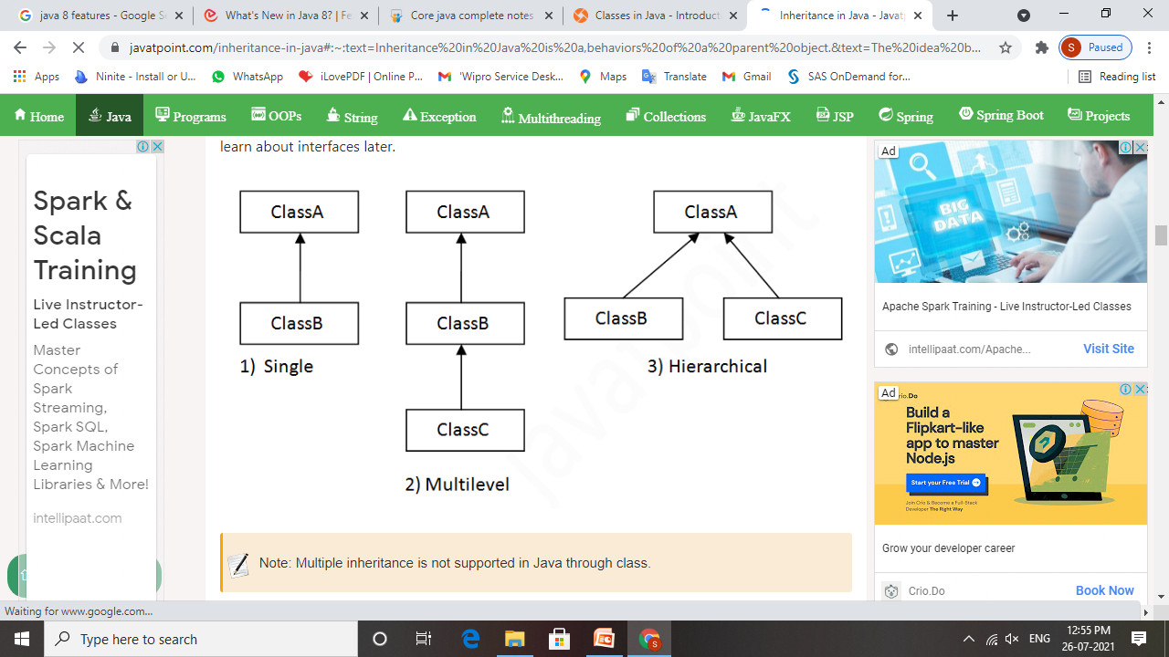
Inheritance

Slide 5
For each loop
Syntax:
for(type iter_var : Collection) statement_block
Example: public class Main { public static void main(String[] args) { int ages[] = {15, 18, 16, 17, 14, 12, 13, 20, 22, 25}; int sum = 0; System.out.print("Ages of the group are : ");
for (int x : ages) { System.out.print(x+" ");
sum += x; } System.out.println("\n Average age of the group = " + (sum/10)); } }

Slide 6
Interface Default
Example:
interface Animals {
default void food() {
System.out.println("Animal eat food");
}
}
class Lion implements Animals {
}
public class MainClass{
public static void main(String...args) {
Animals animals = new Lion();
animals.food();
}
}

Slide 7
Abstraction
*Example:
abstract class Car{
abstract void accelerate();
}
class Suzuki extends Car{
void accelerate(){
System.out.println("Suzuki::accelerate");
}
}
class Main{
public static void main(String args[]){
Car obj = new Suzuki();
obj.accelerate();
}
}

Slide 8
Polymorphism
*Example:
class Bike{
void run(){System.out.println("running");}
}
class Splendor extends Bike{
void run(){System.out.println("running safely with 60km");
}
public static void main(String args[]){
Bike b = new Splendor();
b.run();
}
}

Slide 9


Slide 10
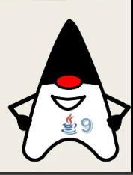
Introduction:
Java 9 version has introduced new enhancements and added new features. It is a new kind of Java programming component that can be used to collect Java code (classes and packages). ... In Java 9, JDK itself has divided into set of modules to make it more lightweight. It also allows us to develop modular applications.

Slide 11
Features of Java 9:

Slide 12
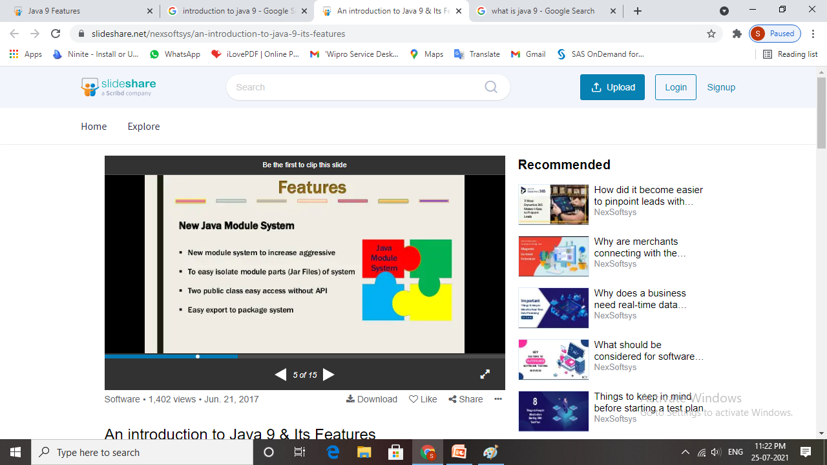
1.Java Module system
to easy isolate module parts (jar files) of system.
two public class easy access without api.
Easy export to package system.

Slide 13
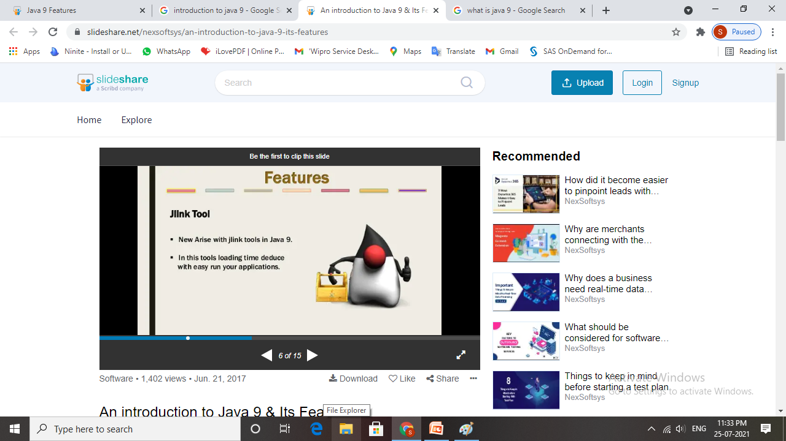
2. Jlink tool
New Arise with Jlink tools in java 9.
In this tools loading time deduce with easy run your applications.

Slide 14
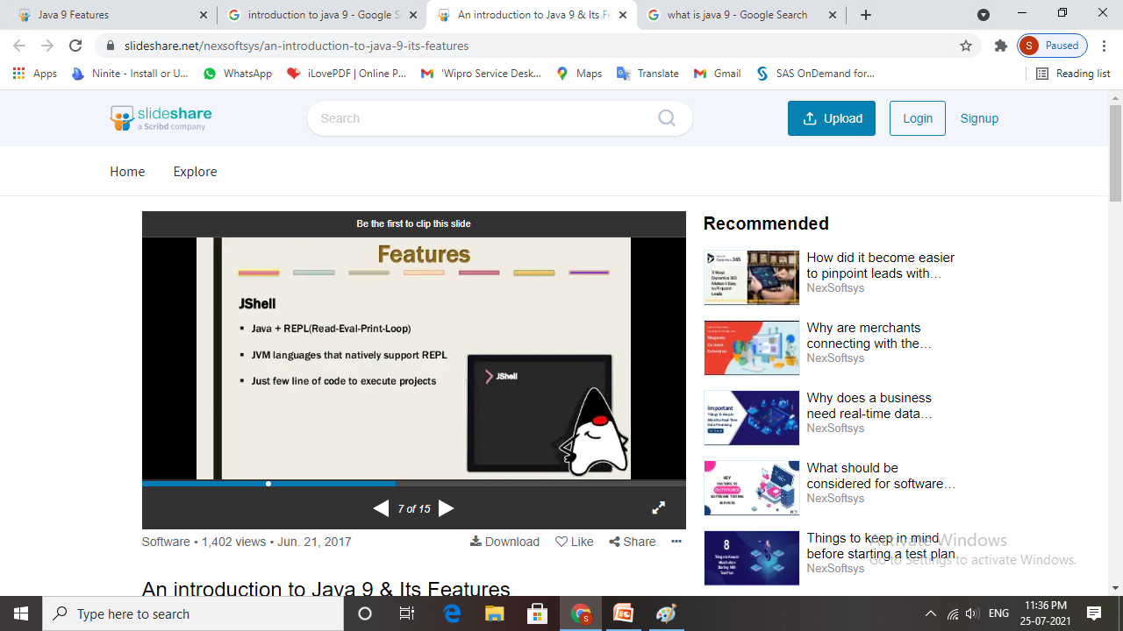
3. Jshell
Java + REPL (Read – Eval – Print – Loop).
JVM languages that natively support REPL.
Just few line of code to execute projects.

Slide 15
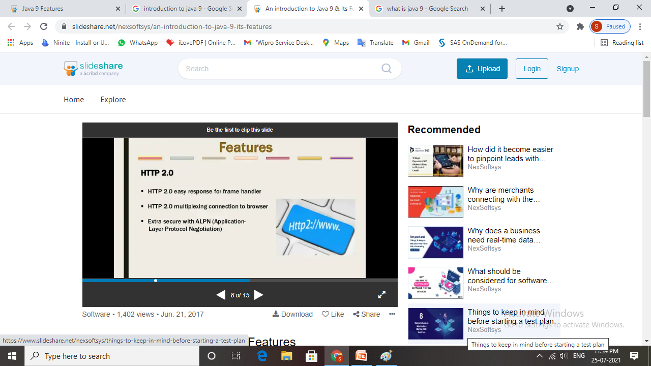
4. http 2.0
HTTP 2.0 easy response for frame handler.
HTTP 2.0 multiplexing connection to browser.
Extra secure with ALPN ( Application – Layer Protocol Negotiation).

Slide 16
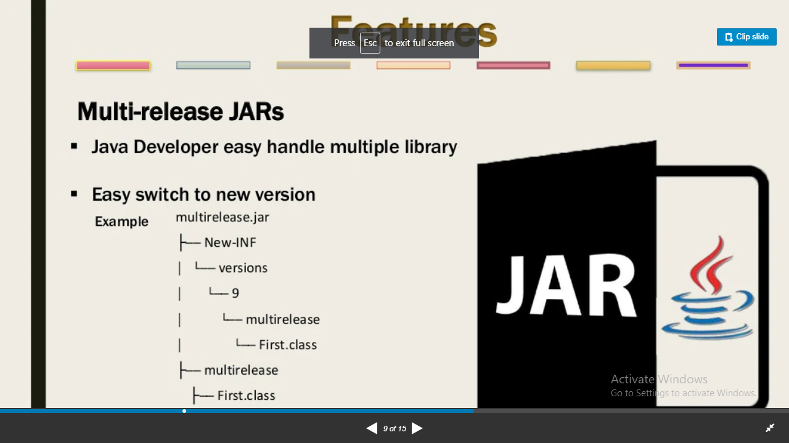
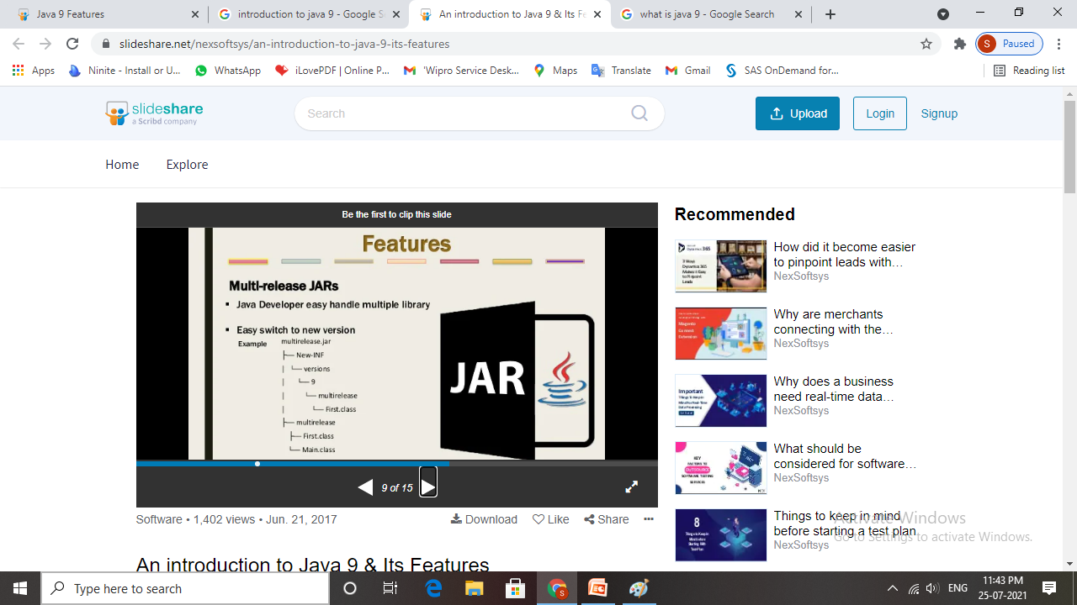
5. multi-release jars

Slide 17
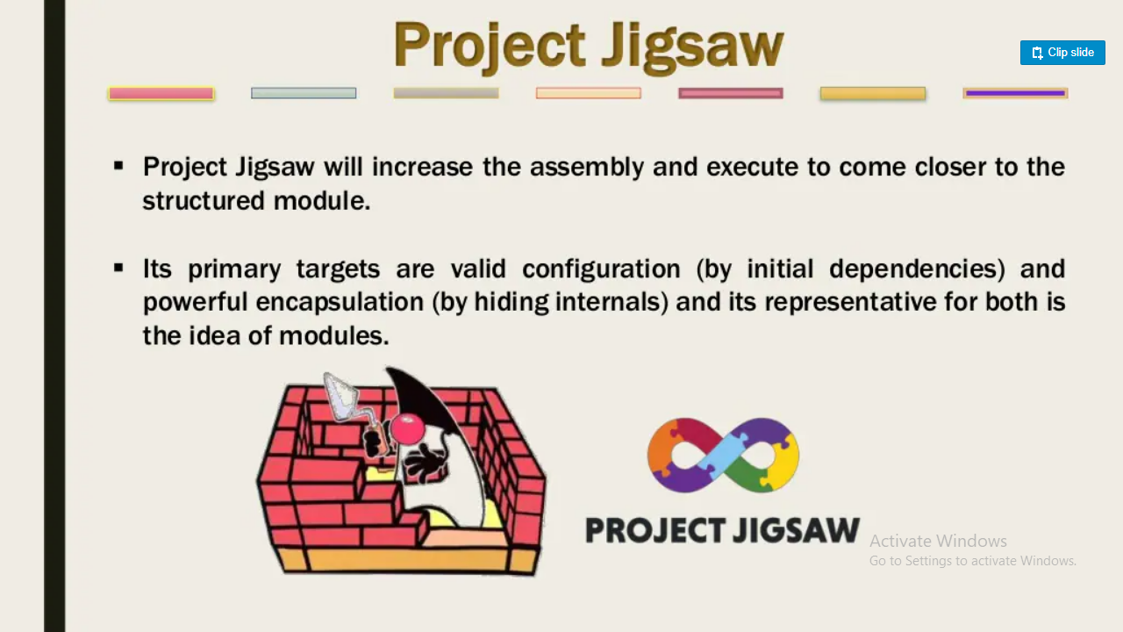
6. Project jigsaw
Project Jigsaw will increase the assembly and execute to come closer to the structured module.

Slide 18
Javadoc in html5

Slide 19
Private Method inside Interface
Java 9 onwards, you are allowed to include private methods in interface.
Using private methods, now encapsulation is possible in interfaces as well.

Slide 20
Some others features :
Private Method Inside Interface
Factory method with Unmodifiable Collections
Try with Resources Enhancement

Slide 21
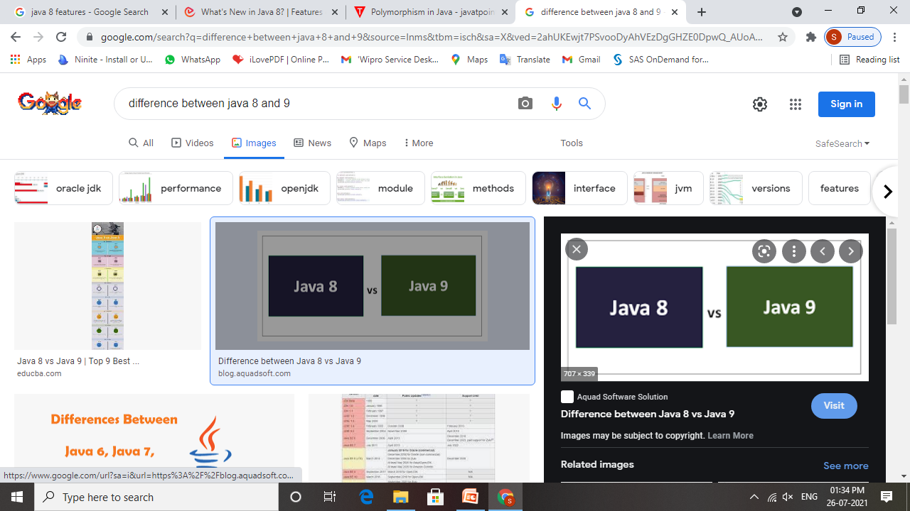

Slide 22
Thank you !!!

