Slide 1
ParaBank
End-to-End Automation Framework
Presented by: Snehal Reddy Godala
Trainer: Navin CK
Date: June 2026
Notes:
Welcome everyone. Today I will walk you through the ParaBank End-to-End Automation Framework I built using Selenium, Java, TestNG, and Maven.

Slide 2
Agenda
01 Project Overview
06 Utilities & Config
02 Objectives
07 Test Cases
03 Technology Stack
08 Execution Flow
04 Framework Architecture
09 Test Results
05 Page Object Model
10 Conclusion
Notes:
Here's our agenda for today's presentation covering 10 main topics.

Slide 3
Project Overview
1.ApplicatioApplication
ParaBank – a web-based banking application used as a real-world testing target for automation practice and skill demonstration.
2.Design Pattern
Implemented the Page Object Model (POM) design pattern to separate test logic from page interactions, improving code reuse.
3.Reusable Framework
Built a scalable, maintainable automation framework with shared utilities, base classes, and centralized configuration management.
Notes:
ParaBank is a sample banking web app. We automated it using POM to keep our code clean and reusable.

Slide 4
Problem Statement – Why Automate?
1.Time Consuming
Manual test execution for each release cycle takes days, delaying delivery and feedback loops.
2.Repetitive Tasks
Testers repeatedly execute the same regression scenarios, leading to fatigue and reduced focus on exploratory testing.
3.Human Errors
Manual testing is prone to missed steps, inconsistent data entry, and oversight—especially under deadline pressure.
4.Difficult Regression
As the application grows, full regression coverage becomes impossible to maintain manually within sprint timelines.
Notes:
Manual testing creates bottlenecks in four key areas — time, repetition, errors, and regression coverage.

Slide 5
Project Objectives
Reduce Manual Effort
Automate repetitive regression scenarios to free testers for exploratory testing
Increase Test Coverage
Cover all critical banking workflows including registration, transfer, and bill pay
Build a Reusable Framework
Create modular, maintainable code using Page Object Model and shared utilities
Achieve Faster Execution
Run the full test suite in minutes rather than hours of manual effort
Easy Maintenance
Centralize locators in page classes so UI changes require minimal code updates
Notes:
Five key objectives drive this project — reducing effort, improving coverage, reusability, speed, and ease of maintenance.

Slide 6
Tools & Technologies
Java
Selenium WebDriver
TestNG
Core programming language for writing test scripts and framework utilities
Browser automation tool that drives Chrome to interact with the ParaBank UI
Test execution framework providing annotations, test sequencing, and reporting
Maven
Eclipse IDE
ChromeDriver
Build and dependency management tool; controls library versions via pom.xml
Development environment for writing, debugging, and running automation code
WebDriver implementation that bridges Selenium with the Chrome browser
Notes:
Our stack includes Java for scripting, Selenium for browser control, TestNG for test management, Maven for builds, Eclipse as IDE, and ChromeDriver for Chrome execution.

Slide 7
Why Selenium WebDriver?
Key Advantages:
Selenium
1. Open Source & Free
No licensing cost — perfect for organizations of all sizes
is the #1 browser
automation framework
in the world
2. Multi-Browser Support
Works with Chrome, Firefox, Edge, Safari and more
3. Java Integration
Native support for Java with clean WebDriver APIs
Used by top companies
including Google,
Microsoft, and Amazon
4. TestNG Integration
Seamlessly combines with TestNG for structured execution
5. Industry Standard
✓ Active Community
✓ Rich Documentation
✓ CI/CD Ready
Widely used in the industry — great for career growth
Notes:
Selenium is the industry standard for web automation. It is free, supports multiple browsers, and integrates well with Java and TestNG.

Slide 8
Framework Architecture
TestNG
Test runner & annotations
Data Flow (Top → Bottom)
▼
Test Cases
RegisterTest · TransferFundsTest · BillPayTest
▼
Page Classes (POM)
LoginPage · RegisterPage · TransferFundsPage · BillPayPage
▼
Utilities
BaseTest · ConfigReader · ScreenshotUtil · TestData
▼
WebDriver
ChromeDriver browser control layer
▼
Browser (Chrome)
ParaBank web application target
Notes:
The framework flows from TestNG at the top through test cases, page classes, utilities, WebDriver, and finally to the browser.

Slide 9
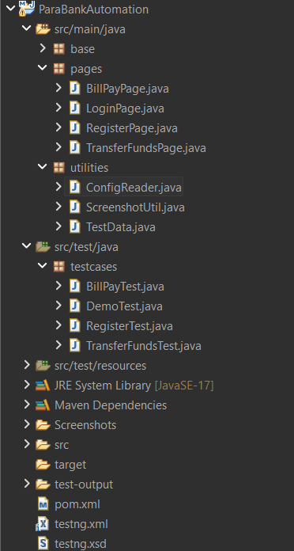
Maven Project Structure
Key Files
pom.xml
Manages all library dependencies — Selenium, TestNG, and Maven plugins
testng.xml
Defines the test suite, execution order, and included test classes
config.properties
Stores URL, username, and password for easy configuration changes
src/main/java
Framework utility code shared across all test cases
src/test/java
All page objects and test case scripts live here
Notes:
Maven provides a standard project layout. The pom.xml and testng.xml files are the heart of the project configuration.

Slide 10
Folder Structure Inside src/main/java & src/test/java
base/
Contains BaseTest.java — responsible for browser setup (@BeforeMethod) and teardown (@AfterMethod)
pages/
Page Object classes for each screen: LoginPage, RegisterPage, TransferFundsPage, BillPayPage
utilities/
Helper classes: ConfigReader, ScreenshotUtil, and TestData for shared test state
testcases/
Actual test scripts: RegisterTest, TransferFundsTest, BillPayTest, DemoTest
Screenshots/
Auto-generated folder where ScreenshotUtil saves PNG evidence on test pass/fail
Notes:
The project is organized into five main packages: base, pages, utilities, testcases, and a Screenshots folder.

Slide 11
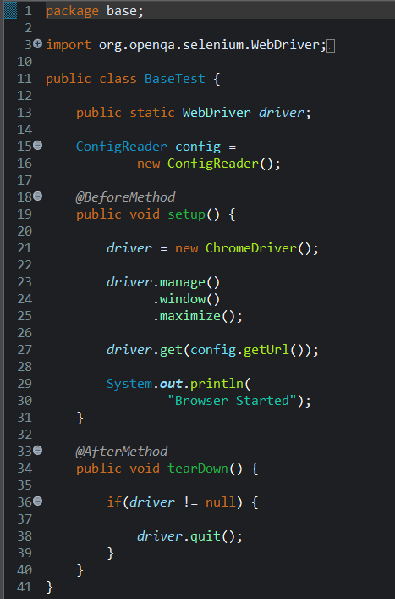
BaseTest.java – Browser Lifecycle Management
@BeforeMethod
Runs before every test method — sets up a fresh browser instance
);
ChromeDriver Setup
Initializes ChromeDriver, maximizes the browser window, and navigates to the app URL from config
@AfterMethod
Runs after every test — closes the browser to release resources and avoid memory leaks
Notes:
BaseTest handles browser lifecycle. @BeforeMethod launches Chrome, and @AfterMethod closes it. Every test class extends BaseTest.

Slide 12
ConfigReader.java – Centralized Configuration
config.properties
ConfigReader.java
url=http://parabank.para...
Properties prop = new Properties();
▶
prop.load(new FileReader(
username=generated_user
"config.properties"));
password=Test@1234
getURL() → prop.get("url")
getUser() → prop.get("username")
getPass() → prop.get("password")
Single Source of Truth
No Hardcoding
Environment Switching
Change URL or credentials in one file — all tests pick it up automatically
Credentials and URLs are never embedded in test code, making maintenance easier
Switch between dev, staging, and production by simply changing config.properties
Notes:
ConfigReader loads properties from config.properties file. This avoids hardcoding and makes it easy to switch environments.

Slide 13
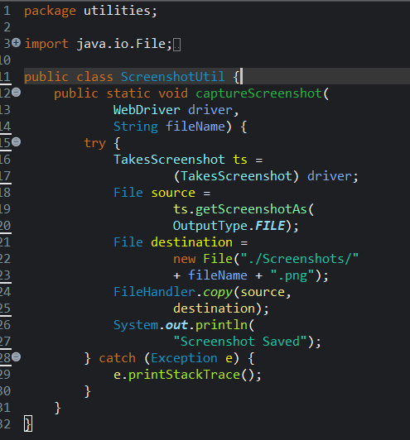
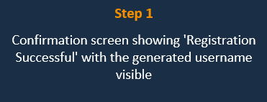
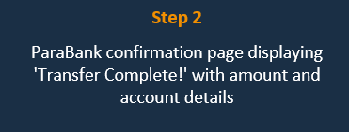
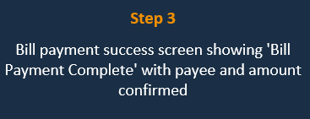
ScreenshotUtil.java –
Notes:
ConfigReader loads properties from config.properties file. This avoids hardcoding and makes it easy to switch environments.

Slide 14
Page Object Model (POM)
Design Pattern
❌ Without POM
✅ With POM
✗ Locators scattered across all test files
✓ Each page has its own class with all locators
✗ Same element found in 10 different tests
✓ Tests call reusable methods from page classes
✗ One UI change requires updating dozens of files
✓ UI change → update only one page class
✗ Tests tightly coupled to implementation details
✓ Clean separation of test logic & page actions
✗ Hard to debug and maintain at scale
✓ Easily scalable as application grows
Notes:
POM separates page interactions from test logic. Each page has a dedicated class, making code reusable and easy to maintain.

Slide 15
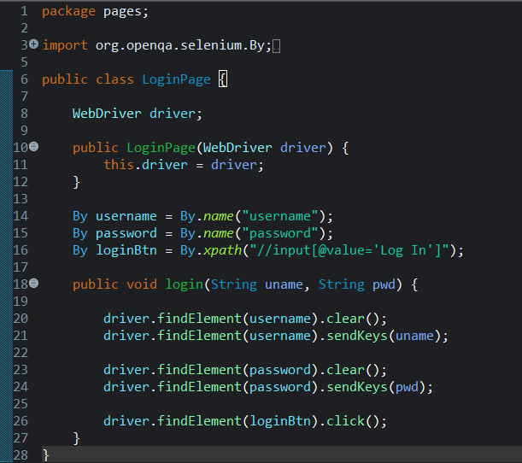
LoginPage.java – Page Object Class
Constructor
Receives the WebDriver instance from the test class so it operates on the same browser
Locators (By)
Element locators stored as class fields — find username/password fields and login button by their HTML attributes
login() Method
Reusable action method — enters username and password, then clicks login. Any test can call this in one line
Notes:
LoginPage encapsulates username field, password field, and login button. The login() method is called by any test needing authentication.

Slide 16
RegisterPage.java – User Registration
1
Navigate to Register
Clicks the 'Register' link on the home page to open the registration form
2
Fill Personal Details
Enters first name, last name, address, city, state, zip code, phone, and SSN into form fields
3
Generate Unique Username
Appends System.currentTimeMillis() to a base string — ensures uniqueness on every test run
4
Set Password
Enters and confirms the password for the new account
5
Submit & Store
Clicks 'Register', then saves the generated username in TestData.java for use in subsequent tests
Notes:
RegisterPage fills out the registration form step by step, generates a unique username using timestamps, and stores it for later test steps.

Slide 17
TransferFundsPage.java – Fund Transfer
→
→
→
→
→
Login
Home Page
Transfer Funds
Enter Amount
Submit
Verify
Use registered credentials
Post-login landing page
Navigate to Transfer page
Input transfer amount
Click Transfer button
Assert success message
Key Code – TransferFundsPage.java
driver.findElement(By.linkText("Transfer Funds")).click();
driver.findElement(By.id("amount")).sendKeys("500");
driver.findElement(By.id("transferButton")).click();
String msg = driver.findElement(By.tagName("h1")).getText();
Assert.assertEquals(msg, "Transfer Complete!");
Notes:
TransferFundsPage navigates to the transfer section, enters the amount, submits, and verifies the success confirmation message.

Slide 18
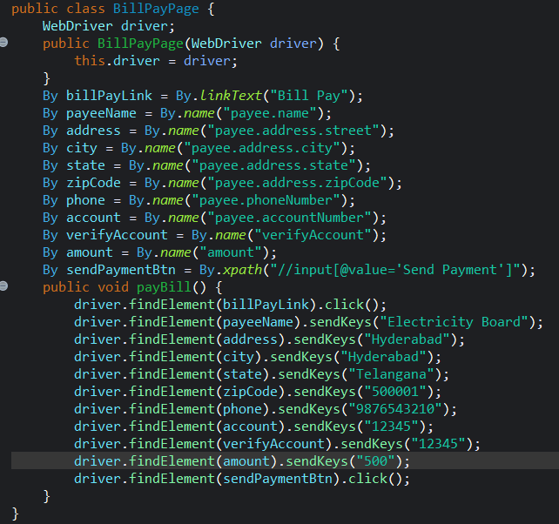
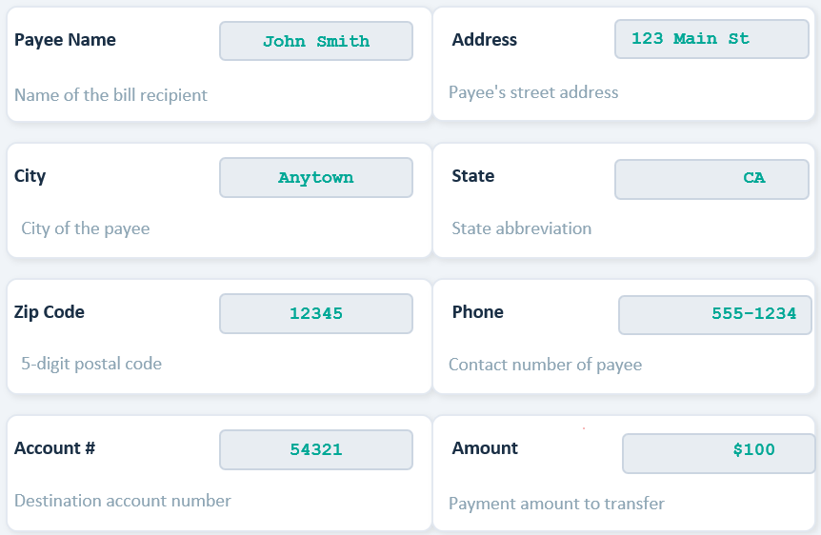
BillPayPage.java – Bill Payment
Notes:
BillPayPage fills in all payee details — name, address, phone, account number, and payment amount — then submits and verifies the success message.

Slide 19
Utility Classes
TestData.java
ScreenshotUtil.java
ConfigReader.java
Shared Test State
Evidence Capture
Configuration Management
Holds the dynamically generated username as a public static variable. This allows RegisterTest to store the username and TransferFundsTest / BillPayTest to retrieve it without re-registering.
Takes a screenshot at the end of each test using TakesScreenshot interface. Saves the PNG to the Screenshots/ folder with a timestamped filename. Called in @AfterMethod.
Reads URL, username (base), and password from config.properties using Java's Properties class. Returns values as strings via static methods for use anywhere in the framework.
public static String username;
captureScreenshot(driver, testName)
getURL()
Notes:
Three utility classes power the framework: TestData shares state between tests, ScreenshotUtil captures evidence, and ConfigReader manages configuration.

Slide 20
Test Cases
RegisterTest
TransferFundsTest
1. Open registration page
1. Login with registered user
2. Fill form with valid data
2. Navigate to Transfer Funds
3. Generate unique username
3. Enter $500 amount
4. Submit registration
4. Select accounts
5. Assert: Registration Successful
5. Assert: Transfer Complete
BillPayTest
DemoTest
1. Login with registered user
1. End-to-end smoke test
2. Navigate to Bill Pay
2. Validates overall flow
3. Fill payee details
3. Uses all page objects
4. Enter payment amount
4. Confirms integration
5. Assert: Bill Payment Complete
5. Assert: Full flow passes
Notes:
Four test classes cover registration, fund transfer, bill payment, and an end-to-end demo flow.

Slide 21
Test Execution Flow
testng.xml
Suite entry point — defines class order
▼
RegisterTest
Creates account & saves username to TestData
T
e
s
t
D
a
t
a
TransferFundsTest
Logs in, reads username from TestData, transfers $500
▼
▼
BillPayTest
Logs in, pays bill using shared username
▼
DemoTest
Full end-to-end validation across all features
Notes:
testng.xml controls the execution order. RegisterTest runs first to create the account. Subsequent tests share the username via TestData.java.

Slide 22
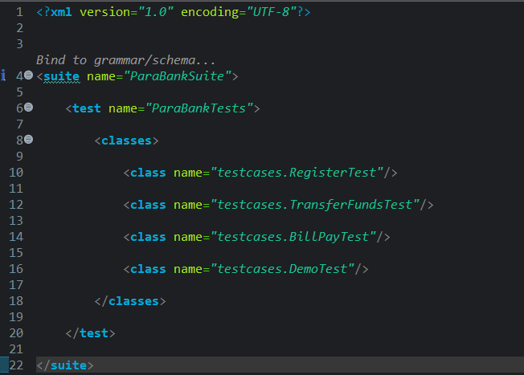
testng.xml – Test Suite Configuration
suite tag
Defines the entire test suite. 'verbose=1' enables console logging during execution.
test tag
Groups a collection of test classes into one logical test batch.
classes section
Lists each test class by its fully qualified name. TestNG executes them in the order listed here — Register first, then Transfer, then BillPay.
Execution Order
RegisterTest → TransferFundsTest → BillPayTest → DemoTest. This order matters because later tests depend on the registered username.
Notes:
testng.xml is the master control file. It specifies suite name, test name, and lists classes in the exact order we want them to execute.

Slide 23
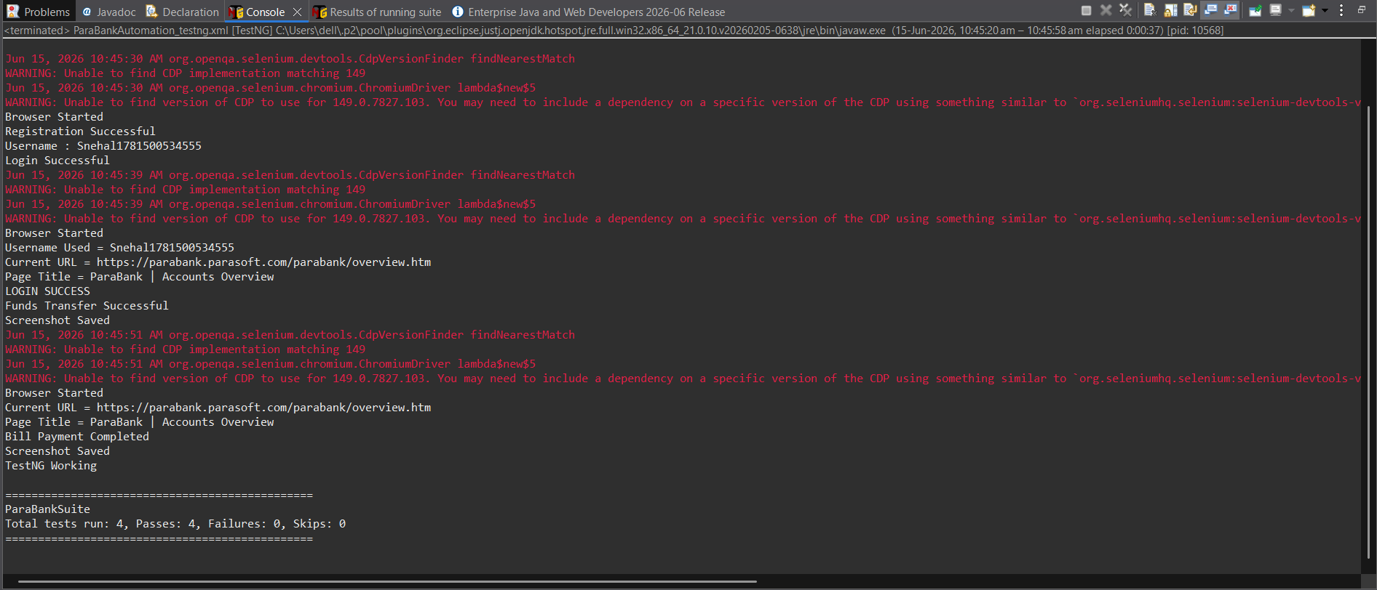
Console Output – Test Execution Log
Notes:
The Eclipse console shows all test steps logged in real-time. The final line 'BUILD SUCCESS' confirms all 4 tests passed with no failures.

Slide 24

Test Results – 100% Pass Rate
0
Skipped
Execution Summary
► Duration: ~38 seconds for full suite
► Browser: Google Chrome (headless-compatible)
► Environment: Local machine via ChromeDriver
► Evidence: Screenshots saved for all 4 tests
Notes:
All 4 tests passed with a 100% pass rate. The full suite completed in approximately 38 seconds.

Slide 25

Conclusion
Key Achievements of the ParaBank Automation Framework
Successfully designed and implemented a Selenium + Java automation framework from scratch
Built a complete framework — no shortcuts
Applied Page Object Model pattern across all 4 page classes for clean, reusable code
Industry-standard design pattern
Executed all 4 test cases with 100% pass rate and zero failures
Verified end-to-end banking flows
Captured automated screenshots as visual evidence for each passing test
Professional test evidence management
Achieved full automation of Register → Login → Transfer → BillPay flow
Complete banking workflow automated
Thank You
Snehal Reddy Godala
Notes:
To summarize — we built a full automation framework, achieved 100% pass rate across all test cases, and demonstrated industry-standard practices. Thank you!

