Slide 1
KANBAN
Snehal Raghunath Thomake
Batch – 7670
Center - Thane

Slide 2
What is kanban?
Kanban is a popular framework used to implement agile and DevOps software development. It requires real-time communication of capacity and full transparency of work. Work items are represented visually on a kanban board, allowing team members to see the state of every piece of work at any time.

Slide 3
Using Kanban in software testing:
Helps keep projects organized
Maintain transparency into project status and pipeline
Easily identify and eliminate bottlenecks
Improve communication
Speed up cycle times
And perhaps best of all, using Kanban in software testing is easy with the right project management solution.

Slide 4
Six rules for the effective application of Kanban:
Never pass on defective products;
Take only what is needed;
Produce the exact quantity required;
4) Level the production;
5) Fine-tune production; and
6) Stabilize and rationalize the process.

Slide 5
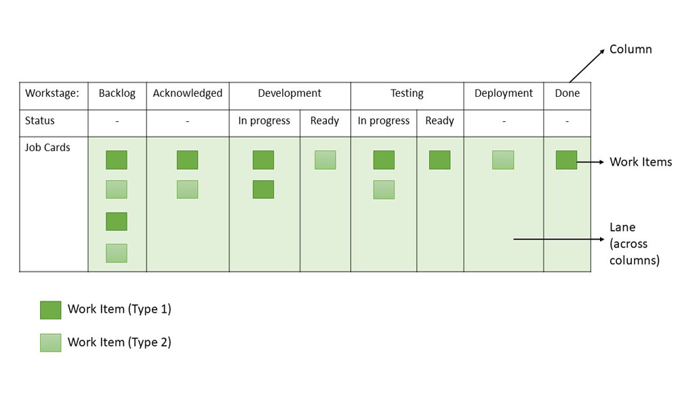
Kanban Board/Card
It is critical to understand the visualization of workflow stages in the task execution pipeline. Kanban board provides a simple way to understand the process.

Slide 6
From the sample board above, these can be inferred about Kanban Boards or Cards:
Workflow: Backlog -> Acknowledged -> Development -> Testing -> Deployment/UAT -> Done
Work stages: Acknowledged, Development (In Progress), Development (Ready), Testing (In Progress), Testing (Ready), Deployment/UAT, Backlog (Arrival Queue), Done (Finished Stage)
Work Items: Two types of tasks (Type 1 and Type 2) are represented by work items

Slide 7
Thank-You

