Slide 1


Enhancing Airbnb Experience
Group: 13
Group 13
Bharath Sreekumar
Sneha Murali
Zeba Karkhanawala
1

Slide 2

About the Data
+
Data Source: opendatasoft Airbnb-Listings dataset (last modified: February 2024)
Dataset Size: 494,954 records
Due to computational issue, we streamed only 10k records.
Each record belongs to an Airbnb property and has around 85 fields ranging from location, finances to property specifications.
2

Slide 3

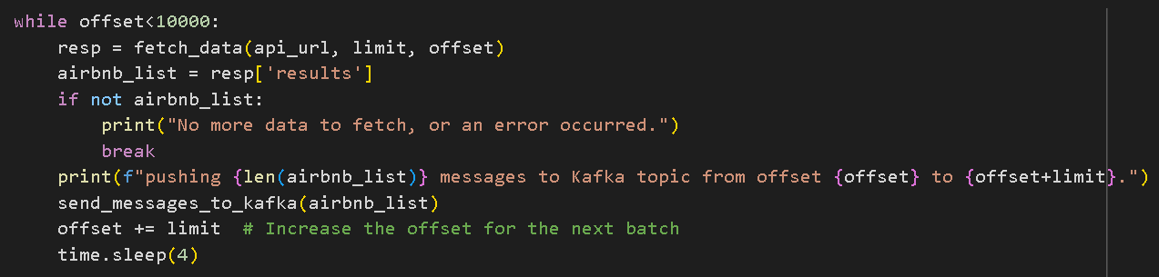
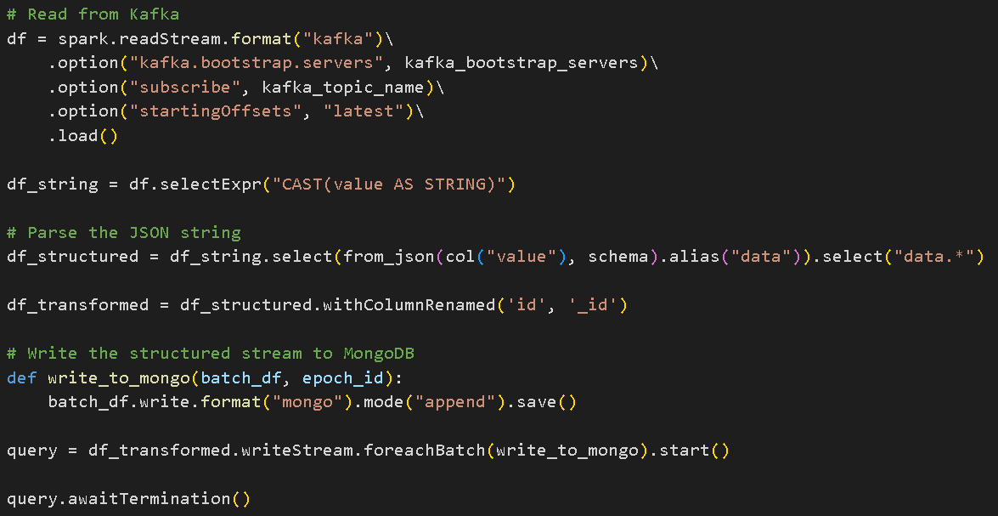
Streaming by
Steps we did for streaming the data using the API provided by opendatasoft
Kafka Producer → Kafka Consumer
Kafka Consumer → MongoDB
Loading into dataframe from MongoDB as JSON documents
3

Slide 4
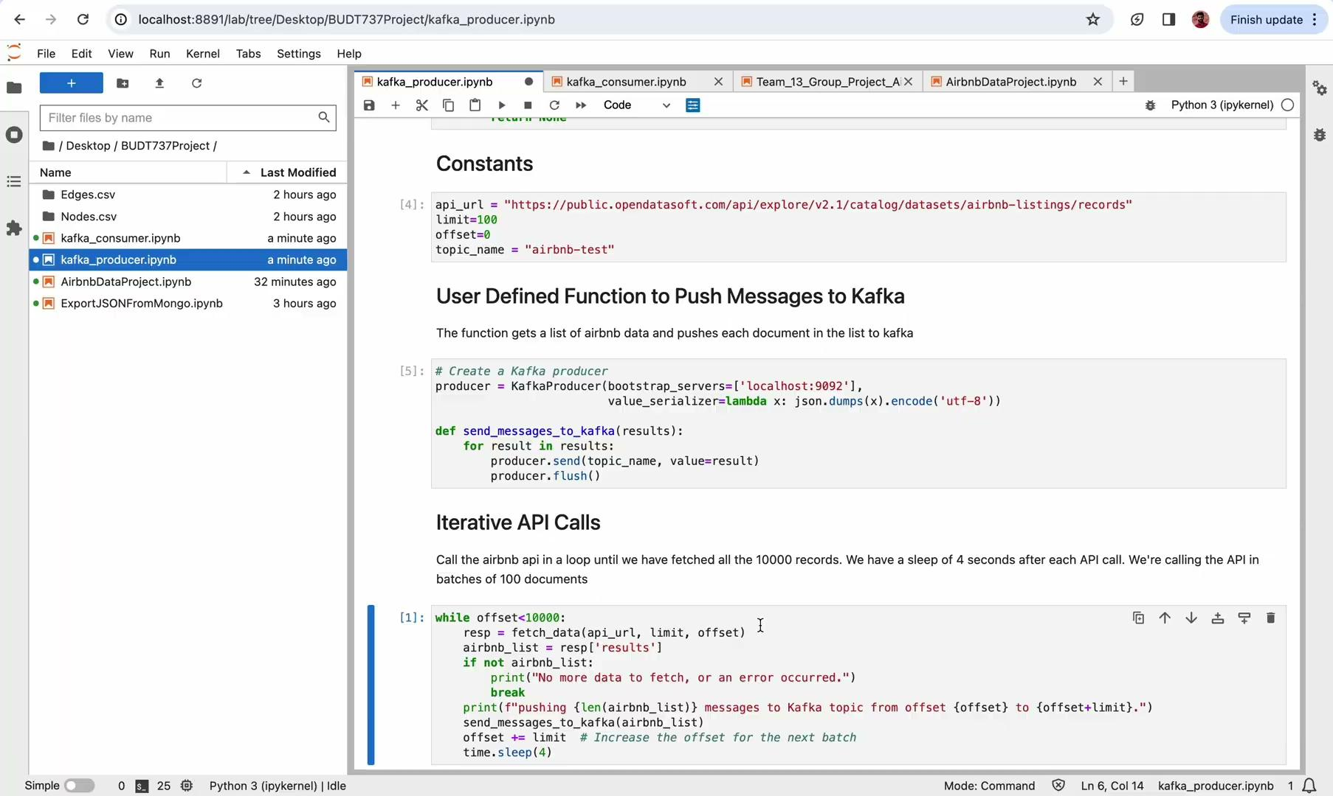
Streaming Data Collection
4

Slide 5
Data Cleaning & Feature Engineering
Filtered the data to include few selective fields (around 32)
Added a column years_host_since to calculate the years since the host has been hosting on Airbnb
Imputing NULL values:
Numeric Field→ Average Value
String Field → ‘Not Mentioned’
Deleting columns with more than 70% NULL values - square_feet, monthly_price, weekly_price
Separating the Amenities column with String Array in it to categorical columns with values 0 & 1.
Using String Indexer, One-hot Encoding convert the string fields to categorical numeric values.
Using Vector Assembler to merge all the features into one feature for machine learning models.
5

Slide 6
Graph Frames
import networkx as nx
import matplotlib.pyplot as plt
def plot_undirected_graph(edge_list, top_n=10):
plt.figure(figsize=(20, 20))
gplot = nx.Graph()
# Count the occurrences of each source node
source_counts = edge_list.groupBy("src").count()
# Get the top N source nodes with the most destinations
top_sources = source_counts.orderBy("count", ascending=False).limit(top_n).select("src").rdd.flatMap(lambda x: x).collect()
# Add only the top sources and their edges to the graph
for row in edge_list.filter(edge_list["src"].isin(top_sources)).select("src", "dst").collect():
gplot.add_edge(row["src"], row["dst"])
# Draw the graph
nx.draw(gplot, with_labels=True, font_weight="bold", node_size=200)
# Assuming mygraph is a GraphFrame with an 'edges' attribute
plot_undirected_graph(mygraph.edges, top_n=10)
plt.show()
The graphs are linking Host (using ID) and the Neighborhood. So, we can see which hosts have listings in which neighborhood.
6

Slide 7
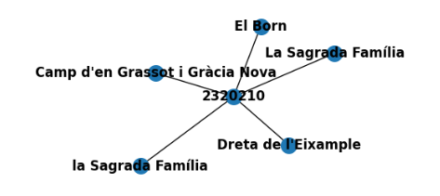
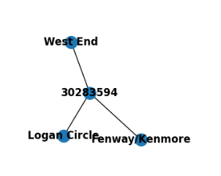
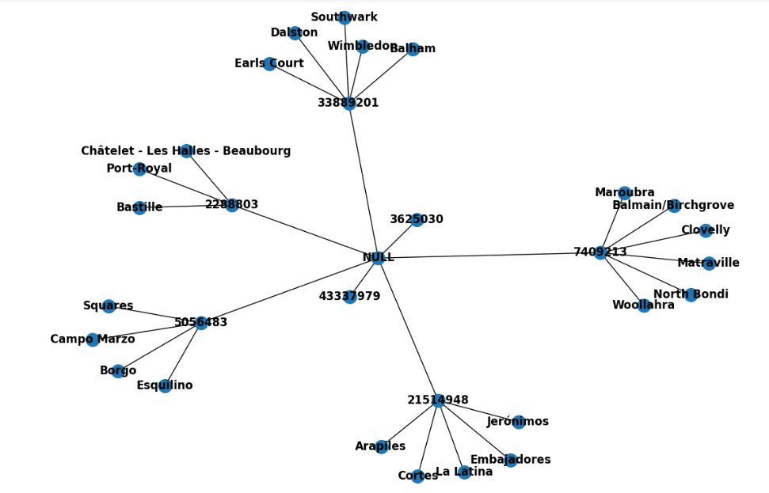
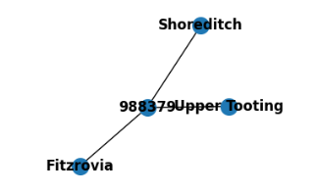
7

Slide 8
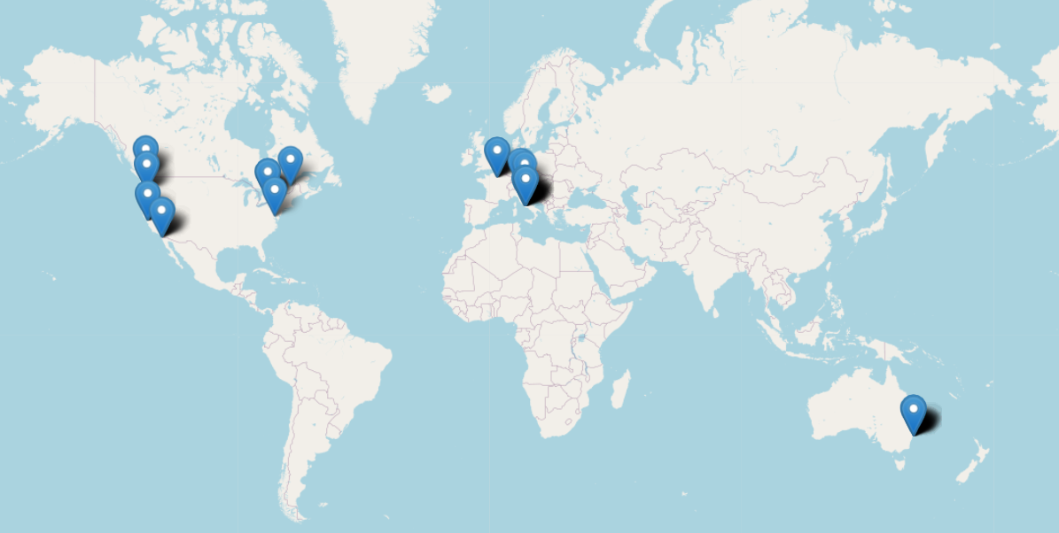
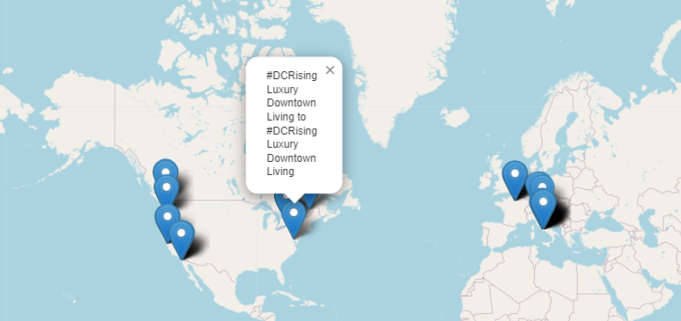
Location based map with Descriptions of Listing
The map displays listings geographically and on zooming and hovering on it, it displays the descriptions of the listings as well.
Description mentions downtown DC as it is a happening lively place
8

Slide 9
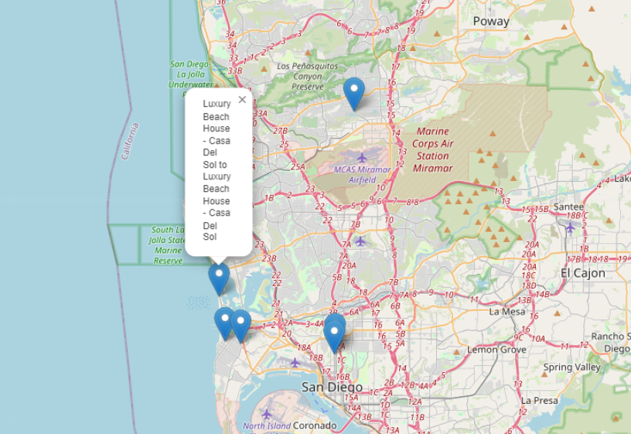
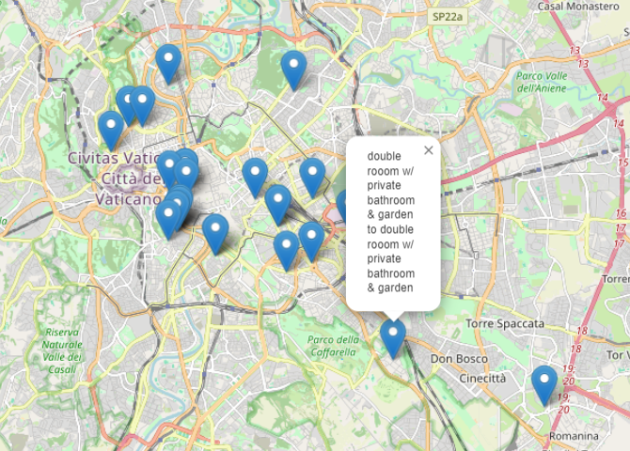
Density of airbnbs is more in Rome as per our data. Descriptions also are specific in nature mentioning rooms and surroundings.
Located near coast and beaches- description mentions luxury beach
9

Slide 10
Linear Regression to estimate
Review Score
10
We are predicting the value of the Review Score using Linear Regression model.
Features used for training the model:
Property Type, Room Type, Cancellation Policy
Host Response Rate, Host Listings Count
Accommodates, Bathrooms, Bedrooms, Beds, Price
vectorAssembler = VectorAssembler(inputCols=assemblerInputs, outputCol="linear_features")
lr = LinearRegression(featuresCol='linear_features', labelCol='review_scores_value')
pipeline = Pipeline(stages=[vectorAssembler, lr])
(train_data, test_data) = try_airbnb_data.randomSplit([0.8, 0.2], seed=1000)
model = pipeline.fit(train_data)
predictions = model.transform(test_data)
Root Mean Squared Error (RMSE) on test data = 0.7889694082098263
Mean Absolute Error (MAE) on test data = 0.5525662998099563

Slide 11
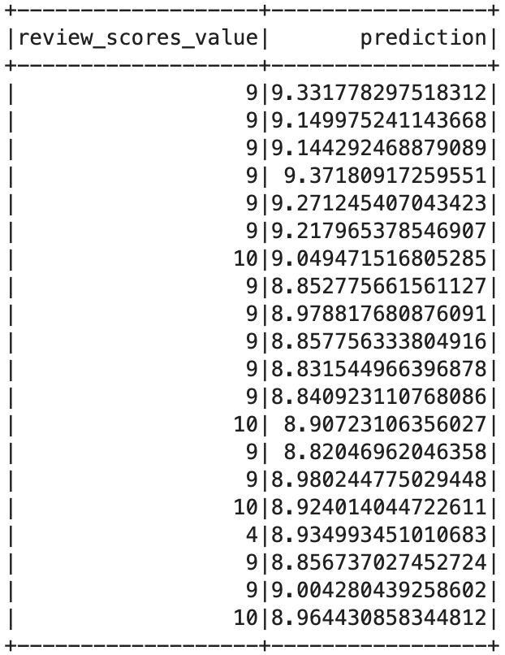
11

Slide 12
Logistic Regression Classification of
Airbnb Properties based on Price
Created new column price_category
high → If Price of the listing > Mean Price
low → If Price of the listing < Mean Price
Features used in the classification model:
Accommodates, Bathrooms, Bedrooms, Security Deposit, Cleaning Fee, Guests Included, Cancellation Policy, Number of Reviews, Experiences Offered, Neighborhood, State, City
Train-Test split of 80-20.
Accuracy = 80%
lr = LogisticRegression(featuresCol='classification_features', labelCol='new_price_category', maxIter=10)
pipeline = Pipeline(stages=[indexer, assembler, lr])
model = pipeline.fit(train_data)
predictions = model.transform(test_data)
predictions.select("price_category", "new_price_category", "probability", "prediction").show()
12

Slide 13
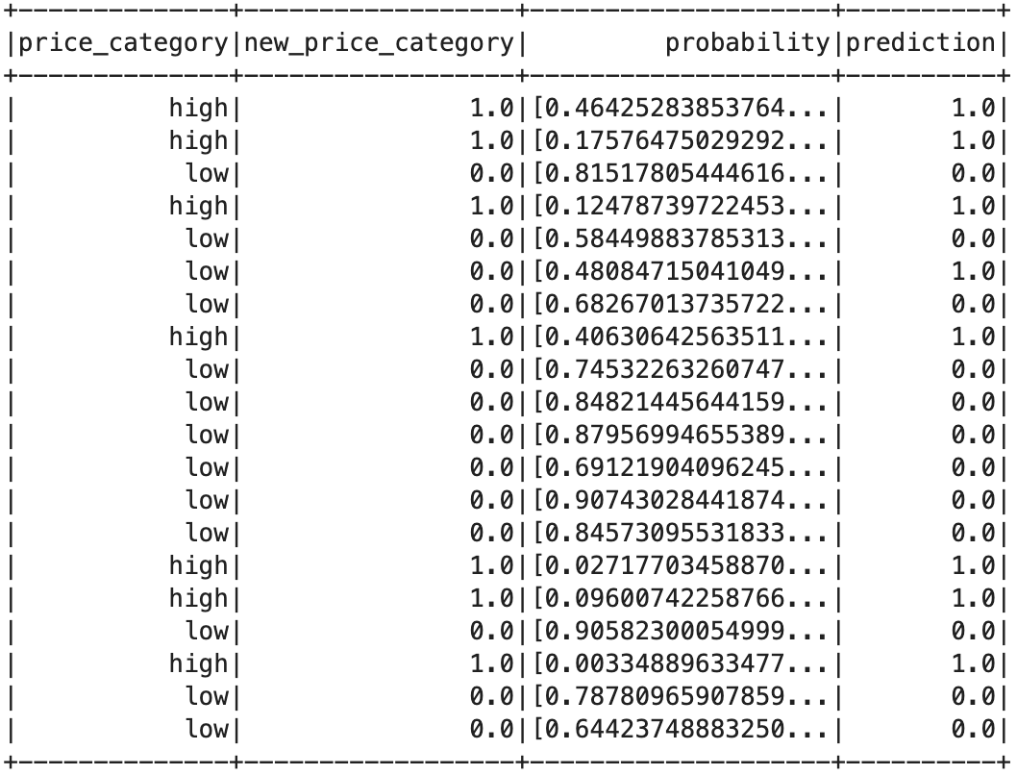
13

Slide 14
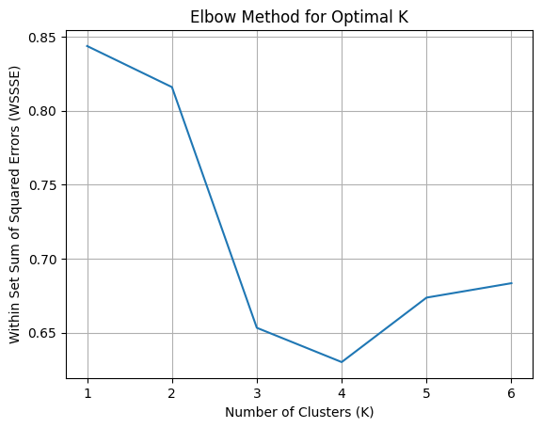
K-Means Clustering of Properties
Fields used to cluster Properties:
1. Country,
2. Price,
3. Review Scores Value,
4. Security Deposit,
5. Number of Reviews
To find the optimal value of k, we used the famous Elbow Method. This gave us the value of k as 4.
kmeans = KMeans(featuresCol="all_features").setK(4)
kmc_results = kmeans.fit(try_airbnb_data).transform(try_airbnb_data)
kmc_results.show(5)
14

Slide 15
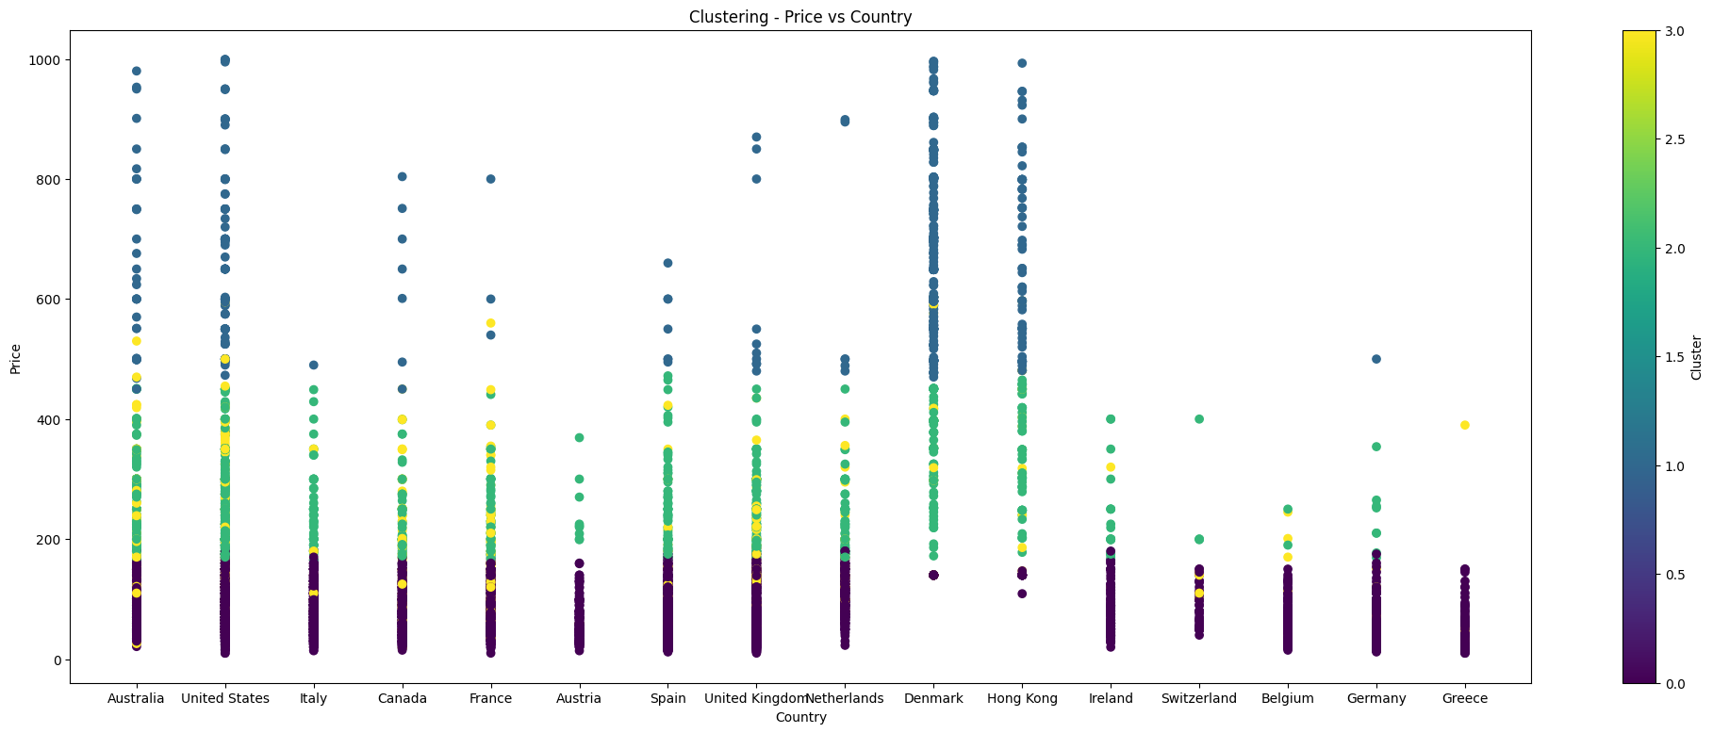
Price vs. Country
15

Slide 16
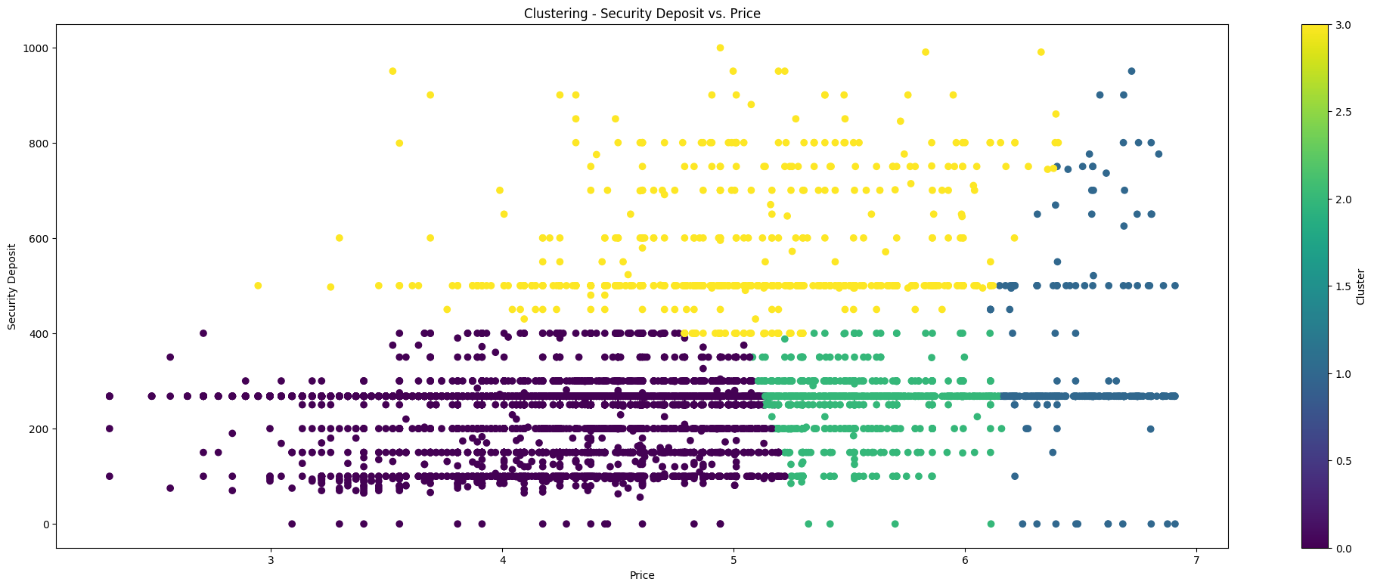
Security Deposit vs. Price
16

Slide 17
Thank You !!
17

