Slide 1

Artificial Intelligence and Machine Learning
Project Report Semester-IV (Batch-2022)
Human Activity Recognition using Smartphone Dataset
ML project
Supervised By: Submitted By:
Rajeev Thakur Roll No. : 2210990858
Group: G-13
Name: Sneha Miglani
Department of Computer Science and Engineering
Chitkara University Institute of Engineering & Technology, Chitkara
University, Punjab

Slide 2
HuMAN ACTIVITY RECOGNITION USING SMARTPHONE DATASET

Slide 3

agenda
Problem Statement
Key Features
Desired Outcomes
Supervised Learning
Algorithms Used
PIP
Libraries Used
Functions Used

Slide 4
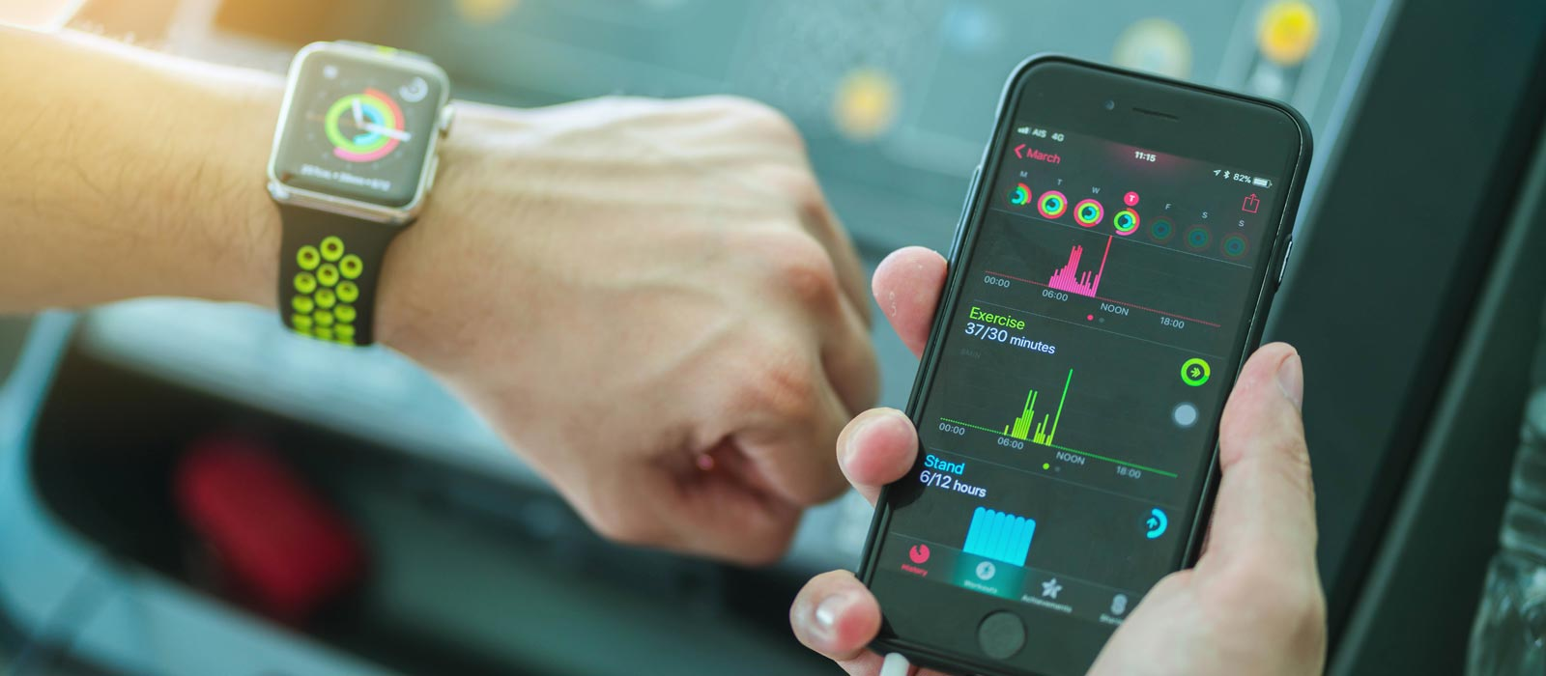
Problem statement The project's goal is to use smartphone sensor data to create a Python-based solution for human activity recognition. Gathering accelerometer and gyroscope readings from smartphones during different activities is the first step in the process. Next, the data is cleaned and normalized, and relevant features are extracted for activity classification. Finally, a machine learning model (such as decision trees, random forests, or neural networks) is trained on the preprocessed data, and its performance is assessed using metrics like accuracy and F1-score. Finally, the model is optimized for better outcomes and is put to use for real-time activity recognition applications.

Slide 5
Key features
Sensor Data Integration: The project leverages data from smartphone sensors like accelerometers and gyroscopes, enabling accurate capture of human movements during different activities.
Machine Learning Classification: By employing machine learning algorithms, the project can classify activities based on sensor data, allowing for automated recognition of various human activities with high accuracy.
Real-time Deployment: The developed solution can be deployed for real-time activity recognition applications, making it applicable in contexts such as fitness tracking, healthcare monitoring, and context-aware computing.

Slide 6
Desired outcomes
High Accuracy: The model accurately classifies human activities based on smartphone sensor data, achieving a high level of precision and recall across different activity categories.
Robustness: The developed solution demonstrates robustness by performing well on unseen data and in real-world scenarios, ensuring reliable activity recognition in various environments and conditions.
Efficiency: The deployed system operates efficiently, with low computational overhead and minimal latency, allowing for real-time activity recognition on mobile devices without significant impact on battery life or performance.

Slide 7
Supervised learning
Supervised learning is a type of machine learning where the algorithm learns from labeled data, meaning each input data point is associated with a corresponding output label. During training, the algorithm is presented with a dataset consisting of input-output pairs, and it learns to map inputs to outputs by adjusting its parameters to minimize the error between its predictions and the true labels.
In supervised learning, the algorithm's goal is to learn a mapping from inputs to outputs, such as predicting categories (classification) or continuous values (regression), based on the provided labeled examples.
In the context of the human activity recognition project using smartphone sensor data, it is indeed a supervised learning task. The reason is that the dataset used for training the machine learning model contains examples of sensor data along with corresponding labels indicating the activity being performed (e.g., walking, running, sitting, standing). The algorithm learns to recognize patterns in the sensor data that are indicative of different activities by observing these labeled examples. Therefore, the project involves supervised learning as the model is trained using labeled data to predict the activity labels for new, unseen sensor data.

Slide 8
Algorithms used
Feature Selection
When using smartphone data for human activity recognition, feature selection plays a critical role in enhancing model performance and lowering complexity. Following the collection and preprocessing of sensor data, features are selected and extracted through the application of strategies such as tree-based methods, recursive elimination, and correlation-based selection. While iterative refinement optimizes the feature set for best performance as measured by metrics like accuracy and F1-score, cross-validation guarantees generalizability.
Techniques Used
Filter Methods: These methods select features based on their statistical properties and are independent of any specific machine learning algorithm.
Correlation-based feature selection (CFS): Select features that have high correlation with the target variable but low correlation with each other.
Chi-square test: Select features that are most dependent on the target variable.
Wrapper Methods: These methods select subsets of features and evaluate them using a specific machine learning algorithm.

Slide 9
Cont..
Recursive Feature Elimination (RFE): Start with all features, recursively remove one feature at a time and select the subset of features that gives the best model performance.
Regression Used
Random Forest Regression
When using smartphone datasets for human activity recognition projects, Random Forest Regression is a useful tool. Relevant features are extracted and the dataset is divided into training and testing sets following the collection of sensor data and labeled activity information. After that, the model is trained using the training set of data to discover how features from the sensor data relate to continuous activity variables like intensity or duration. Model performance is optimized through hyperparameter tuning, which is measured with metrics such as mean squared error. After validation, the model can forecast fresh data, which helps with applications such as health monitoring and fitness tracking. Random Forest Regression is a good option for these kinds of projects because it can handle high-dimensional data, capture intricate relationships, and reduce overfitting.
Logistic regression is a statistical method used for binary classification tasks where the target variable is categorical and has only two possible outcomes, typically represented as 0 and 1. The model predicts the probability that a given input belongs to one of the two classes. It uses the logistic function, also known as the sigmoid function, to model the relationship between input variables and the probability of the binary outcome. The logistic function is defined as:
(z)=1+e^−z

Slide 10

pip
Python package installer pip makes it possible to manage Python software packages. Through a command-line interface, it makes package installation, updating, and removal from PyPI and other repositories simple. Pip further facilitates version control, package upgrades, removal, and installation from requirements files, making it easier for users and developers to manage Python dependencies.

Slide 11
Libraries used
1. Pandas:
Pandas simplifies data manipulation and analysis with its DataFrame and Series data structures, offering tools for reading/writing data and performing operations like cleaning, filtering, and aggregation.
2. Seaborn:
Seaborn is a statistical visualization library that builds on matplotlib, providing a high-level interface for creating attractive plots with minimal code. It's particularly useful for exploring relationships in datasets.
3. Matplotlib.pyplot:
Matplotlib is a comprehensive plotting library, and pyplot is its interface for creating figures and plots. It offers extensive customization options for creating publication-quality visualizations.
4. Scikit-learn (sklearn):
Scikit-learn is a machine learning library offering tools for data preprocessing, model training, and evaluation. It provides various algorithms and utilities for building and deploying machine learning models.
5. Joblib:
Joblib is a library for efficient pipelining in Python, useful for saving/loading machine learning models. It simplifies the process of serialization, allowing for easy reuse of trained models.
6. Tkinter:
Tkinter is the standard GUI toolkit for Python, providing tools for creating desktop applications with graphical interfaces. It enables the creation of windows, buttons, and other GUI elements.
7. Filedialog and messagebox from tkinter:
These submodules of tkinter offer additional functionality for file handling and displaying messages in GUI applications, enhancing usability and interactivity.

Slide 12
Functions used
1.Data Manipulation and Analysis:
pandas: Used for reading and handling datasets, including functions like read_csv(), drop(), head(), tail(), and isnull().sum().
2. Visualization:
seaborn and matplotlib.pyplot: Employed for creating visualizations such as count plots, with functions like countplot() and xticks().
3. Machine Learning:
scikit-learn (sklearn): Utilized for model training, evaluation, and feature selection, including functions like train_test_split(), LogisticRegression(), RandomForestClassifier(), SelectKBest(), RFE(), and accuracy_score().

Slide 13
Cont..
4.Model Persistence:
joblib: Used for saving and loading trained machine learning models, with functions like dump() and load().
5.Graphical User Interface (GUI) Development:
tkinter: Employed for building a GUI application, with functions like Tk(), Button(), askopenfile(), showerror(), pack(), and mainloop().
These libraries and functions collectively enable tasks such as data handling, visualization, machine learning model training and evaluation, feature selection, and GUI development, offering a comprehensive toolset for data analysis and application development in Python.

Slide 14
conclusion
In conclusion, the Python project for human activity recognition using sensor data from smartphones offers a promising use case for machine learning. Through the application of supervised learning techniques, we can create models that reliably classify human activities from sensor data obtained from smartphones. Our goal in activity recognition is to attain high accuracy and robustness through meticulous preprocessing, feature extraction, and model training operations. By offering useful insights and improving user experiences, the implementation of such a system opens doors to numerous applications in context-aware computing, healthcare monitoring, and fitness tracking. Nonetheless, maintaining the efficacy and dependability of the implemented solution in real-world scenarios requires constant optimization as well as adaptation to fresh data and environments.

Slide 15
Thank you

