Slide 1
RAG-POWERED SEARCH ENGINE
Q&A over Research Papers with Retrieval-Augmented Generation
Final Capstone Project — GenAI Leadership Certification
EICT IIT Guwahati
Prepared by Sneham Vaidya | GCP Data Engineer
Built & run locally on Apple M1 (8GB) · Gemini API · FastAPI · FAISS

Slide 2
Project Overview
Problem Statement
Researchers spend significant time manually scanning paper abstracts to answer a single research question. Keyword search fails when the answer is phrased differently from the query, and it doesn't scale past a handful of papers.
Why Option 2: RAG Search Engine
Data-pipeline heavy — ingestion, chunking, embeddings, vector storage mirror real data engineering work
Direct GCP tie-in: Vertex AI Embeddings + Vector Search + Gemini map 1:1 onto this architecture
RAG is the most in-demand GenAI skill employers ask data engineers to have shipped
Shows architectural depth: chunking strategy, retrieval evaluation, latency/cost tradeoffs
Objective
Ingest research paper abstracts live from a public API (arXiv)
Index them for fast semantic (meaning-based) search
Retrieve the most relevant chunks for a natural-language question
Synthesize a grounded, cited answer with an LLM (Gemini)
RAG-Powered Search Engine — Capstone Project
2

Slide 3
Architecture
arXiv API
→
Chunking
→
Embeddings
→
FAISS Index
→
Gemini
→
FastAPI
ingest.py
rag/chunking.py
MPS · M1 GPU
cosine sim
generation
serve
Data flow: public arXiv abstracts → overlapping text chunks → local sentence-transformer embeddings (accelerated on the M1's Metal GPU) → FAISS vector index → top-k retrieval → Gemini-generated, source-cited answer → served over a FastAPI JSON API.
Index-build flow (offline, one-time per topic)
Query flow (online, per request)
ingest.py → data/corpus.jsonl → RAGPipeline.build_index_from_corpus() → data/index/ (FAISS + metadata)
POST /query → embed question → FAISS top-k search → build context → Gemini generateContent (20s timeout, extractive fallback) → JSON answer + sources
RAG-Powered Search Engine — Capstone Project
3

Slide 4
Tech Stack — Local → GCP Production Path
Every local component is written so it swaps 1:1 for a managed GCP service — the interfaces (.encode(), .add()/.search(), generate_answer()) don't change, only the backend does.
Component | This Project (local, free) | GCP Production Equivalent
Ingestion | ingest.py — Python script hitting arXiv API | Cloud Function / Cloud Run Job → GCS or BigQuery
Embeddings | sentence-transformers (MiniLM-L6-v2) on M1 GPU (MPS) | Vertex AI text-embedding-004
Vector store | FAISS flat index (cosine similarity) | Vertex AI Vector Search (managed ANN)
Generation | Gemini API (gemini-flash-latest, API key) | Gemini via Vertex AI (service-account auth)
Serving | uvicorn (local FastAPI server) | Cloud Run (containerized, autoscaling)
Storage | data/corpus.jsonl (local file) | BigQuery table / GCS bucket
RAG-Powered Search Engine — Capstone Project
4

Slide 5
Running on Apple M1, 8GB RAM
1
GPU Acceleration
2
Memory-Safe Batching
Embeddings auto-detect and run on Apple's MPS (Metal) backend instead of CPU. Confirmed in logs:
"Loading embedding model ... on device='mps'"
Embedding batch size capped at 16 so an 8GB unified-memory machine doesn't swap or OOM while indexing.
3
CPU-only FAISS
4
Python 3.12 pin
faiss-cpu is intentional — no meaningful GPU-FAISS path on Apple Silicon, and it stays out of MPS's way.
uv venv --python 3.12 — faiss-cpu has no cp313 wheels yet, so the venv is pinned below the Mac's default 3.13.
RAG-Powered Search Engine — Capstone Project
5

Slide 6
Results — Corpus & Retrieval Quality
60
66
mps
Sample query: "How do you choose chunk size for retrieval augmented generation?"
papers ingested
(arXiv, live)
chunks indexed
(384-dim vectors)
embedding device
(M1 GPU)
Score | Paper Title
0.504 | Evaluating Chunking Strategies for RAG on Academic Texts
0.493 | Knowledge Graph-Guided Retrieval Augmented Generation
0.485 | HeteRAG: Heterogeneous RAG with Decoupled Knowledge Representations
0.425 | Corrective Retrieval Augmented Generation
0.414 | Creating a Taxonomy for Retrieval Augmented Generation Applications
All five retrieved chunks were genuinely on-topic RAG papers — none of the off-topic results seen before the arXiv query fix (see Challenges & Fixes).
RAG-Powered Search Engine — Capstone Project
6

Slide 7
Results — Gemini-Generated Answer
POST /query { "question": "What are common chunking strategies for RAG systems, and what tradeoffs do they involve?" }
Based on the provided research paper abstracts, the following chunking strategies and tradeoffs are discussed:
• Fixed-size & recursive chunking — simple baseline strategies.
• Cluster-based semantic chunking — did NOT outperform simpler strategies in the tested setup; performance varied heavily by document formatting.
• Semantic-based isolated chunk retrieval — retrieves relevant chunks but ignores relationships between them.
• KG-guided chunk expansion — uses knowledge graphs to organize chunks by fact-level relationships, improving diversity & coherence of results.
SOURCES CITED
FAIR-RAG: Faithful Adaptive Iterative Refinement for RAG (0.399)
Engineering the RAG Stack: Architecture & Trust Frameworks (0.370)
Evaluating Chunking Strategies for RAG on Academic Texts (0.333)
Knowledge Graph-Guided Retrieval Augmented Generation (0.329)
RAG-Powered Search Engine — Capstone Project
7

Slide 8
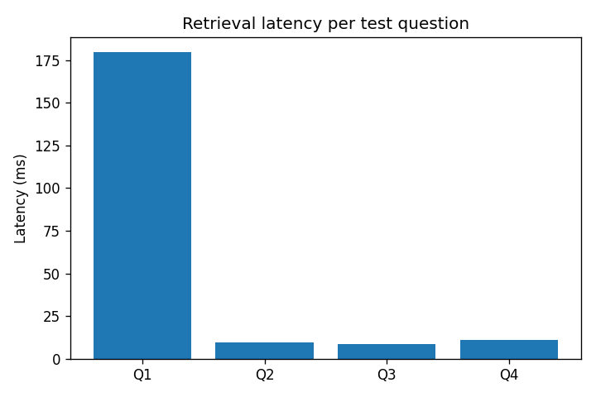
Testing & Evaluation
Question | Result | Top Score | Top Match
Main components of a RAG pipeline? | MISS | 0.342 | Engineering the RAG Stack
How is retrieval evaluated in QA systems? | HIT | 0.652 | Evaluating Chunking Strategies for RAG
Known failure modes of RAG? | HIT | 0.575 | Creating a Taxonomy for RAG Applications
How does vector search scale to large collections? | HIT | 0.412 | Beyond Benchmarks: Embedding Model Similarity
Actual latency per test question (from project.ipynb run)
3 / 4
52.2 ms
relevance coverage
(top match ≥ 0.35 threshold)
average retrieval latency
per question (M1 GPU)
RAG-Powered Search Engine — Capstone Project
8

Slide 9
Deployment — FastAPI
Why FastAPI over Streamlit
Production-grade async API, not a notebook-with-buttons
Mirrors how GCP Cloud Run / Cloud Functions gen2 are structured
Auto-generated Swagger docs at /docs for easy testing
Typed request/response models via Pydantic
🔎 RAG-Powered Search Engine
Ask a question about RAG research papers.
What are common chunking strategies for RAG?
Ask
Endpoints
Fixed-size & recursive chunking are simple baselines. Cluster-based semantic chunking did not outperform them here...
— Sources: 5 papers cited, top score 0.399
GET | /health | liveness + config check
POST | /ingest | pull fresh papers from arXiv
POST | /build-index | (re)build the FAISS index
POST | /query | ask a question, get a cited answer
RAG-Powered Search Engine — Capstone Project
9

Slide 10
Challenges Encountered & Fixes
Challenge | Fix Applied
Python 3.13 default on macOS has no faiss-cpu wheel | Pinned venv to Python 3.12 via uv venv --python 3.12
arXiv query OR-matched individual words, returning off-topic papers | Phrase-quoted the query + switched sort to relevance
arXiv tightened rate limits in 2026 (429 errors) | Slower request pacing + automatic retry/backoff
.env values weren't reaching the FastAPI process | Added load_dotenv() at app startup + /health key-check
gemini-1.5-flash model was retired (404 error) | Switched to gemini-flash-latest (auto-updating alias) + GEMINI_MODEL override
A stalled Gemini call could hang a request indefinitely | Added a hard 20s timeout with automatic extractive fallback
RAG-Powered Search Engine — Capstone Project
10

Slide 11
Future Improvements
1
2
3
Scale to GCP
Full-text ingestion
Hybrid search
Swap FAISS → Vertex AI Vector Search, embeddings → Vertex text-embedding-004, for a fully managed production deployment.
Ingest full paper PDFs via GCS + a PDF-parsing Cloud Function, not just abstracts.
Add BM25 keyword search alongside dense vectors to catch exact-term queries (model names, acronyms).
4
5
6
Feedback loop
Cloud Run deployment
Chunking evaluation
Log thumbs-up/down per answer to BigQuery to measure real answer quality over time.
Containerize app.py and deploy to Cloud Run for a managed, autoscaling API endpoint.
Systematically compare fixed-size vs. semantic chunking on this corpus, following the pattern in 'Evaluating Chunking Strategies for RAG'.
RAG-Powered Search Engine — Capstone Project
11

Slide 12
Skills Demonstrated
End-to-end data pipeline design (ingest → transform → index → serve)
GenAI integration: embeddings, vector search, LLM-grounded generation
GCP-aligned architecture with a documented production swap-in path
Production API design with FastAPI, timeouts, and graceful fallbacks
Local GPU optimization (Apple MPS) under real hardware constraints
Debugging live third-party API changes (model deprecations, rate limits)
Thank you

