Slide 1
British Airways – Predicting Customer Booking Behavior

Slide 2
Project Objective
Build a machine learning model to predict if a customer will complete a booking, based on their search and trip details.

Slide 3
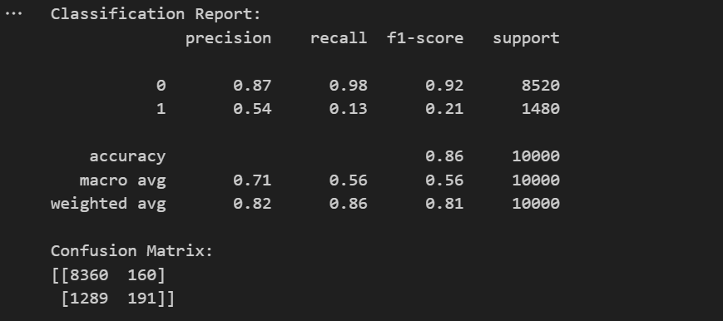
Model Summary
Model Used: Random Forest Classifier
Target Variable: booking_complete (1 = booked, 0 = not booked)
Train-Test Split: 80% train / 20% test
Performance (replace with your actual results):
Accuracy: 86%
Precision: 54%
Recall: 13%
F1-Score: 21%

Slide 4
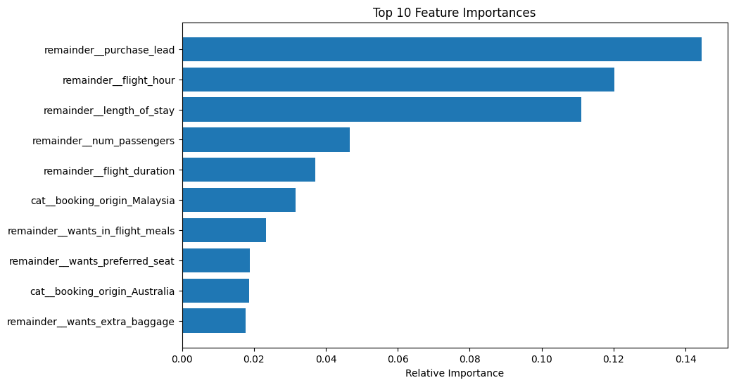
Top 10 Influential Features

Slide 5
Key Insights
Early planners (remainder purchase_lead) are more likely to complete booking.
Shorter trips and specific destinations correlate with higher conversion.
Group travelers (more num_passengers) tend to book more reliably.

Slide 6
Approach
Cleaned and encoded categorical variables (OneHotEncoding)
Used RandomForestClassifier with pipeline
Evaluated with classification report and confusion matrix
Recommendation
Target high-likelihood customers with personalized offers
Improve booking conversions through smart segmentation

