Slide 1




Project Overview: NeuroFleetX – AI-Driven Urban Mobility Optimization System
AI-Based System
Comprehensive Features
Internship Project
Fleet and traffic optimization using intelligent routing algorithms and predictive analytics
Routing, real-time tracking, maintenance scheduling, and booking management in unified platform
Built during Infosys Springboard program with mentorship and agile development practices

Slide 2
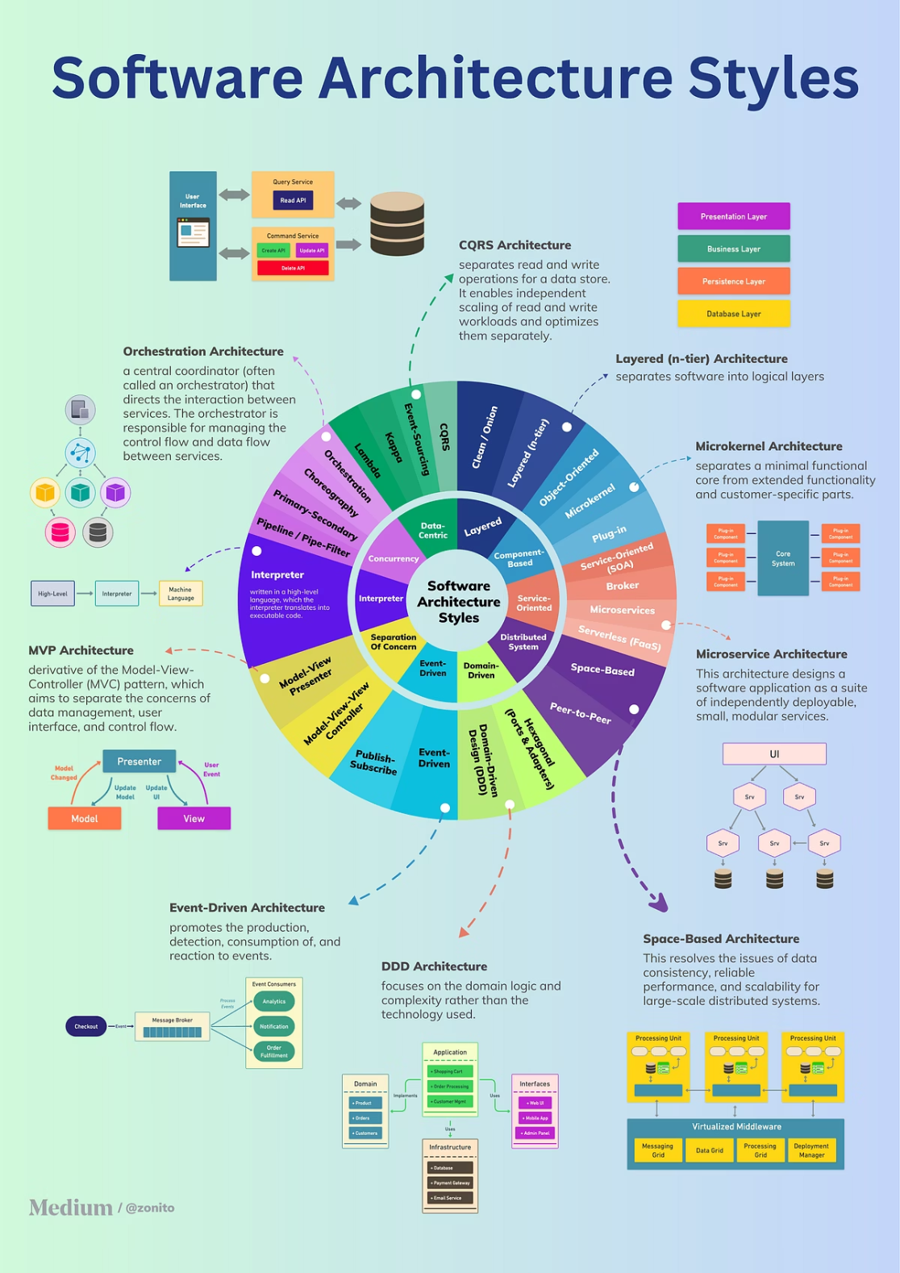




System Architecture
Frontend Layer
React dashboards with responsive UI components and real-time data visualization
Backend APIs
Spring Boot services handling business logic, authentication, and data processing
Data Storage
MySQL relational database for fleet data, routes, bookings, and maintenance records
AI Engine
Intelligent algorithms for route optimization, traffic prediction, and maintenance alerts

Slide 3
Modules Implemented
Core System Components
1
2
3
Authentication & Role Management
Fleet Management System
Route Optimization Module
Vehicle tracking, status monitoring, and fleet composition management with real-time GPS data integration
Secure user authentication with role-based access control for drivers, fleet managers, and administrators
Dynamic path calculation using shortest path algorithms with traffic-aware routing logic

Slide 4



Modules
Predictive Maintenance
Booking & Scheduling
Admin Dashboard
Automated maintenance scheduling based on vehicle usage data, mileage thresholds, and component wear patterns
Reservation system with time slot management, vehicle availability checks, and booking confirmation workflows
Comprehensive analytics interface with KPI tracking, fleet performance metrics, and operational insights

Slide 5
Key Features Developed
01
02
03
Real-Time Vehicle Tracking
Dynamic Route Calculation
Maintenance Alert System
Simulated vehicle tracking is implemented using GPS data.
Locations are updated dynamically to mimic real-time movement on maps.
Vehicle status indicators (active, idle, maintenance) are shown for monitoring.
Intelligent pathfinding that adjusts routes based on traffic conditions and vehicle availability
Automated notifications triggered by usage thresholds and predictive analytics
04
05
Dashboard Analytics
Booking Interface
Visualizations of fleet utilization, route efficiency, and maintenance schedules
User-friendly reservation portal with calendar integration and booking confirmation

Slide 6
AI & Algorithmic Logic
Dijkstra Algorithm
Traffic-Aware Routing
Predictive Maintenance
Smart Recommendations
Implemented shortest path calculation for optimal route finding between multiple waypoints with weighted edges
Dynamic adjustment of route weights based on simulated traffic conditions and historical congestion patterns
Data-driven threshold analysis for component wear, mileage-based scheduling, and usage pattern detection
Intelligent suggestions for fleet allocation, maintenance timing, and route preferences based on learning models

Slide 7
System Workflow
The system works in a continuous flow, starting from vehicle data inputs and ending with dashboard outputs
Simulated GPS, vehicle status, and sensor data are collected to mimic real-time conditions
This data is transmitted to the backend through API requests for further processing
The backend processes, validates, and securely stores the data in the MySQL database
AI logic is applied to optimize routes and predict maintenance requirements
Based on analysis, optimal routes and alert notifications are generated
Finally, the processed information is displayed on the dashboard as maps, analytics, and vehicle status

Slide 8





Challenges Faced
Module Integration
Data
API Communication
Coordinating frontend React components with Spring Boot backend services and AI algorithm integration required careful interface design
Used dummy data to simulate real-time vehicle tracking
Managed multiple vehicle updates in parallel
Maintained consistent data flow in the system
Debugged asynchronous API calls between frontend and backend
Handled error responses and improved reliability
Ensured smooth data transmission across system components
Security Issues
System Scalability
Implementing robust authentication middleware and role-based access control without compromising system performance
Designing database schemas and API structures that can accommodate growing fleet sizes and increasing data volume

Slide 9





Key Learnings
API Integration & Testing
Full-Stack Development
Practical skills in RESTful API design, endpoint testing with Postman, and debugging cross-module communication
Hands-on experience building complete applications from React frontend through Spring Boot backend to MySQL persistence
2
1
Database Design
Relational database modeling, schema optimization, query performance tuning, and data integrity constraints
3
Agile Collaboration
5
Daily standups, sprint planning, and version control workflows that mirror professional software development practices
AI Implementation
4
Applied algorithmic thinking to real-world problems, balancing computational efficiency with accuracy requirements

Slide 10




Outcome & Future Scope
Working Prototype
Successfully developed functional system with all core modules integrated and tested end-to-end
Technical Mastery
Deepened understanding of smart mobility systems architecture and real-time fleet management challenges
Future Enhancements
IoT sensor integration for real vehicle telemetry, live traffic API connections, machine learning models for predictive analytics
Mobile Application
Cross-platform mobile app for drivers and passengers with push notifications and location-based services

Slide 11
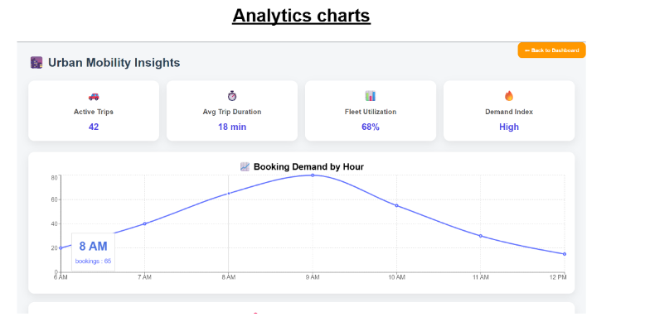
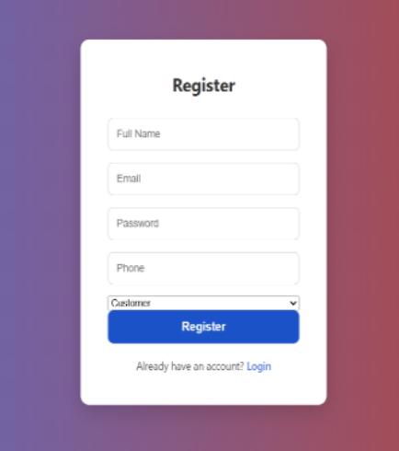
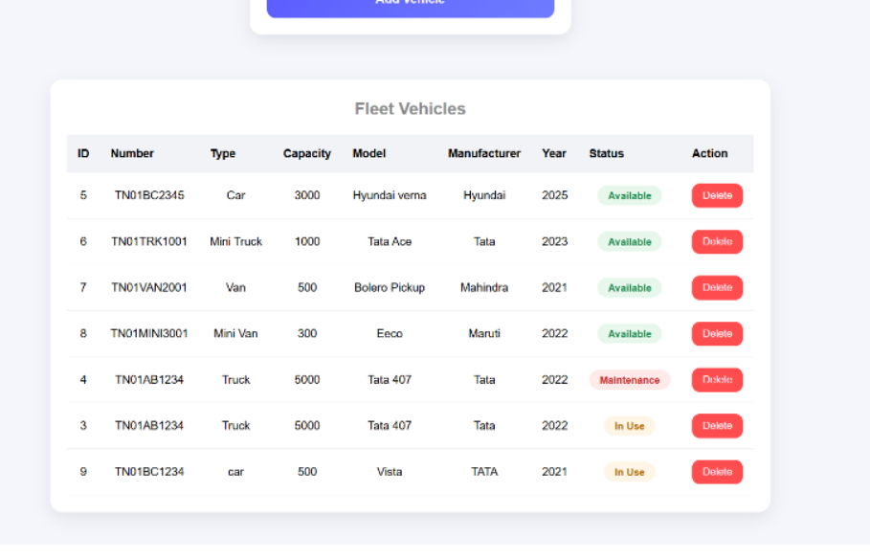
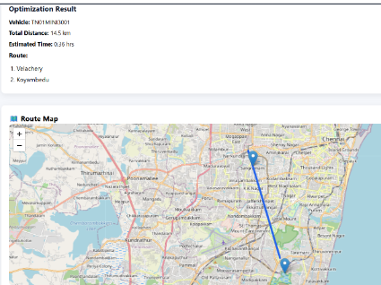
System Implementation Screens

