Slide 1
Ontology for Laptops
(with Reasoner and DL querier)
Sneha Oram, IIT Bombay
08th May 2026

Slide 2
Problem Statement
To create ontology for a product (laptop) and integrate a Reasoner to check the consistency of the ontology. Subsequently, use of DL queries for inferencing.

Slide 3
Ontology design
The idea is to create a hierarchy of classes for specifications of laptops such as display (screen), memory (RAM), operating system (OS), processor (CPU), storage (hard drive/SSD).

Slide 4
Experiment setup
Platforms: Desktop Protégé (Version: 5.6.9) / Web Protégé (by (BMIR) at Stanford University)
Desktop Protégé Plugins:
DL Query (Version: 4.0.1)
HermiT Reasoner (Version: 1.4.3)

Slide 5
Terminologies in Ontology
- IRI (Internationalized Resource Identifier): A unique identifier used to represent ontology elements (ontology and entities) on the web.
- Active ontology: The ontology currently loaded and being edited or analyzed.
- Entities: The main components used to define knowledge in an ontology.
Class: Represents a category or group of similar objects or concepts.
Object Properties: Define relationships between two individuals or entities.
Data Properties: Define relationships between individuals and data values.
Individuals: Specific instances or examples of a class.

Slide 6
Entities: Classes
Following classes are created for developing ontology for laptops. The class hierarchy is presented on the right.
Device
Computers
Laptops
All classes are subclass of owl:Thing (superclass of all classes)
Components
Processor (CPU)
Memory (RAM)
Storage (Hard Drive/SSD)
Display (Screen)
OperatingSystem (OS)

Slide 7
Entities: Object Properties (Relationships)
This links the Laptops to their components
Component
hasComponent (Domain: Device, Range: Component)
hasDisplay (Sub-property of hasComponent)
hasMemory
hasOS
hasProcessor
hasStorage
All object properties are subclass of the owl:topObjectProperty

Slide 8
Entities: Data Properties (Attributes)
These hold the literal values (numbers, strings) for the specifications
modelName (Range: string)
osName (Range: string)
processorName (Range: string)
ramSizeGB (Range: integer)
storageCapacityGB (Range: integer)
screenSizeInches (Range: float/decimal)
All data properties are subclass of the owl:topDataProperty

Slide 9
Entities: Individuals (The Laptops) [1/5]
This is to create instances for the specific hardware components first, then the laptops themselves. Following are the component individuals that are created with the details of the data properties assigned:
Instance: Intel_Core_i5_1135G7 (Class: Processor)
processorName: Intel Core i5-1135G7
Instance: Apple_M2_Chip (Class: Processor)
processorName: Apple M2 (8-core CPU)
Instance: Dell_RAM_16GB (Class: Memory)
ramSizeGB: 16

Slide 10
Entities: Individuals (The Laptops) [2/5]
Instance: Apple_Unified_Memory_16GB (Class: Memory)
ramSizeGB: 16
Instance: Dell_Screen_15.6 (Class: Display)
screenSizeInches: 15.6
Instance: Mac_Liquid_Retina_13.6 (Class: Display)
screenSizeInches: 13.6
Instance: Windows_11_Pro (Class: OperatingSystem)
osName: Windows 11 Pro

Slide 11
Entities: Individuals (The Laptops) [3/5]
Instance: macOS_Monterey (Class: OperatingSystem)
osName: macOS Monterey

Slide 12
Entities: Individuals (The Laptops) [4/5]
Next, Laptop Individuals are created. Main Laptop instances are created first, and then linked to the components using object properties. Below are the details of Dell Inspiron 15 3000
Individual: Dell_Inspiron_15_3000
Class: Laptop
Data Property Assertions:
modelName: Dell Inspiron 15 3000
Object Property Assertions
hasProcessor -> Intel_Core_i5_1135G7
hasMemory -> Dell_RAM_16GB
hasDisplay -> Dell_Screen_15.6
hasOS -> Windows_11_Pro

Slide 13
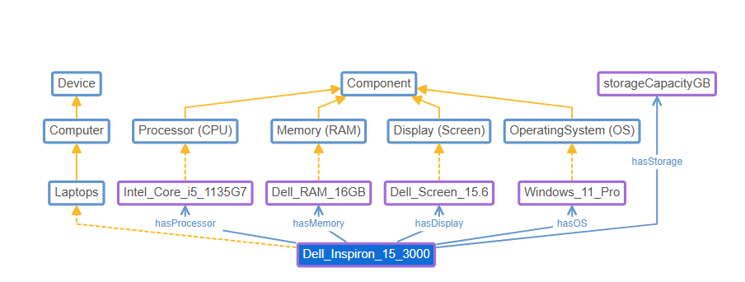
Individual: Dell Inspiron 15 3000

Slide 14
Entities: Individuals (The Laptops) [5/5]
Below are the details of MacBook Air M2
Individual: MacBook_Air_M2
Class: Laptop
Data Property Assertions:
modelName: MacBook Air M2
Object Property Assertions
hasProcessor -> Apple_M2_Chip
hasMemory -> Apple_Unified_Memory_16GB
hasDisplay -> Mac_Liquid_Retina_13.6
hasOS -> macOS_Monterey

Slide 15
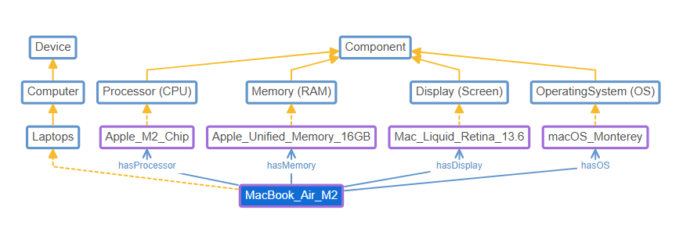
Individual: MacBook Air M2

Slide 16
HermiT Reasoner
Reasoner (HermiT (selected by default))
Start Reasoner: This starts verifying the individuals with respect to their relationships and data properties. In case of any error, the reasoner presents an option ‘Explain’, where the inconsistencies with constraints or logic definition are pointed.

Slide 17
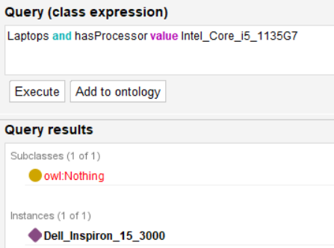
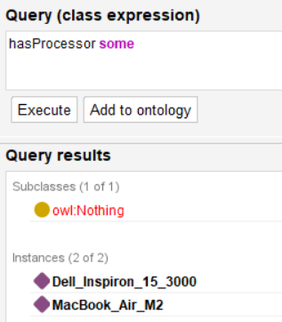
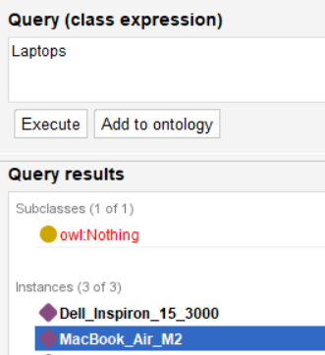
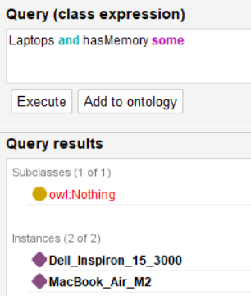
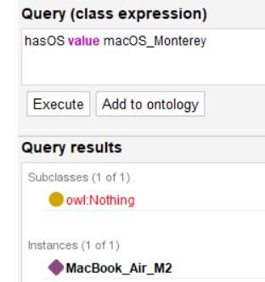
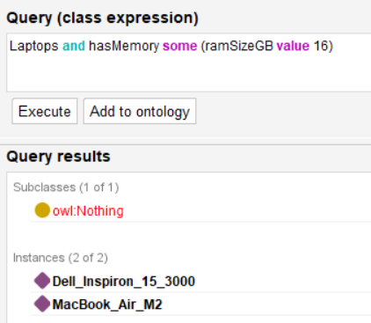
DL queries
Example queries and results

Slide 18
Notes
This experiment is conducted on simple ontology for laptops.
In future, the ontology will be expanded with other specifications. Further, constraints and logics to be validated by the Reasoner.

Slide 19
Thank You

