Slide 1

Technology innovation for competitive advantage
CS782 – IT STRATEGY & MANAGEMENT
ASSIGNMENT 6
SNEHA PUTTAMARAIAH
BOSTON UNIVERSITY
psneha@bu.edu

Slide 2
TABLE OF CONTENTS
Topics | Page no.
ORGANIZATIONAL BACKGROUND | 4-5
TECHNOLOGY DESCRIPTION | 6-7
USES AND BENEFITS | 8-9
TECHNOLOGY ANALYSIS | 10-12
OPERATIONAL AND COMPETITIVE RISKS | 13
ADOPTION ANALYSIS SUMMARY | 14-15
REFERENCES | 16-17

Slide 3

Table of figures
Figures | Page no.
Figure 1: About Etsy | 4
Figure 2: Etsy Business Model | 6
Figure 3: Revenue Generated By Social Media | 7
Figure 4: Technology Hype Curve | 10
Figure 5: Example of Four Areas of Social Media Disruptors | 11
Figure 6-1: Estimates Based on Essential Development Stages | 15
Figure 6-2: Estimates Based on The Region Where The Software Will Be Developed | 15

Slide 4
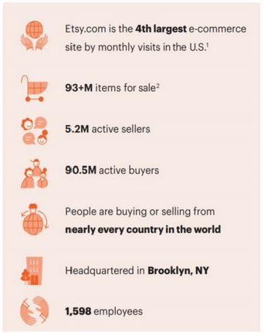
ORGANIZATIONAL BACKGROUND
Etsy, Inc. is a product-based e-commerce company providing handcrafted products in categories like jewelry, toys, art & collectibles, apparel, and much more.
Etsy marketplaces:
Etsy.com
Depop.com
Reverb.com
Elo7.com.br
Figure 1: About Etsy
Notes:
Etsy, Inc. (Etsy) profits from competitive advantages generated by a dual-purpose system, implying sellers and shoppers draw one another to the program. Etsy, Inc. is a publicly traded e-commerce company founded in 2005 and has its headquarters in Brooklyn, New York. The company’s primary marketplace is Etsy.com which is a universal market for rare and creative products tying artists and entrepreneurs with considerate customers. According to Etsy’s fact sheet, the company incorporates three more marketplaces: Reverb, Depop, and Elo7. Reverb is a marketplace for musical instruments, Depop is a marketplace that comprises reselling fashion items, and Elo7 is a marketplace based in Brazil for hand-crafted products.
According to Statista.com’s report on Apr 2021, Etsy ranks 4 among the most visited online marketplace. 1st being Amazon followed by eBay and Walmart.
According to WiredDelta, Etsy used artificial intelligence (AI) technology and machine learning to allow shoppers to navigate easily on the platform and sellers to classify their distinctive products.
The current technology stack is as follows:
Customer relationship management (CRM) system: Zendesk
Server-side programming language: PHP
Client-side: JavaScript, Flash
Markup language: HTML5

Slide 5
ORGANIZATIONAL BACKGROUND – continued
OPPORTUNITIES:
Market expansion
Globalization
Brick-and-mortar presence
SWOT ANALYSIS
STRENGHTS:
Niche market
Accurate search results Product visibility
WEAKNESSES:
High costs
Foreign exchange fees
THREATS:
Low entry barrier
Possible damage to reputation
Notes:
SWOT ANALYSIS
Strengths:
Etsy competes with a focus on a niche market that emphasizes mainly on specialty products. This makes its marketplace the no.1 destination for consumers looking for unusual, exclusive goods. Improved search results are a high-tech triumph for Etsy, and more and more a financial victory too. Etsy caters to lesser traffic compared to Amazon, thereby increases the visibility of products.
Weaknesses:
Etsy charges per listing and takes a percentage of profit the seller makes when an item is sold. There are transaction processing charges as well. If sellers feel they are not making enough profit, they may shift to competitors that offer better services.
The sellers and buyers are from across the world, so a buyer from a country with weak currency is at a disadvantage and may drift away from using the platform.
Opportunities:
Etsy can add new line of products or business; for example, build its own social media platform or a streaming service that focuses creating videos on home improvement, online art and craft classes, etc. Etsy can expand its operations internationally which can result in higher sales volume and popularity.
Etsy could open brick-and-mortar stores to draw more customers and gain trust.
Threats:
The threat of new entrants is high as companies like Amazon, eBay, and AliExpress have already entered the industry and are offering similar services provided by Etsy, Inc. Anyone can start an e-commerce business as it does not require much investment. If the competitors offer the same services and goods offered by Etsy in a more efficient and cost-effective way, customers may transition from Etsy to other businesses.
There is no assurance as the shoppers are not guaranteed that they will receiving a product of good quality or if it is authentic.

Slide 6
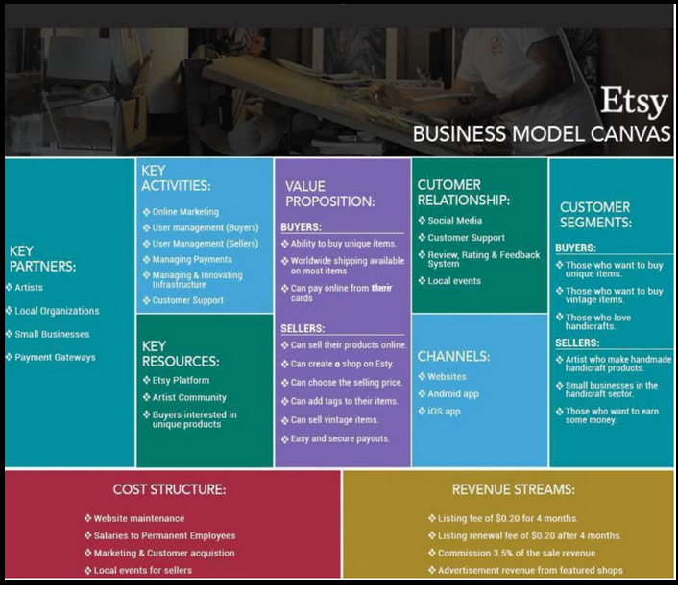
Technology description
Figure 2: Etsy Business Model
Notes:
Business model evolution recap:
Etsy can extend its business by entering a new line of business. The company can still have a niche market within this new line of e-commerce, called EtsyPets, for pet products that are handmade. These products shall be hemmed with a tag to create brand recognition. These products shall be made available for wholesalers, resellers, retailers, and individual customers, so they are sold in bulk quantities. Though the products are handmade, there should be mass standard customization. The firm should have brick-and-mortar stores which will increase the profitability of the business.

Slide 7
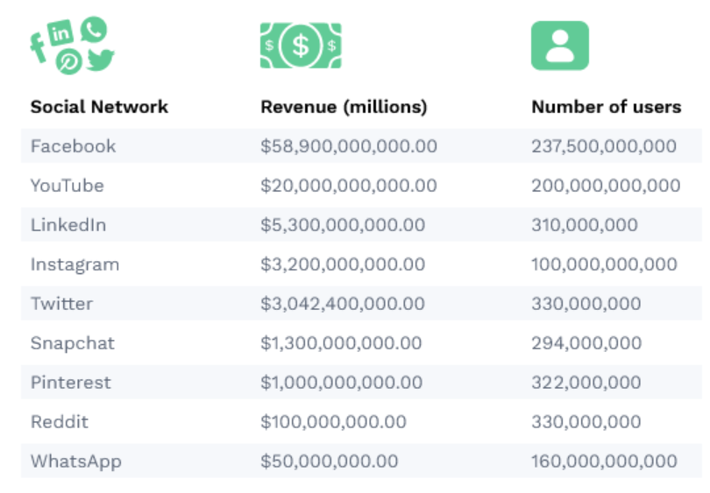
Technology description - continued
EtsyGram, a social media platform that allows users to share photos and short videos.
EtsyGram creates social engagement that can lead to purchase of goods.
NEW ADDITION
Figure 3: Revenue Generated By Social Media
Notes:
New addition:
Etsy shall consider non-e-commerce initiative such as producing a social media platform called EtsyGram, where people can share photos or videos. Although Facebook and Instagram are providing these services, consumers may be willing to migrate due to Facebook’s anti-trust violations. The social media site shall be accessible over the Internet both on desktop and other handheld devices like smartphones and tablets. Etsy shall integrate service-oriented architecture (SOA) to make the site scalable to accommodate growing number of users. SOA ensures the social media site is accessible as a mobile app and/or a mobile site.
According to Ryabenko, once the social media platform is deployed to the market, dynamic activities like trailing quantitative metrics and looking over the important key performance indicators (KPIs) must be constantly implemented.
Benefits of such practices:
Better customer retention
Produces data-driven insights
Enriches product features
Recognizes weaknesses and gaps
Amplifies revenue

Slide 8
Uses and benefits – part 1
OPERATIONAL USES AND BENEFITS
Product recommendations
Product references
Demographical information
Notes:
EtsyGram creates social engagement that can lead to purchase of goods. The following provides some of the uses of the social media platform:
Operational uses and benefits:
Product recommendations:
Upon registering, users will be asked to choose topics of their interest that can be product groups or lifestyle topics. Product categories include bedding, jewelry, craft supplies, etc. and lifestyle topics can be sports, art & culture, career/ business, technology, etc. This data will be used to provide product recommendations and provide an opportunity to coordinate with other users with similar interests.
Product references:
EtsyGram will allow users to add other users and upload photos and short videos. User will tag the products in the image or share links to products in the image. Only the links from Etsy.com are allowed, links from competitors or external sites are prohibited.
Demographical information:
Users have different product and shopping preferences, and these preferences can correlate with shoppers’ demographic attributes such as age, income, gender, and ethnicity. The data collected from demographics will help understand the spending power and the current size of the market.

Slide 9
Uses and benefits – part 2
COMPETITIVE USES AND BENEFITS
Larger audience
Go viral
Creativity
Brand recognition
Increases website revenue
Notes:
Competitive uses and benefits:
Caters to larger audience: According to a study by Pew Research Center, 81% of US adults use YouTube and 69% use Facebook.
Things go viral: Users share posts and short videos which promotes visibility to products by bringing in more shoppers. This also helps cut down costs on advertising. While influencers on Instagram and Facebook can promote any brand and business, influencers on EtsyGram can only promote Etsy products and stores.
Brand recognition: More users are subjected to the brand and develop brand awareness.
Creativity: Etsy boasts handcrafted goods that are not easily available from its competitors like Amazon and eBay.
Website revenue increases: Generates revenue as there will be more traffic entering EtsyGram which will in turn direct the traffic to Etsy website.

Slide 10
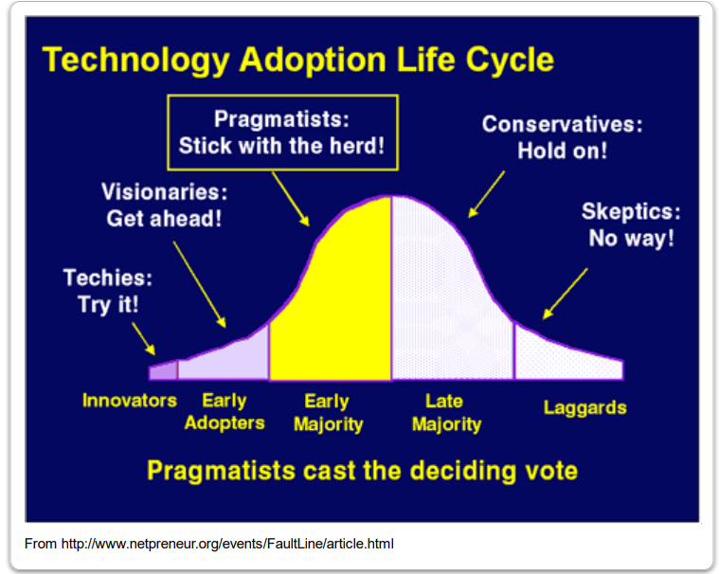
Technology analysis
The adoption of new technology falls into the category of early adopters.
Figure 4: Technology Hype Curve
Notes:
EtsyGram is a photo-based and video-based social networking tool that can provide opportunities to leverage competitive advantages. Everett Rogers' classic theory (Rogers, 2003) divides adopters into five categories, depending on when they choose to adopt.
• Innovators
• Early adopters
• Early majority
• Late majority
• Laggards (Module 6)
Technology maturity
The adoption of new technology falls into the category of early adopters, and the technology is opportunity-driven. Although Facebook has Facebook Marketplace and Instagram has Shops, they do not have an exclusive e-commerce website. The new technology falls between the first two stages on Gartner Hype Curve i.e., technology trigger and peak of inflated expectations. The technology is in early stages, so it is early to recognize all the difficulties involved in deploying the new technology. The technology will require additional testing and evaluation to identify and mitigate any risks.

Slide 11
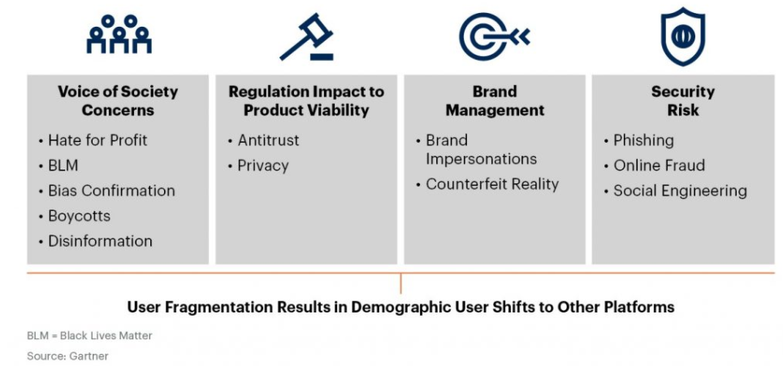
Technology analysis – continued
Figure 5: Example of Four Areas of Social Media Disruptors
Notes:
Technology displacement
The technology will be developed as an independent entity, so it will not displace or disrupt existing technologies within the organization.
Gartner provides the following four disruptors that may threaten the social media strategy:
Voice of Society Concerns – political and socioeconomic measures affecting user approaches that activate changes in the behavior of public and usage of EtsyGram
Regulation Impact to Product Visibility – regulatory, legal, and privacy changes that impact product sustainability in terms of transparency, data usage and product integration with EtsyGram
Brand Management – market developments and risks that impact brand recognition
Security risk – security concerns that originate from EtsyGram that weaken users’ confidence may necessitate inflated remediation and time

Slide 12
Technology analysis – continued
COMPLIANCE RISKS OF A SOCIAL MEDIA PLATFORM
Reputational risk
Legal risk
AVOID RISKS BY ENSURING AN EFFECTIVE SOCIAL MEDIA COMPLIANCE PROGRAM
Train employees to understand what is violating the company’s policies and protect the company’s reputation by taking necessary actions.
Establish a dedicated team that communicates and monitors compliance across departments.
Centralize social media governance.
Notes:
Technology impacts
Having a social media platform to leverage the business can have both positive and negative impacts, so it is important to monitor activities on social media and prevent the spread of deceptive information. Thomson Reuters outlines the following compliance risks of social media:
Reputational risk - The impulsive and possibly viral nature of social media can cause a significant dent on the company’s reputation.
Legal risk – There are wide range of legal implications such as privacy laws, content ownership, intellectual property infringement, etc.
To ensure an effective social media compliance program, Brandle suggests the following steps:
Train employees to understand what is violating the company’s policies and protect the company’s reputation by taking necessary actions.
Establish a dedicated team that communicates and monitors compliance across departments.
Centralize social media governance.
Technology evolution
The technology will continue to evolve and contribute to the company’s growth. An article by Maryville University states, “As social media companies grew their user bases into the hundreds of millions, the business applications of Facebook, Twitter, and other social platforms began to take shape. Social media companies had access to some of the richest trackable user data ever conceived. In addition to placing ads on social media platforms, companies discovered the potential utility of cultivating an active, engaged social media presence. Whereas social media advertising must be paid for, the act of creating and sharing informative or entertaining content on Facebook, Instagram, Twitter, and other platforms is an attempt by brands to grow an audience organically, in other words, without paying for it directly.”

Slide 13
OPERATIONAL AND competitive Risks
Unreliable third-party applications
Scams
Defamations
Competitors
Notes:
Apart from reputational and legal risks, there are other risks to the organization.
Unreliable third-party apps – the most awful lawbreakers for reaping data from the social media platforms. These apps only gather personal information about users and take over their identity or commit crimes in their name. It is important to monitor and authorize what applications have access to EtsyGram.
Scams – false advertisements and misinformation regarding shipping and payments. Influencers and sellers shall not be permitted to ask shoppers to meet them to sell products directly. Etsy payment methods involve PayPal, internet banking, credit card, debit card, Etsy coupons, and Etsy gift cards. Sellers or influencers shall not be allowed to obtain confidential information or request shoppers to make payments using any other methods. Any purchase or transaction should only be made over Etsy.com.
Defamations – it is possible that a particular shop or seller on Etsy gets slandered on EtsyGram. When defamations go viral, it can harm both the seller as well as Etsy.
Competitors – can recruit resources or sellers working on EtsyGram.

Slide 14

ADOPTION ANALYSIS SUMMARY
Start by building a minimum viable product (MVP).
Include basic features
Sign up, sign in, search, likes, comments, etc.
required specialists
Project manager, developers, QA, etc.
Notes:
There are several social media adoption and usage models. Some of them are listed below:
OASIS Model
ACCESS Model
Social Engagement Journey (SEJ) Model
Staged Model of Social Media Adoption (SMSMA) (El-Den, Adhikari, Azam, 2017)
OASIS Model and ACCESS Model fit more accurately with EtsyGram’s adoption strategies that include sustainability, reaching large audience, and analyzing competitor’s online activities.
Cost to build a social media application (Ryabenko, 2021)
The development of the application will start off with building bare minimum features, i.e., minimum viable product (MVP).
Basic features:
Sign up
Sign in
Search
Subscription
Newsfeed
Likes
Content publishing
Comments
Required Specialists:
1 Project Manager
1 UI/UX engineer
1 Backend developers
1 iOS developer
1 Android developer
1 QA engineer

Slide 15
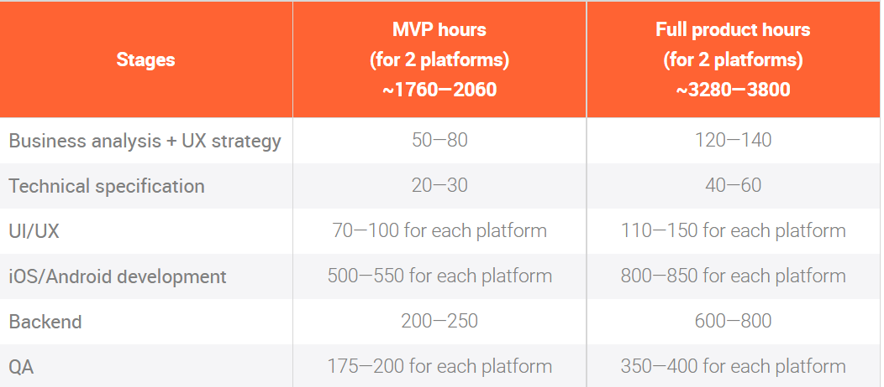
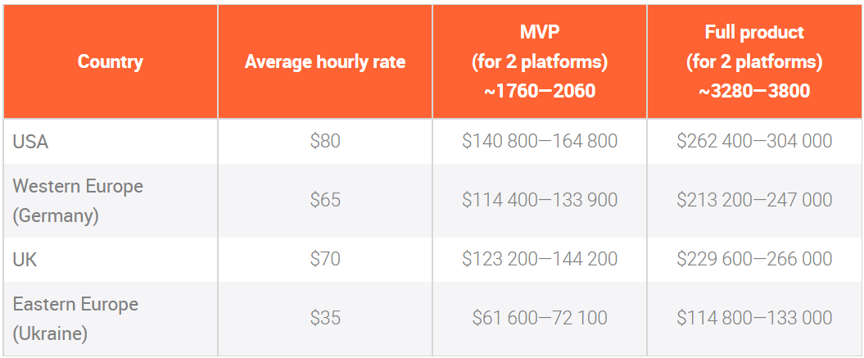
ADOPTION ANALYSIS SUMMARY - continued
Figure 6-1: Estimates Based on Essential Development Stages
Figure 6-2: Estimates Based on The Region Where The Software Will Be Developed
Notes:
The figure above provides estimates for both MVP and full product hours based on most essential application development stages for a social media platform. The 2 platforms in the table refer to Google Play and App Store.
The cost of development also varies based on the country. The developers will require 4 months to build the social media platform and construct the required features. The cost of development varies anywhere from $15,000 to $100,000 for one platform. Maintenance costs are expected to go up to $30,000 per year.

Slide 16
REFERENCES
Auxier, Brooke, and Monica Anderson. “Social Media Use in 2021.” Pew Research Center: Internet, Science & Tech, 7 Apr. 2021, www.pewresearch.org/internet/2021/04/07/social-media-use-in-2021.
Brandle, Inc. “Social Media Compliance | Brandle Inc.” Brandle, www.brandle.net/social-media-compliance. Accessed 17 Oct. 2021.
El-Den, Jamal, et al. “A Model for Social Media Adoption in Social Enterprise: A Comparative Analysis With Existing Models.” Journal of Advanced Management Science, vol. 5, 2017. ResearchGate, doi:10.18178/joams.5.6.467-473Journal.
“The Evolution of Social Media: How Did It Begin and Where Could It Go Next?” Maryville Online, 3 Mar. 2021, online.maryville.edu/blog/evolution-social-media.
“How to Create a Social Media App: Crucial Development Steps.” Aimprosoft, 15 June 2021, www.aimprosoft.com/blog/how-to-make-a-social-media-app.
2020-Integrated-Annual-Report_final.pdf (q4cdn.com)

Slide 17
REFERENCES – CONTINUED
Martin, Sophia. “How Much Does It Cost to Create A Social Media App in 2021.” Medium, 9 Aug. 2021, medium.com/flutter-community/build-a-social-media-mobile-app-its-cost-features-business-model-etc-62718c7d05e4.
Pace, Barika. “The 4 Disruptive Trends Threatening Your Social Media Strategy In 2021.” Barika Pace, 8 Feb. 2021, blogs.gartner.com/barika-pace/the-4-disruptive-trends-threatening-your-social-media-strategy-in-2021.
Thomson Reuters Legal. “The Compliance Risks of Social Media.” Thomson Reuters Legal, Thomson Reuters, legal.thomsonreuters.com/en/insights/articles/compliance-risks-social-media. Accessed 17 Oct. 2021.
“Web Technologies Used by Etsy.Com.” W3techs, w3techs.com/sites/info/etsy.com. Accessed 17 Oct. 2021.
Singh, Tanvir. “Etsy Business & Revenue Model Explained: How Etsy Works & MakesMoney.” JungleWorks, 23 July 2021, jungleworks.com/etsy-business-revenue-model-explained-how-etsy-works-makes-money.
“Module 6 - IT Strategy, Governance, Adoption, and Innovation.” Bu.Edu, Boston University, onlinecampus.bu.edu/bbcswebdav/pid-9311636-dt-content-rid-57724910_1/courses/21fallmetcs782_o1/course/module6/allpages.htm

