Slide 1










H A Ġ K
About Team
Team Name: syntax error
Team Leader’s Name: Sneha parmar
Team Members: samraddhi tomar, sarshti gour, Sanjana ahirwar
SYNAPSE

Slide 2



Problem Description
The Innovation Silo: Students, startups, industry giants, and local communities all have valuable ideas and problems, but they operate in complete isolation.
Resource Deficit: Brilliant ideas die because a student lacks funding, a startup lacks data, an industry lacks fresh talent, and a community lacks a technical platform.
The Execution Void: There is no single, unified marketplace to securely connect a local problem with the exact human knowledge and material resources needed to solve it.
The Innovation Silo: Students, startups, industry giants, and local communities all have valuable ideas and problems, but they operate in complete isolation.
Resource Deficit: Brilliant ideas die because a student lacks funding, a startup lacks data, an industry lacks fresh talent, and a community lacks a technical platform.
The Execution Void: There is no single, unified marketplace to securely connect a local problem with the exact human knowledge and material resources needed to solve it.

Slide 3
Solution
[NexusOpen]
The Quadruple-Helix Network: A decentralized open innovation hub linking four critical pillars: Students, Startups, Industry, and Communities.
Dynamic Resource Pooling: An intelligent platform where ideas are instantly matched with verified execution resources, academic knowledge bases, and corporate infrastructure.
Frictionless Collaboration: Breaking down walls to turn abstract concepts into tangible, deployable, real-world implementations.

Slide 4
Flow of solution
Step 1 (The Post): A community or industry posts a real challenge (e.g., "Our local farm needs an automated crop water-level tracking script").
Step 2 (The Collaboration Assembly): NexusOpen's matching engine pairs the problem with an agile Startup to manage it, a corporate Industry partner to fund the hardware, and enthusiastic Students to code it.
Step 3(The Deployment): The platform serves as a shared, transparent dashboard providing documentation, open-source code repositories, and project tracking to launch a real solution.

Slide 5

Technology Used
Smart Matching Graphs: Utilizing open data relationship mapping to automatically connect resource providers with resource seekers.
Unified Collaboration Dashboards: A cloud-based, modern workspace consolidating live communication tools and task tracking into one screen.
Scalable Web Infrastructure: Built on standard web frameworks optimized for low-bandwidth, secure, and cross-platform access.

Slide 6
Impact & Feasibility
Accelerated Innovation Cycles: Cuts down product development time from months to weeks by crowd-sourcing solutions from ready talent.
Economic & Social Upliftment: Solves real, painful grassroots community problems while simultaneously creating high-impact internships for students.
Low Operational Barrier: Relies entirely on connecting existing assets (unused industry servers, student free-time, startup agility) making it highly cost-effective and feasible.

Slide 7
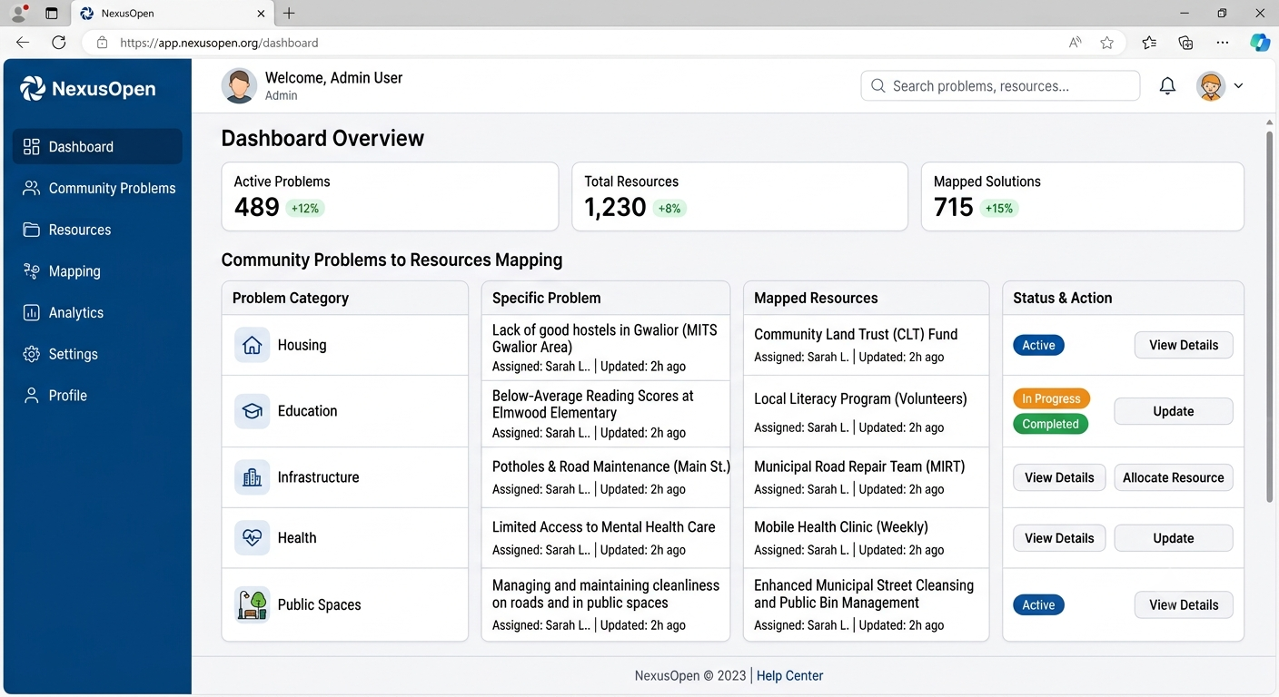
Prototype
Figure 1.0: Conceptual Product UI Mockup for architectural visualization.
Figure 1.0: Conceptual Product UI Mockup for architectural visualization.
Figure 1.0: Conceptual Product UI Mockup for architectural visualization.

Slide 8
Future scope
Cross-Border Innovation Exchanges: Scaling the localized platform to support nationwide public-private partnership challenges.
AI Matchmaking Upgrades: Integrating machine learning algorithms to predict and auto-allocate structural funding based on historical project success rates.

Slide 9
THANK YOU!
NexusOpen: Bridging the Gap Between Ideas & Implementation
Presented by: Team Syntax Error
Email: snehaparmar1309@gmail.com
Github repository : https://github.com/snehaparmar005/NexusOpen
Videopitch:https://drive.google.com/drive/folders/1HI5ucTgWbqde9rW_x_UYRRQ3QNwhaO7N?usp=drive_link

