Slide 1
LockBench
An automotive-radar chirp-PLL loop-filter designer
PVT-robustness verification · machine-learning inverse design
Sneha Prasad 24BEC0391 Shreya M Bharat 24BEC0289
Live: controlbench.onrender.com

Slide 2
THE PROBLEM
The frequency chirp is made by a PLL
Every FMCW automotive radar sweeps a frequency chirp and listens to the echo to measure range and speed.
That chirp is generated by a phase-locked loop (PLL).
The one part an engineer hand-tunes is the PLL loop filter — a resistor and two capacitors.
It sets chirp settling, phase noise and stability — and must hold from −40 °C to +150 °C.
The chirp signal chain
Reference oscillator
Phase detector + charge pump
Loop filter (R, C₁, C₂) ← design
VCO ÷N
×8 multiplier
77 GHz radar transmit

Slide 3
WHAT LOCKBENCH DOES
From requirements to a buildable, qualified design
1
2
3
4
Pick a real chip
Set radar targets
Design + verify
Get the result
LMX2594 · ADF5355 · ADF4351 — datasheet parameters
loop bandwidth, phase margin, temperature grade
synthesise R/C, then check every PVT corner
buildable values + Qualified verdict + charts

Slide 4
THE THEORY
A PLL is a feedback control loop
Phase det.
+ charge pump
Loop filter
Z(s)
VCO
Kvco / s
÷ N feedback
L(s) = [ Icp · Kvco / (2πN) ] · Z(s) / s
The VCO's 1/s plus the filter's pole at the origin make it a Type-II loop, so the loop filter's zero is what recovers phase margin.
This is the linear charge-pump model of Gardner (1980) — the exact math LockBench implements.

Slide 5
THE PROCESS
How a design is produced
1
Build the loop model
2
Synthesise the filter
from the real chip (Icp, Kvco, N) + candidate filter
solve R, C₁, C₂ from bandwidth + phase-margin targets
3
Measure, don't assume
4
Sweep temperature corners
phase margin, chirp settling, jitter peaking from L(s)/H(s)
perturb Kvco/Icp per AEC-Q100 grade; flag any violation
5
Refer to 77 GHz
6
Return the result
×N multiplier: +20·log₁₀N phase noise, jitter invariant
R/C values, verdict, per-corner metrics, plots

Slide 6
NOVELTY
What makes it stand out
Real silicon
Temperature-robust
Anchored on datasheet parameters of shipping synthesizer ICs — not toy numbers.
Proves the design across AEC-Q100 corners, not just at 25 °C. The core contribution.
Honest ML
Full-stack + live
Inverse design that accelerates the physics model and is always re-verified by it.
Control theory + RF/VLSI + ML + web, deployed at one URL on a safety-critical problem.

Slide 7
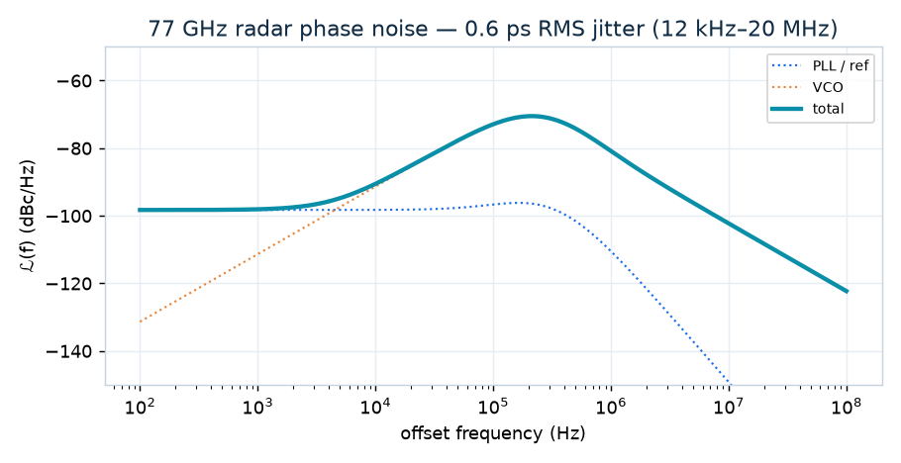
RESULTS
Phase noise & jitter at 77 GHz
77.0 GHz
radar RF
4.4 µs
chirp settling
0.6 ps
RMS jitter
Real ADF/LMX-class 77 GHz radar profile · flat in-band, peaking bump at the loop bandwidth, VCO roll-off outside it.

Slide 8
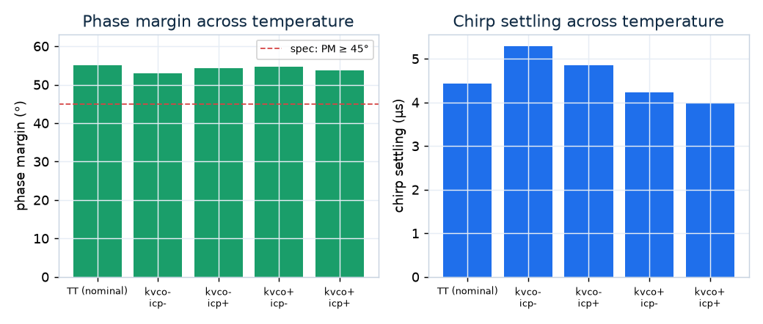
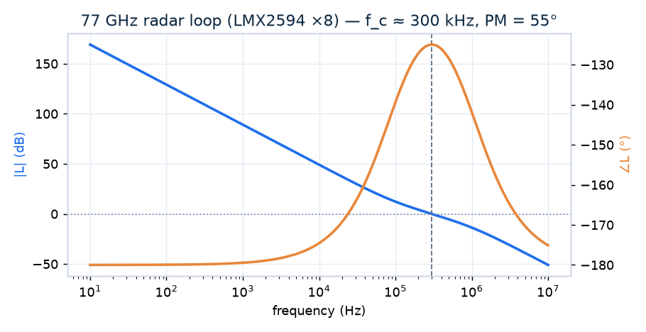
RESULTS
Robust across the automotive temperature range
Phase margin stays above the 45° spec at every corner; the loop-filter zero gives the phase bump at crossover (right).
✓ Qualified across AEC-Q100 Grade 1 (−40 to +125 °C)

Slide 9
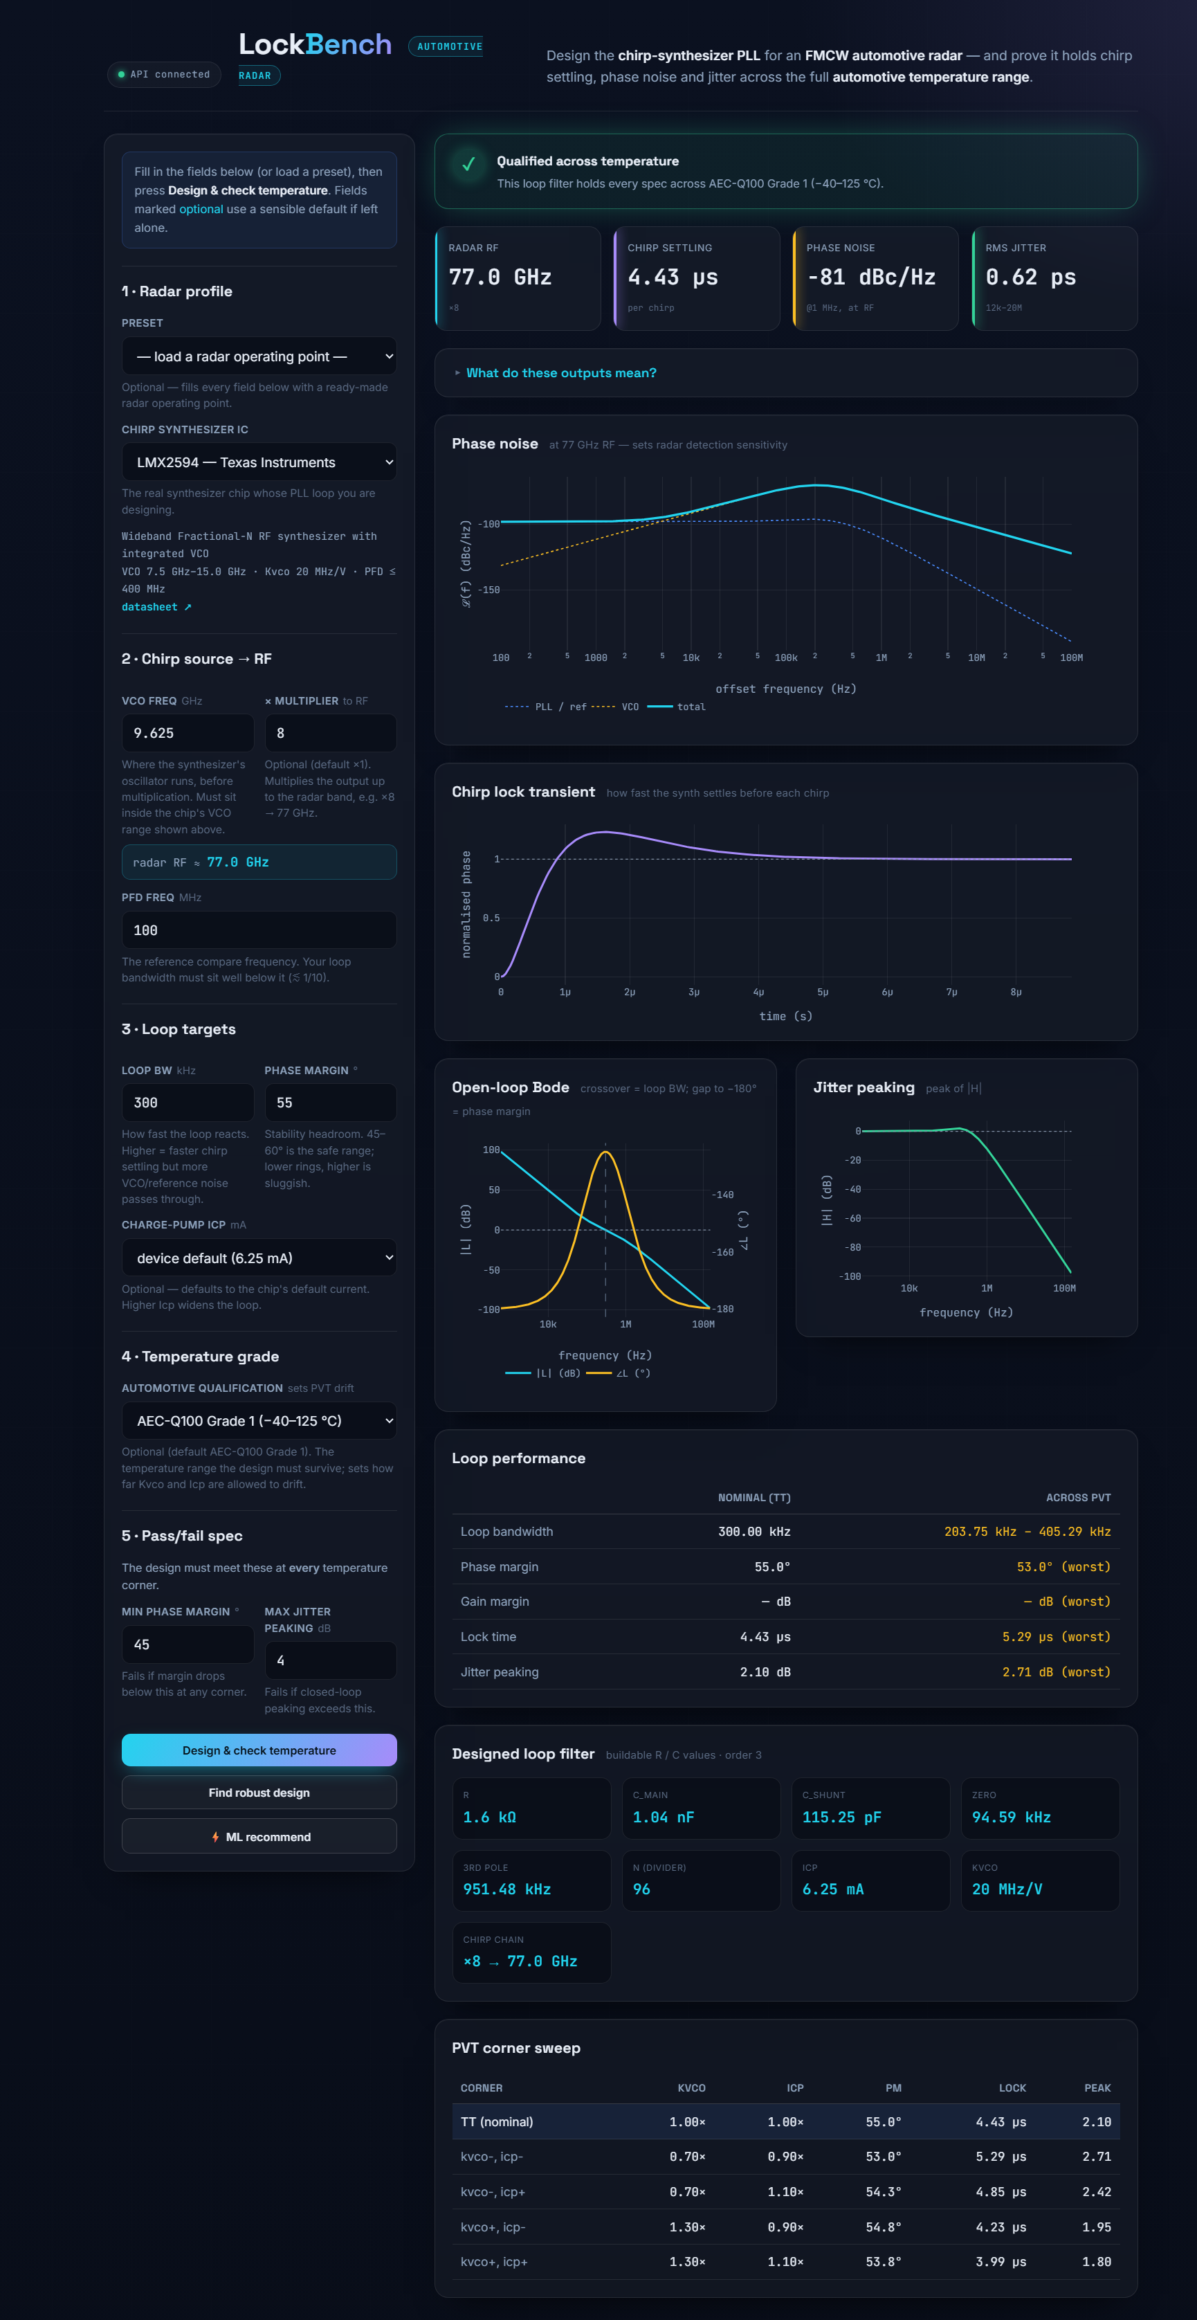
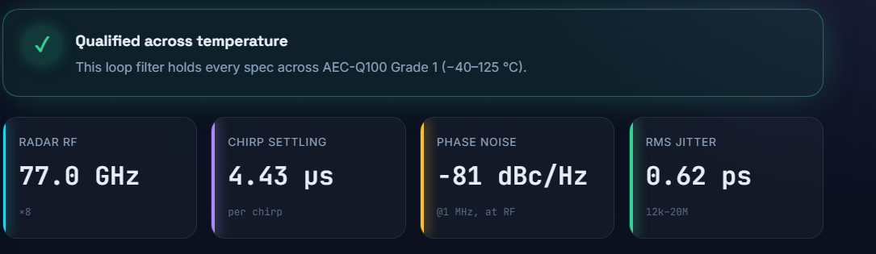
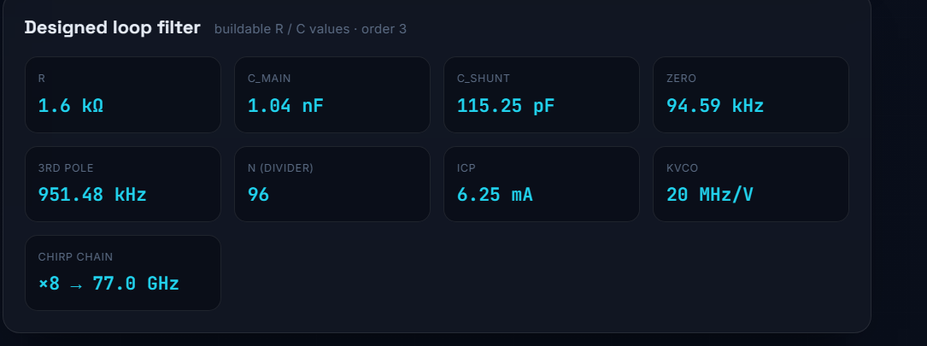
DEMO
The live web application
Verdict + headline metric tiles
The full app
Buildable loop-filter output (R / C values)

Slide 10
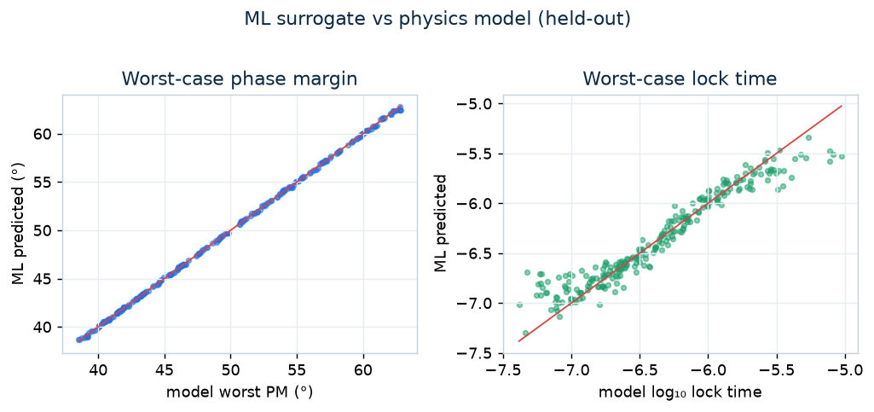
ACCELERATION
Machine-learning inverse design
A random forest predicts a design's worst-case-across-PVT performance instantly.
So it scans hundreds of designs in milliseconds and recommends the best one from your spec.
It reproduces the physics model closely (left: phase margin; right: lock time) — and 'Apply' always re-runs the exact engine to verify.

Slide 11
ENGINEERING
How it is built — and its honest scope
Architecture
Scope & limitations
React + Vite frontend (Plotly charts)
FastAPI REST backend
Python engine (NumPy, python-control)
One Docker service on Render, one URL
62 tests, GitHub Actions CI
Linear PLL model (valid for BW ≪ fPFD)
Phase noise / jitter are first-order estimates
Ideal ×N multiplier to 77 GHz
Temp grades → representative Kvco/Icp drift
ML ground truth is the model, not SPICE

Slide 12
Design → prove → deploy.
LockBench turns automotive-radar chirp-PLL loop-filter design into an instant, temperature-qualified, ML-accelerated workflow grounded in real device data.
References [1] F. M. Gardner, “Charge-Pump Phase-Lock Loops,” IEEE Trans. Communications, 1980. [2] “A Low-Phase-Noise 77-GHz FMCW Radar Transmitter with a 12.8-GHz PLL and ×6 Multiplier,” IEEE, 2016.
Sneha Prasad · 24BEC0391 Shreya M Bharat · 24BEC0289

