Slide 1
DriftLess
Automated cloud-side few-shot calibration for EOG gaze estimation
Advanced Cloud Computing · Project Report
Sneha Prasad (24BEC0391)
Anushvi Tiwari (24BEC0310)
Sambhav Mandawewala (24BML0093)
github.com/snehaprasad11/DriftLess · driftless-demo.onrender.com

Slide 2
The Problem: Baseline Drift
EOG reads eye movement as an electrical signal
Electrodes near the eyes sense the voltage as the eye rotates — no camera. Great for hands-free / assistive control.
But the signal drifts
Even with a still eye, the baseline slowly wanders — and it drifts differently for every person, and changes within a session.
The core issue
A model tuned for one person is wrong for the next — so a shared model can’t just work for everyone out of the box.
Prior work fixes this by hand, per-person, offline. No one made it an automatic, live cloud service.

Slide 3
The Data — UM Malta EyeCon EOG
Public research dataset (University of Malta, CBC)
6 real subjects · 256 Hz · horizontal + vertical EOG
300 trials per subject, band-pass filtered
Labels: target gaze angle per saccade + blink flag
We use the cleanest set (zero-centred H+V)
Each trial (4 seconds):
Forward
saccade
Return
saccade
Blink
Real human recordings — replayed, not live hardware.
https://www.um.edu.mt/cbc/ourprojects/eyecon/eogdataset/

Slide 4
Our Approach — in Three Moves
1
Learn once
2
Adapt fast
3
Serve elastically
Train one shared model on several people — it captures what’s common to everyone and is decent for anyone.
For a new user, freeze the shared model and fine-tune a tiny drift adapter on ~10 of their eye movements. Seconds, not hours.
Store each personal model and serve predictions from a stateless service that scales up on load and to zero when idle.
Result: on people the model never saw, calibration cuts gaze error up to 34% in seconds.

Slide 5
The Model — GazeNet
Raw EOG
(2 × 320)
→
1D-CNN
local shapes
→
BiLSTM
over time
→
Drift Adapter
per-user
→
Gaze + Blink
heads
Shared backbone — frozen during calibration
Only this adapts
The CNN spots sharp shapes (saccade steps, blink spikes); the BiLSTM reads how they unfold over time.
The drift adapter is only ~8,400 parameters (6% of the model) — the only per-user part, so calibration is fast and few-shot.

Slide 6
Cloud Architecture
Web client
(EOG stream)
→
API Gateway
front door
→
Inference
fast, scale-to-zero
↓ new user
Redis queue
→
Calibration
worker
→
Model registry
base + per-user
Stateless inference clones and scales to zero. Async calibration runs off a queue, so the gateway never waits. One command: docker compose up.

Slide 7
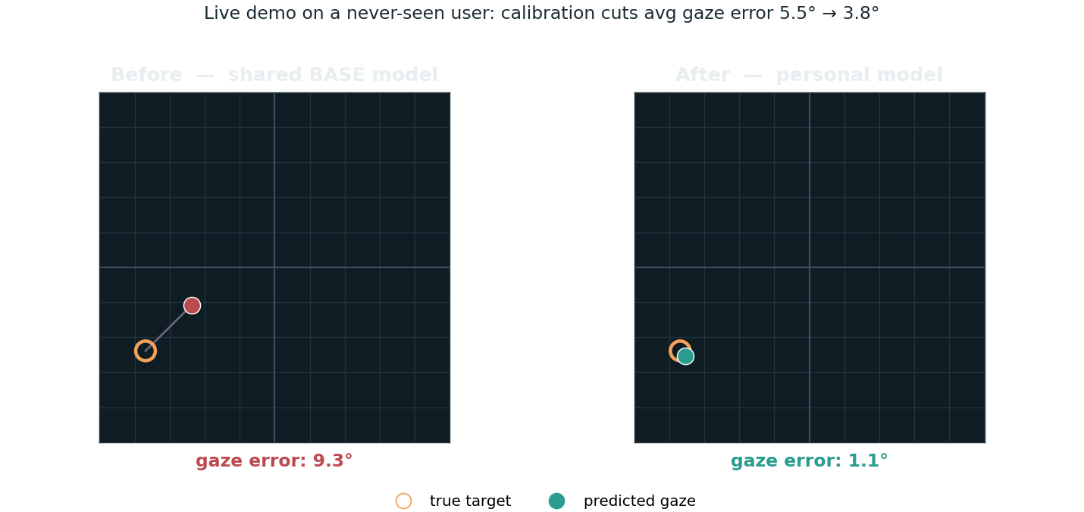
Live Demo — It Personalises in Seconds
Left: shared BASE model on a never-seen user (dot beside target). Right: after ~seconds of calibration, the PERSONAL model — dot on target, avg error 5.5° → 3.8°.
Live at driftless-demo.onrender.com/demo/ · runs locally with docker compose

Slide 8
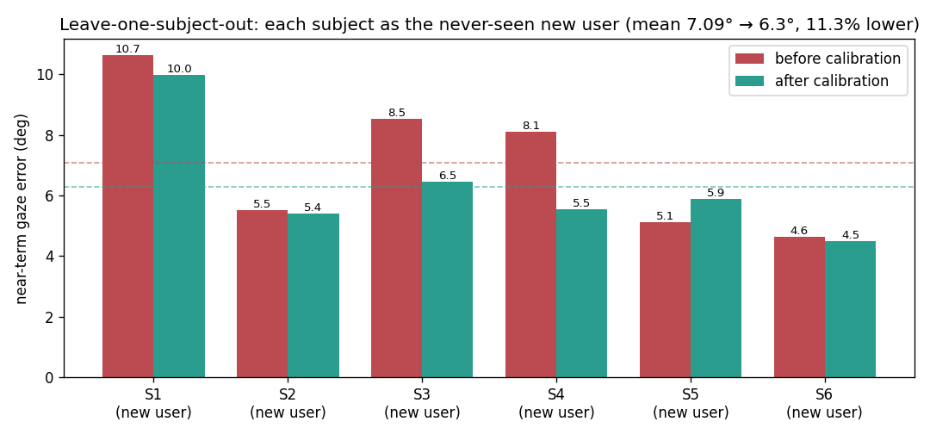
Results — on People the Model Never Trained On
10.18°
−34%
5 / 6
~6 ms
baseline error
(never-seen)
best-case after
calibration
subjects improved
(leave-one-out)
warm prediction
latency
Honest reading
Leave-one-subject-out: every subject is held out and tested — no leakage.
Helps 5 of 6; big wins where drift is real (S3/S4).
Only 6 subjects + time-varying drift make it noisy — our honest limitation.

Slide 9
Deployed, Scalable, Tested
Serverless
Autoscaling
Stateless inference deploys with scale-to-zero (Render / Cloud Run). Live public URL.
Verified on Kubernetes: the worker scaled 1 → 4 pods automatically under load (HPA).
Tested + CI
One command
16 automated tests; GitHub Actions runs tests and builds images on every push.
The whole stack runs locally with docker compose up — gateway, inference, worker, Redis.

Slide 10
Honest Limitations & Future Work
Limitations
Future work
Time-varying drift — a one-time calibration slowly goes stale over a long session.
Only 6 subjects — per-user gains are noisy; not uniform across everyone.
Lab data — chin rest + clean electrodes; a real wearable is noisier.
Periodic / continual re-calibration to track drift as it changes.
Larger subject cohort for a firmer efficacy claim.
Live EOG headset in place of dataset replay.
Federated / on-device personalisation for privacy.

Slide 11
DriftLess
Turns per-person eye-signal drift into an automatic, cloud-hosted service
that tunes itself to any new user in seconds.
Thank you
Sneha Prasad (24BEC0391) · Anushvi Tiwari (24BEC0310) · Sambhav Mandawewala (24BML0093)
github.com/snehaprasad11/DriftLess

