Slide 1
CSN – 291 Project Presentation
Group Number 18

Slide 2
Tools & Technologies Used
Software Used: Android Studio
Programming Languages used: Java
App Compatibility: Android 4.2 (Jelly Bean) or higher
External Libraries used
br.com.simplepass:loading-button-android:1.7.2
com.github.PhilJay:MPAndroidChart:v3.1.0-alpha
com.diegodobelo.expandingview:expanding-view:0.9.4
com.sdsmdg.tastytoast:tastytoast:0.1.0
com.airbnb.android:lottie:2.2.0

Slide 3
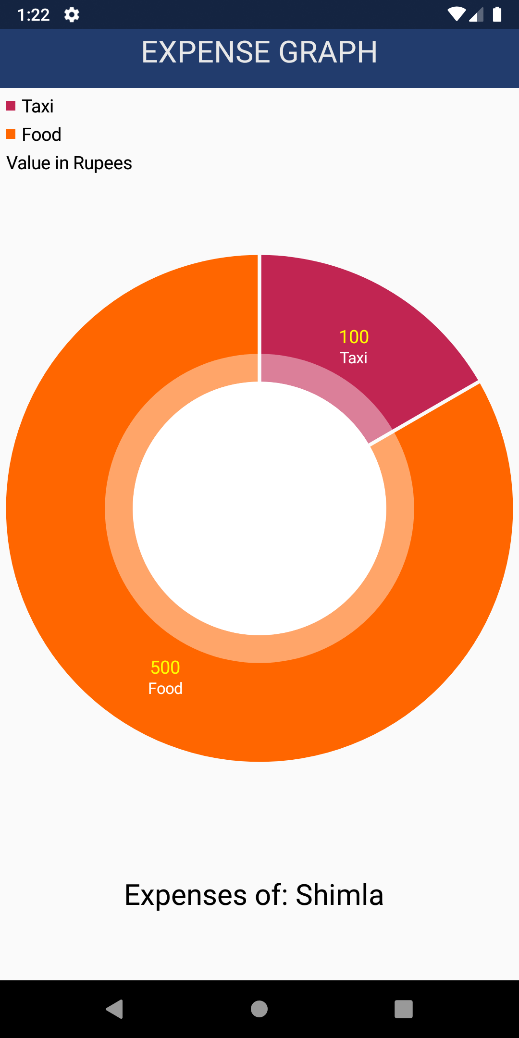
Algorithms Used
By using external library called MPAndroidChart, we can create a Pie chart showing how much was spent on a specific expense type.
Code for creating this pie graph is shown in the next slide. Contributed By Sneha

Slide 4
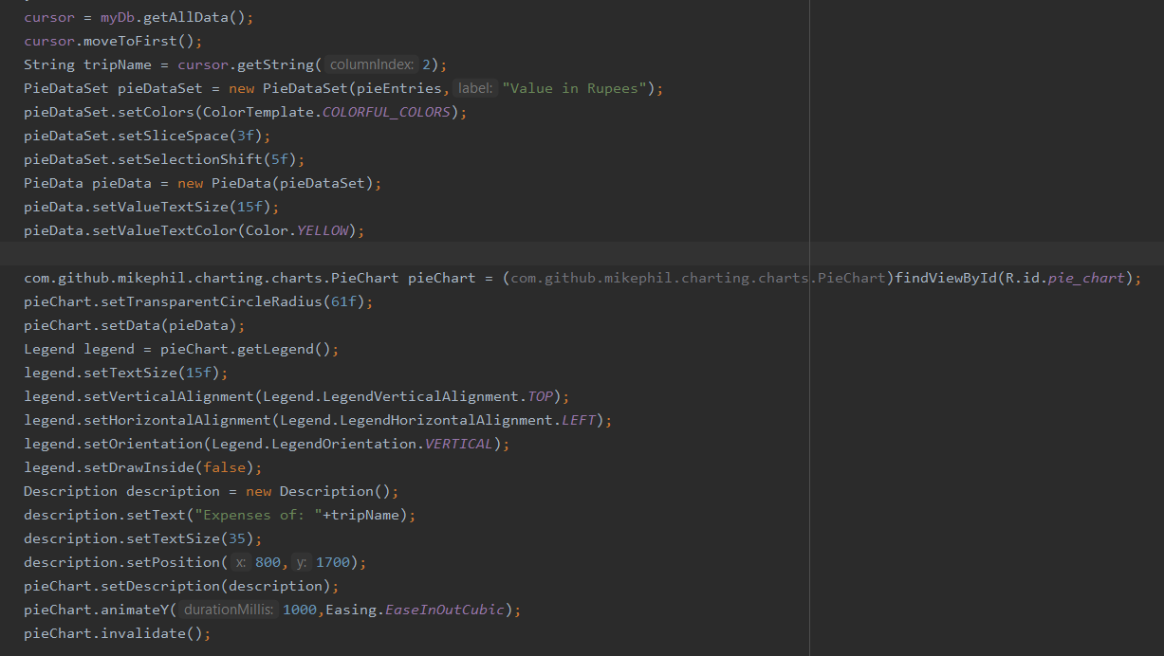
Algorithms Used

Slide 5
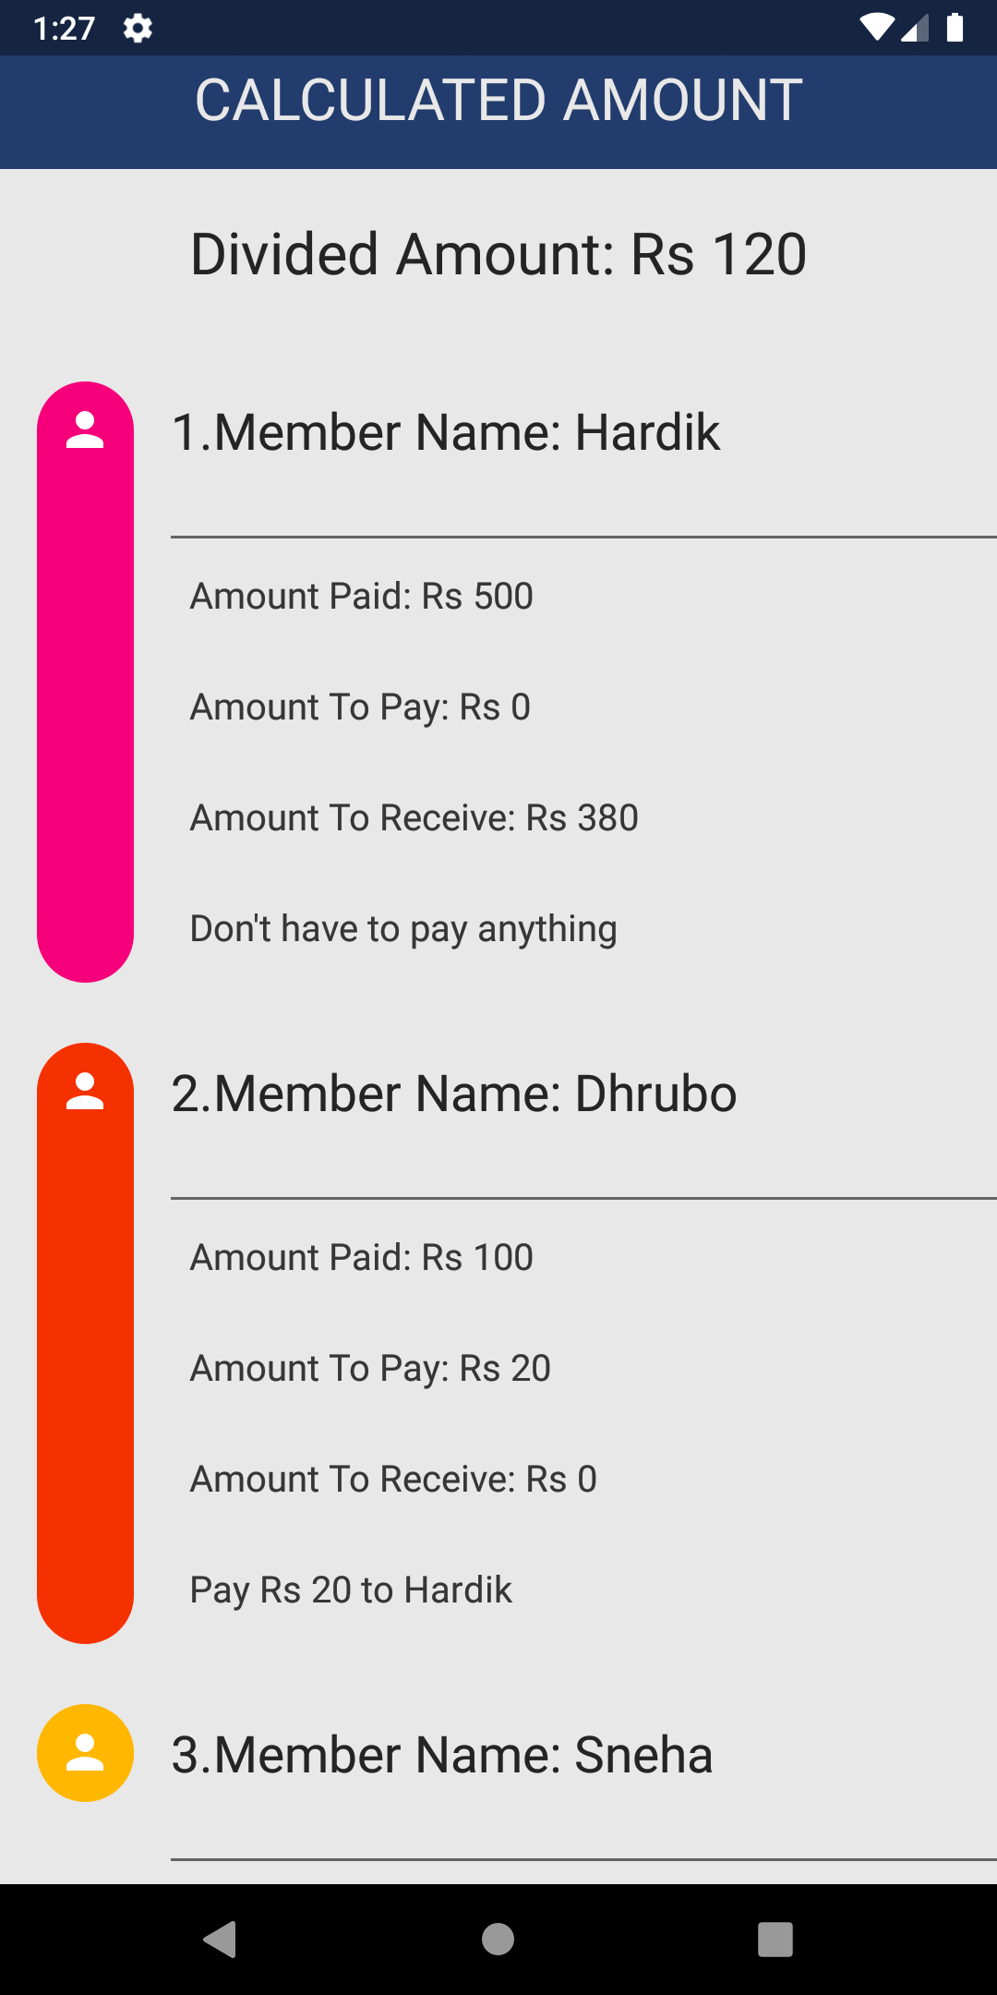
Algorithms Used
This screen shows the how much does a person need to pay to someone, how much are going to receive and how much did they pay in total.
Code for this algorithm is shown in the next slide. Contributed by Hardik

Slide 6
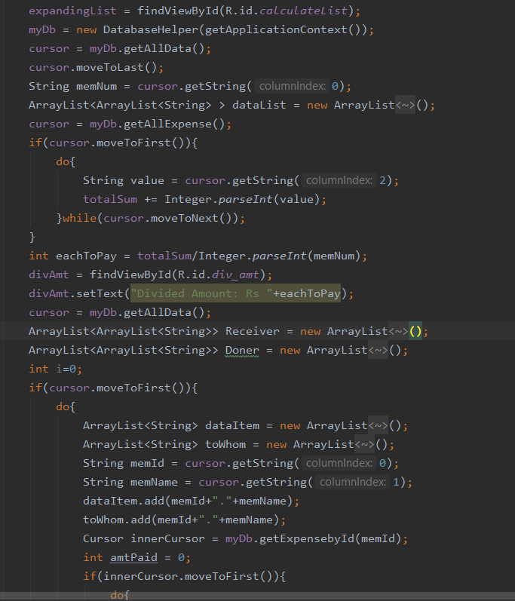
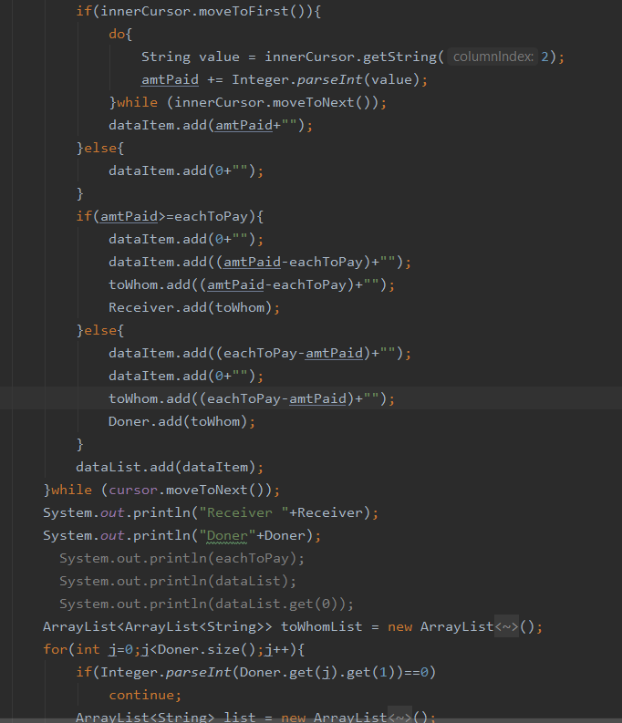
Algorithms Used

Slide 7
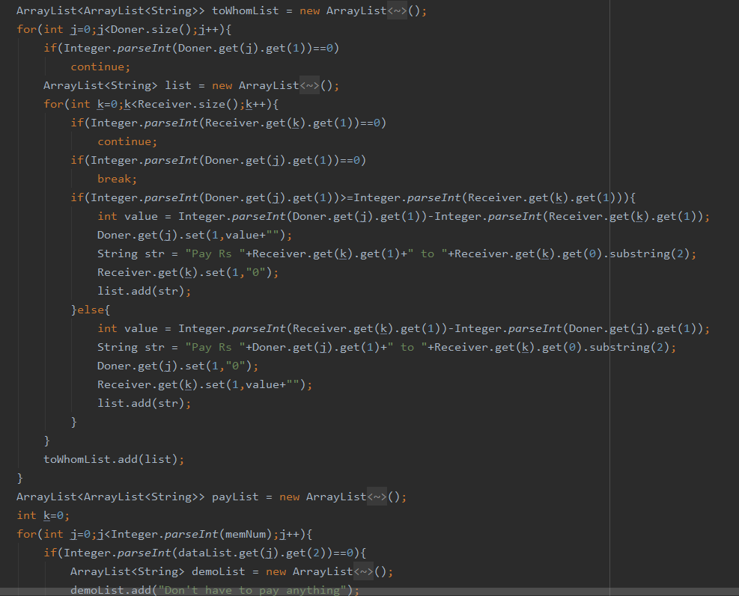
Algorithms Used

Slide 8
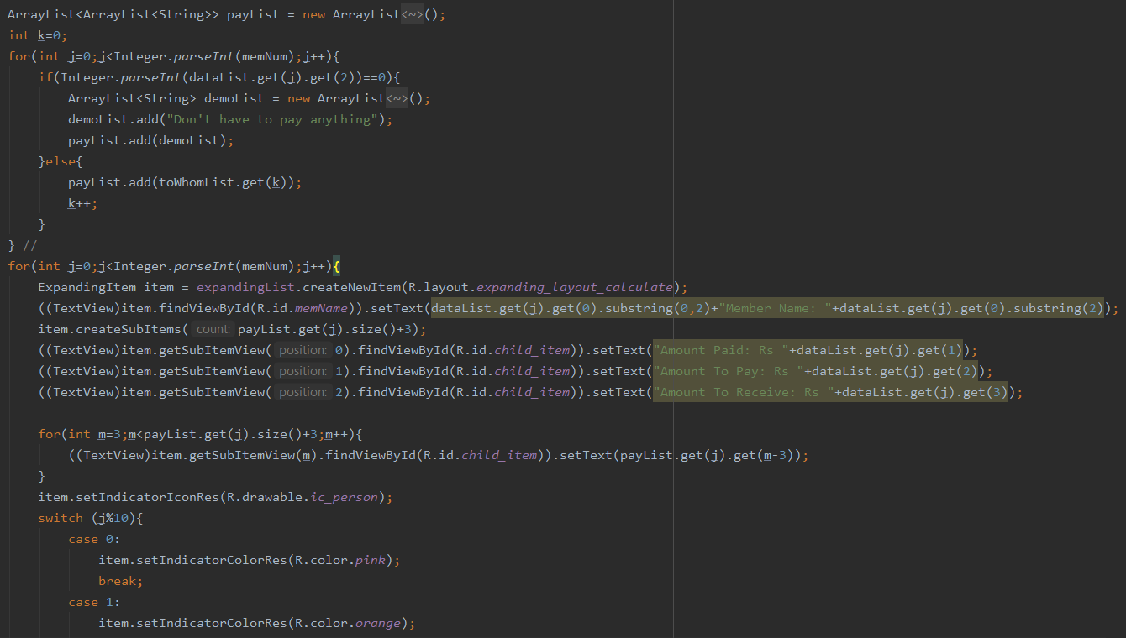
Algorithms Used

Slide 9
Algorithms Used
Database Helper Class is also created to help with insert/update queries to the database.
Code for this algorithm is shown in the next slide. Contributed by Piyush

Slide 10
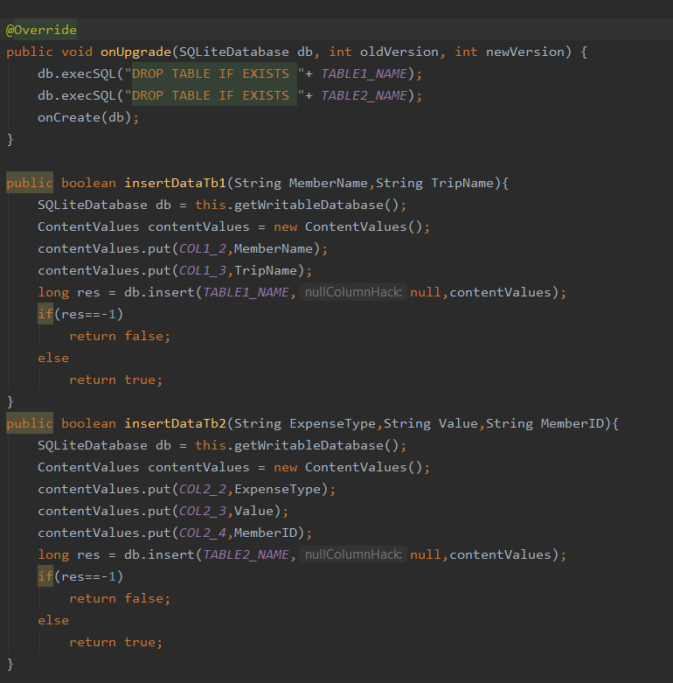
Algorithms Used

Slide 11
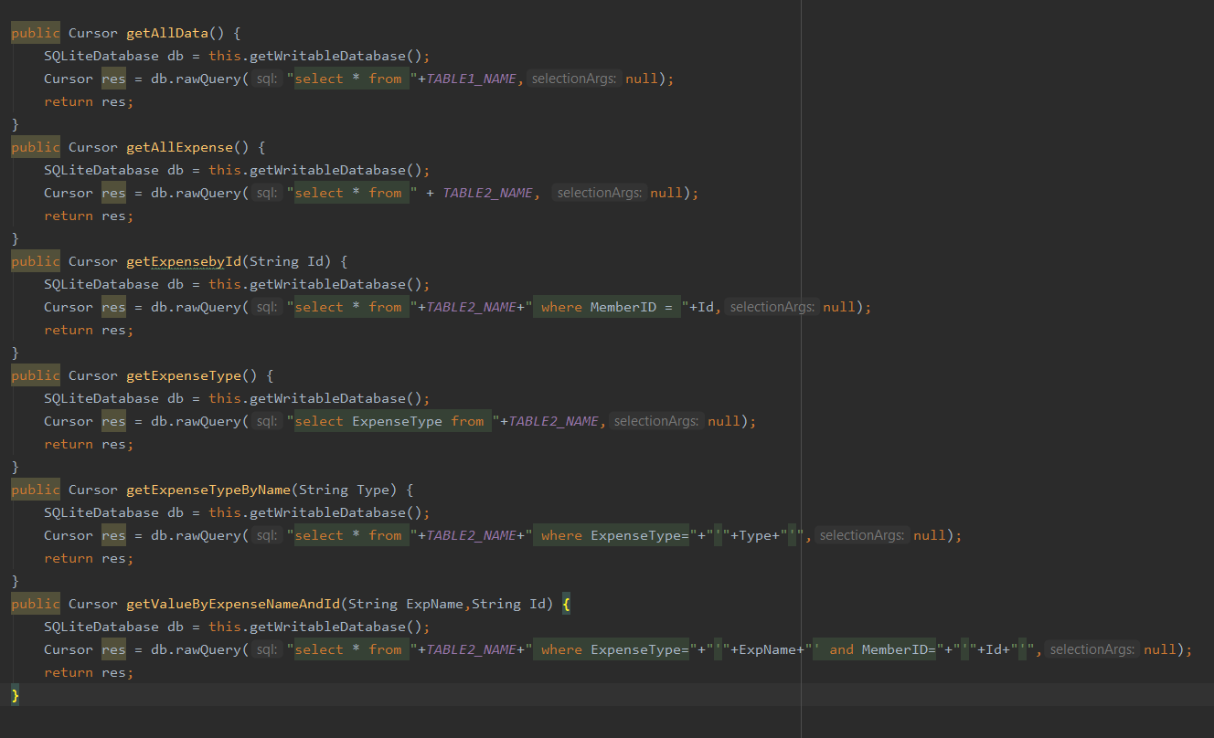
Algorithms Used

Slide 12
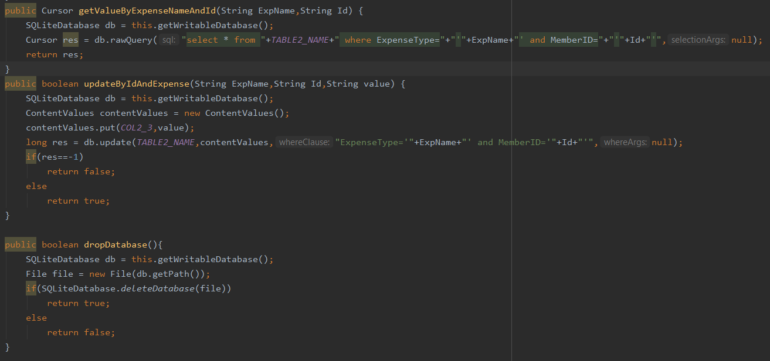
Algorithms Used

Slide 13
References
https://medium.com/@mithunmk93/algorithm-behind-splitwises-debt-simplification-feature-8ac485e97688

Slide 14
Thank You

