Slide 1
INTRODUCTION

Slide 2
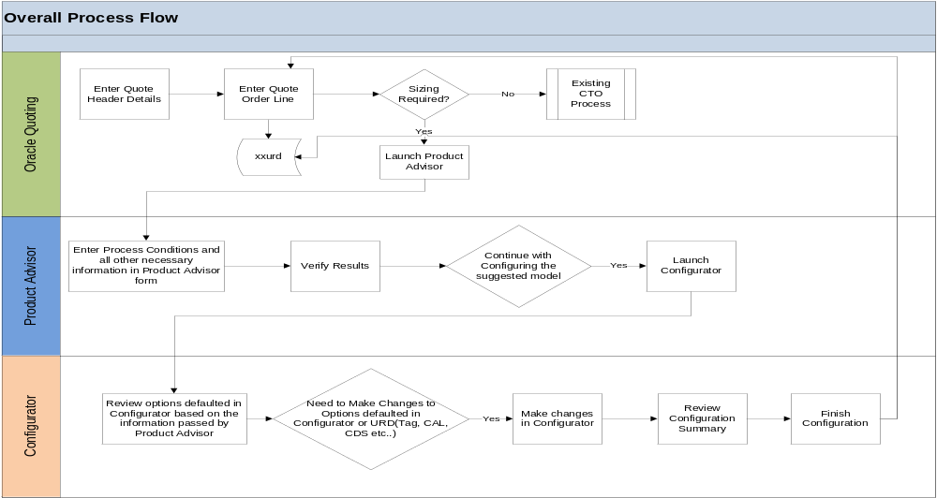
In flow models Product advisor application is in ADF but in level model it’s Azure Application

Slide 3
Difference between ADF and Azure Application
ADF Application | Azure Application
It stores the data in database(either oracle or Microsoft) | It stores the data in cloud database
It retrieves information little bit in case of bulk records | It retrieves information very fast.
Maintaince cost is high | Maintaince cost is low

Slide 4
Start
ADF
Product advisor Application
Azure Application
There is no need to change the existing configurator extension
Requires to modify the either existing CE or propose new CE
END
END

Slide 5
Difference between oracle database and cloud database in configurator
FPA Database | LPA Database
Sizing details stores in oracle database | Sizing details stores in cloud database
Debug: To verify the sizing details requires SQL developer | Debug: To verify the sizing details in Azure database or execute the service in postman
Execution time is better | Execution time is fast

Slide 6
Drawbacks to modify existing configurator
Pros | Cons
1.Easily modify existing configurator extension by using some conditions | 1.It will work only in Flow and level models. In future again more effort is required for other families
 | 2.Execution time will change that lead to face problems in model performance
Considering above cons and planning to propose new configurator extension

Slide 7
Planning to propose new configurator extension:
Calling Azure API in configurator extension
In future all RMT families will utilize proposed extension
Pros:
Cloud service performance is high than compare to oracle database
Maintaince is Good.
Cons:
Depends on Network.

Slide 8
If we propose new configurator extension,
Analyzed the impact of current flow models

Slide 9
No changes in existing code
FLOW standalone model
FLOW
Super Model
FLOW
Assembly Model
Scalar Models
Only one DP flow Model
Example:
R-1495
Combination of two standalone flow Models
Example:
R-3051CFA
R-3051C
R-485
Combination of multiple Flow standalone models
Example:
RA-1495-DPF
R-1495
R-3051S
R-2051C
Let us assume combination of both flow and level models
Code changes are required in existing Extension
R-3051S
R-485
R-2051L
NO IMPACT
NO IMPACT
Extension triggers once
Extension triggers once
Extension triggers once
Extension triggers once
NO IMPACT
IMPACT

Slide 10
R-3051SAL
Proposed new configurator extension
Level
standalone model
Level
Super Model
Level
Assembly Model
Scalar Models
Only one Level
Model
Example:
R-2051L
Combination of two standalone flow Models
Example:
R-3051CFA
R-T2M
R-U2
Combination of multiple Flow standalone models
Example:
RA-2051L-DPL
R-2051L
R-1199
Let us assume combination of both flow and level models
Code changes are required in existing Extension
R-3051S
R-485
R-2051L
New extension will work
New extension will work
Extension triggers once
New extension will work
Extension triggers once
Extension triggers once
IMPACT
Extension triggers once

Slide 11
Existing FPA to OCD configurator Extension Logic

Slide 12
Quote/
Order
User click on Product Advisor Application
Start
Selected user required options
After product advisor selections PA_REF_ID generates
By using Oracle PL/SQL code based on pa_ref_id, sizing details will be stored in Oracle tables
By using java code calling the oracle table data and populate in cofigurator
Extension triggers only once to all models
EXIST

Slide 13
Proposing LPA to OCD configurator Extension Logic

Slide 14
Quote/
Order
User click on Product Advisor Application
Start
Selected user required options
After product advisor selections PA_REF_ID generates
By using java code calling the Service with input parameters pa_ref_id, header_id and line_id
Extension triggers only once to all models
EXIST

Slide 15
Difference between FPA and LPA
FPA | LPA
Stores in oracle database | Stores in cloud database
Calling database tables in configurator extension | Calling azure api in configurator extension
 | Setup is similar to FPA

Slide 16
Queries??

