Slide 1
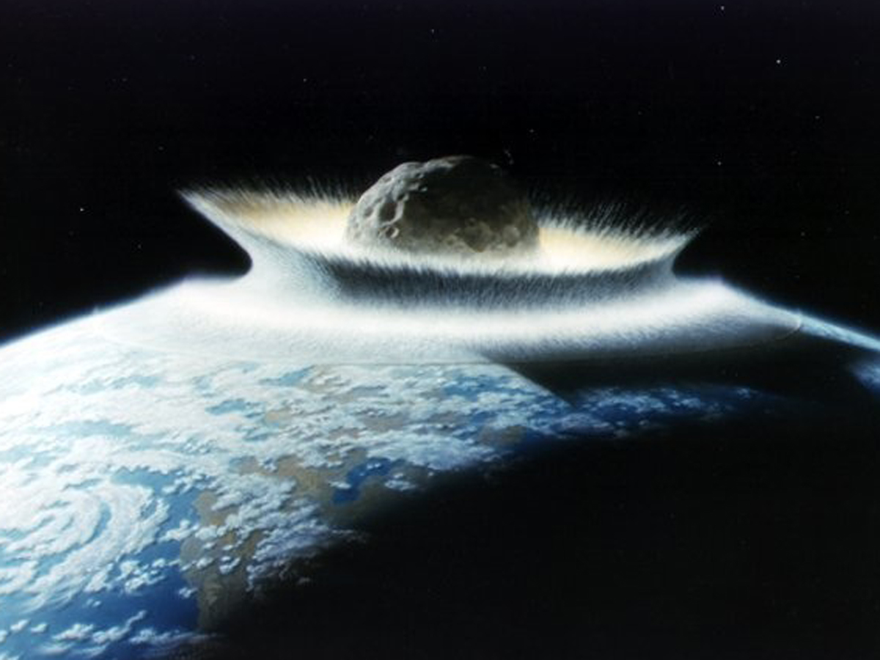
Predicting Potential Hazardous Asteroid
Team 20
Sneha Ravichandran - 001096251
PavanSaiPati - 001521280

Slide 2
Index
Goal - 3
Description of data - 4
Attributes - 5
Target Variable - 6
Exploratory Data Analysis -7
Data Preprocessing - 12
MinMax Scaling - 17
Data Split - 19
Metrics Function - 20
Classification models - 21
Logistic Regression - 22
Logistic Regression (SMOTE) - 23
Gaussian Naive Bayes - 24
Gaussian Naive Bayes (hyperparameter Tuning) - 25
Random Forest Classifier - 26
Feature Importance - 27
Decision Trees - 28
Metric Measures - 30
F1 Scores - 31
Accuracy Scores - 32
Best Machine Learning Model - 33
References - 34

Slide 3
Goal
Our goal is to predict whether a Particular asteroid is potentially hazardous to Earth or not. We will be achieving this by building machine learning models to learn the features in the dataset and tune the model to predict the PHA or the Potential Hazard Asteroid value.
We also aim to find the best classification algorithms for the given dataset.

Slide 4
Description of data
This Dataset contains all the information recorded regarding asteroids till date.
This dataset is officially maintained by Jet Propulsion Laboratory of California Institute of Technology which is an organization under NASA.
Number of Records : 958524
Size of the dataset : 435 MB
Number of attributes : 45
Attributes are String : 7
Attributes are Boolean: 2
Attributes are Decimal : 36

Slide 5
Attributes
SPK-ID
Object ID
Object fullname
NEO
PHA: Potentially Hazardous Asteroid (PHA)
H
i
rms
sigma
class
Diameter
Albedo
Diameter_sigma
Orbit_id
Epoch
Equinox
Eccentricity
ad
q
tp
moid_ld
w
tp

Slide 6
Target Variable
The dependent Target Variable is PHA (Potential Hazardous Asteroid) which is a discrete class label that contains YES or NO.
If PHA is YES : The asteroid can be determined as a potential hazard to Earth
If PHA is NO : The asteroid can be determined as not a potential hazard to Earth.

Slide 7
Exploratory Data Analysis
Plotting visual graphs for better understanding of the dataset and relationship between various features

Slide 8
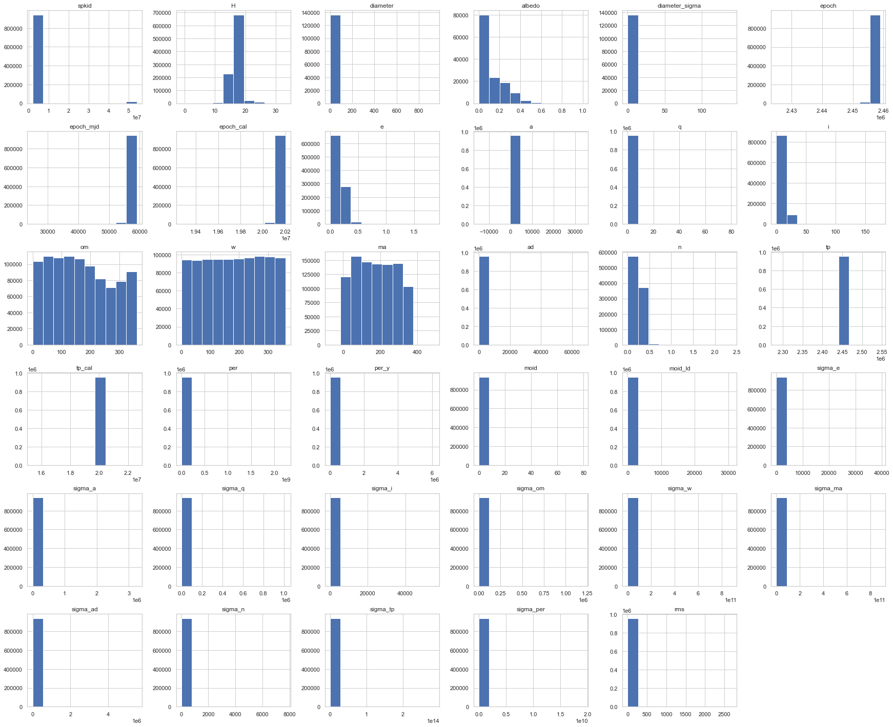
Printing the histograms for all the features

Slide 9
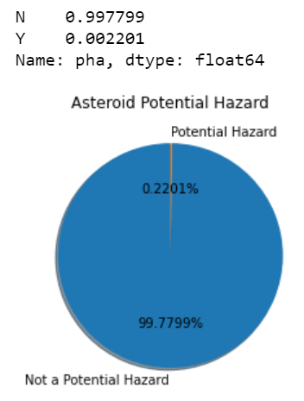
Pie chart of Potential Hazard Asteroids

Slide 10
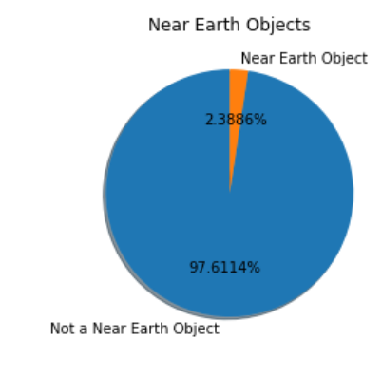
Pie chart of Near Earth Objects

Slide 11
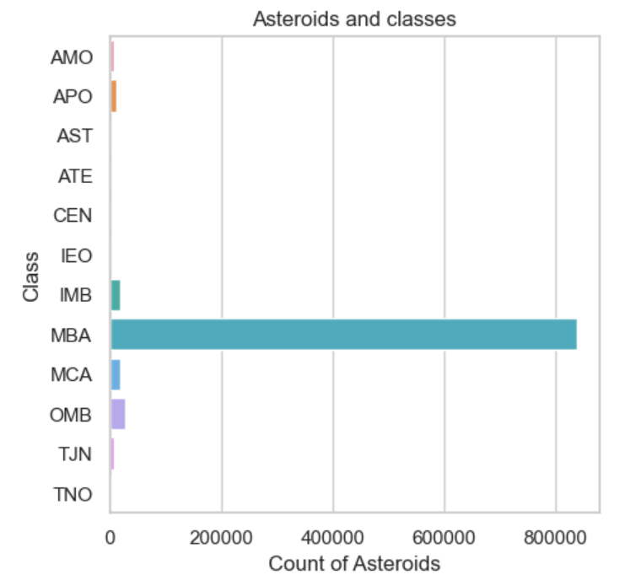
Bar graph shows the classification of Asteroids among the different classes

Slide 12
Data Preprocessing
Cleaning the data by handling missing values, removing redundant columns and preparing the raw data for the machine learning models.

Slide 13
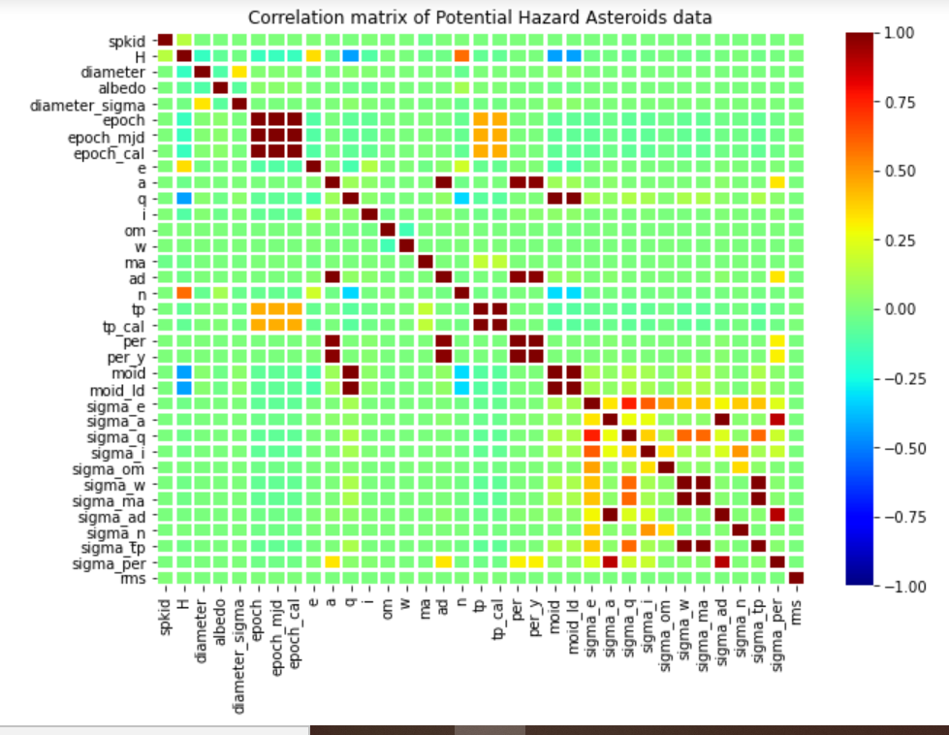
Removing
epoch_mjd and epoch_cal since they are highly correlated to epoch and redundant.
A correlation matrix is a tabular data representing the relation between the pairs of variables in the given data

Slide 14

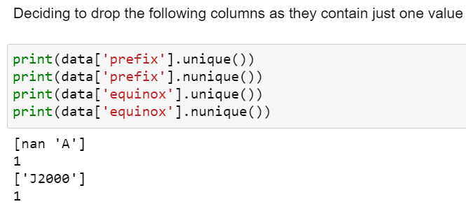
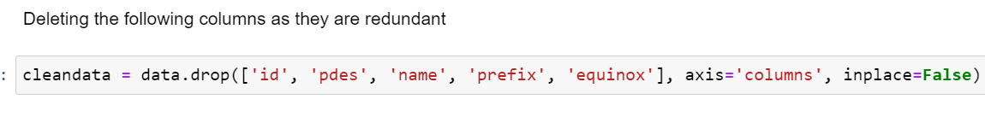
Dropping the redundant features by checking the unique values of that particular feature

Slide 15
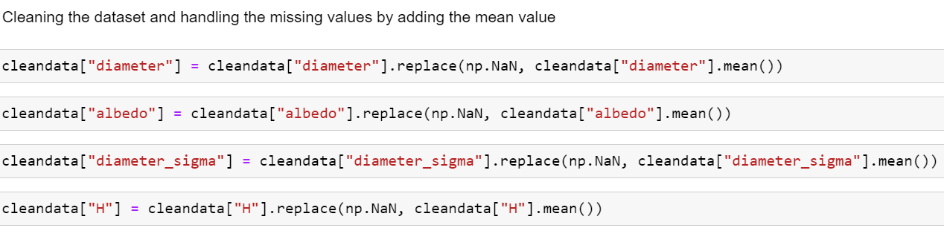

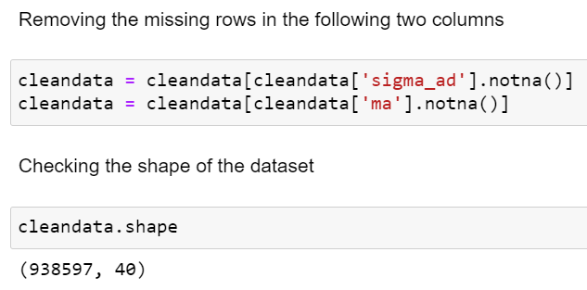
Replacing the missing values with the features’ mean value

Slide 16
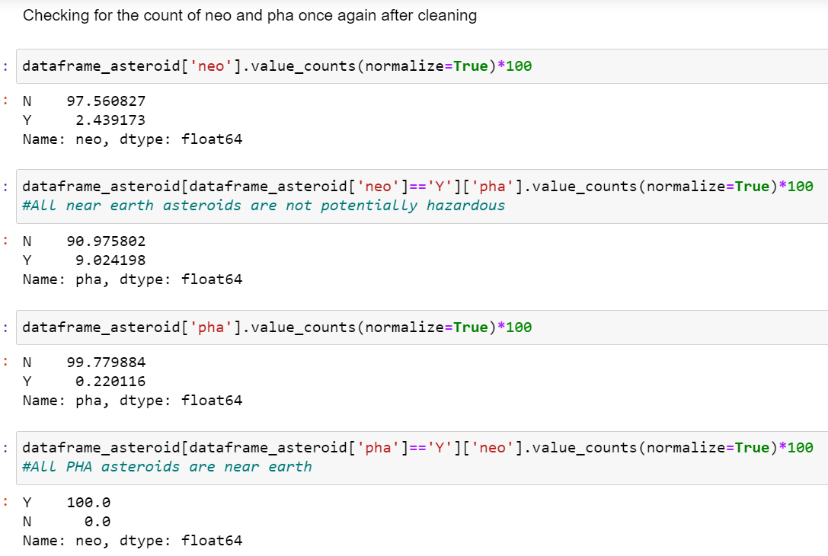
Checking the Near Earth Object and Potential Hazard Asteroid count after cleaning

Slide 17
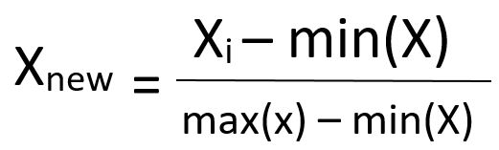
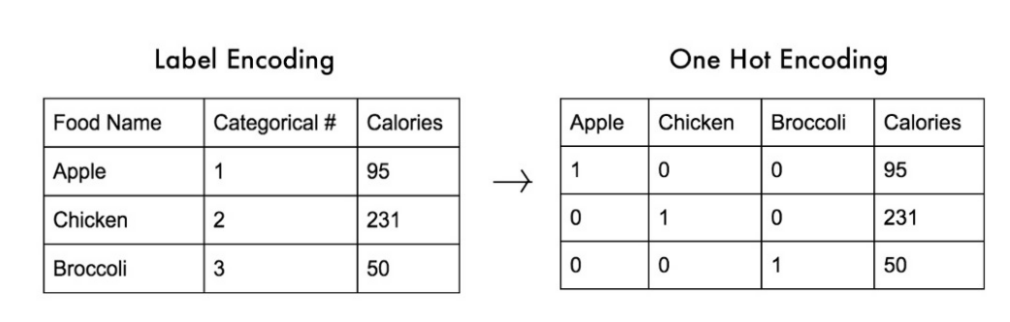
Minmax Scaling
&
get_dummies
Minmax Scaling is a simple method of rescaling the range of features to scale the range in [0, 1] or [−1, 1]
Get_dummies is a process by which categorical variables(Strings) are converted into a form that could be provided to ML algorithms to do a better job in prediction.

Slide 18
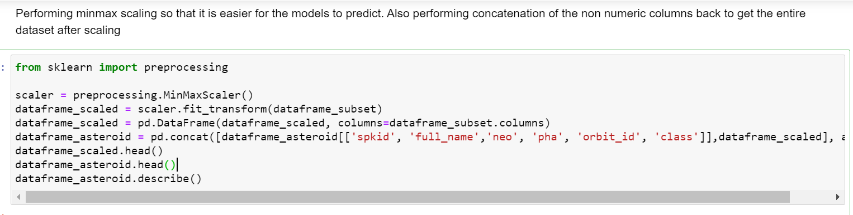
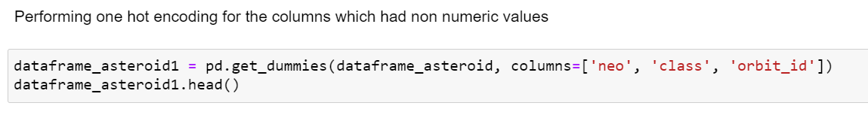
Performing MinMax scaling on the subset of dataset which contains numerical values
Performing One Hot Encoding on the dataset which contains non-numerical values

Slide 19
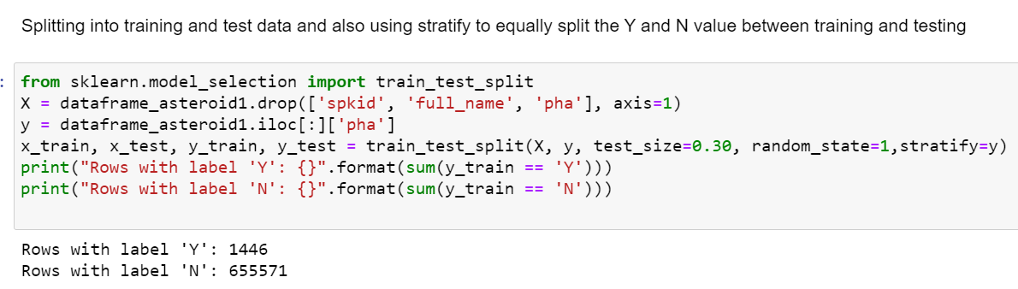
Training and Test data set split

Slide 20
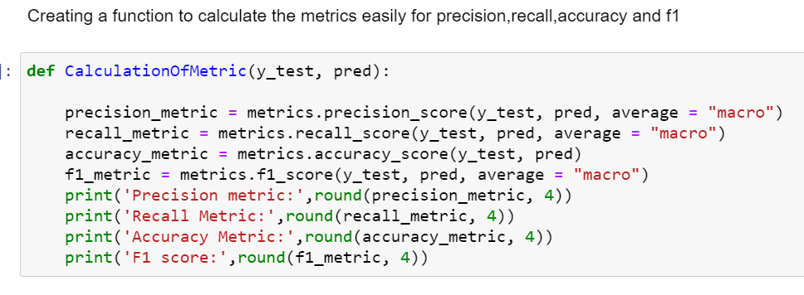
Metrics function

Slide 21
Classification Models
Logistic Regression
Logistic Regression after SMOTE oversampling
Gaussian Naive Bayes Classifier
Gaussian Naive Bayes after Hyperparameter Tuning
Random Forest Classifier
Decision Tree Classifier

Slide 22

Logistic Regression
Logistic regression is a Statistical model that uses a logistic function to model a binary dependant variable which is “PHA” in this case
The logistic model will determine the probability of an existing class as Yes/No, Win/Lose etc.
On Asteroid dataset : Accuracy Score is 99.77%
As you can see here the True Positives count is very less

Slide 23

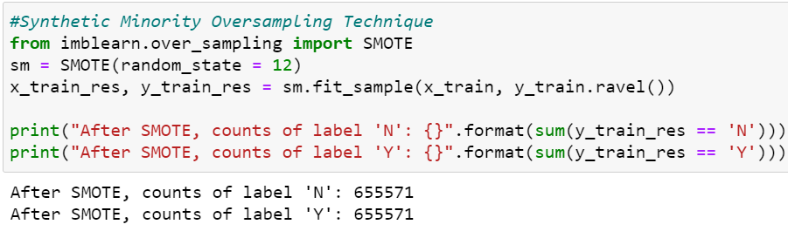
Logistic Regression after using SMOTE
SMOTE (Synthetic minority oversampling technique)
It is an oversampling technique where synthetic samples are generated for the minority class (True positives (PHA=Y))
For Asteroid dataset Accuracy score: 99.1%

Slide 24

Gaussian Naive Bayes
Gaussian Naive Bayes Classifier is a simple and effective classification algorithm
It predicts on the basis of probability on applying Bayes theorem with strong independence assumption between attributes.
For Asteroid dataset: Accuracy Score is 97.9%

Slide 25

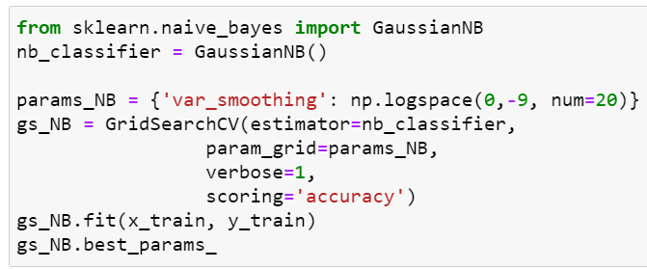
Gaussian Naive Bayes After Hyperparameter tuning
Hyperparameter optimization or tuning is the problem of choosing a set of optimal hyperparameters for a learning algorithm
Cross validation is often used to generalize the performance.
For Asteroid dataset: Accuracy Score is 99.57%

Slide 26

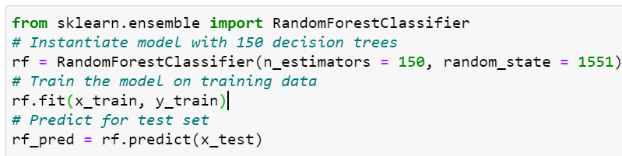
Random Forest Classifier
Random forest classifier operates by creating multiple decision trees at training time and selects the class that is mode of the classes or mean of the prediction of individual trees.
On Asteroid dataset : Accuracy Score is 99.99%

Slide 27
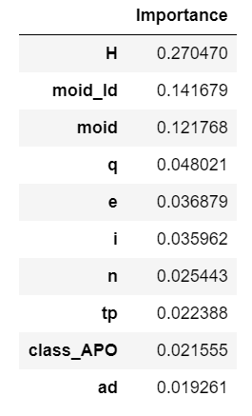
Important features for the Random Forest Classifier

Slide 28

Decision Trees
It uses a predictive model to go from observations about an item to determine the item’s target variable
Class labels and branches are represented as leaves in Classification tree structures
The goal is to create a model that predicts the value of a target variable based on several input variables.

Slide 29

The decision tree graph is large hence redirecting to a different window using the below link.
https://drive.google.com/file/d/1ngEZC5IxGfaF5IU1Wbxj2HbLTwN9Q8qz/view?usp=sharing

Slide 30
Metric Measures
Model | Precision | Recall | Accuracy | F1 score
Logistic Regression | 0.7278 | 0.582 | 0.9977 | 0.6204
Logistic Regression (SMOTE) | 0.5972 | 0.9858 | 0.991 | 0.66
Random Forest | 0.9949 | 0.9718 | 0.9999 | 0.983
Gaussian Naive Bayes (Tuning) | 0.6274 | 0.7516 | 0.9957 | 0.6691
Gaussian Naive Bayes | 0.5455 | 0.9638 | 0.9791 | 0.5778
Decision Tree | 0.991 | 0.9871 | 0.9999 | 0.989

Slide 31
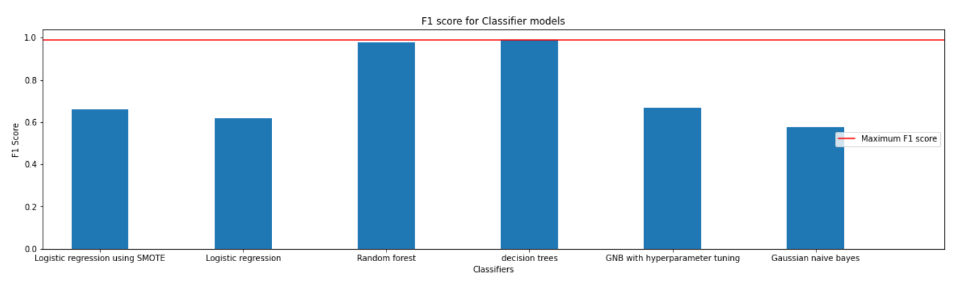
F1 Scores
Visualizing F1 scores of all models as a bar graph

Slide 32
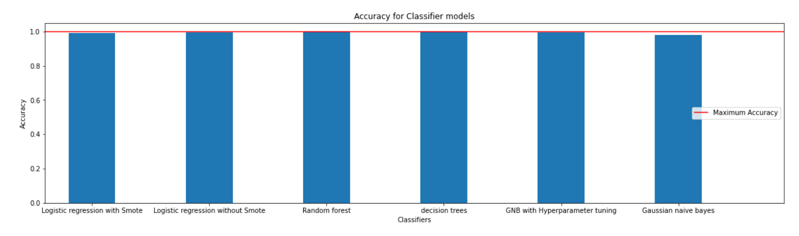
Accuracy Scores
Bar graph of accuracy scores for all models
99.1% 99.7% 99.98% 99.99% 99.57% 97.9%

Slide 33

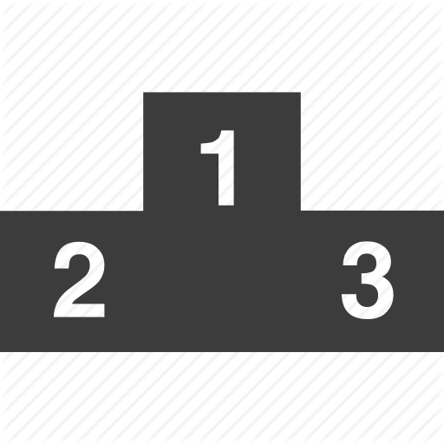
Best Machine Learning Model for our dataset
The best machine learning model for the asteroid dataset is the Decision tree as it provides 99.99% accuracy and a F1 score of 98.9%
The second best model is the Random forest classifier as it provides 99.99% accuracy and a F1 Score of 98.3%
Decision Tree
Random Forest
Logistic Regression

Slide 34
References
https://www.geeksforgeeks.org/ml-feature-scaling-part-2/
https://stackoverflow.com/questions/47606873/jupyter-no-module-named-imblearn-after-installation
https://www.kaggle.com/marissafernandes/asteroid-prediction
https://stackoverflow.com/questions/39828535/how-to-tune-gaussiannb
https://www.youtube.com/watch?v=pooXM9mM7FU
https://www.youtube.com/watch?v=VqKq78PVO9g
https://www.youtube.com/watch?v=FheTDyCwRdE
https://en.wikipedia.org/wiki/Decision_tree_learning
https://en.wikipedia.org/wiki/Hyperparameter_optimization#Bayesian_optimization
https://scikit-learn.org/stable/modules/tree.html
https://ssd.jpl.nasa.gov/sbdb_query.cgi

Slide 35
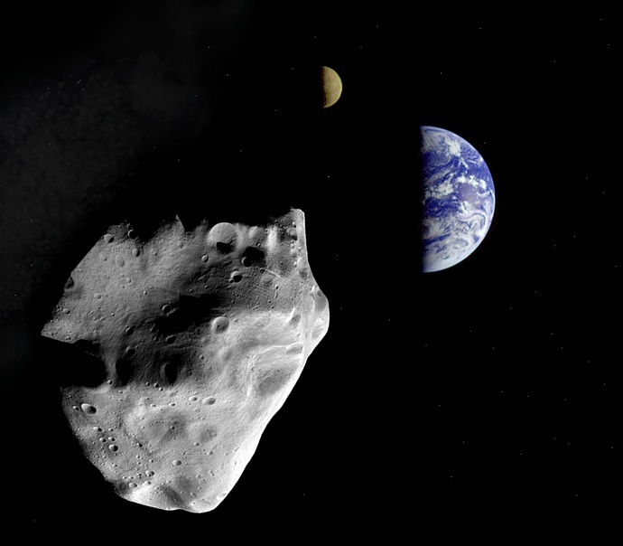
Thanks for listening!
Email id:
pati.p@northeastern.edu
ravichandran.sn@northeastern.edu

