Slide 1
CUSTOMER SHOPPING BEHAVIOR
Turning shopper data into smarter retail decisions
Python · SQL · Power BI

Slide 2
The business problem
A retailer sees shifting purchase patterns and wants to know why
“How can the company use shopping data to spot trends, improve engagement, and optimize marketing and product strategy?”
Discounts
1
Do they lift spend?
2
Reviews & seasons
What drives demand?
3
Payments & loyalty
Who comes back?

Slide 3
Our approach
Four steps from raw data to recommendations
1
2
3
4
Clean
Query
Visualize
Recommend
Python: prepare and transform the raw dataset
SQL: 16 queries on segments, loyalty and drivers
Power BI: interactive dashboard
Report and actions for stakeholders

Slide 4
The business at a glance
3.9K
$233K
Customers
Total revenue
$59.76
3.75
Avg. purchase
Avg. review rating

Slide 5
Clothing and Young Adults lead revenue
Revenue by category and by age group ($)

Slide 6
Discounts don’t lift basket size
Average purchase amount is nearly flat across both
No discount
$60.13
Discount applied
$59.28
Non-subscriber
$59.87
Subscriber
$59.49

Slide 7
A loyal base, skewed male
Who our customers are
68%
of revenue comes from male customers
27%
of customers are subscribers
80%
are Loyal (11+ prior purchases)

Slide 8
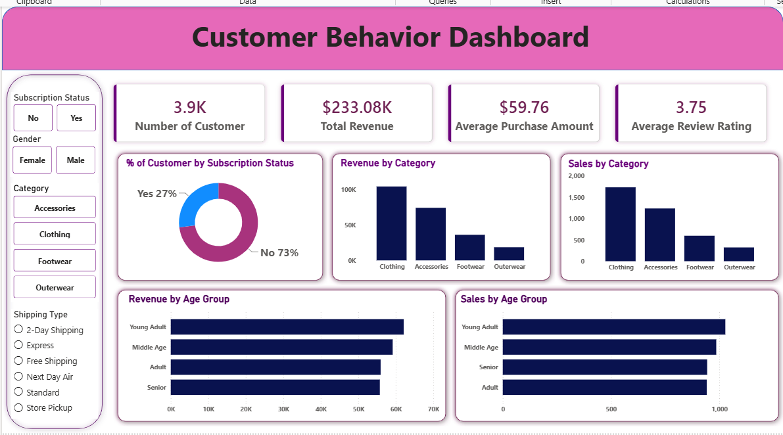
The Power BI dashboard
Interactive filters by subscription, gender, category and shipping

Slide 9
Recommendations
1
Rethink blanket discounts
They don’t raise spend; target them at lapsed or new customers.
2
Give subscribers real value
Spend matches non-subscribers; add perks to grow the 27%.
3
Lean into Clothing & Accessories
Top revenue drivers; stock up ahead of Fall, the peak season.
4
Market to Young Adults and women
Young Adults lead revenue; women are an under-served 32%.

