Slide 1
Hybrid Databases
The next generation of data management
Presented By
Sneha Shankar
MS in CS, UCLA
UID - 404946026

Slide 2
Overview
SQL v/s NoSQL
SQL access to NoSQL
Conclusion
Hybrid Databases: Bridging SQL and NoSQL
NoSQL in SQL

Slide 3

SQL v/s NoSQL
Relational
Non Relational
Structured
Unstructured
Stable
Scalable
Mature
Emerging

Slide 4
Bridging SQL and NoSQL
The Need
Generally, only part of data is unstructured
Rest is relational
Example: E-Commerce company has product data and CRM data
What data storage should be used?
Obvious compromise: Relational + NoSQL
Challenges:
Extra programming to combine data
Application complexity increases and maintainability decreases

Slide 5

The Problem Statement
Division of data creates a gap in terms of Uniform Data access
Goal: Bridge this gap between SQL and NoSQL
How to get the best of both worlds?
Hybrid Database
SQL
NoSQL

Slide 6
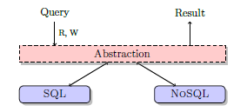
The Hybrid Database
Approaches
Separate Software Layer
SQL access to NoSQL
NoSQL in SQL

Slide 7
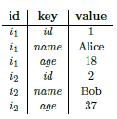

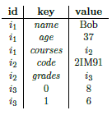
NoSQL in SQL
Triple Representation (s,p,o) i.e. (id,key,value)
E.g.: Bob’s age is 37 -> {(h,name,Bob), (h,age,37)}
d = {name: Bob, age: 37,
courses: {code: 2IM91, grades: [8,6]}}
Relation F(id, key, value) in SQL
Advantages: Standardization, flexibility

Slide 8
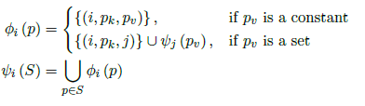
Data Reconstruction
Triples of same (sub)structure are given the same id
To connect back, a triple is added whose value is the key of the nested key-value pair
Formal transformation:
Function φ_{i} : to transform a key-value pair
Function ψ_{i} : expects a set of key-value pairs

Slide 9
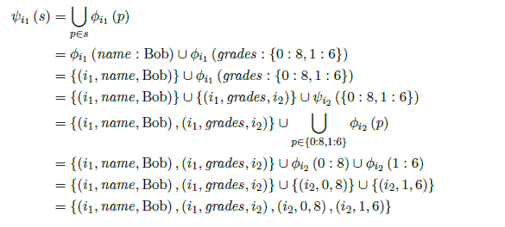
Data Reconstruction
s = { name : Bob, grades : [8, 6] } -> {name : Bob, grades : {0 : 8, 1: 6} }

Slide 10



Data Retrieval
T1 = ρ_{T1 (id)} (π _{vi} ( σ_{ki = id} ( ρ_{Ti ( i, ki, vi)} (T) ) ) )
T2 = ρ_{T2 (id,name)} (π _{vi,vn} ( σ_{ki = id ^ kn=name} ( ρ_{Ti ( i, ki, vi)} (T) ⋈ π ρ_{Tn( i, kn, vn)} (T) ) ) )
T3= ρ_{T3 (id,name,age)} (π _{vi,vn,va} ( σ_{ki = id ^ kn=name ^ ka=age} ( ρ_{Ti ( i, ki, vi)} (T) ⋈ ρ_{Tn( i, kn, vn)} (T) ⋈ ρ_{Ta( i, ka, va)} (T) ) ) )

Slide 11

Query Language
Inspired by SPARQL
Follows the basic graph pattern
A basic graph pattern is a set of RDF-like triples
Can contain variables
Values are bound to the variables
( ?i, name, ?name ),
( ?i, name, ?j ),
( ?j, 0, ?f ),
( ?j, 1, ?s )
( #i, name, ?name ),
( #i, name, #j ),
( #j, 0, ?f ),
( #j, 1, ?s )

Slide 12
Collaboration with SQL
Select r.name FROM
NoSQL (
name: ?name,
grades: (
0: ?f,
1: ?s
)
) AS r
WHERE r.f = 8
Allows easy transformation to SQL
Provides isolation

Slide 13
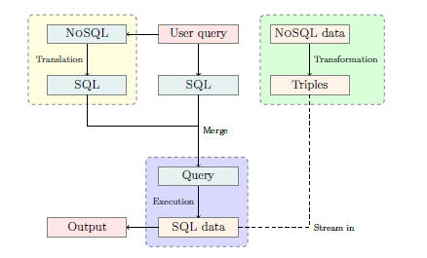
Architectural Overview

Slide 14
Drawbacks
If NoSQL data streamed at query time, then:
Query atomicity violation: Unavailability of NoSQL DB can lead to an empty relation F
Inconsistent query result: If any user modifies the NoSQL data during streaming
If NoSQL data not streamed at query time, then:
What amount of NoSQL data is SQL capable of storing ???

Slide 15
SQL Access to NoSQL
What is it?
Generalizable SQL query interface for both relational and NoSQL systems
Will support SQL querying of NoSQL systems
Unity: Integration and Virtualization system
Motivation
To overcome the drawbacks of the previous approach
Primary reasons:
SQL is a standardized language allowing portability between systems
Massive existing knowledge base of database developers
SQL is a declarative language
Enables NoSQL’s interaction with other enterprise systems (using SQL and JDBC/ODBC)

Slide 16
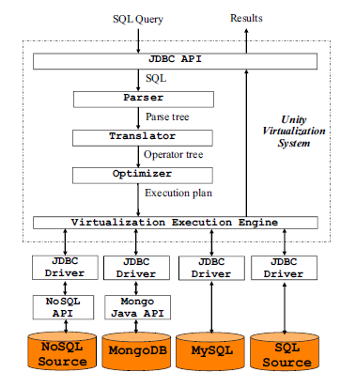
Unity Architecture

Slide 17
Unity Architecture
Query Optimizer
Separates out the operators of each source
Pushes down as much of the computation as possible
Plans optimal ordering of joins to combine data retrieved from sources
Techniques
Push-down filters: A selection operator is pushed down for execution on a source
Join ordering: Uses a cost-based optimizer.
Joins across systems have a higher priority than within a source
Push-down, staged join: Used generally across two systems
Retrieves the rows from one join result and uses it to modify the query to other source.

Slide 18
Execution
Customer (cid, cname, addr.street, addr.city)
{“cid”:1, “cname”:”Fred”, “address”: {“street”: ”Main”, “city”: “New York”} }
Orders(oid, cid, odate, total)
(100, 1, ‘2017-11-10’, 35.45)
Total number of all orders for ‘Fred’ since January 1st, 2017
SELECT SUM(total) as totalAmount
FROM mongo.customer C
INNER JOIN mysql.orders O ON C.cid = O.cid
WHERE C.name = ‘Fred’
And O.odate > ‘2017-01-01’

Slide 19
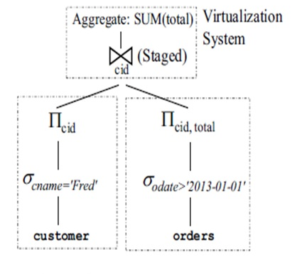
Query Execution Plan
SQL queries executed by each source:
MongoDB
SELECT cid from customer WHERE cname = ‘Fred’
Mongo JSON query format:
db.customer.find ( {“cname”:”Fred”}, {“cid”:1})
MySQL
SELECT cid, total FROM orders WHERE odate > ‘2017-01-01’ and cid IN (1)

Slide 20
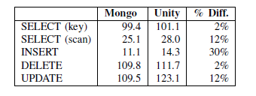
Experimental Results
Database with 15k records
Unity has less than 15% overhead for most operations
The only exception is INSERT
Insertion time is so low that overhead is more of a factor
Larger datasets with more users would show better performance
Relative overhead decreases as query time increases

Slide 21
Conclusion
SQL access to NoSQL better than NoSQL in SQL
Systems like Unity, SonarSQL allow NoSQL standardization
UnityJDBC allows MongoDB to interact with relational databases and enterprise reporting applications
Future Work: Benchmarking performance of other systems (e.g. Cassandra), Parallelizing for cluster environment

Slide 22
References
Roijackers, John, and G. Fletcher. "Bridging sql and nosql." Master's thesis, Eindhoven University of Technology (2012).
Lawrence, Ramon. "Integration and virtualization of relational SQL and NoSQL systems including MySQL and MongoDB." Computational Science and Computational Intelligence (CSCI), 2014 International Conference on. Vol. 1. IEEE, 2014.
Rakesh Agrawal, Amit Somani, and Yirong Xu. Storage and querying of e-commerce data. In Proceedings of the 27th VLDB Conference, VLDB ’01. VLDB Endowment, 2001.
Sharma, Vatika, and Meenu Dave. "Sql and nosql databases." International Journal of Advanced Research in Computer Science and Software Engineering 2.8 (2012).
Rith, Julian, Philipp S. Lehmayr, and Klaus Meyer-Wegener. "Speaking in tongues: SQL access to NoSQL systems." Proceedings of the 29th Annual ACM Symposium on Applied Computing. ACM, 2014.
https://www.youtube.com/watch?v=0jn7rydiF5k

Slide 23
Thank You !
Questions ?

