Slide 1
Combining Multiple Evidence from Different Types of Thesaurus for Query Expansion
Sneha Shankar Narayan

Slide 2

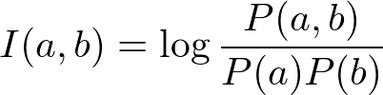
Thesaurus – Construction Methods
Wordnet based thesaurus
Co-occurence based thesaurus
Combined approach
  Average of the two similarities

Slide 3
Thesaurus - examples
Wordnet based thesaurus
  “Beethoven's birthplace” - expanded to “Beethoven birthplace origin sources composer”
Co-occurence based thesaurus
  “Best retirement country” - expanded to “best retirement country two pension project”

Slide 4
Results - Graphs

Slide 5
Results and Reasoning
Haha

