Slide 1
Combining Multiple Evidence from Different Types of Thesaurus for Query Expansion
Sneha Shankar Narayan
(snehas@cs.umass.edu)

Slide 2
Background
Using a combination of thesaurus based approaches to expand queries in order to improve the performance of the retrieval system.

Slide 3

Thesaurus – Construction Methods
Wordnet based thesaurus
  Np : Number of nodes in path from w1 to w2
  D: Maximum depth of taxonomy

Slide 4
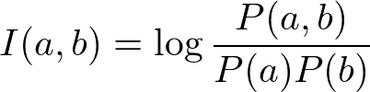
Thesaurus – Construction Methods
Co-occurence based thesaurus
  P(a), P(b): Estimated by counting the number of occurrences of words a and b.
Combined approach
  Average of the two similarities

Slide 5
Thesaurus - examples
Wordnet based thesaurus
  “Beethoven's birthplace” - expanded to “Beethoven birthplace origin sources composer”
Co-occurence based thesaurus
  “Best retirement country” - expanded to “best retirement country two pension project”

Slide 6
Evaluation Methodology
Similar terms to query terms are determined for each of the approaches.
Original query is concatenated with the determined terms and the experiments in P2 are repeated again. System used: Galago
Ranked lists for the expanded queries are compared against the P2 baseline.

Slide 7
Results – Mean Average Precisions
 | Baseline (P2) | Wordnet thesaurus | Co-occurence thesaurus | Combined approach
Books | 0.3647 | 0.1954 (-46%) | 0.2906(-20.3%) | 0.2047 (-43.84%)
Robust-class | 0.3910 | 0.2812 (-28%) | 0.3811 (-2 %) | 0.2879 (-26.3%)
Robust-community | 0.2295 | 0.1549 (-32%) | 0.1843 (-19.69 %) | 0.1582 (-31.06%)

Slide 8
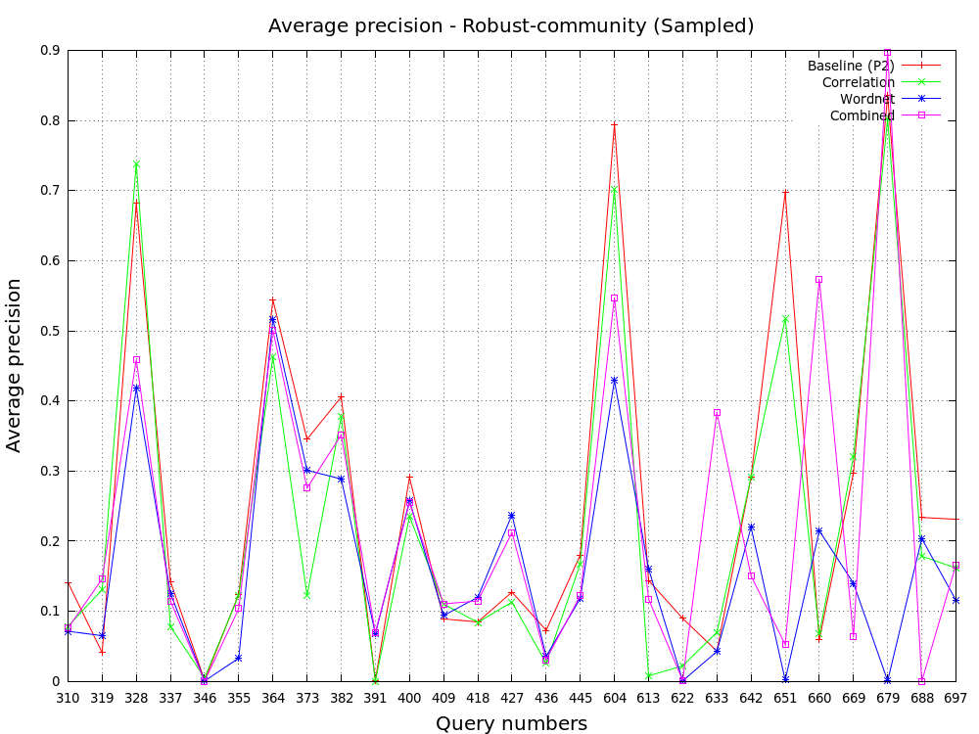
Results - Graphs

Slide 9
Observations
Comparing average precisions show that the combined approach is not as bad as the MAP values show it to be.
Main issue: Query words are considered as unique entities and expanded, expanding each word may not give the same connotation as all of the original query words put together.
  Example: “brazil forest industry” becomes “brazil forest industry woods timberland manufactures”
Words used while calculating similarities is restricted to the words in the top 50 ranked documents of the original query which may result in bad expansions.
Future work: Perhaps the co-occurence can be tried with considering two of the query words at a time.

Slide 10
References
"Combining multiple evidence from different types of Thesaurus for query expansion" by Rila Mandala, Takenobu Tokunaga, Hozumi Tanaka.

