Slide 1
Digital Portfolio
STUDENT NAME: SNEHA K
REGISTER NO AND NMID: 9C3D957CF559D82A94E468418E3CA46B
DEPARTMENT: B. Sc Computer Science
COLLEGE: Apollo College of Arts and Science

Slide 2
PROJECT TITLE
Digital Student Portfolio

Slide 3


AGENDA
Problem Statement
Project Overview
End Users
Tools and Technologies
Portfolio design and Layout
Features and Functionality
Results and Screenshots
Conclusion
Github Link
3/21/2024 Annual Review

Slide 4

PROBLEM STATEMENT
:To create a professional digital portfolio to showcase skills, projects, and contact information as an aspiring software engineer.
Problem Addressed: Lack of a centralized platform to present academic achievements, technical skills, and projects to potential employers or academic evaluators.
Purpose: Build a user-friendly, responsive website to highlight personal and professional growth.

Slide 5

PROJECT OVERVIEW
Description: A personal portfolio website developed to showcase academic background, technical skills, and projects.
Key Features:
Responsive navigation with sections for About, Skills, Projects, and Contact.
Interactive elements like a “Hire Me” button and a contact form
Clean and modern design using HTML, CSS, and JavaScript.
Goal: To create an online presence that reflects technicaprofessionalism.

Slide 6

WHO ARE THE END USERS?
Primary Audience:
Potential employers looking for entry-level software engineers.
Academic evaluators or professors reviewing student projects.
Peers or collaborators interested in technical skills and projects.
Secondary Audience:
General visitors interested in learning about work senting users (e.g., a silhouette of a person or a network).

Slide 7

TOOLS AND TECHNIQUES
Frontend Development:
HTML: Structure of the portfolio website.
CSS: Styling for a modern and responsive design (e.g., sticky header, project cards).
JavaScript: Interactive features like smooth scrolling and form submission alerts.
Development Tools:
Code Editor -VS Code

Slide 8
POTFOLIO DESIGN AND LAYOUT
Design Philosophy: Clean, minimalistic, and user-friendly interface.
Layout Details:
Header: Sticky navigation bar with links to About, Skills, Projects, and Contact.
Hero Section: Bold introduction with a “Hire Me” button.
Sections: Organized content for About, Skills, Projects, and Contact with consistent styling.
Footer: Copyright information for professionalism.
Responsive Design: Ensures compatibility across devices using meta viewport and flexible CSS.
8

Slide 9
FEATURES AND FUNCTIONALITY
Key Features:
Navigation: Smooth scrolling to sections using JavaScript (scrollIntoView).
Contact Form: Form with validation and sn alert (resets after submission).
Project Cards: Display projects with descriptions in a clean, shadowed card layout.
Responsive Design: Adapts to different screen sizes for accessibility.
Interactive Elements: “Hire Me” button redirects to the contact section.

Slide 10
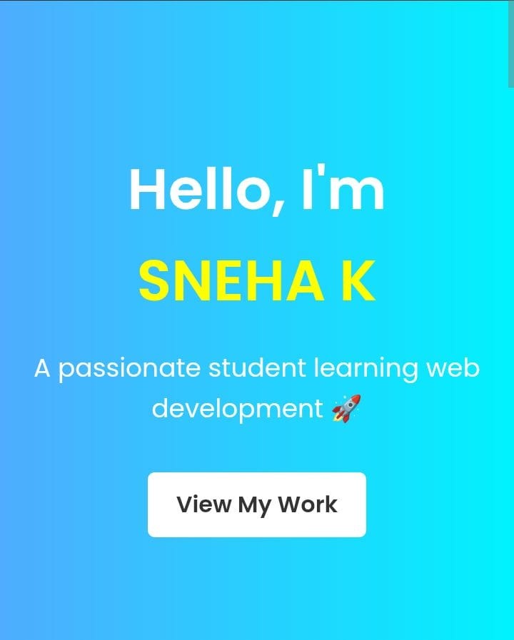

RESULTS AND SCREENSHOTS
3/21/2024 Annual Review
10

Slide 11
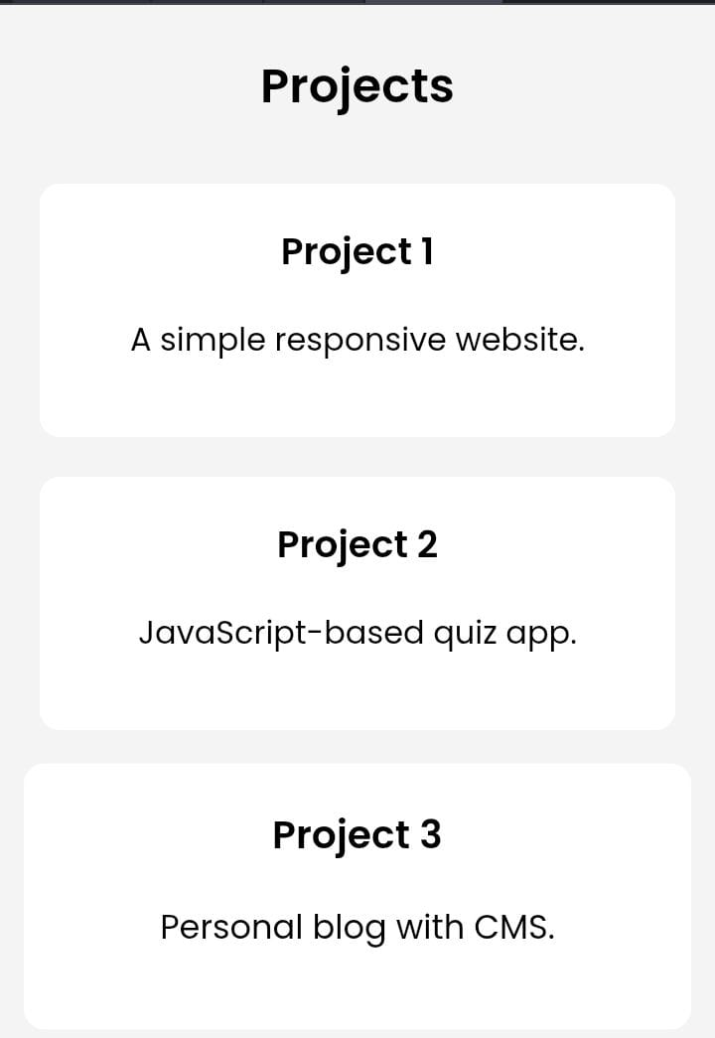

Slide 12
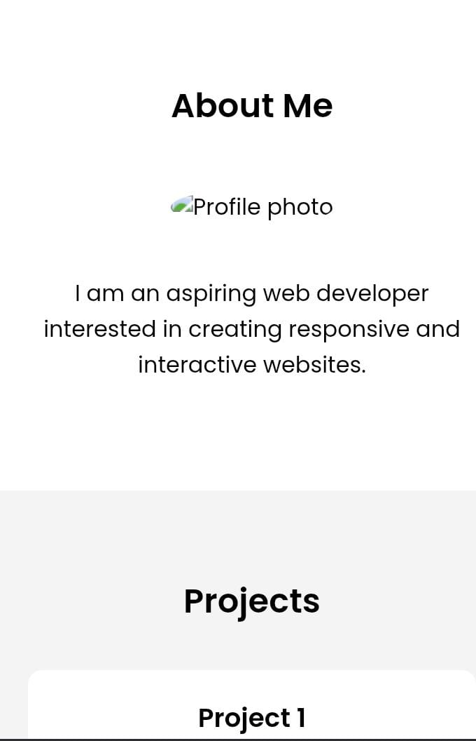

Slide 13
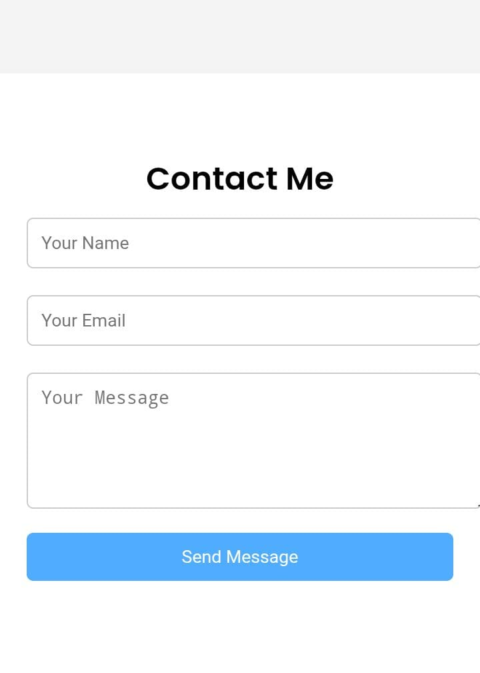

Slide 14
CONCLUSION
Summary: The digital portfolio effectively showcases skills, projects, and contact information, serving as a professional online presence.
Future Improvements:
Add more projects to the portfolio.
Enhance interactivity with advanced JavaScript features (e.g., animations).
Integrate a backend for the contact form to store messages.
Impact: Strengthens employability and demonstratescompetence.
14

