Slide 1
Employee Data Analysis using Excel
STUDENT NAME: Sneha . K
REGISTER NO:122204057
DEPARTMENT:B.COM (CS)
COLLEGE:SHRI KRISHNASWAMY COLLEGE FOR WOMEN

Slide 2
PROJECT TITLE
Employees Gender Analysis

Slide 3


AGENDA
Problem Statement
Project Overview
End Users
Our Solution and Proposition
Dataset Description
Modelling Approach
Results and Discussion
Conclusion
3/21/2024 Annual Review

Slide 4

PROBLEM STATEMENT
Gender equality in the workplace is one of the crucial aspects that make a company the best place to work.
While many urban corporates are focused on making their organizations discrimination-free, the Gender Gap repport by the World Economic Forum suggests that at the current rate, women may have to wait around 135 years to bridge this gap completely.
"How can we address and overcome the systemic gender biases and barriers that hinder equal opportunities, representation, and outcomes for individuals of all genders in the workplace, education, healthcare, and broader society?"

Slide 5

PROJECT OVERVIEW
Gender equality and the empowerment of women and girls are central to addressing the world’s unprecedented intertwined global crises from food insecurity and climate change to conflict, fragility, and violence, to sluggish economic growth.
.
Gender in the Workplace:
Diversity and Inclusion: Creating a welcoming environment for all genders.
Equality and Equity: Ensuring equal opportunities, pay, and treatment.
Gender Balance: Striving for representative gender ratios in all roles and levels
Inclusive Culture: Encouraging gender expression and challenging biases.

Slide 6

WHO ARE THE END USERS?
Employees
Customers
Client-facing team
IT and technical teams
Management and leadership
Remote workers

Slide 7

OUR SOLUTION AND ITS VALUE PROPOSITION
filter-remove
pivot- summary
graph data visualization

Slide 8
Dataset Description
Employee= Kaggle
9 features
name-text
Pivot Summary
Performance level
Gender- male female

Slide 9

THE "WOW" IN OUR SOLUTION
Career development workshops
Mentorship programs
3 . Networking events
4. Women-led project showcases
5. Recognition and awards for outstanding achievements
6. Inclusive hiring practices
7. Diversity and inclusion training
8. Support for women-led businesses or initiatives
9. Creating a sense of community and belonging
10. Continuous feedback and improvement mechanisms
3/21/2024 Annual Review
9

Slide 10
MODELLING
DATA COLLECTION:
In edunet dash board downloading the data sets while using the kaggle
FEATURE :
Identifying the employee ID
Identifying employee names
identifying employee performance
identifying employee gender
DATA CLEANING :
1. to find the missing value
2. to the filtering the missing value
GENDER ANALYSIS :
FIVOT TABLE
2. separating the gender
3. graph
4. filter remove
5.pivot summary
6.data visualization
10

Slide 11
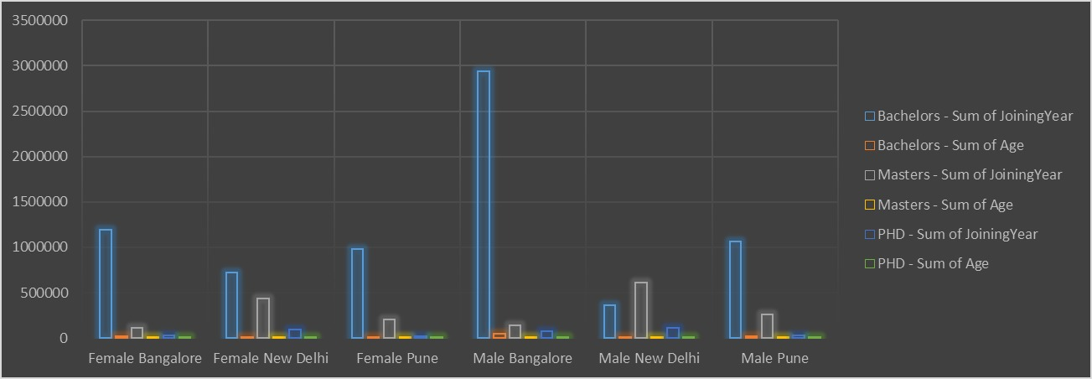
RESULTS
11

Slide 12
conclusion
In conclusion, gender is a complex and multifaceted aspect of human identity that plays a significant role in shaping our experiences, opportunities, and outcomes. Through data analysis and modeling, we have identified persistent gender disparities in various domains, including education, employment, health, and economic empowerment.

