Slide 1

Loan Approval Prediction System
Elizabeth Subba | Sneha Shrestha
BCA 8th Sem, Xavier International College |
Notes:
Introduce the project: a web system that predicts whether a loan will be approved, built as a BCA final project.

Slide 2
Table of Content
5. Tools Used
6. Key Features
7. Diagrams
Introduction
Problem Statement
Objectives
Algorithm

Slide 3
Introduction
The Loan Approval Prediction System is a machine learning-based application that predicts whether a loan application is likely to be approved or rejected. It analyzes applicant details such as income, credit history, and loan amount using a trained machine learning model. The system helps make the loan evaluation process faster, easier, and more efficient.
Notes:
Manual loan assessment is slow and subjective. We built a tool that gives applicants and officers a quick, data-driven prediction.

Slide 4
Problem Statement
Loan officers assess applications by hand
Slow, subjective and inconsistent decisions
Risk of approving applicants who default
In Nepal, no platform lets people check eligibility
Notes:
Manual loan assessment is slow and subjective. We built a tool that gives applicants and officers a quick, data-driven prediction.

Slide 5
Objectives
Predict loan approval using the Random Forest algorithm

Slide 6
Algorithm
Random Forest
Random Forest is a machine learning algorithm that uses multiple decision trees to make predictions.
It combines the results of many trees to improve accuracy and reliability.
It reduces overfitting compared to a single decision tree.
In our project, it is used to predict whether a loan will be approved or rejected based on applicant information.
Notes:
Manual loan assessment is slow and subjective. We built a tool that gives applicants and officers a quick, data-driven prediction.

Slide 7


Tools Used
▶
Node.js + MySQL
▶
Next.js
▶
Python
Backend logic and data storage
Web interface for users and admin
Machine learning
Notes:
Data flows left to right. The model is built in Python and exposed through Flask; the web app talks to it via the Node.js backend. Development followed the waterfall model.

Slide 8
Key Features
User
Admin
Register and log in
Enter details, get Approved or Not Approved
Download a PDF prediction report
View past predictions
Send feedback
View and download all predictions
Dashboard chart: approved vs rejected
Add and manage bank loan details
Manage blog posts
Review user feedback
Notes:
Two roles: applicants predict their own loan outcome; admins manage content and monitor predictions.

Slide 9
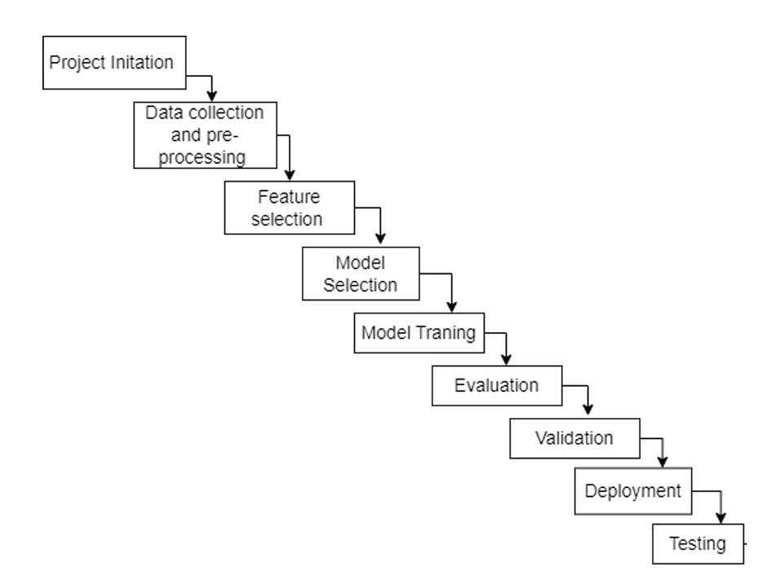
Diagrams
Fig. Waterfall Model of Loan Approval Prediction System
Notes:
Two roles: applicants predict their own loan outcome; admins manage content and monitor predictions.

Slide 10
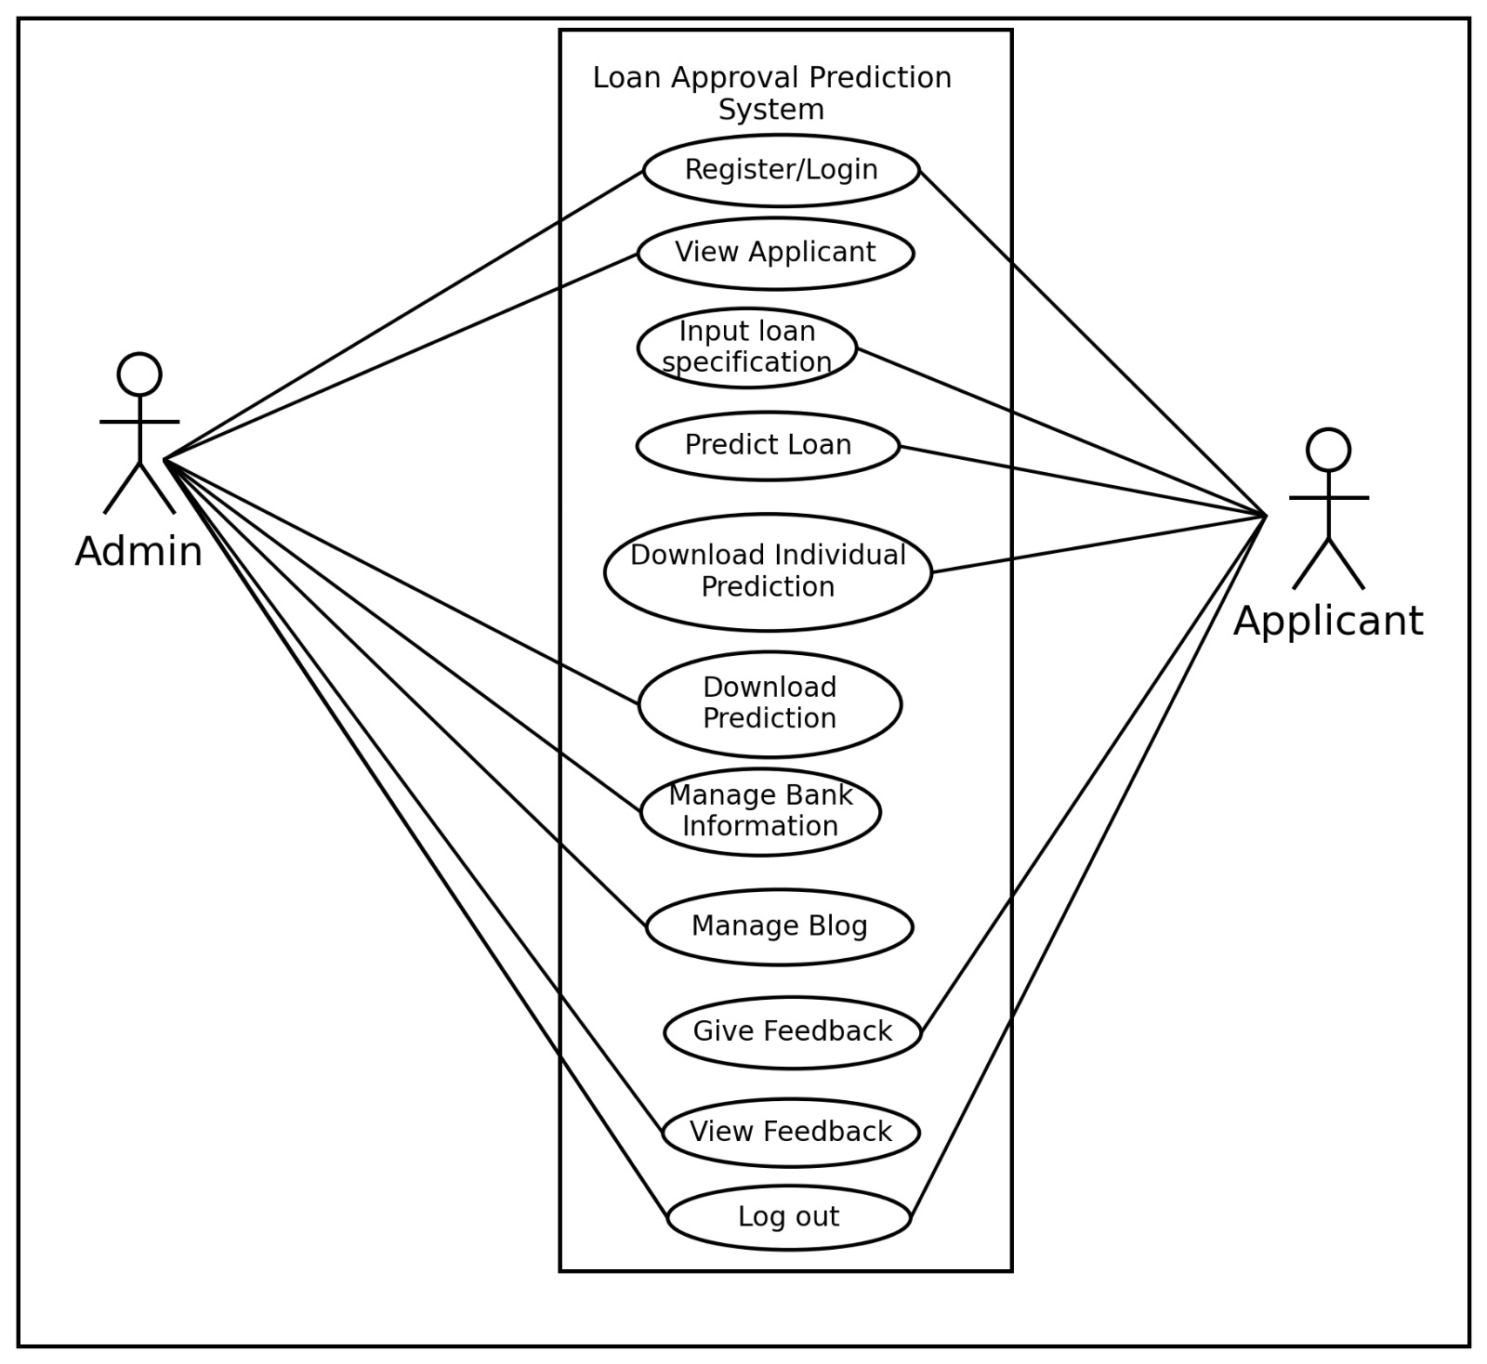
Fig. Use Case Diagram of Loan Approval Prediction System

Slide 11
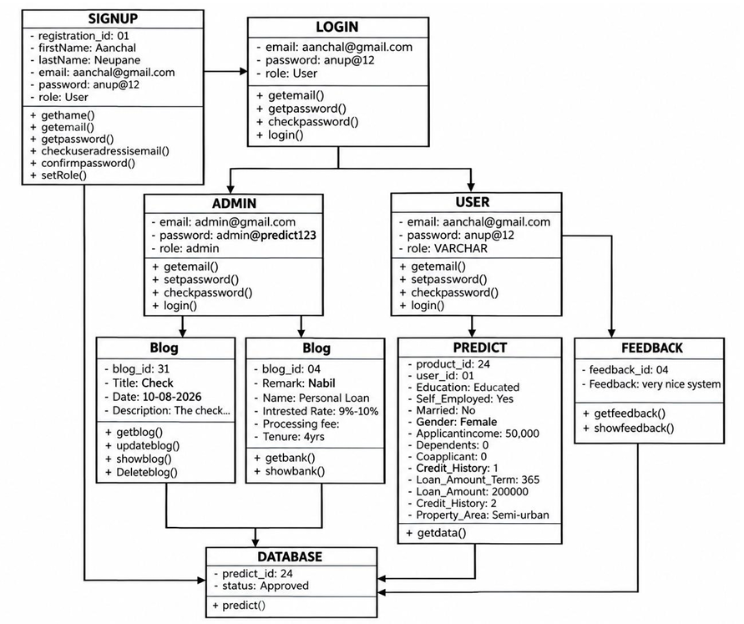
Fig. Object Diagram of Loan Approval Prediction System

Slide 12
Future Recommendation
More Data
More historical loan data can be collected and used to improve the prediction performance.
More Features
Additional financial and risk-related factors can be included to make predictions more accurate.
Different Models
Different machine learning models and prediction approaches can be compared to identify the most effective model.
Better Accuracy
The accuracy of the system can be improved through better-quality data, feature selection, and model training.
More Financial Parameters
Along with individual information, additional financial and risk assessment parameters can be included for more reliable loan predictions.
Notes:
Wrap up: the system meets its objectives. Thank the audience and invite questions.

Slide 13
Conclusion
The Loan Approval Prediction System helps determine whether a loan application is likely to be approved or rejected based on the applicant’s information. It makes the process faster, easier, and more efficient, helping users make better decisions.
Notes:
Wrap up: the system meets its objectives. Thank the audience and invite questions.

