Slide 1
Heart DISEASE PREDICTION SYSTEM BY SNEHA SINGH

Slide 2
ABSTRACT
Cardiovascular disease is one of the most fatal conditions in the present world.
Statistical data display the lethalness of Cardiovascular disease by revealing the percentage of deaths worldwide caused by heart diseases.
Thus, there is an implicit necessity to predict the condition at the earliest.

Slide 3
Problem statement
Not able to efficiently perform sales planning around cardiovascular field
Spending much time in identifying territory for cardiovascular field
No forecasting system available around cardiovascular

Slide 4
Business Use case
A prediction system using Machine Learning for cardiovascular disease which predict the heart disease.
Utilize the prediction to plan and target the patient in the particular geographical territory

Slide 5
Solution Component
Python Script
Pandas: data analysis
library Numpy: scientific computing
Library Sklearn: machine learning
library Itertools : library contains functions for creating iterators to use for efficient looping
Matplotlib: 2D plotting
Library Seaborn: statistical data visualization

Slide 6
Workflow
The dataset used in this project contains 14 features from Cleveland Clinic Foundation for heart disease.
Clean the data and find any missing values
Evaluate two models linear Stochastic Gradient Descent and decision tree
Train the data using both models and predict the probabilities of disease belonging to a particular class
Applying cross validation on the training and test set for validating our Models

Slide 7
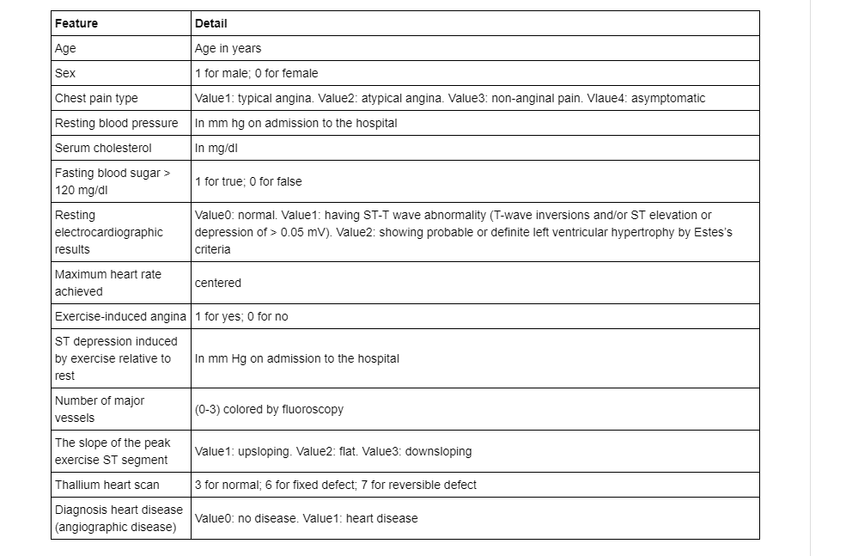
Attributes

Slide 8
FINDINGS
We can consider that the person with
is the most likely have 4 type of the heart disease
age > 38 man with chest pain = 4 blood pressure > 112 serum_cholestoral > 166 | fasting_blood_sugar = 0 electrocardiographic = 2 max_heart_rate > 114 ST_depression about 2 slope >=2 vessels about 1.6 thal more than 6

Slide 9
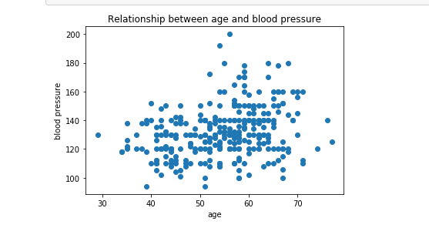
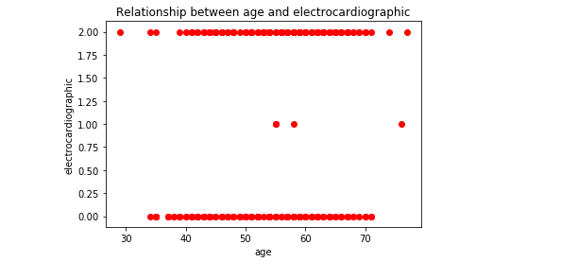
Visualization

Slide 10
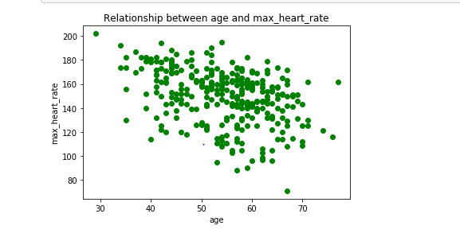
Visualization

Slide 11
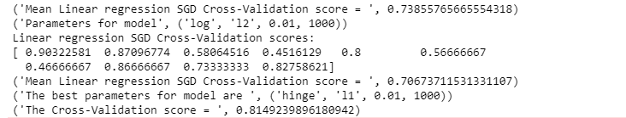
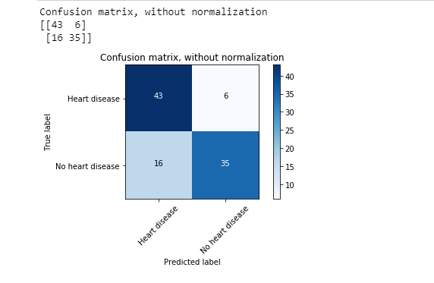

Model Evaluation - SGD

Slide 12
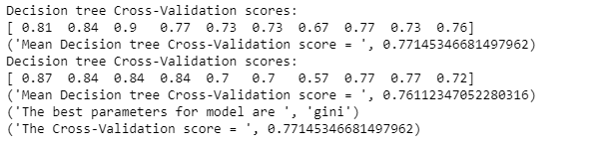
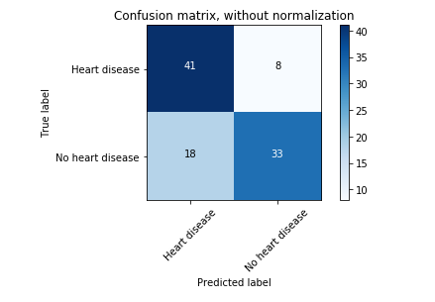

Model Evaluation – Decision tree

Slide 13
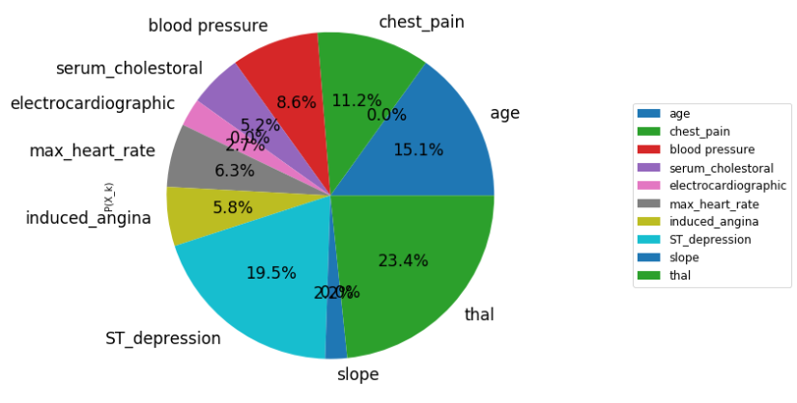
Most DECIDING Parameters

Slide 14

Combination OF Models

Slide 15
THANK YOU !

