Slide 1
A SIMPLE Operating System
A very simple UNIX-based operating system in C++

Slide 2
SCOPE
It is a very simple UNIX-based operating system in C++.
The OS would be able to boot, start a user shell and be extensible.
It would provide services such as memory management, process management and multitasking.
To use these services this OS can be extended further with more features.
Currently, the OS would load all modules and load successfully with a friendly message to user.

Slide 3
How IT WORKS?
Vagrant has been used to install and configure a virtual Ubuntu 32-bit box.
Once vagrant has installed the box , we have added some instructions in vagrant file to install ‘qemu’ (for simulation) and grub (for booting the OS).

Slide 4
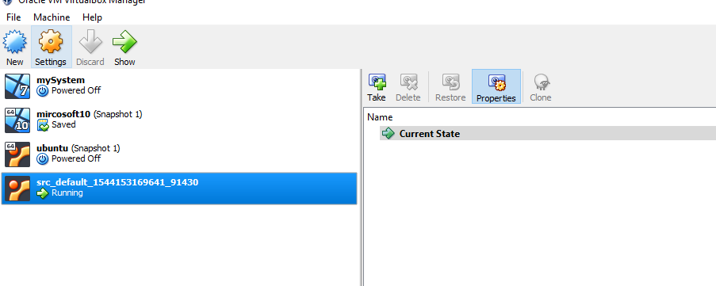
How it works?
Once all the required software's are installed, we initiate the box. The source code is automatically loaded in the ‘vagrant’ folder in virtual box. We can see a temporary box running in the virtual box manager.

Slide 5
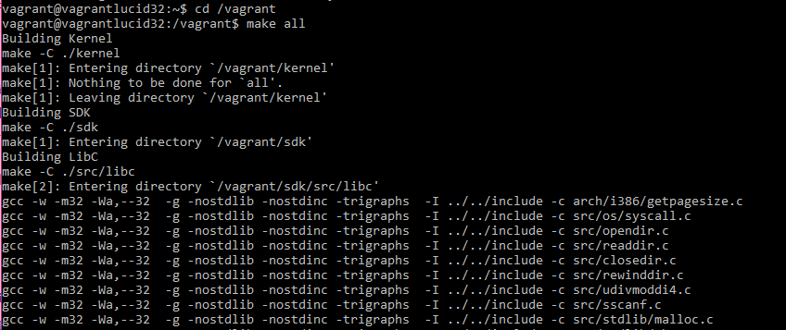
How it works?
Once the virtual box starts with Ubuntu running in it, we use ‘make all’ and ‘make run’ commands to build and boot the OS.

Slide 6
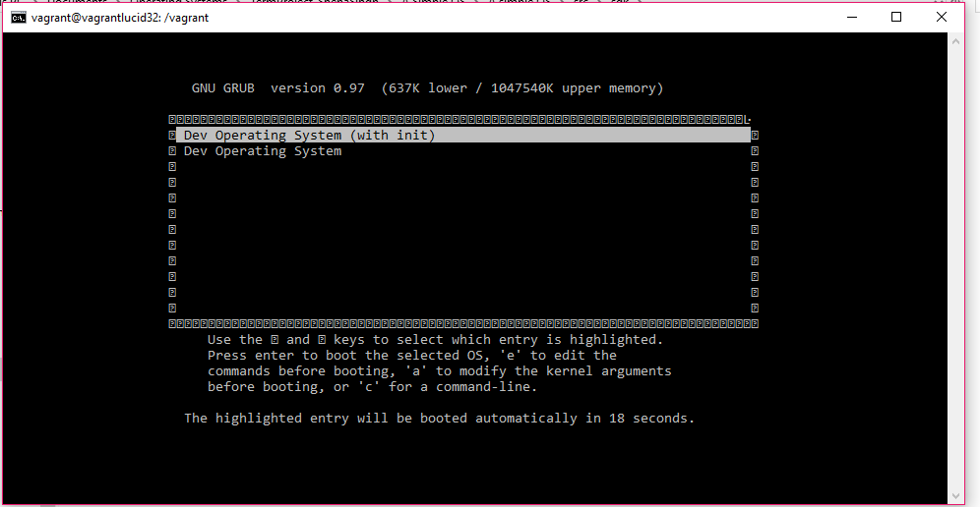
BOOTING
OS boots and GRUB provides a user friendly UI to simulate a more real experience.

Slide 7
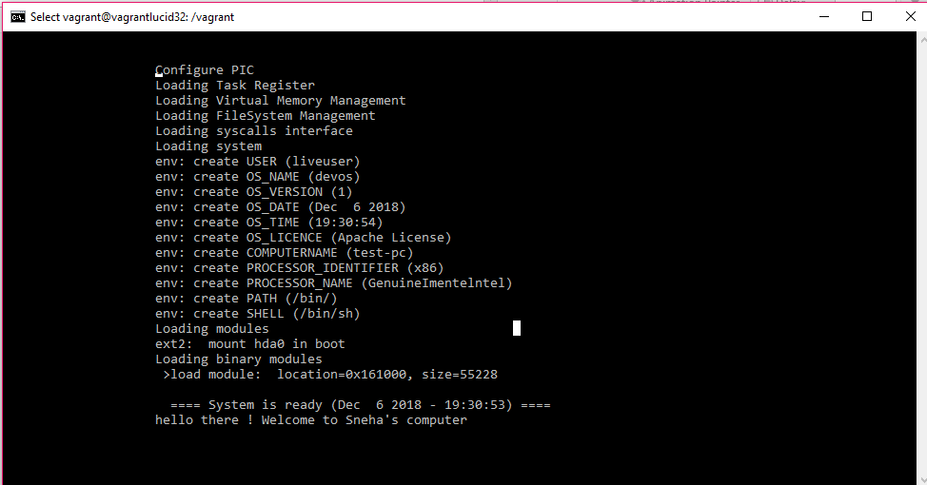
Output (Preview)

Slide 8
Thank you !!!!!!!!

