Slide 1


DASX : Hardware Accelerator for Software Data Structures
Snehasish Kumar, Naveen Vedula,
Arrvindh Shriraman (Simon Fraser University), Vijayalakshmi Srinivasan (IBM Research)

Slide 2










Executive Summary
High level info lost!
H1
H2
H3
H4
H5
mov $400, %r1
mov $4, %r2
mul %r3, %r2
add %r1, %r2
ld (%r2), %r4
for each array
element!
mov $400, %r1
mov $4, %r2
mul %r3, %r2
add %r1, %r2
ld (%r2), %r4
for each array
element!
Extra work encumbers the core!
Data
ld
CORE
void simple() {
for (int i = 0; i<size; ++i){
a[i] = b[i] + c[i];
}
}
add
mul
mov
DASX : Accelerate the access of and compute on software data structures
mov
Reorder Buffer
Notes:
Lots of data, many sources but at the heart of the algorithms stored in simple software data structures.
For example, trees, hashtables and array
However, hardware exec model discards this high level information. It does not exploit the rich abstraction we introduced to help the programmer.
Furthermore, even for a simple program which updates the sum, many instructions are required to access each element.
This implies that hardware resources are used to execute seemingly uneccessary instructions.
To summarize, high level information of the data structure and traversal is lost.
Extra work needed to get at the data encumbers the core.
We introduce a hardware exec model which exploits this high level information.
Our approach to address these issues is to build a data structure specific accelerator, which accelerates the access of and compute on software data structures in a decoupled fashion.

Slide 3
Outline
Challenges of data-centric applications
Existing mechanisms to address challenges
DASX : Data Structure Accelerator
Benchmarks and Evaluation

Slide 4
Challenge 1/3 : Instruction Overhead
Instructions / Element
void simple() {
for (int i = 0; i<size; ++i){
a[i] = b[i] + c[i];
}
}
1D Vector : 2
2D Vector : 3
6D Vector : 12
OLAP Cube [Gray et al. DMKD ‘96] upto 15D!
Unordered Set : avg. 12 instructions
BTree : 100s of instructions
9%
COMPUTE DATA
66%
Notes:
Say more details are available in Table 1 of the paper.

Slide 5
Challenge 2/3 : Memory Level Parallelism
Each element independent
Cant discover more MLP!
mov $400, %r1
mov $4, %r2
mul %r3, %r2
add %r1, %r2
ld (%r2), %r4
for each array
element!
ld
CORE
add
Accessing multiple data structures makes this worse!
mul
mov
mov
Reorder Buffer
Notes:
Define : Memory Level Parallelism – Why we want more? – Fully utilize bandwidth

Slide 6
Challenge 3/3 : Managing Cache Space
CPU
Not enough space in cache
L1
L2
MEM
Notes:
We only need the red parts to complete the operation but excess is brought in due to the absence of data structure information.

Slide 7
Outline
Challenges of data-centric applications
Existing mechanisms to address challenges
DASX : Data Structure Accelerator
Benchmarks and Evaluation

Slide 8
Existing Mechanisms – Prefetching
void simple() {
for (int i = 0; i<size; ++i){
prefetch(a + k);
prefetch(b + k);
prefetch(c + k);
a[i] += b[i] + c[i];
}
}
load
mov
pref
add
add
Reorder Buffer
+ Increases Memory Level Parallelism
– Increases instructions (SW PF)
– Best effort (HW PF)
– Can cause cache thrashing

Slide 9
Existing Mechanisms – SIMD
void simple(){
for (int i = 0; i<size; i+=k){
SIMD_LOAD(a[i]:a[i+k]);
SIMD_LOAD(b[i]:b[i+k]);
SIMD_LOAD(c[i]:c[i+k]);
SIMD_ADD(a[…], b[…], c[…]);
}
}
add
add
load
load
add
add
Reorder Buffer
+ Reduce Instructions
– Algorithm change
– Increase power

Slide 10
Outline
Challenges of data-centric applications
Existing mechanisms to address challenges
DASX : Data Structure Accelerator
Benchmarks and Evaluation

Slide 11
Our Approach – DASX
OOO
CORE
Processing
Elements
(PEs)
Lightweight pipelines
All ins. fixed latency
Data structure specific
fetch engine
Collector
CACHE
DASX
SHARED LAST
LEVEL CACHE
Notes:
Conclusion – We do all of this to make sure that we can exploit the high level information in the hardware execution model.
SPMD model, each pipeline mapped an independent loop iteration
Area for DASX including FPU same as OOO core.

Slide 12
DASX – Sample Programmer’s API
void simple() {
for (int i=0; i<size; ++i){
a[i] = b[i] + c[i];
}
}
auto kfn = [](auto i, auto j) {
return i + j;
}
BEGIN SIMPLE
END SIMPLE
coll_a = new coll(ST, &a, INT, size, 0, VEC);
coll_b = new coll(LD, &b, INT, size, 0, VEC);
coll_c = new coll(LD, &c, INT, size, 0, VEC);
Run in lock-step
Initialize Collectors
group::add(coll_a, coll_b, coll_c);
start(kfn, size);
Start processing

Slide 13

DASX – Data Structure Accelerator
STOP
GO
STOP
5
Compute (SPMD)
Write back dirty data
PEs
Fill local storage
4
6
7
3
Unlock iteration data
Lock iteration data
Collector
CACHE
Allocate
2
1
MEM
Translate key,
fetch elements
Notes:
Name PE and Collector (left)
LLC change to Cache
Change arrow for 4 – left first then up .. Adding the dual arrow will make it clear it uses the same path

Slide 14
DASX – Data Structure Accelerator
STOP
5
Compute (SPMD)
6
Write back dirty data
PEs
4
Fill local storage
7
Unlock iteration data
3
Lock iteration data
DECOUPLED
ACCESS (1 – 3)
EXECUTE (5 – 7)
Collector
CACHE
2
Allocate
1
MEM
Translate key,
fetch elements
Notes:
Fix elbow arrow.
4 is the glue which feeds the execute engine.

Slide 15
Challenges Recap
Challenge 1 : Reduce Instruction Overhead
Challenge 2 : Increase Memory Level Parallelism
Challenge 3 : Better Cache Management

Slide 16
DASX – Processing Elements
Instruction
Memory (1KB)
Features
3 stage pipeline
Single Program Multiple Data
Each PE – exec. 1 iteration
No address generation
Reference data using “keys”
…
REG (32)
REG
(32)
…
…
LANE 1
LANE 8
“Reduce Instruction Overhead” by using SPMD Model and removing address generation.

Slide 17
DASX – Key Interface
Vector Keys
LD Key == LD Iter * Size + Offset
0
1
2
3
Hash Table Keys
LD KEY
Key
Data
Remove address generation overhead
BTree Keys
0
Data
1
Data
2
Data

Slide 18
DASX – Collector
Data structure fetch engine
Specialize traversal
User defined elements
Data Structure | Collector HW OP
Vector | Address / Stride Calc. – ADD, CMP
Hash Table | Index Calc + Bucket Traversal. – INT ALU
BTree | Traversal – CMOV, ADD, CMP
Tasks – 1) Prefetch 2) Manage Cache Space
Notes:
Message – We have demonstrated this is possible using 3 Collectors.
There are few data structures but many data element types.
The data structures themselves do not vary as much.
Focus on how to use data structure information to develop a hardware accelerator.
Squeeze some space
Add Collector Tasks to introduce before moving on

Slide 19

Collector Task 1 : Prefetch
Collector
CACHE
2
Allocate
1
Translate keys,
fetch elements
MEM
Run asynchronously with compute
Reduce address generation cost
Granularity of access : Data structure element
Enhanced memory level parallelism
Notes:
LLC → Cache
Elaborate on these points.

Slide 20
Collector Task 2 : Manage Cache Space
OBJ-Store
PEs
4
6
Write back dirty data
Fill local storage
7
3
Lock iteration data
Unlock iteration data
Collector
CACHE
Manage cache fill and replacement
Bulk fill OBJ-Store before iteration
Per element refill from cache to OBJ-Store
Notes:
TODO : Show some connectivity between the Collector and the storage
Arrow from text with circle around the orange stuff.
Also name it in the figure.

Slide 21
Outline
Challenges of data-centric applications
Existing mechanisms to address challenges
DASX : Data Structure Accelerator
Benchmarks and Evaluation

Slide 22




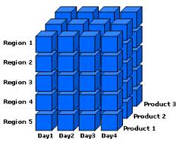

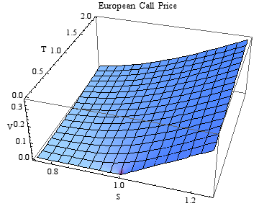
Benchmarks
Recommender
Text Search
Hash Table
H1
H2
H3
H4
H5
OLAP Cubing
BTree
Black-Scholes

Slide 23
Evaluation – Setup
OOO CORE
IO CORE
IO CORE
8
vs
vs
1KB
64 KB L1
32 KB L1
32 KB L1
OOO
MT (8 threads)
DASX
LLC – 4MB, 16 WAY, NUCA
DRAM – DDR2-400, 16GB, 4 Chn.
Notes:
Aminate and bring in separately?

Slide 24
Evaluation – Performance Breakdown
Normalized to OOO Core ( Lower is better)
1.25
1 In-Order Core at LLC
1.00
+ Collector
(data structure engine)
0.75
MT
– Address Gen. + Local Store
0.50
MT
0.25
X 8
0.00
D. Cube
(Memory Bound)
Black.
(Compute Bound)
Notes:
DASX-1 to DASX-8 : D.Cube (5.2X) Black. (7.1X) scaling

Slide 25
Evaluation – Performance
MT (8)
Notes:
D.Cube – Streaming memory application, benefits due to prefetching data and effective management of cache space (2 large arrays).
Reco – Again streaming but divergent branches
Btree – Only accelerate lookup, hardware specialization of traversal. L1 thrashing, repeated eviction of root node for OOO
HashTable – Lookup accelerated, no PEs involved. Flatter hierarchy.
BlackScholes and Text – Removal of instruction overheads, managing multiple data structures leads to average 15X improvement.

Slide 26
Evaluation – Energy vs Performance
Data-Cubing
OOO
MT-32
MT-16
MT-8
Energy
Best
DASX-8
DASX-4
Execution Cycles
Notes:
Bottom left better
Only talking about one workload
Even with half exec lanes, iso-performance with 3X better energy
Other evaluations present in paper – area, dram bandwidth utilization

Slide 27
Summary
Highlighted the challenges of data-centric workloads
Demonstrated the effectiveness of using data structure specific information
Data structure aware hardware accelerator achieves 4.4X performance improvement

Slide 28

Q & A

Slide 29
Backup
Percentage of data structure instructions – 30
Why collector groups? – 31
Energy breakdown – 32
Obj-Store details – 33
Address Translation for keys – 34

Slide 30
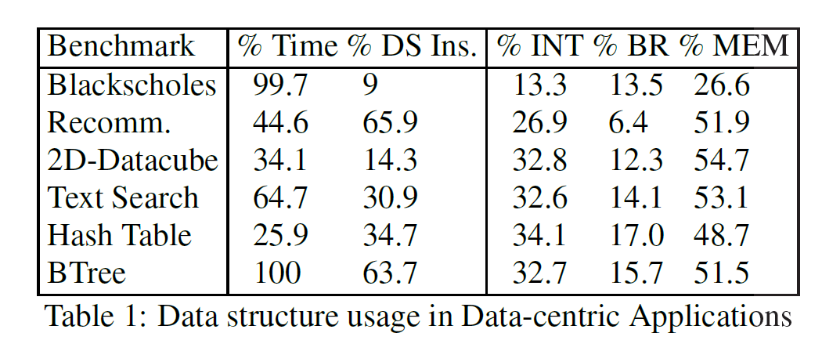
Percentage of data structure instructions

Slide 31
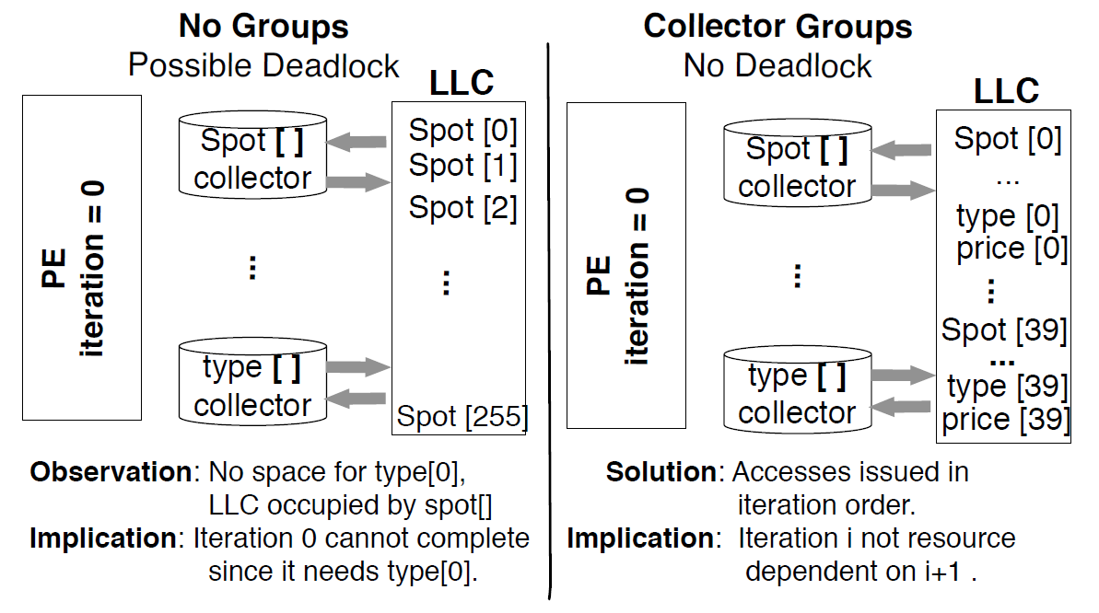
Why collector groups

Slide 32
Evaluation – Energy Reduction
Streaming
Cache Thrashing
Notes:
Blackscholes – L1 Thrashing – More LLC-L1 transfers, same for Btree

Slide 33
DASX – OBJ-Store
Reduce energy –
filter access to LLC
Organization : Decoupled sector cache (1KB)
Minimize tag overhead for vectors
Adapt to spatial locality (eg. struct fields)
Tag
Data
KEY
V/I
LLC*
LD / ST – PE
Write backs

Slide 34
DASX – Address Translation for Keys
Reduce energy overhead
Keys are coalesced by the collector into cache lines
Only one translation per line vs. per access
No reverse translation, due to back pointer (refer OBJ-Store)

