Slide 1

Fusion : Design Tradeoffs in Coherent Cache Hierarchies for Accelerators
Snehasish Kumar, Arrvindh Shriraman, Naveen Vedula

Slide 2

“It’s not about the FLOPS“ – Bill Dally, IPDPS 2011
0.5 pJ
ADD
8 pJ / mm
WIRE
ALU
Using accelerators – makes it worse!
Specialize compute
More data movement
Challenge – data migration
Notes:
For current generation systems, wires haven’t scaled as well compute. So the energy consumed during data transfer is a significant overhead.
For example, fetching operands over a mm of wire for an integer add costs 16 times as much as actually performing the addition.
Introducing accelerators makes the problem worse because
Now we have reduced the energy cost of computation by specialization
Introduced data movement to and from the accelerator
With the increasing use of accelerators, data migration cost is the key energy overhead we need to address.

Slide 3

Executive Summary
Inter – AXC Transfer
AXC
AXC
?
CPU
CPU
?
Coherent
Cache Hierarchy
?
CPU – AXC Transfer
Multicore Tile
Accelerator Tile
Notes:
Consider a split organization where fixed function accelerators are grouped in a tile.
So given an organization with distinct Multicore and Accelerator tiles, the questions we answer in this work are :
How to transfer data efficiently between the CPU and Accelerators
How to cache data efficiently within an accelerator tile
How to transfer data efficiently between accelerators

Slide 4
Outline
CPU and Accelerator Execution
Current approaches
Our approach : Fusion and Fusion-DX
Modeling, Benchmarks & Evaluation
Notes:
The rest of my talk is organized as follows.
I am going to discuss the key discerning features between sequential execution on a CPU versus that on an Accelerator using an example.
I will briefly touch upon a couple of current approaches employed
I will then describe our approach entitled Fusion and an optimized version, Fusion-Direct
Finally, I will conclude by describing our modeling infrastructure, benchmarks and evaluation

Slide 5
CPU Execution ( histogram )
contrast_enhancement (img) {
…
temp = FN1(img);
hist = FN2(temp);
temp = FN3(hist, temp);
res = FN4(temp);
…
}
CPU
FN4
FN3
FN2
FN1
Caches capture locality
Data
L1
Legend
Coherence moves data implicitly
img
temp
L2
hist
res
Notes:
The example consists of 4 functions which perform contrast enhancement.
As they execute in a sequential order, you can see the data allocated and retained in the cache memory hierarchy.
When the next function executes, the required data is supplied from the cache hierarchy.
Similarly for function 3 and finally function 4 produces the final resulting image.
The key feature of the sequential execution is
the caches capture locality
Coherence moves data implicitly when required.

Slide 6

Accelerator Execution ( histogram )
Legend
AXC1
AXC3
img
temp
hist
res
Caching or Scratchpad ?
Data needs to be transferred
Across tiles (CPU – AXC)
Between accelerators (AXC – AXC)
FN{X} mapped to AXC{X}
CPU
contrast
AXC2
AXC4
Notes:
Now let’s look at how execution would proceed on an accelerator tile.
Note that we have mapped functionX described in the previous slide to acceleratorX.
The storage and communication structures for the accelerator tile are depicted in a nebulous fashion as I will discuss the actual designs later on in my talk.
--Walkthrough animation—
The key difference is that the data now needs to be transferred across tiles and between accelerators.

Slide 7
Accelerator – Monolithic vs Modular
contrast
Modular + Cache Design
+ Data path reuse
? Data migration
? Coherence
? Virtual memory
AXC1
AXC3
Scratchpad-based Monolithic Design
+ Local communication
– No datapath reuse
– Extra local memory
FUSION
AXC2
AXC4
Notes:
The first question that comes to mind when trying to address
inter-accelerator communication overheads is why not just build a monolithic structure?
Monolithic approach localizes communication but now you don’t have any data path reuse and need to provision local storage inside.
A modular design enables data path reuse.
A cache hierarchy complements a modular approach
by automatically transferring and managing data instead of punting the problem to software.
However, we now need to address how to efficiently support
Data migration
Coherence
Virtual Memory
Our approach is entitled Fusion

Slide 8
Outline
CPU and Accelerator Execution
Current approaches
Scratchpad
Shared Cache (L1X)
Our approach : Fusion and Fusion-DX
Modeling, Benchmarks & Evaluation

Slide 9
Current Approach : Scratchpad
CPU
DMA
Scratch
L1
DMA
LLC
Scratch
+ Monolithic / Compute Intensive
– Fine grain data sharing
– No localized inter– AXC communication
Notes:
The scratchpad based model transfers data to and from
the private accelerator storage via explicit DMA operations.
This is a push based model, as data is pushed into the scratchpad via explicit software management.
→
This is great for monolithic or compute intensive accelerators. But not so good for fine grain data sharing or when inter-accelerator communication is frequent.

Slide 10
Scratchpad : Execution Timeline
LLC
Scratch
AXC2
Short term locality captured in scratchpad
1
LD temp
ST hist
2
– Inter-AXC transfer crosses tile boundary
TIME
Scratch
Extra DMA for inter-AXC transfer
AXC3
3
Multicore – Accelerator Tile Boundary
LD temp,hist
ST temp
4
Notes:
For the timelines I show you, only functions 2 and 3 are used to illustrate the designs.

Slide 11
Current Approach : Shared L1X [Zheng et al. TECS 2013]
MESI
CPU
L1D
Scratch
Scratch
L1X
LLC
Replace scratchpad with shared L1X
+ Enable sharing without DMA
– Every access incurs high penalty

Slide 12
Shared-L1X : Execution Timeline
LLC
SH-L1X
TILE MISS
AXC2
No local private storage!
TILE MISS
LD temp
ST hist
– Every access incurs penalty of accessing large L1X
TIME
AXC3
Inter AXC reuse captured by L1X
Shared cache for accelerators
LD temp,hist
ST temp
Multicore – Accelerator Tile Boundary
Notes:
Note that there is no private local storage for each accelerator, instead a shared L1 is introduced.

Slide 13
Outline
CPU and Accelerator Execution
Current approaches
Our approach : Fusion and Fusion-DX
Modeling, Benchmarks & Evaluation

Slide 14
Our Approach : Fusion
MESI
MESI
AXC Coherence
CPU
Add L0X
L1
L1X
L0X
L0X
LLC
TRANSLATE
L1X
Physical Address
Virtual Address
Notes:
Accelerator L1X is the only visible peer from the Multicore tile.
We only translate on misses from the L1X, I don’t have the time to discuss it here, please refer to the paper for a discussion.

Slide 15
Fusion : Execution Timeline
LLC
SH-L1X
L0X
TILE MISS
AXC2
Add L0X
Intra-AXC reuse captured by L0X
TILE MISS
LD temp
ST hist
Features :
+ 2-level cache hierarchy
+ Localized coherence between AXCs
TIME
AXC3
Inter-AXC reuse captured by L1X
LD temp,hist
ST temp
Multicore – Accelerator Tile Boundary
Notes:
DMA is responsible not CPU.. When talking about this
Popup right after B, not at end
Dotted line to show tile separation. Move to right side make the LD, ST smaller.
Big Conclusion – Everytime 1 acc talks to another , data has to make a round trip.

Slide 16
Fusion-DX : Producer – Consumer
LLC
SH-L1X
L0X
TILE MISS
AXC2
Write Back
+L1X Access
TILE MISS
LD temp
ST hist
Feature :
Fusion + Reduce energy by forwarding data from Producer to Consumer
PRODUCE
TIME
FWD
Request
+L1X Access
CONSUME
AXC3
LD hist,temp
ST temp
Response
Notes:
We found a common producer – consumer pattern amongst the workloads we studied.

Slide 17
Fusion – Implementation Details
Temporal or LCC [Singh. HPCA 2013, Shim MIT-TR 2011]
Data exclusive between CPU and accelerator tile
Translate only on tile miss
+ Write Caching
→ Reduce spurious invalidation
traffic across tiles
→ Fewer TLB accesses
Notes:
We build the Accelerator Protocol on timestamp based, self invalidating proposals such as Temporal Coherence
and Library Cache Coherence.
A key difference is that both these works advocate the use of Write Through private caches whereas we found Write Caching an important feature for our workloads. Implementing write caching is non-trivial for such type of protocols and more details can be found in the paper.
Data is exclusively cached between CPU and accelerator tiles; this reduces invalidation traffic across tiles.
Address translations are only performed on accelerator tile misses, this reduces the TLB accesses by operating in a virtual address space.

Slide 18
Outline
CPU and Accelerator Execution
Current approaches
Our approach : Fusion and Fusion-DX
Modeling, Benchmarks & Evaluation

Slide 19


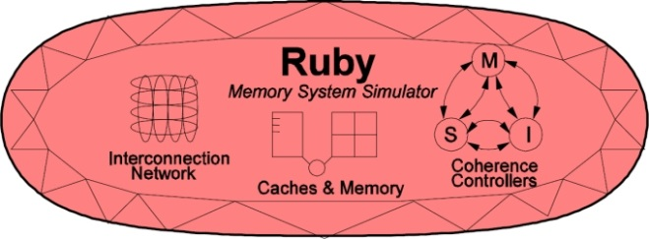
Modeling
Sequential Program
Accelerator Analysis
contrast_enhancement (img) {
…
temp = rgb2hsl (img);
hist = histogram (temp);
temp = equalize (hist,temp);
res = hsl2rgb (temp);
…
}
rgb2hsl
histogram
rgb2hsl
histogram
equalize
hsl2rgb
equalize
hsl2rgb
LLVM
+ acc
Run Binary
equalize
histogram
TRACE

Slide 20
Evaluation – Energy
Shared cache reduces frequent LLC accesses
MSGs for SHARED increases LINK energy, less in FUSION.
Compute Intensive
(Small data footprint)
More L1X accesses
increase energy
Notes:
The energy evaluation is broken down into energy spent in LINKS, Last Level Cache and Accelerator Caches / Scratchpad. The values are normalized to the Scratchpad baseline.
For DMA intensive applications, introducing a shared cache reduces the number of accesses to the LLC and saves energy. This can be seen from the diminished yellow stack.
For compute intensive applications, the Shared-L1X approach suffers from the high overhead of frequent accesses to the L1X. Additionally, there is a significant cost in sending messages over the link. The Shared L1X approach performs rather poorly but Fusion is comparable to the Scratchpad based approach.
Why is scratchpad vs cache access energy comparable? ---

Slide 21
Evaluation – Performance (Cycles)
Eliminate DMA, improve performance
Notes:
We do not show the Shared-L1X approach in this graph since it is not energy efficient compared to Scratch and Fusion. The message in this graph is simple, eliminating DMA improves performance as the Fusion design is able to
Overlap the memory accesses with the compute in a fine grain fashion.
Double buffering ? We want small scratchpads for energy, but double buffering needs 2x size scratchpad.
Also can’t double buffer producer-consumer.

Slide 22
Evaluation – Fusion-DX (Energy)
PRODUCER
CONSUMER
L0X
L0X
L1X
 | AXC Cache | AXC Link
FFT | 6.4% | 16.9%
TRACK | 1.5% | 5.7%

Slide 23
Evaluation – Others
As wire energy begins to dominate Write-Through vs Write-Back caching becomes an interesting tradeoff.
Optimizing for hit energy is important. Larger not better?
L0X (x2) and L1X (x4) resulted in 48% increase in energy
Moving translation to tile miss path reduces energy overhead.
In Fusion, address translation accounts for 1% energy

Slide 24
Summary
Managing data movement and locality for accelerators is important
Two level cache hierarchies + coherence for accelerators is useful
Evaluated our design Fusion and highlighted the tradeoffs between data movement strategies in accelerators

Slide 25

Q & A
Thank you

Slide 26
Backup
Evaluation : Performance Cycles (including Scratch) – 27
Characteristics (FFT, Disparity, Tracking) – 28
Characteristics (adpcm, Susan, filter, hist) – 29
DMA Breakdown – 30
Virtual Memory Lookups – 31
Accelerator Execution Metrics – 32

Slide 27
Evaluation – Performance (Cycles)
Notes:
ADPCM, SUSAN, FILTER – Working set size less than 30kb with less DMA.

Slide 28
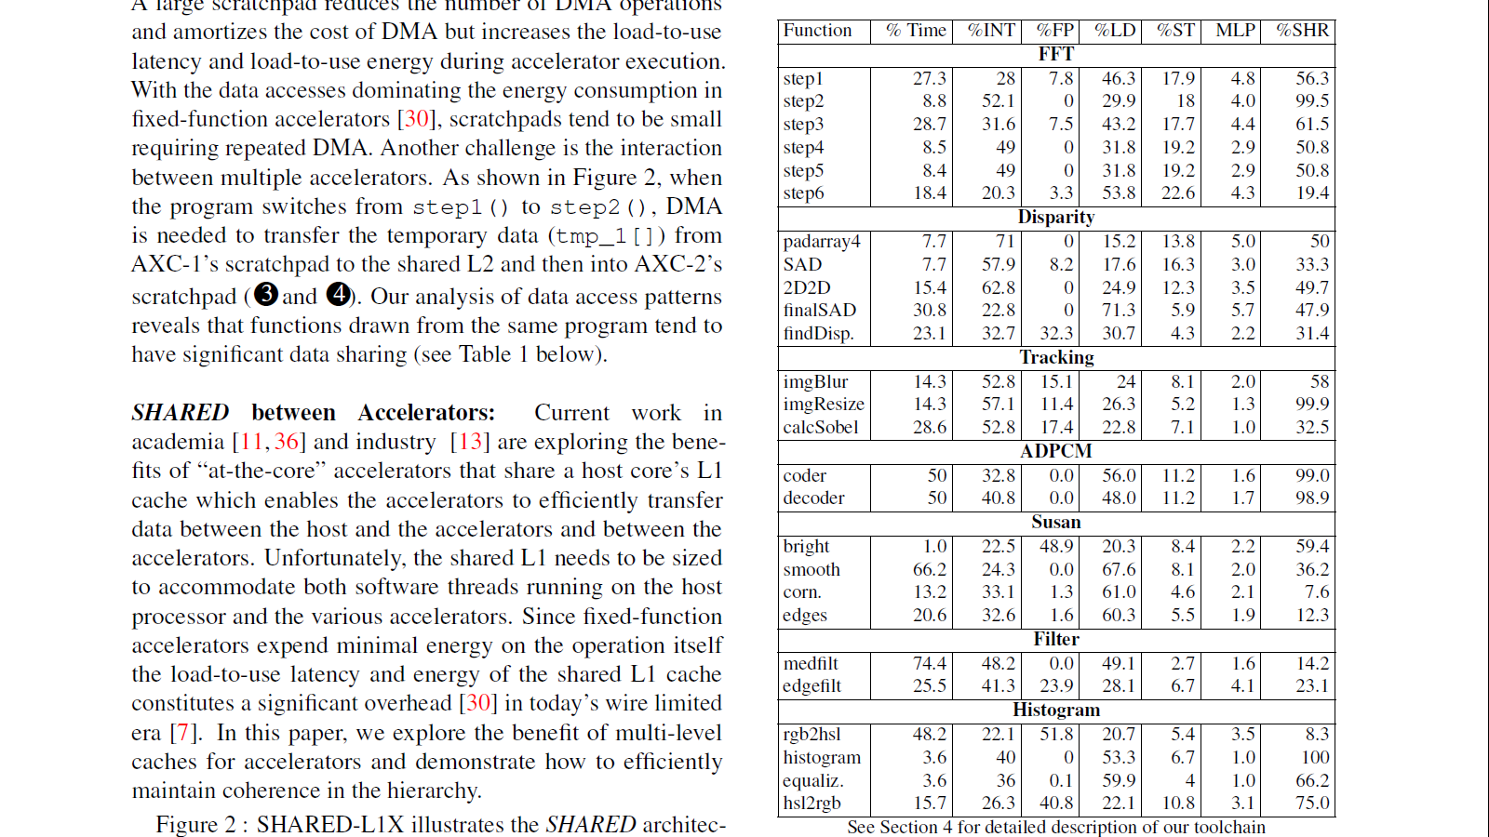
Benchmark – Characteristics (1/2)

Slide 29
Benchmark – Characteristics (2/2)

Slide 30
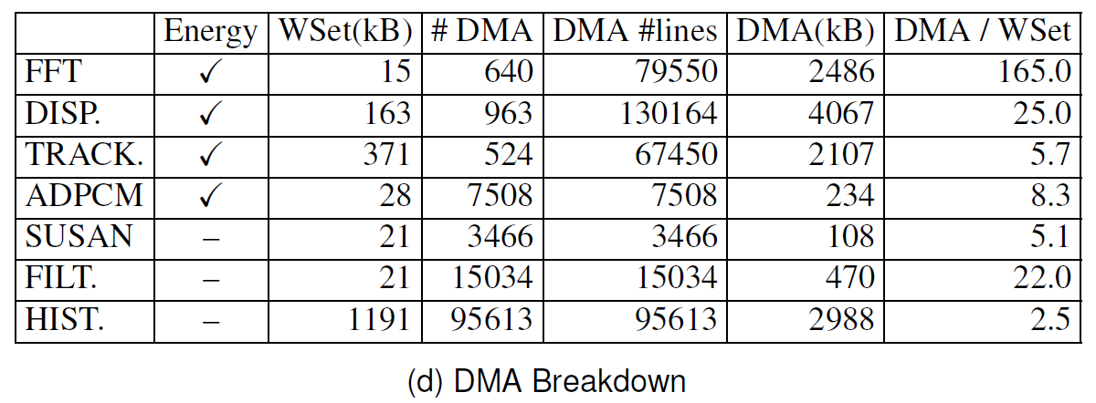
DMA Breakdown

Slide 31
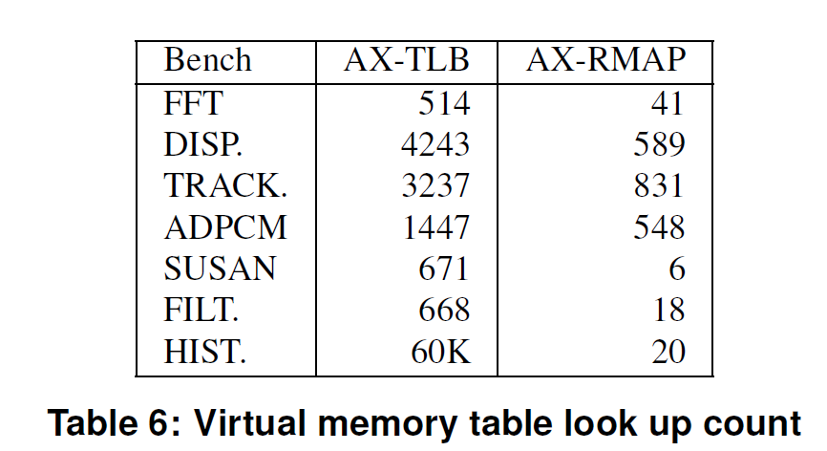
Virtual Memory Lookups

Slide 32
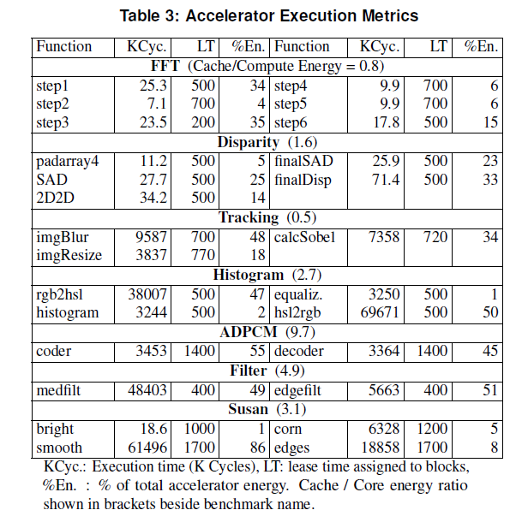
Accelerator Execution Metrics

