Slide 1
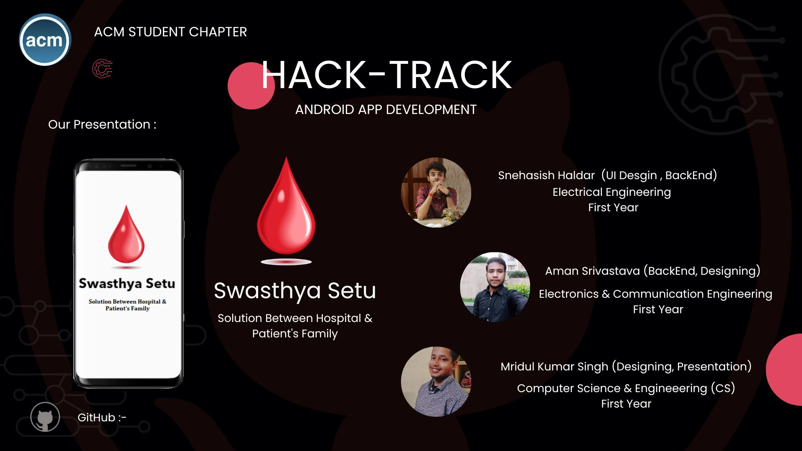
https://github.com/snehasishhaldar/Swasthya_Setu.git

Slide 2

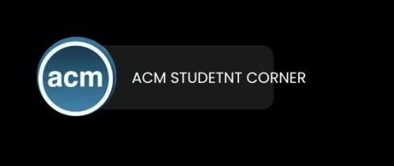
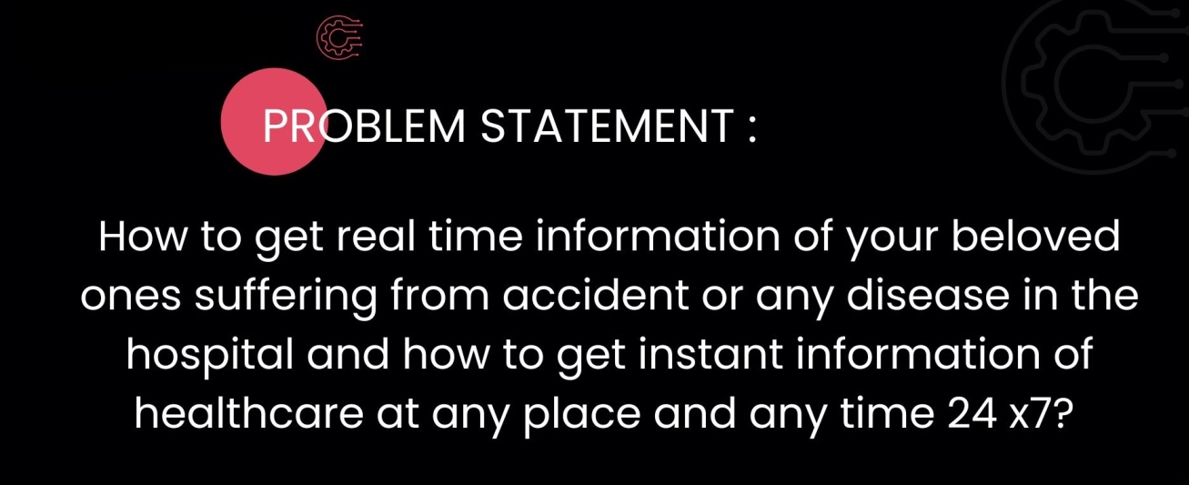


Swasthya Setu
Solution:-
The most revolutionary app ever thought. It’s not just an app it’s a revolution in medical science and way of connection between doctor, patient and hospital .it increases the trust which is most important thing which you do whenever you go to any hospital or doctor if you don’t have trust on doctor ,you think you will be cheated he/she will charge you more.
Many cases have been encountered that dead bodies kept for 3 to 4 days and bills are piling up, making money from a dead body of a person. This is the dark side of the medical industry. This all things brings you to a situation of hopelessness and not able to build trust on anyone.
But here come SWASTHYA SETU to bring back your hope and your trust. Our app with real time monitoring system gives you A to Z information about the patient .Patient details, medicine give to the patient, doctor details who are seeing the patient, lab report of patient, blood bank details and availability of blood in blood bank of, hospital details in which the patient is admitted, room number, bed number, location of the hospital, patient’s BP and whether the patient is alive or dead with emergency alarm system. This app provides you number of the ambulance, number of hospitals located in the area on an instant basis based on your GPS location.

Slide 3
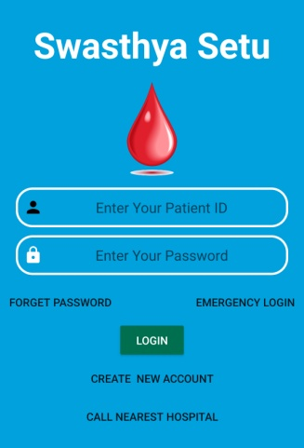
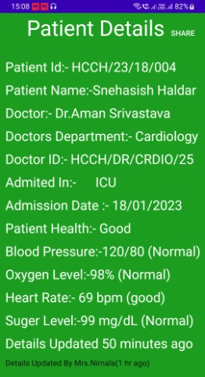
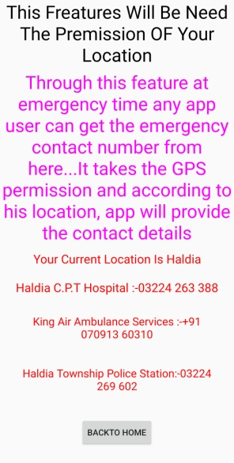
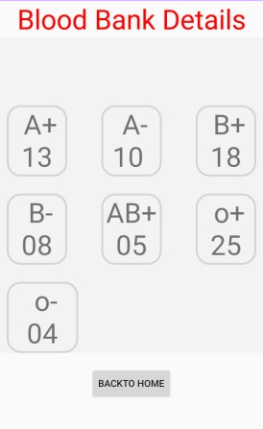
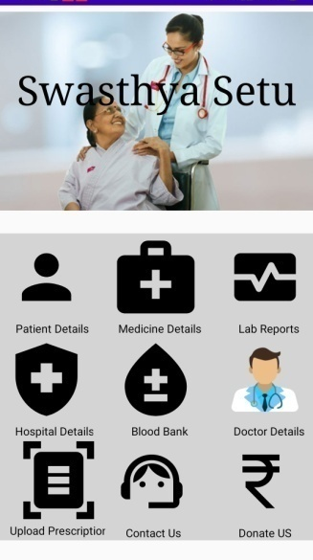
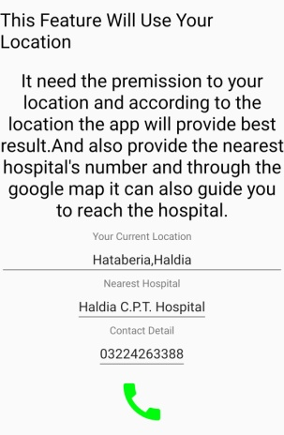

APPLICATION FREATURES AND DETAILS
Swasthya Setu
LOGIN PAGE :- Through login page , using patient id & password you can login into app & check the full details of your patient
EMERGENCY LOGIN:- In this function You can get the details of your nearest hospital, ambulance & etc details based on your GPS Location
CALL NEAREST HOSPITAL:- Through this function, get the hospital phone number based on your location
MAIN PAGE:- After login in this app this page will display , it’s provide you PATIENT DETAILS, MEDICINE DETAILS, LAB REPORT,HOSPITAL DETAILS, BLOOD BANK DETAILS, DOCTOR DETAILS, UPLOAD PRESCRIPTION.
PATIENT DETAILS:- This page provide the details of patient health conditions ,etc. with last updated time. Also You Can share the details with any one.
MEDICINE DETAILS:- It Provides You The Proper Medicine Details Which is Taken By The Patient.
LAB REPORT:- You can get the Lab report of patient in this page.
BLOOD BANK :- You will get the live blood bank details .Stock Of Bloods and Donor Details with Contact Number.
UPLOAD PRESCRIPTION:- On any Emergency time you can upload the prescription and it will directly forwarded to hospital , So they can provide you the correct solution.
GitHub

Slide 4

Future Goals:-
Swasthya Setu
This is a full stack solution for a proper functional, medical system. This provides 100% clarity to the patient family and hospital both. So, there is no space for fraud .A very big hammer on the corruption going in medical industry and saving lots of innocent people who are being bluffed and cheated in the medical field every day. This is not only an app it’s a revolution, revolution in life in life of thousands of people and revolution in medical field and our aim to reach this revolution to the whole mankind, humanity and the whole world.
IMPLIMENTATION IN FUTURE:-
24 X 7 Online Doctor Consultancy
We will have an AI Enabled Health Intelligence System With Accident Alarm
AI Medicine Guidance
Free Of Cost Services For Differently Abled Persons
- Thank You –
Swasthya Setu Family

