Slide 1

GROUP- 7
VEHICLE SERVICE
MANAGEMENT SYSTEM
A Modern Solution for Service Centers
1. Souvik Ghosh Roll No: 108250600263
2. Snehasish Kundu Roll No: 108250600245
3. Sansuddhi Mukhopadhyay Roll No: 108250600210
4. Sneha Tiwari Roll No: 108250600244
Under The Guidance of : Asst. Professor Bikram Saha
Institute Name : Asansol Engineering College

Slide 2
🚀 Introduction
A console-based application to streamline vehicle service operations.
Replaces manual record-keeping with digital workflows.
Core Features:
Vehicle Registration
Service History Tracking
Secure Authentication
Built with C for high performance and reliability.

Slide 3
🎯 Problem & Objective
The Problem:
⚠️ Manual records are error-prone and easy to lose.
⚠️ Searching old history takes too much time.
⚠️ No security restricts access to sensitive data.
The Objective:
✅ Build a lightweight, efficient tracking system.
✅ Implement Role-Based Access (Admin/User).
✅ Ensure permanent data storage without complex SQL.

Slide 4
⚙️ System Workflow
1. Start Application ➡️ Welcome Screen
2. Authentication 🔒
Login (Admin/User) or Register New Account.
3. Role-Based Dashboard 🖥️
Admin: Manage Vehicles, Services, Reports.
User: View History, Search Status.
4. Data Processing 💾
Inputs verified and saved to .dat files.
5. Exit 🛑

Slide 5
💻 Requirements
Hardware (Minimalist):
Processor: i3 or any modern CPU.
RAM: 4GB recommended.
Storage: < 50MB disk space.
Software:
OS: Windows 10/11.
Terminal: PowerShell or Command Prompt.
Compiler: GCC (MinGW) for development.

Slide 6
🛠️ Tech Stack
Language: C (Standard C99) - Core Logic.
IDE: Visual Studio Code.
Compilers: GCC / Make tools.
Scripts: Batch (.bat) for auto-compilation.
Design: ANSI Escape Codes for CLI Colors.
Version Control: Git & GitHub.

Slide 7
⚙️Technologies/Tools Used
Programming Language: C
Concepts Used:
File handling
Structures
Functions
Development Tools:
GCC Compiler
VS Code / CodeBlocks
Platform: Desktop based application

Slide 8
🧩 Implementation
Modular Architecture:
📄 auth.c: Login/Register & Encryption.
🚗 vehicle.c: Vehicle Inventory Management.
🔧 service.c: Service job Tracking.
🎨 ui.c: Styling & Interface Helpers.
Key Techniques:
Binary File I/O (fread/fwrite).
Pointers for efficient memory usage.
Structs for data modeling.

Slide 9
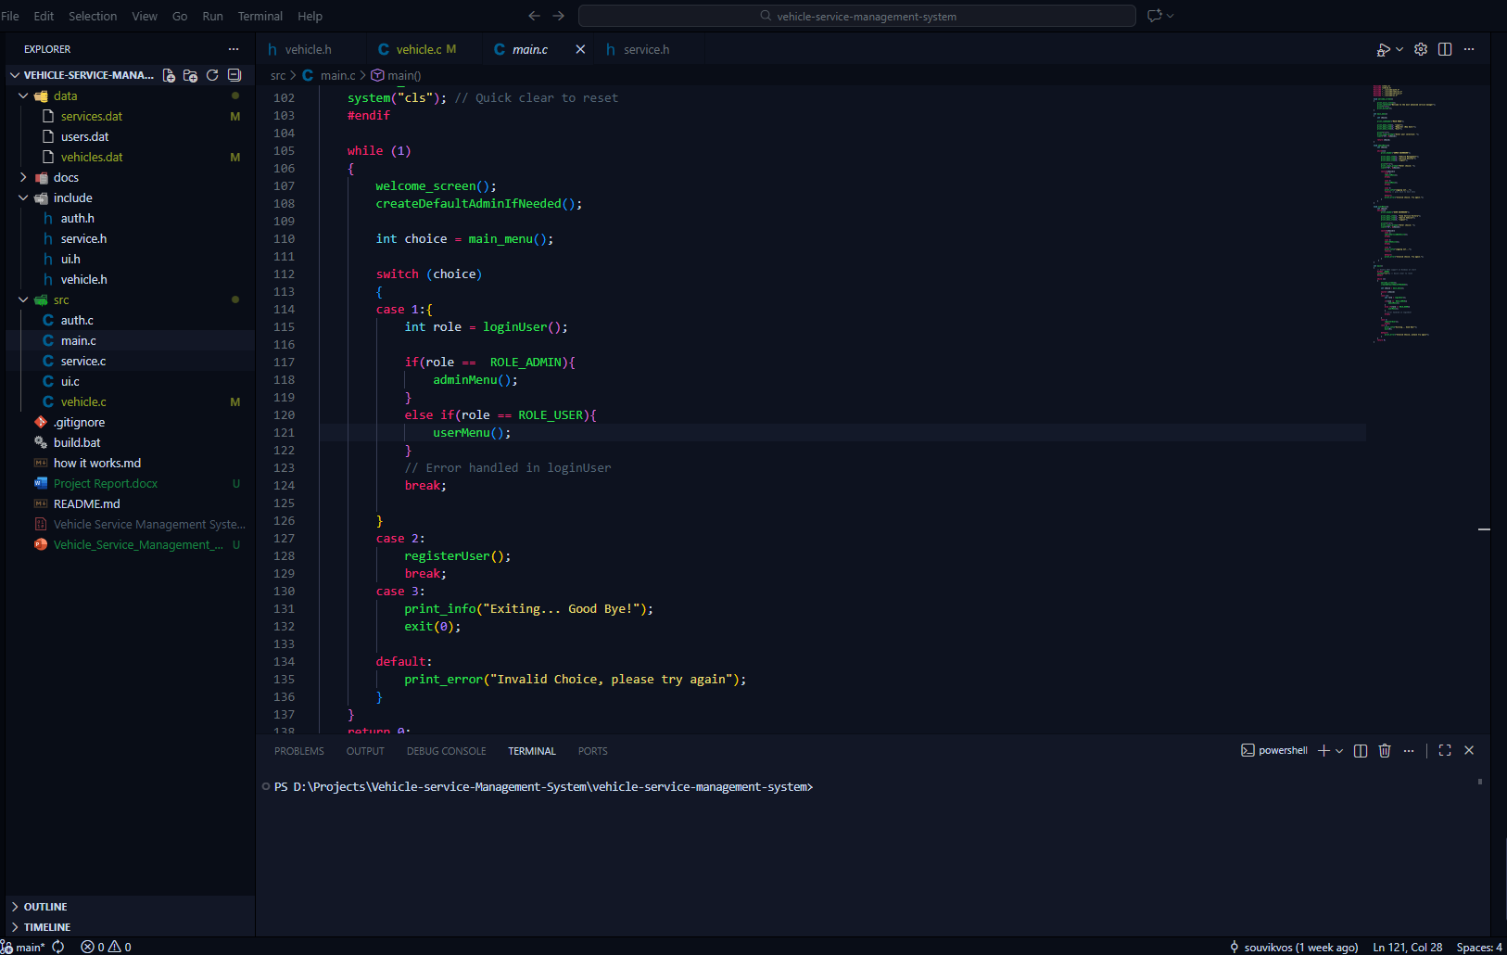
📸Snapshots:
The Folder structure

Slide 10
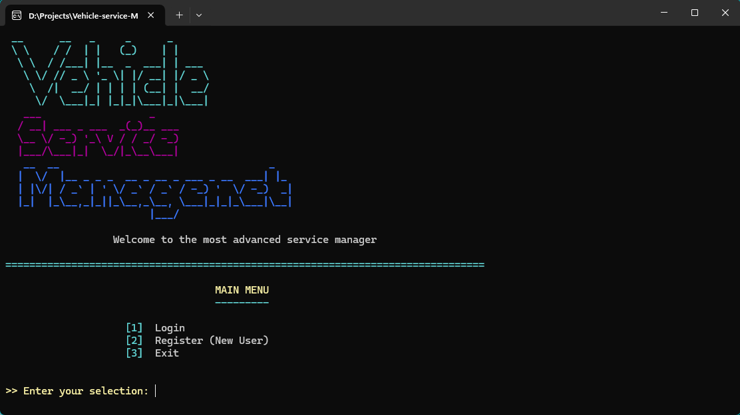
The Welcome Screen / Auth Interface

Slide 11
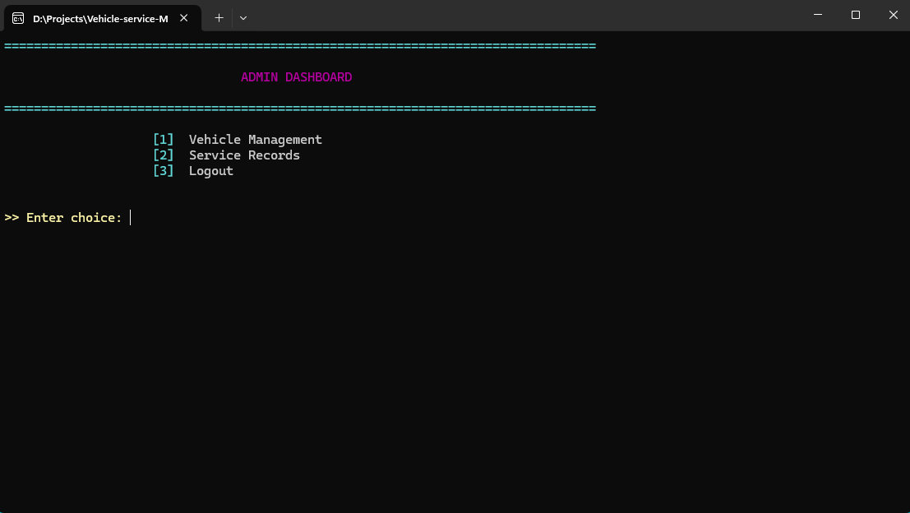
Admin Dashboard / Menu

Slide 12
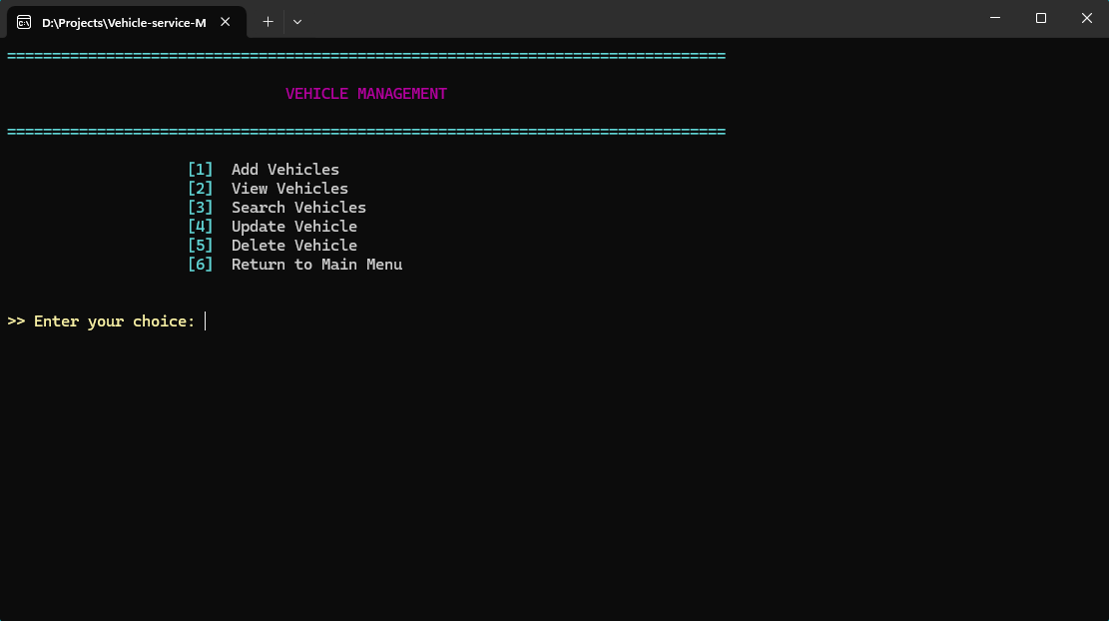
Vehicle Management Menu

Slide 13

User Dashboard / Menu

Slide 14
📊 Results
✅ Successful Deployment on Windows.
✅ Admin Can easily Add,update or delete Vehicles.
✅ Instant Search functionality for finding vehicles.
✅ Zero-Crash stability during file operations.
✅ Professional CLI look with Green/Red status indicators.
✅The system successfully stores and manages vehicle service records.
✅Users can easily add, view, and search service details.
✅All data is saved permanently using file handling, even after the program is closed.
✅The output generated by the system is accurate and reliable.

Slide 15
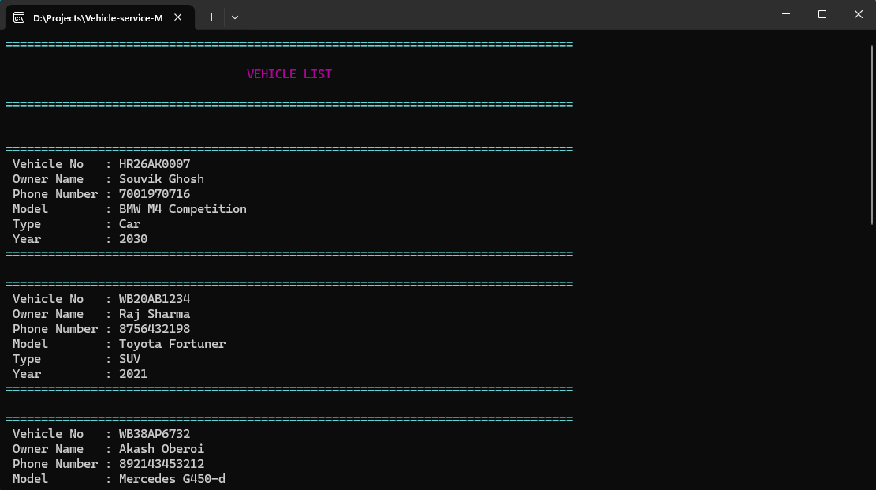
📊📸Result Snapshots
View Vehicles :Shows all vehicles list (Can only be accessed by admin)

Slide 16
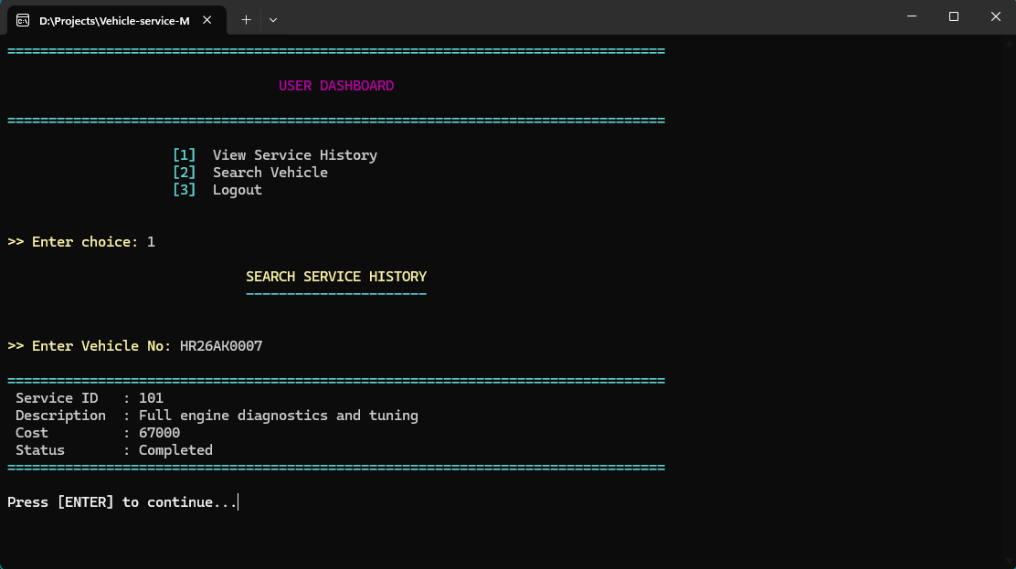
Service History: Shows Service History of Vehicle using Vehicle No. (For User)

Slide 17
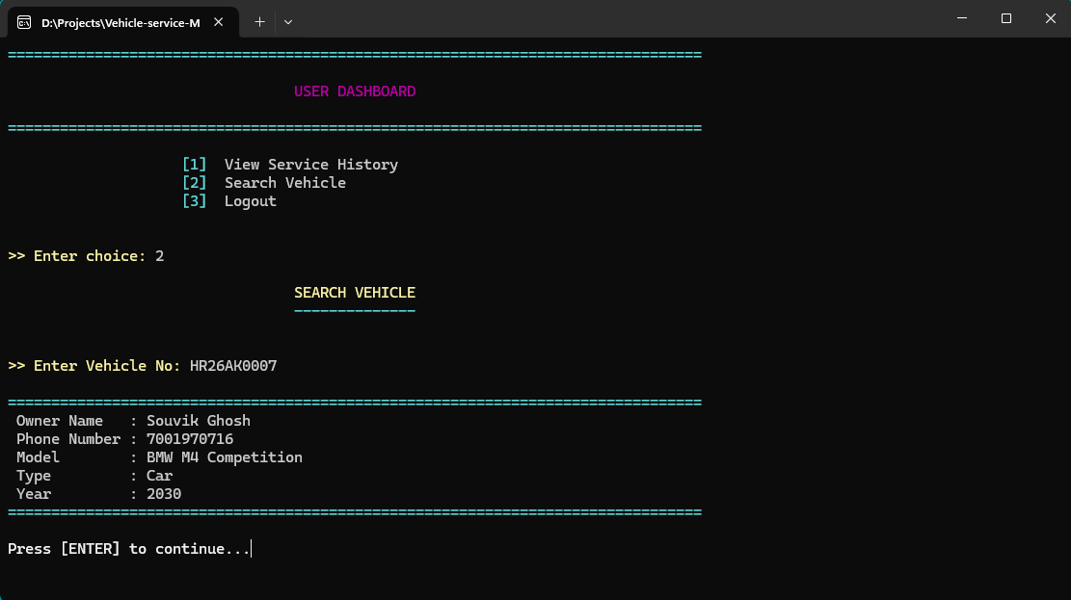
Search Vehicle : Shows the details of vehicle after taking Vehicle No.(For Both User and Admin)

Slide 18
⚖️ Analysis
Advantages:
⚡ Blazing Fast (No bloatware).
🔒 Secure Data (Local binary storage).
🎒 Portable (Single .exe file).
Disadvantages:
⌨️ Keyboard Only (No mouse support).
🌐 No Online Sync (Local only).
📉 Scaling limits with file-system DB.

Slide 19
🔮 Future Enhancements
Graphical User Interface (GUI):
Migrate to Qt framework for mouse support.
Database Upgrade:
Move from .dat to SQLite/MySQL.
Billing Module:
Generate PDF Invoices automatically.
Networking:
Allow multiple computers to access the same DB.

Slide 20
📝 Conclusion
The Vehicle Service Management System provides an efficient solution for managing vehicle service records.
It replaces the traditional manual system with a computerized and structured approach.
The use of C programming language, structures, and file handling ensures reliable data storage.
The system reduces errors, saves time, and improves overall productivity.
This project helps in understanding real-world application of C concepts.
Overall, the project is successful and fulfills all the defined objectives.

Slide 21
THANK YOU
Any Questions?
Source Code on GitHub

