Slide 1
Skin Cancer Detection
MTH 522 Final Project
Comparing Logistic Regression, Random Forest, SVM, and Cross-Validation
Authors: Rohanraje Bhosale, Sneha Sonkusare & Rohit Parihar

Slide 2
Motivation
WHY
Skin cancer is among the most common types of cancer globally.
Early detection is crucial.
WHAT
Aim to evaluate the performance of Logistic Regression, Random Forest, and Support Vector Machine (SVM) models, and incorporate Cross Validation techniques.
HOW
Data Collection and Preparation
Model Implementation
Evaluation

Slide 3
ABOUT THE DATASET
The dataset represents each pixel of the image.
Each cell in the dataset ranges from 0 to 255 where the number denotes the color of the pixel from the colour pallet.
It contains over 600 images categorized into seven common skin lesion types based on expert assessments.

Slide 4
Logistic Regression
Overview: Logistic Regression is a statistical model.
Mechanism: The model predicts the probability.
Application: Its simplicity and interpretability make Logistic Regression a popular
Random Forest
Overview: Random Forest is an ensemble learning method.
Mechanism: Each tree in the forest is built from a random sample of the training set.
Application: This model is effective in handling complex datasets

Slide 5
Support Vector Machine (SVM)
Overview: SVM is a powerful classifier.
Mechanism: SVM uses techniques called kernels to transform data into a higher dimension.
Application: SVM is renowned for its effectiveness in high-dimensional spaces.
Cross Validation
Overview: Not a model but a technique to evaluate the effectiveness of the models.
Mechanism: The most common method is k-fold cross-validation.
Application: It helps to ensure that the model's findings are not dependent on how data is split.

Slide 6
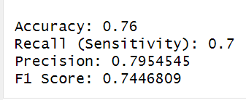
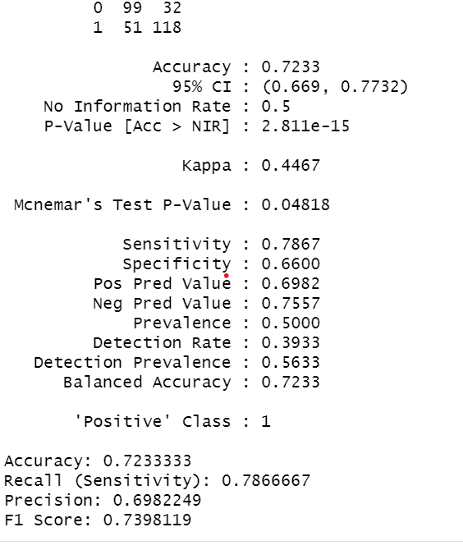
Results
Logistic Regression:
Random Forest:

Slide 7
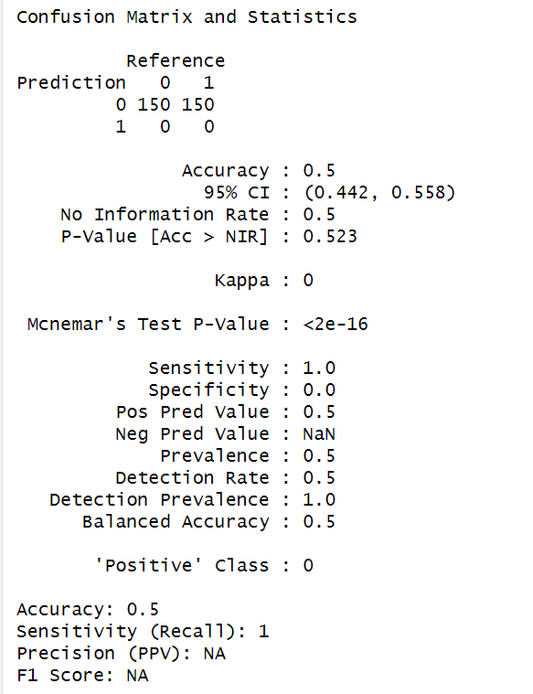
Result(Continued..)
Support Vector Machine:

Slide 8
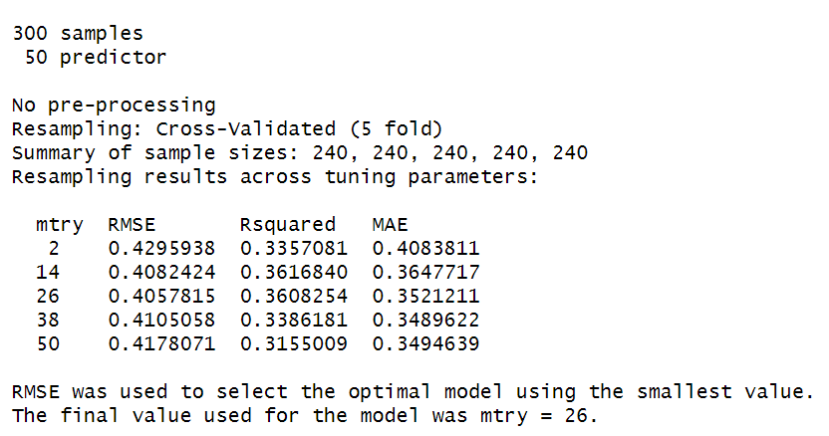
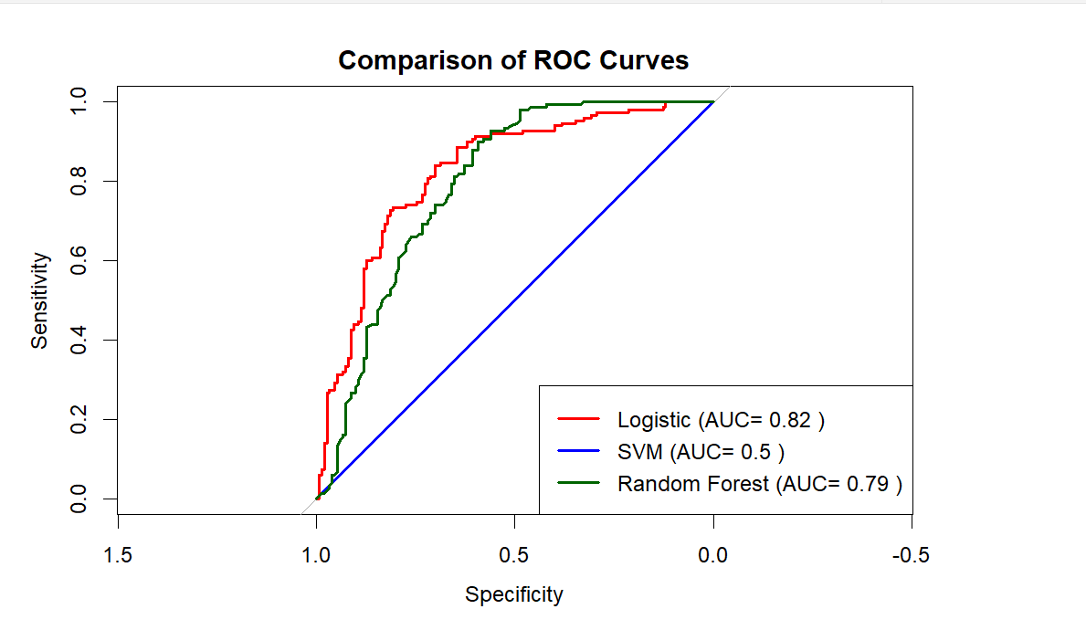
Result(Continued…)
Cross Validation:
ROC curve:

Slide 9
Conclusion/Discussion
This project underscores the potential of machine learning in medical diagnostics.
We found that while no single model was universally superior, Logistic Regression and Random Forest performed well in our tests.

Slide 10
Future Scope
Hyperparameter Optimization: Further tuning of model parameters could yield improvements in model performance.
Cross-Validation: Implementing more robust cross-validation techniques to ensure the models' stability and generalizability.
Feature Engineering: Exploring more detailed feature selection and engineering techniques to enhance model accuracy.

Slide 11
Team Member's Contributions
Each team member contributed equally to different aspects of the project, from data preparation to model implementation and result analysis.
Average communication and discussion time: 12 + hours

