Slide 1
E-AUTHENTICATION SYSTEM USING QR CODE AND OTP
Minor Project

Slide 2
Contents
Introduction
Abstract
Problem Statement
Existing System
Limitations of Existing system
Proposed System
System Requirement Specifications
System Design
Implementation
Result
Conclusion
Thank you
Any Queries

Slide 3
Introduction
The project aims to implement E-Authentication methods using One-Time Passwords(OTP) and Quick Response(QR) codes. By leveraging these technologies users can securely authenticate their identities for various online services.
The system will generate OTPs and QR Codes ensuring a robust authentication process, enhancing security , and user convenience.
The system uses QR code and OTPS to authenticate users and prevent the unauthorized access, fraud, and identify theft.

Slide 4
Abstract
In this project we develop E-Authentication System using QR code and OTP for
the Students Attendance System. The use of QR code-based technologies and
applications has become prevalent in recent years where QR codes are accepted to
be a practical and intriguing data representation / processing mechanism amongst
worldwide users.
The aim of this study is to design and implement an alternative two-factor identity
authentication system by using QR codes and to make the relevant mechanism
and process that could be more user-friendly and practical than OTP mechanisms.
The proposed system has been designed in order to enable verification and
validation steps with security and networking options during the login process.

Slide 5
Problem Statement
Develop a secure and efficient E-Authentication System utilizing a combination of QR codes and OTP (one time password) technology. The System should provide seamless authentication for users while ensuring high levels of security to protect sensitive information.

Slide 6
Existing System
In “A Secure mobile payment system using QR code” paper, the authors proposed a
state of affairs for mobile payment that tackles each considerations of the methods,
namely: speed of group action and security, while not complicating the method or
creating it undesirable to users.
In the system “Advanced online banking authentication system using One-Time
Passwords embedded in QR code”, The authors explained implementation details of
online banking authentication system.
Secure mobile transaction authentication, the authors contributed with the QR-Tan
authentication technique. QR-Tan authentication area unit a dealing authentication
technique supported two dimensional bar codes.

Slide 7
Limitations of Existing System
The most drawbacks is that data on the web may be haphazardly changed by malicious code.
Easily hacked by Intruders/hackers.
Very traditional method of using passwords or using complex passwords makes to store the data somewhere so it is mostly leakable to some other easily.
Need to change the password in regular interval of time

Slide 8
Proposed System
In the proposed scheme, the user can easily and efficiently login into the system. We analyze the security and usability of the proposed scheme, and show the resistance of the proposed scheme to hacking of login credentials, shoulder surfing and accidental login.
In order to use this authentication system, user need to first register himself into this system by filing up the basic registration details. After a successful registration, user can access the login module where he/she need to first authenticate the account by entering the email id and password which was entered while registration. Once the email id and password is authenticated, the user may proceed with next authentication section where he/she need to select the type of authentication as QR (Quick Response) Code and OTP (One Time Password).

Slide 9
System Requirement Specifications
HARDWARE REQUIREMENTS
System : Pentium i3 Processor
Hard Disk : 500 GB
. Monitor : 15’ LED
Input Devices : Keyboard, Mouse
Ram: 2GB
SOAFTWARE REQUIREMENTS
Operating System : Windows 10
Coding Language : JAVA
Tool : Net-beans 8.2
Database : MYSQL
9

Slide 10
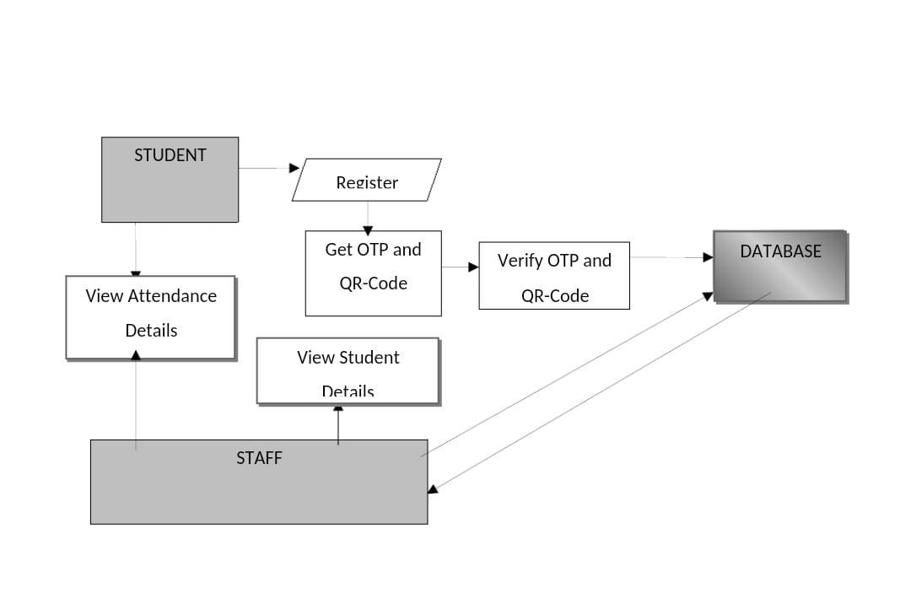

System Design

Slide 11
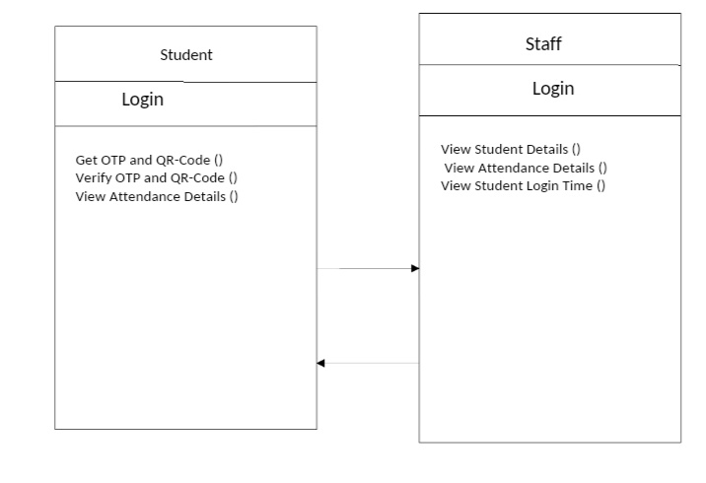
Class Diagram:

Slide 12
Implementation
MODULES:
This project contains following modules:
1. Registration
2. Login
3. OTP Verification
4. Scan QR codes
5. Main page access
MODULE DESCRIPTION:
Registration:
To access the system, user need to first register by entering the basic registration details like name, email id, mobile number, gender, etc.

Slide 13
Login:
If the login credentials are validated by the system, the page will be redirected to user authentication page where user need to select any one authentication type as OTP or QR Code.
OTP Verification:
If user select's OTP authentication, then system will send an OTP in the form of SMS on the registered mobile number which was provided by the user at the time of registration.
Scan QR Code:
If user select's QR code, then code is generated in backend and sent on the user's email id.User need to scan the QR Code using system webcam to validate the QR Code sent over the mail.
Main Page Access:
If the user passes the authentication process, then the page will be redirected to Main Page else, it will redirect to login page.

Slide 14
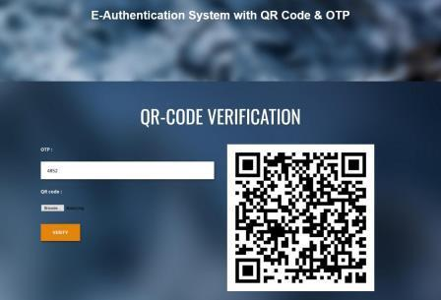
Result

Slide 15
Conclusion
In conclusion, an E-Authentication System using OTP and QR code is a secure and efficient way of authenticating users for online services. The system offers an easy-to-use and accessible way for users to login securely and reduce the risk of unauthorized access.
The system’s use of OTP and QR code technologies ensures that the users identity is verified in timely and secured manner. The system’s design allows for flexibility, scalability, and ease of integration with other systems.

Slide 16
THANK YOU!

