Slide 1
FAKE PROFILE DETECTION USING
MACHINE LEARNING

Slide 2
CONTENTS
Introduction
Abstract
Problem statement
Existing system
Limitations of Existing System
Proposed System
Advantages
System Requirement Specifications
System Design(UML Diagrams)
Model Implementation
System Workflow
Results
Performance Evaluation
Future Work
Conclusion
Bibliography

Slide 3
INTRODUCTION
Nowadays, online social media is dominating the world in several ways. Day by day the number of users using social Media is increasing drastically.
The main advantage of online social media is that we can connect to people easily and communicate with them in a better way.
This provided a new way of a potential attack, such as fake identity, false information, etc.
A recent survey suggest that the number of accounts present in the social media is much greater than the users using it.This suggest that fake accounts have been increased in the recent years. Online social media providers face difficulty in identifying these fake accounts.

Slide 4
ABSTRACT
Social media platforms (Facebook, Twitter, Instagram, LinkedIn, etc.) are rapidly growing, but face rising issues of fake accounts.
Fake profiles (created by humans, bots, or computers) spread false information, scams, phishing, and identity theft.
Detecting these accounts is a major challenge for social media providers.
This project proposes a fake profile detection model using machine learning & boosting techniques.

Slide 5
PROBLEM STATEMENT
The rise of fake profiles on social media leads to issues like misinformation, fraud, and cybercrime. Manual detection is ineffective, so this project aims to build a machine learning-based system to automatically classify user accounts as real or fake using profile and activity features.

Slide 6
EXISTING SYSTEM
The existing systems use very fewer factors to decide whether an account is Fake or not. The factors largely affect the way decision making occurs. When the number of factors is low, the accuracy of the decision making is reduced significantly.
There is an exceptional improvement in fake account creation, which is unmatched by the software or application used to detect the fake account. Due to the advancement in creation of fake account, existing methods have turned obsolete.
The most common algorithm used by fake account detection Applications is the Random forest algorithm.

Slide 7
The algorithm has few downsides such as inefficiency to handle the categorical variables which has different number of levels.
Also, when there is an increase in the number of trees, the algorithm's time efficiency takes a hit.

Slide 8
LIMITATIONS OF EXISTING SYSTEM
Limited Factors Considered – Only a few profile/activity features are analyzed, leading to lower accuracy.
Obsolete Techniques – Fails to keep up with advanced fake profile creation strategies.
Random Forest Drawbacks –Struggles with categorical variables having multiple levels. Increased trees higher time complexity and slower performance.
Scalability Issues – Cannot efficiently handle very large datasets from real-time social media.
Generalization Problem – Models may overfit and fail to detect newly emerging fake account patterns.

Slide 9
Generalization Problem – Models may overfit and fail to detect newly emerging fake account patterns.
Lack of Real-Time Detection – Most systems are offline and not suitable for live social media monitoring.

Slide 10
PROPOSED SYSTEM
The gradient boosting algorithm is similar to the random forest algorithm in that it relies heavily on decision trees. We have modified the way we find fake accounts, using new approaches to locate them. Spam commenting, interaction rate, and artificial behaviour are some of the techniques used.
The gradient boosting algorithm uses these inputs to build decision trees, which are then used in the gradient boosting algorithm. Even if some inputs are missing, this algorithm produces a result. This is the primary reason for using this algorithm.

Slide 11
We were able to obtain extremely accurate results by using this algorithm. XGBoost and GBM performed brilliantly when compared with the previous work. It outperforms the accuracy of fake account identification by a large margin even with the default values of the hyperparameters provided in. Finally, we achieved a better result than earlier attempts.

Slide 12
ADVANTAGES
Handles Missing Data – The algorithm can still produce reliable results even if some inputs Higher Accuracy – Gradient Boosting (GBM/XGBoost) outperforms Random Forest with more precise classification of fake accounts are missing.
Considers More Features – Factors like spam commenting, interaction rate, and artificial behavior improve decision-making.
Robust Performance – Works well even with default hyperparameters and can be fine-tuned for better results.
Better Generalization – Reduces overfitting and adapts well to new fake account creation strategies.

Slide 13
Efficient for Complex Data – Handles categorical variables and high-dimensional data effectively.
Scalable – Suitable for large-scale social media datasets and real-time detection.

Slide 14
SYSTEM REQUIREMENT SPECIFICATION
Hardware Requirements:
Processor : Intel i3/i5 or equivalent (i7 recommended for faster training)
RAM : Minimum 4 GB (8 GB or more preferred)
Storage : 250 GB HDD / 128 GB SSD (SSD preferred)
Graphics : Basic GPU (optional, for faster ML model training)
System : Laptop/Desktop

Slide 15
Software Requirements:
Operating System : Windows / Linux / macOS
Programming Language : Python 3.x
Libraries/Frameworks : Scikit-learn(ML algorithms)
Pandas,
NumPy (data handling)
Matplotlib /Seaborn (data visualization)
TensorFlow / PyTorch (if deep learning is used
IDE/Tools : Jupyter Notebook / PyCharm / VS Code
Database : MySQL / MongoDB (if profile data is stored)

Slide 16
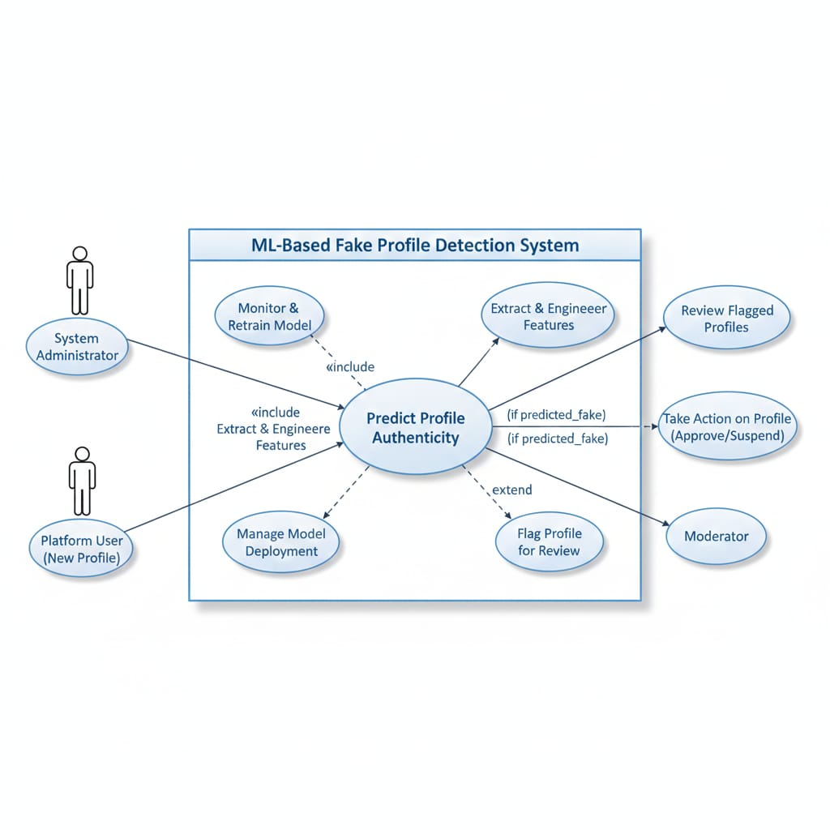
SYSTEM DESIGN (UML DIAGRAMS)
Use-Case Diagram:

Slide 17
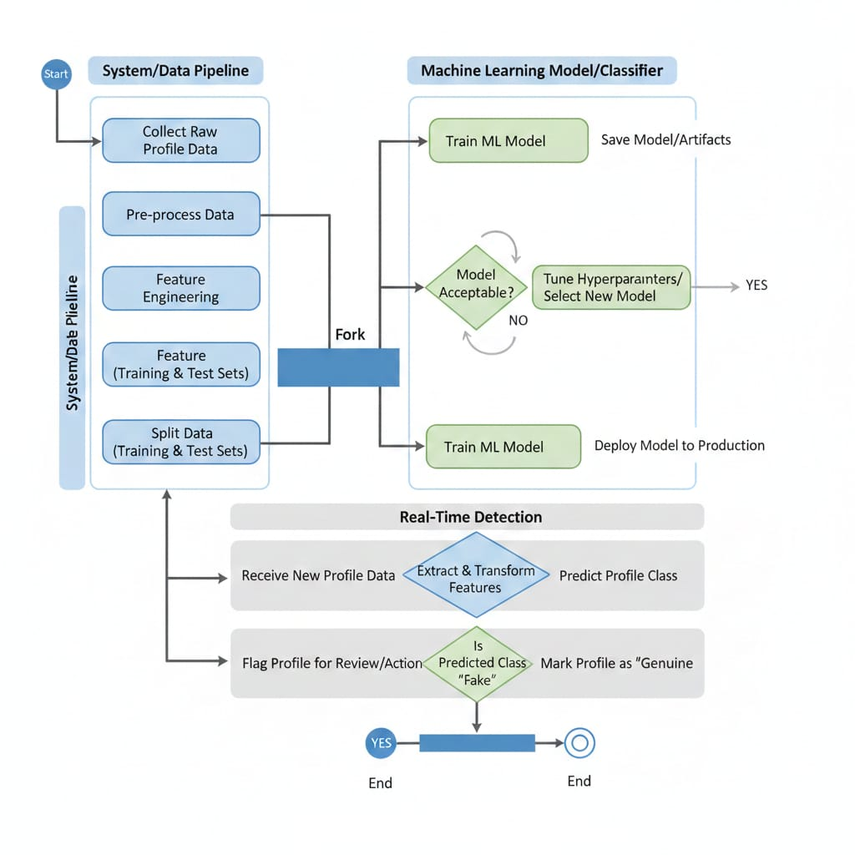
Activity Diagram:

Slide 18
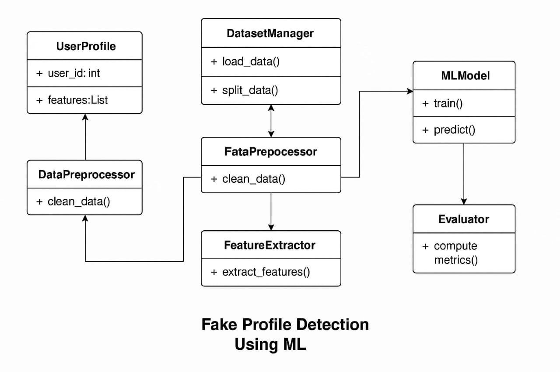
Class Diagram:

Slide 19
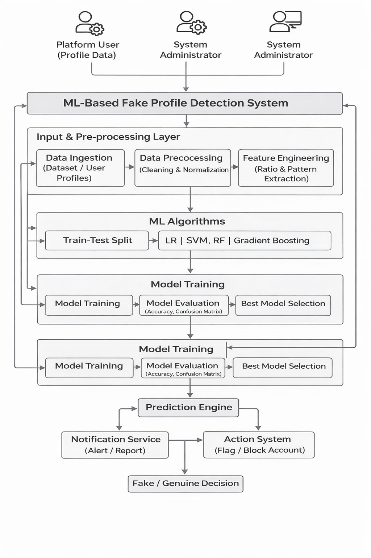
SYSTEM ARCHITECTURE

Slide 20
MODEL IMPLEMENTATION
Implemented multiple machine learning algorithms:
Logistic Regression
Support Vector Machine (SVM)
Random Forest
Gradient Boosting
Trained all models on the same dataset.
Selected Gradient Boosting based on best performance.

Slide 21
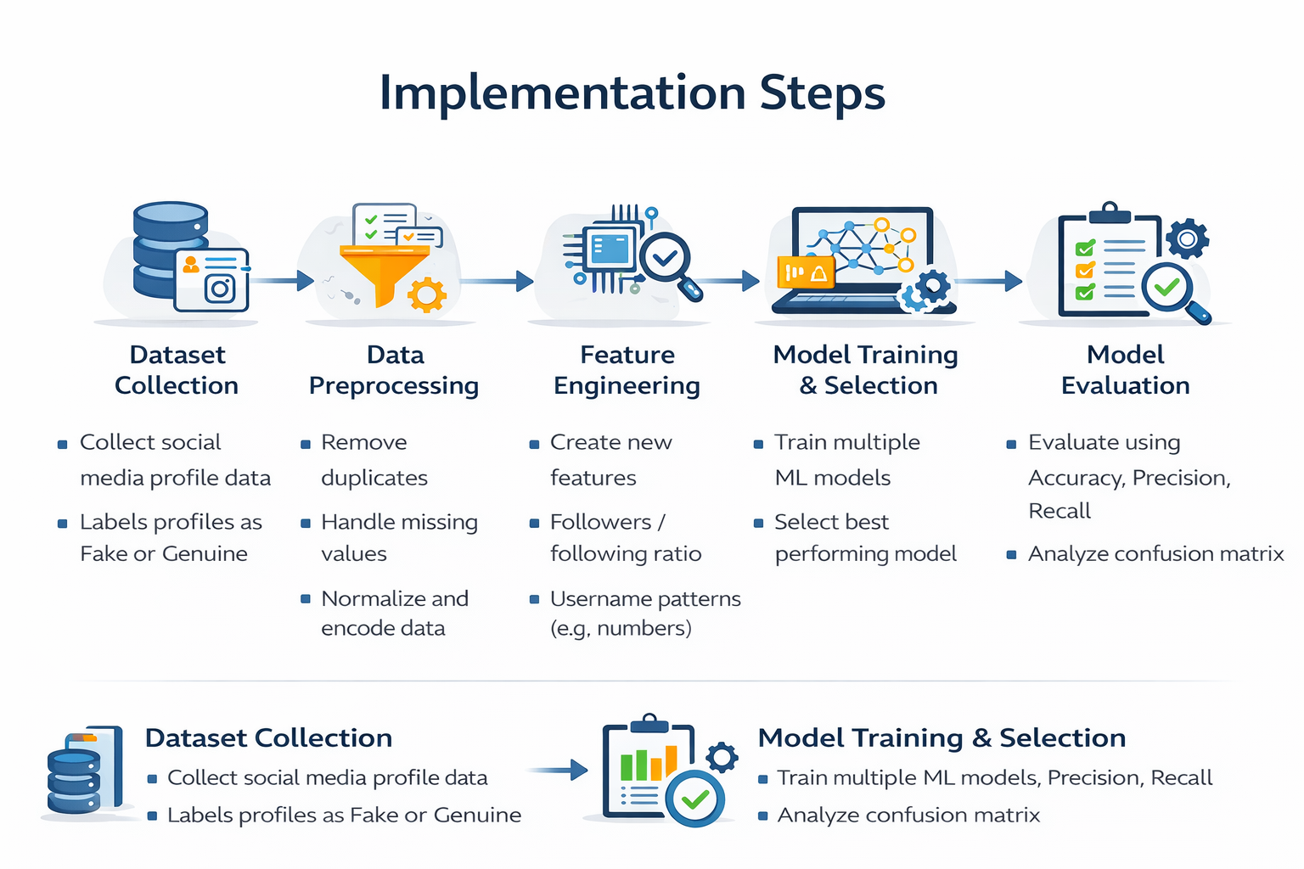
SYSTEM WORKFLOW

Slide 22
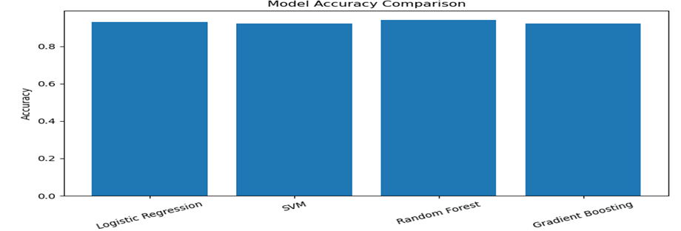
RESULTS
The system is expected to accurately classify fake and genuine social media profiles.
Machine learning models are expected to achieve high classification accuracy.
Feature engineering is expected to improve detection performance.
Gradient Boosting is expected to outperform other algorithms.

Slide 23
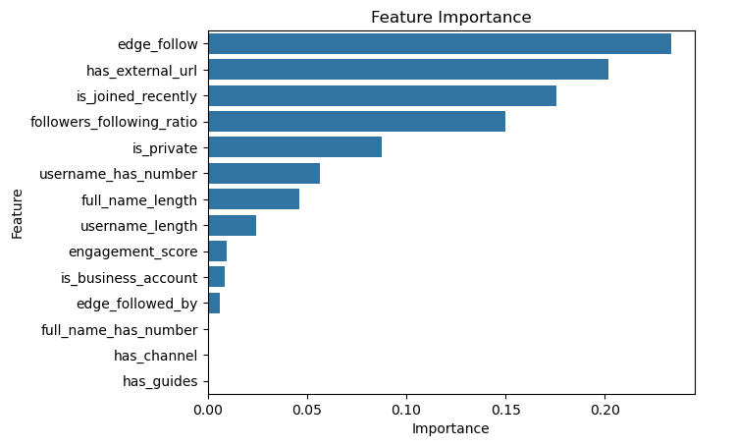
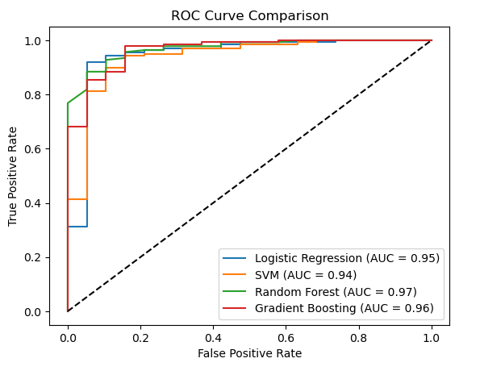

Slide 24
PERFORMANCE EVALUATION
Evaluated using Accuracy, Confusion Matrix, ROC Curve
Compared LR, SVM, RF, and GB models
Gradient Boosting achieved best performance
High accuracy and low misclassification observed
ROC curve shows strong model efficiency

Slide 25
FUTURE WORK
Apply Deep Learning models (ANN, CNN) for higher accuracy
Integrate real-time detection using social media APIs
Include user behavior & content analysis for better prediction
Deploy as a web application (Streamlit/Flask)
Improve detection of advanced and evolving fake profiles
Expand dataset for better generalization and scalability

Slide 26
CONCLUSION
The Fake Profile Detection system uses a strong Machine‑Learning process to stop fake accounts, which helps keep the platform safe and trustworthy. It creates important features from user behavior and network data to accurately spot fraudulent profiles.
The system works in real time, so it can quickly flag suspicious accounts for administrators to review. This automated approach is faster and more reliable than manual checking, greatly reducing spam and fraud.

Slide 27
BIBLIOGRAPHY
Scikit-learn Documentation – https://scikit-learn.org
Pandas Documentation – https://pandas.pydata.org
NumPy Documentation – https://numpy.org
Seaborn Documentation – https://seaborn.pydata.org
Kaggle – Dataset source

Slide 28
Thank you!

