Slide 1
Predictrix - by Genovate
an intelligent web-based platform designed to predict retail product demand

Slide 2
Table of Contents
Introduction
Problem Statement
Technical Details
Objectives
Methodology
Key Features
Project Highlights
Conclusion
References

Slide 3
Introduction
Predictrix is a cutting-edge, intelligent web-based platform engineered to forecast retail product demand with high precision. Leveraging real-time data streams and advanced artificial intelligence models, Predictrix empowers retailers with actionable insights to optimize inventory management, supply chain logistics, and marketing strategies.
At the core of Predictrix is a powerful data integration engine that seamlessly combines multiple data sources—historical sales records, current and forecasted weather conditions, and real-time social media sentiment analysis. This multi-dimensional data fusion enables the system to generate both short-term and long-term demand forecasts tailored to specific products, locations, and customer segments.
With an intuitive user interface and customizable dashboards, retailers can monitor dynamic market conditions, respond proactively to demand fluctuations, and make data-driven decisions that enhance operational efficiency and customer satisfaction. Whether preparing for a seasonal surge or adjusting to sudden market shifts, Predictrix offers the intelligence and agility needed to stay ahead in the competitive retail landscape.

Slide 4
Problem Statement
Retailers today face significant challenges due to inaccurate demand forecasting and sluggish inventory response times. Traditional forecasting methods primarily depend on historical sales data, failing to capture dynamic market conditions and emerging consumer trends. As a result, businesses often grapple with stockouts, leading to missed sales opportunities, or overstock situations, which tie up capital and increase holding costs.
Predictrix addresses these challenges by combining advanced artificial intelligence with to deliver accurate, real-time demand predictions. Unlike conventional models, Predictrix continuously ingests and analyzes a wide array of real-time data streams—including live sales activity, regional weather changes, and social media sentiment—to detect demand shifts as they happen.

Slide 5
Technical Details
⚙️ Tech Stack
Frontend/UI: Streamlit
Data Processing: Pandas, NumPy
Visualization: Matplotlib
Modeling: TensorFlow/Keras (LSTM)
Metrics: RMSE (Root Mean Squared Error)
Deployment-Ready Format: Web-based interactive dashboard

Slide 6
Technical Details
📈 Evaluation Metrics
Root Mean Squared Error (RMSE): Displayed on the dashboard to evaluate model performance on unseen test data.
Actual vs Predicted Plot: Helps visualize the accuracy of the model’s predictions on the test set.

Slide 7
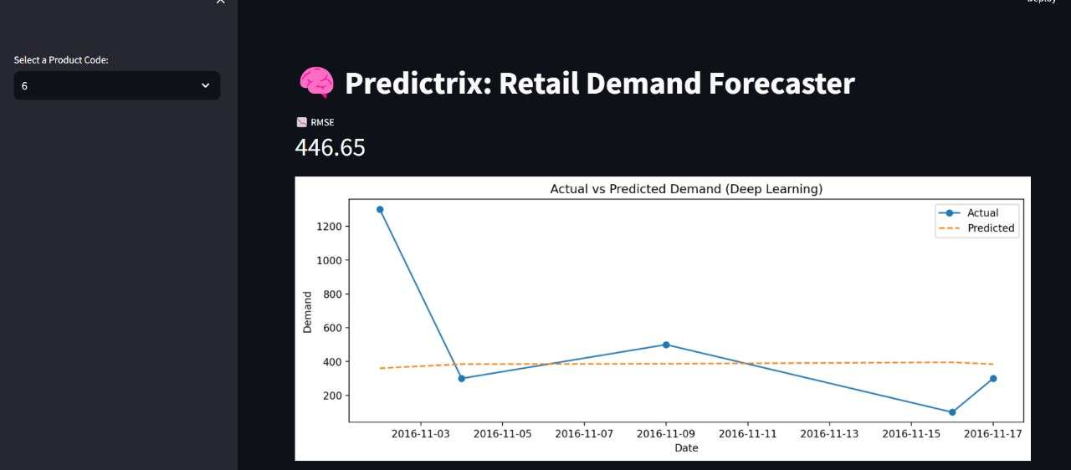
Project Highlights
Fig. 1

Slide 8
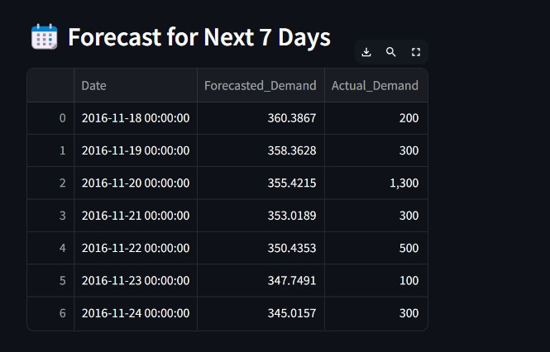
Project Highlights
Fig. 2

Slide 9
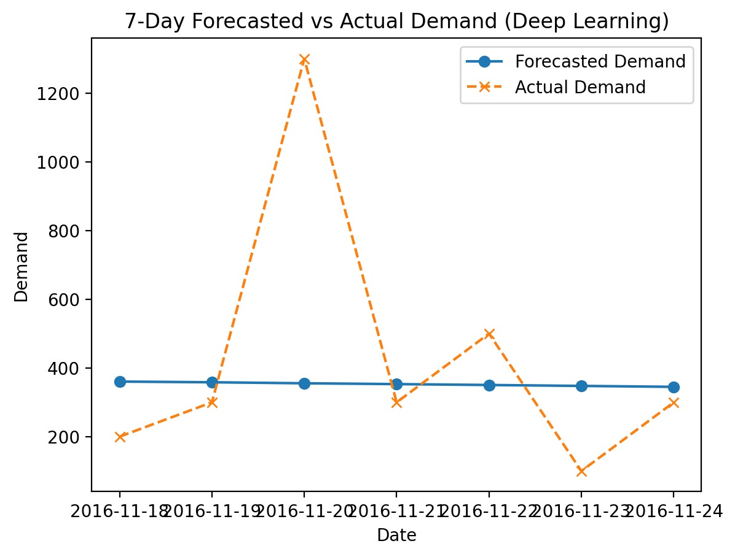
Project Highlights
Fig. 3

Slide 10
FUTURE SCOPE
Smarter price suggestions
Better stock planning
Advanced AI predictions
Add external features
Use more advanced models

Slide 11
CONCLUSION
Predictrix is a smart solution for retail stock prediction and inventory management. It uses real-time data and AI to help store avoid stockouts, reduce waste, and make faster, smarter decisions. With advanced forecasting and automation, Predictrix improves efficiency and supports better retail planning.

Slide 12
THANK YOU

