Slide 1



Forest Fire Detection Using Deep Learning
Name : T Sneha
AICTE ID:STU67a5e9c59d6791738926533

Slide 2

Learning Objectives
I understood the use of Convolutional Neural Networks in forest fire detection and how they help in identifying fire patterns from image data.
I learned how the Conv2D layer works in CNNs and in extracting important features from images.
I explored and built a classification model for two classes – fire and no fire – to accurately detect the presence of fire in images.
I analyzed the accuracy of the model using evaluation metrics like accuracy score, confusion matrix, and loss curves to measure performance.
I extended the model for real-time fire detection using video or live camera input and considered applying transfer learning for better accuracy.
I gained experience using TensorFlow, Keras, and OpenCV for developing deep learning models and performing image processing tasks.
I learned how to preprocess and structure image datasets effectively through techniques like resizing, normalization, and augmentation to improve model training.
GOAL
Source :
www.freepik.com/

Slide 3
Tools and Technology used
Scikit-learn –I learned how to split the dataset, apply evaluation metrics, and compare the CNN model with traditional machine learning classifiers.
OpenCV –I learned how to use OpenCV to read images and video streams, perform real-time image conversion, and apply preprocessing techniques.
Kaggle –I explored fire-related image datasets on Kaggle and learned from kernels and community discussions to improve my model.
Python –I improved my Python skills by writing scripts for model training, preprocessing images, and handling data pipelines..
Google Colab/Jupyter Notebook –I learned to train deep learning models on GPU using Google Colab and documented my work interactively in notebooks.
TensorFlow & Keras – I learned to design CNN models using Keras and TensorFlow and trained them easily with the help of high-level APIs.
NumPy & Pandas – I used NumPy and Pandas to manipulate image arrays, manage labels, and analyze the model outputs efficiently.

Slide 4
Methodology
Data Collection: I started by collecting the necessary dataset consisting of images categorized into two classes: fire and no fire.
Data Preprocessing: I rescaled, resized, and normalized the images to make them suitable for training the CNN model. This helped improve model efficiency and accuracy.
Model Selection: I built a CNN model with 3 convolutional layers followed by dense layers and a final output layer for binary classification (fire/no fire).
Model Training: I trained the model for 12 epochs and monitored the training loss and accuracy during each epoch to ensure proper learning.
Evaluation: I evaluated the model performance using accuracy as the main metric. The model achieved an accuracy of 90.62% on the test data.
Validation: I performed validation to check the model’s performance on unseen data and ensure it generalizes well beyond the training set.

Slide 5
Problem Statement:
Wildfires are a major threat to the environment, wildlife, and human life, as they often spread rapidly before detection. I wanted to create a system that can automatically detect wildfire images using deep learning. This system would help in identifying fire at an early stage, enabling faster responses and reducing damage.
The focus was on building a reliable model that can differentiate between fire and non-fire images accurately. One of the main challenges I faced was training the model to perform well across different forest conditions and fire appearances while reducing false positives and missed detections.
To achieve this, I used Convolutional Neural Networks (CNNs) and trained the model on a carefully prepared dataset. I also applied various preprocessing techniques to improve image quality and model performance. The project helped me understand how deep learning can be applied to real-world problems and showed how technology can play a key role in disaster prevention and environmental protection.

Slide 6
Solution:
To address the problem of early wildfire detection, I built an image classification model using Convolutional Neural Networks (CNN). The goal was to accurately identify the presence of fire in forest images. I used the Wildfire Dataset from Kaggle, which helped train the model to recognize detailed patterns that distinguish fire from normal scenes. I designed the model with convolutional, pooling, dropout, and dense layers to ensure strong performance while avoiding overfitting.
The trained model achieved nearly 80% accuracy in identifying unseen wildfire images. This shows that deep learning can be a powerful tool for automatic wildfire detection. Such a system can be integrated with real-time video surveillance, drones, or even mobile apps to support early warnings and response. This solution lays the groundwork for building smarter and more efficient forest monitoring systems.
To further improve the system's performance, I plan to experiment with data augmentation techniques to increase the variety of training images, which can help the model generalize better in real-world scenarios.
GITHUB REPOSITORY : https://github.com/snehaturala/Forest-Fire-Detection-Using-Deep-Learning/tree/main

Slide 7
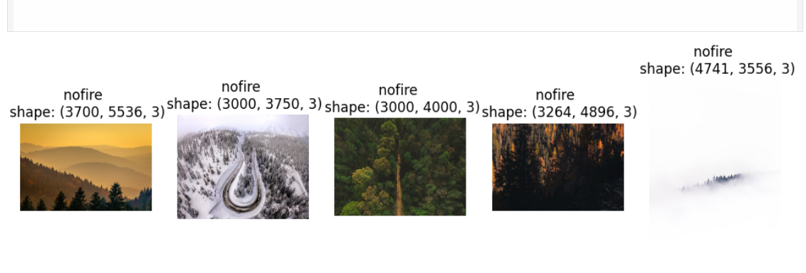
Screenshot of Output:

Slide 8
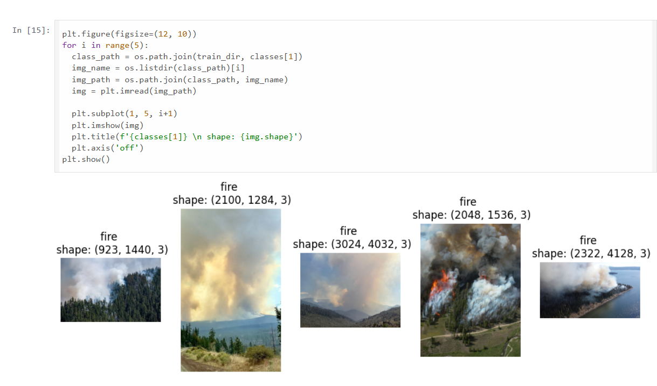
Screenshot of Output:

Slide 9
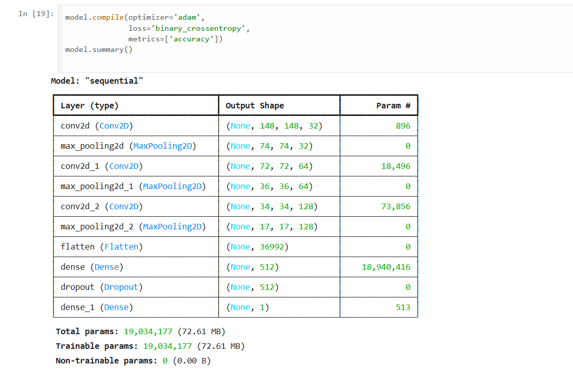
Screenshot of Output:

Slide 10
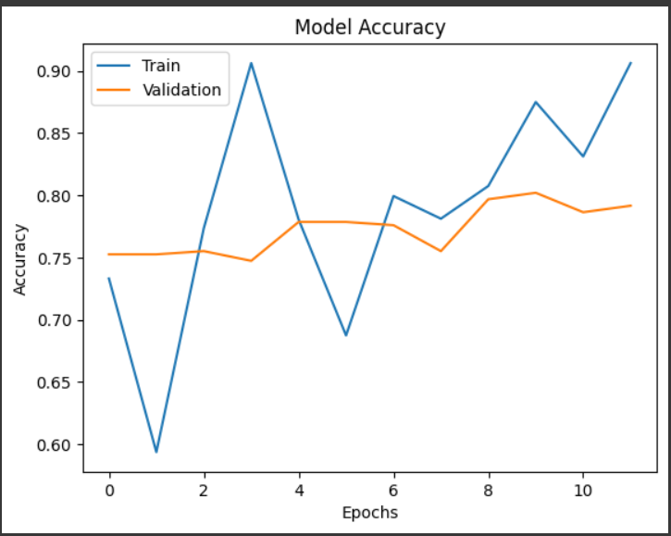
Screenshot of Output:

Slide 11
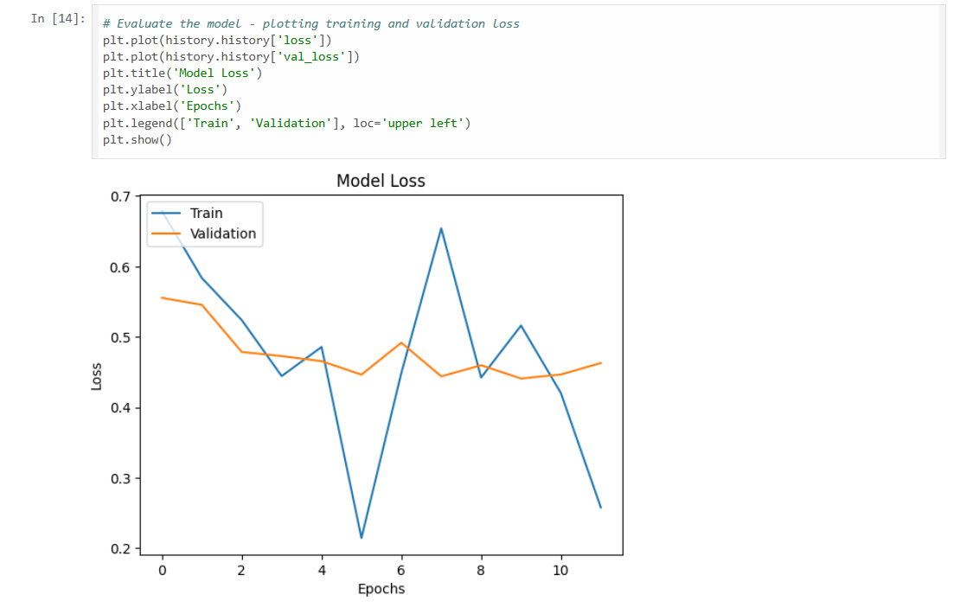
Screenshot of Output:

Slide 12
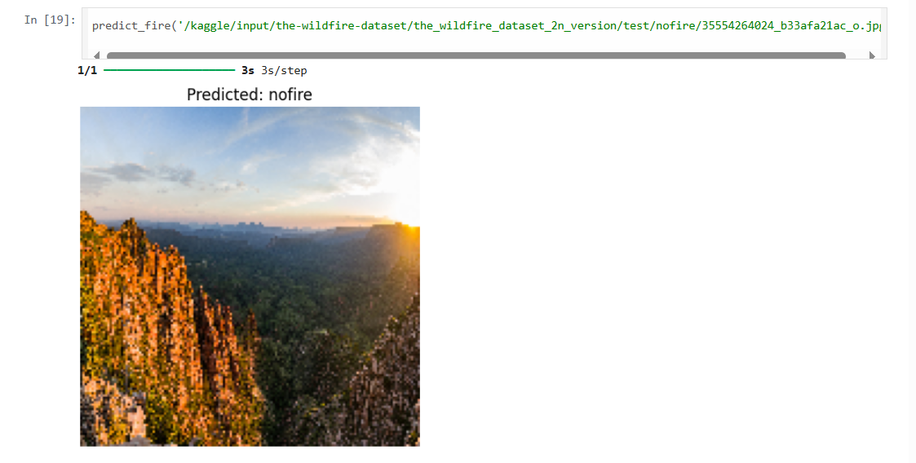
Screenshot of Output:

Slide 13
Conclusion:
Working on this project gave me a deeper understanding of how deep learning can be applied to solve real-world environmental problems. By developing a CNN model trained on wildfire image data, I was able to build a system that distinguishes fire from non-fire situations with encouraging accuracy. This experience not only strengthened my technical knowledge of model building and training but also highlighted the real-life importance of early wildfire detection in protecting lives and nature.
Although the model has performed well on test images, I see a lot of scope for making it even more powerful. I’m particularly interested in extending this work through real-time video processing, integration with drones or IoT-based surveillance, and deploying the system on scalable platforms. Overall, this project has been a major milestone in my AI journey and has strengthened my confidence in using technology for impactful, socially meaningful work.
Beyond the technical accomplishments, this project also helped me grow as a problem solver and researcher. I learned the importance of data quality, model tuning, and iterative testing—skills that are essential for any AI-based solution. It also made me more aware of the ethical responsibilities involved when building systems that could impact safety and the environment. This experience has motivated me to continue exploring AI solutions that are not just innovative, but also responsible and impactful.

